Slide 1


Slide 2


Slide 3
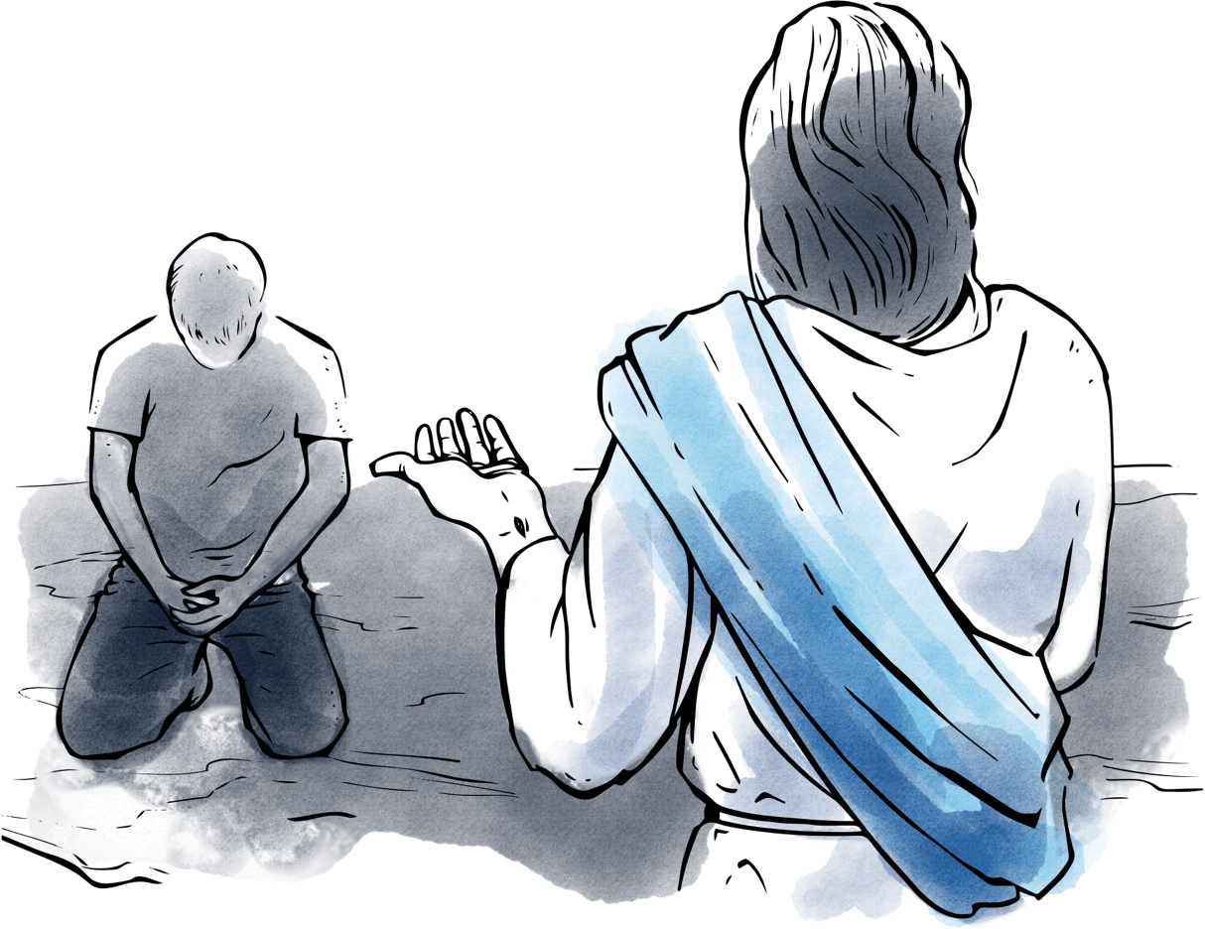

Jesus Be in Control of My Life
By Pastor Fee Soliven
Galatians 5:22-23
Sunday Morning
December 30, 2018

Slide 4
Galatians 5:22-23
22 But the fruit of the Spirit is love, joy, peace, longsuffering, kindness, goodness, faithfulness, 23 gentleness, self-control. Against such there is no law.

Slide 5
Is there any area of your life that is out of control? Perhaps it’s finances, moral issues, relationships, attitudes, habits, gossip, or laziness.

Slide 6
Do you struggle with any of
these desires?

Slide 7
1. Acceptance by Others

Slide 8
2. Being loved by Others

Slide 9
3. Pleasure

Slide 10
4. Sex

Slide 11
5. Wealth and Security

Slide 12
6. Notoriety or Fame

Slide 13
7. Happiness

Slide 14
8. Personal Attractiveness

Slide 15
9. Control

Slide 16
10. Self-Acceptance

Slide 17
The Flesh Versus the Spirit

Slide 18
Galatians 5:22-23
22 But the fruit of the Spirit is love, joy, peace, longsuffering, kindness, goodness, faithfulness, 23 gentleness, self-control. Against such there is no law.

Slide 19
The Deeds of the Flesh

Slide 20
Galatians 5:19-22
19 Now the works of the flesh are evident, which are: adultery, fornication, uncleanness, lewdness, 20 idolatry, sorcery, hatred, contentions, jealousies, outbursts of wrath, selfish ambitions, dissensions, heresies,

Slide 21
21 envy, murders, drunkenness, revelries, and the like; of which I tell you beforehand, just as I also told you in time past, that those who practice such things will not inherit the kingdom of God.

Slide 22
The Fruit of the Spirit

Slide 23
Galatians 5:22-23
22 But the fruit of the Spirit is love, joy, peace, longsuffering, kindness, goodness, faithfulness, 23 gentleness, self-control. Against such there is no law.

Slide 24
1 Corinthians 6:9-11
9 Do you not know that the unrighteous will not inherit the kingdom of God? Do not be deceived. Neither fornicators, nor idolaters, nor adulterers, nor homosexuals, nor sodomites, 10 nor thieves, nor covetous, nor drunkards, nor revilers, nor extortioners will inherit the kingdom of God.

Slide 25
11 And such were some of you. But you were washed, but you were sanctified, but you were justified in the name of the Lord Jesus and by the Spirit of our God.

Slide 26
2 Timothy 2:19-26
19 Nevertheless the solid foundation of God stands, having this seal: "The Lord knows those who are His," and, "Let everyone who names the name of Christ depart from iniquity." 20 But in a great house there are not only vessels of gold and silver, but also of wood and clay, some for honor and some for dishonor.

Slide 27
21 Therefore if anyone cleanses himself from the latter, he will be a vessel for honor, sanctified and useful for the Master, prepared for every good work. 22 Flee also youthful lusts; but pursue righteousness, faith, love, peace with those who call on the Lord out of a pure heart.

Slide 28
23 But avoid foolish and ignorant disputes, knowing that they generate strife. 24 And a servant of the Lord must not quarrel but be gentle to all, able to teach, patient, 25 in humility correcting those who are in opposition, if God perhaps will grant them repentance, so that they may know the truth,

Slide 29
26 and that they may come to their senses and escape the snare of the devil, having been taken captive by him to do his will.

Slide 30
1 John 1:9-10
9 If we confess our sins, He is faithful and just to forgive us our sins and to cleanse us from all unrighteousness. 10 If we say that we have not sinned, we make Him a liar, and His word is not in us.

Slide 31
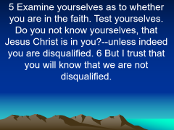

2 Corinthians 13:4-6
4 For though He was crucified in weakness, yet He lives by the power of God. For we also are weak in Him, but we shall live with Him by the power of God toward you.

Slide 32
5 Examine yourselves as to whether you are in the faith. Test yourselves. Do you not know yourselves, that Jesus Christ is in you?--unless indeed you are disqualified. 6 But I trust that you will know that we are not disqualified.

Slide 33
The Key to Self-Control

Slide 34
Galatians 5:16-18
16 I say then: Walk in the Spirit, and you shall not fulfill the lust of the flesh. 17 For the flesh lusts against the Spirit, and the Spirit against the flesh; and these are contrary to one another, so that you do not do the things that you wish. 18 But if you are led by the Spirit, you are not under the law.

Slide 35
Self-Control requires that we think before we Act

Slide 36
We must have a strong desire to Obey God

Slide 37
We must believe in our hearts that the Holy Spirit who lives within us will enable us

Slide 38
1. How will this affect me Spiritually?

Slide 39
2. How will this affect me financially?

Slide 40
3. How will this affect my health?

Slide 41
4. How is it going to affect how others see me?

Slide 42
5. Is this better than having God’s best for my life?

Slide 43
Don’t be Deceived

Slide 44
Galatians 6:7-10
7 Do not be deceived, God is not mocked; for whatever a man sows, that he will also reap. 8 For he who sows to his flesh will of the flesh reap corruption, but he who sows to the Spirit will of the Spirit reap everlasting life.

Slide 45
9 And let us not grow weary while doing good, for in due season we shall reap if we do not lose heart. 10 Therefore, as we have opportunity, let us do good to all, especially to those who are of the household of faith.

Slide 46
1 Peter 1:3-9
3 Blessed be the God and Father of our Lord Jesus Christ, who according to His abundant mercy has begotten us again to a living hope through the resurrection of Jesus Christ from the dead,

Slide 47
4 to an inheritance incorruptible and undefiled and that does not fade away, reserved in heaven for you, 5 who are kept by the power of God through faith for salvation ready to be revealed in the last time. 6 In this you greatly rejoice, though now for a little while, if need be, you have been grieved by various trials,

Slide 48
7 that the genuineness of your faith, being much more precious than gold that perishes, though it is tested by fire, may be found to praise, honor, and glory at the revelation of Jesus Christ, 8 whom having not seen you love. Though now you do not see Him, yet believing, you rejoice with joy inexpressible and full of glory, 9 receiving the end of your faith--the salvation of your souls.

Slide 49
1. In what part of life do you lack self-control?

Slide 50
2. Why is it so difficult for you to surrender this to the Lord?

Slide 51
3. Think about the areas in which you have already relinquished control to God. What has been the result?

Slide 52
4. How would remembering God’s faithfulness in the past help you yield even more of your life to Him today?

