Slide 1


Slide 2


Slide 3
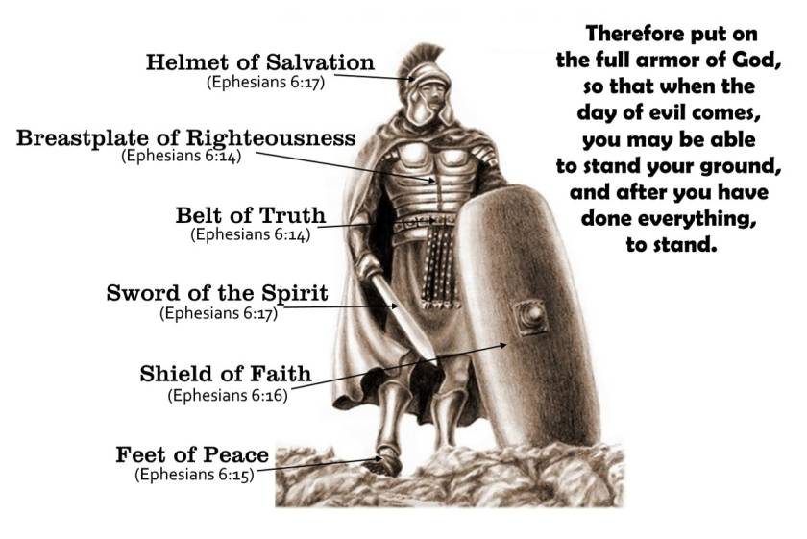

Principalities
By Pastor Fee Soliven
Ephesians 6:10-13
Sunday Morning
December 16, 2018

Slide 4
10 Finally, my brethren, be strong in the Lord and in the power of His might. 11 Put on the whole armor of God, that you may be able to stand against the wiles of the devil. 12 For we do not wrestle against flesh and blood, but against principalities, against powers, against the rulers of the darkness of this age, against spiritual hosts of wickedness in the heavenly places. 13 Therefore take up the whole armor of God, that you may be able to withstand in the evil day, and having done all, to stand.

Slide 5
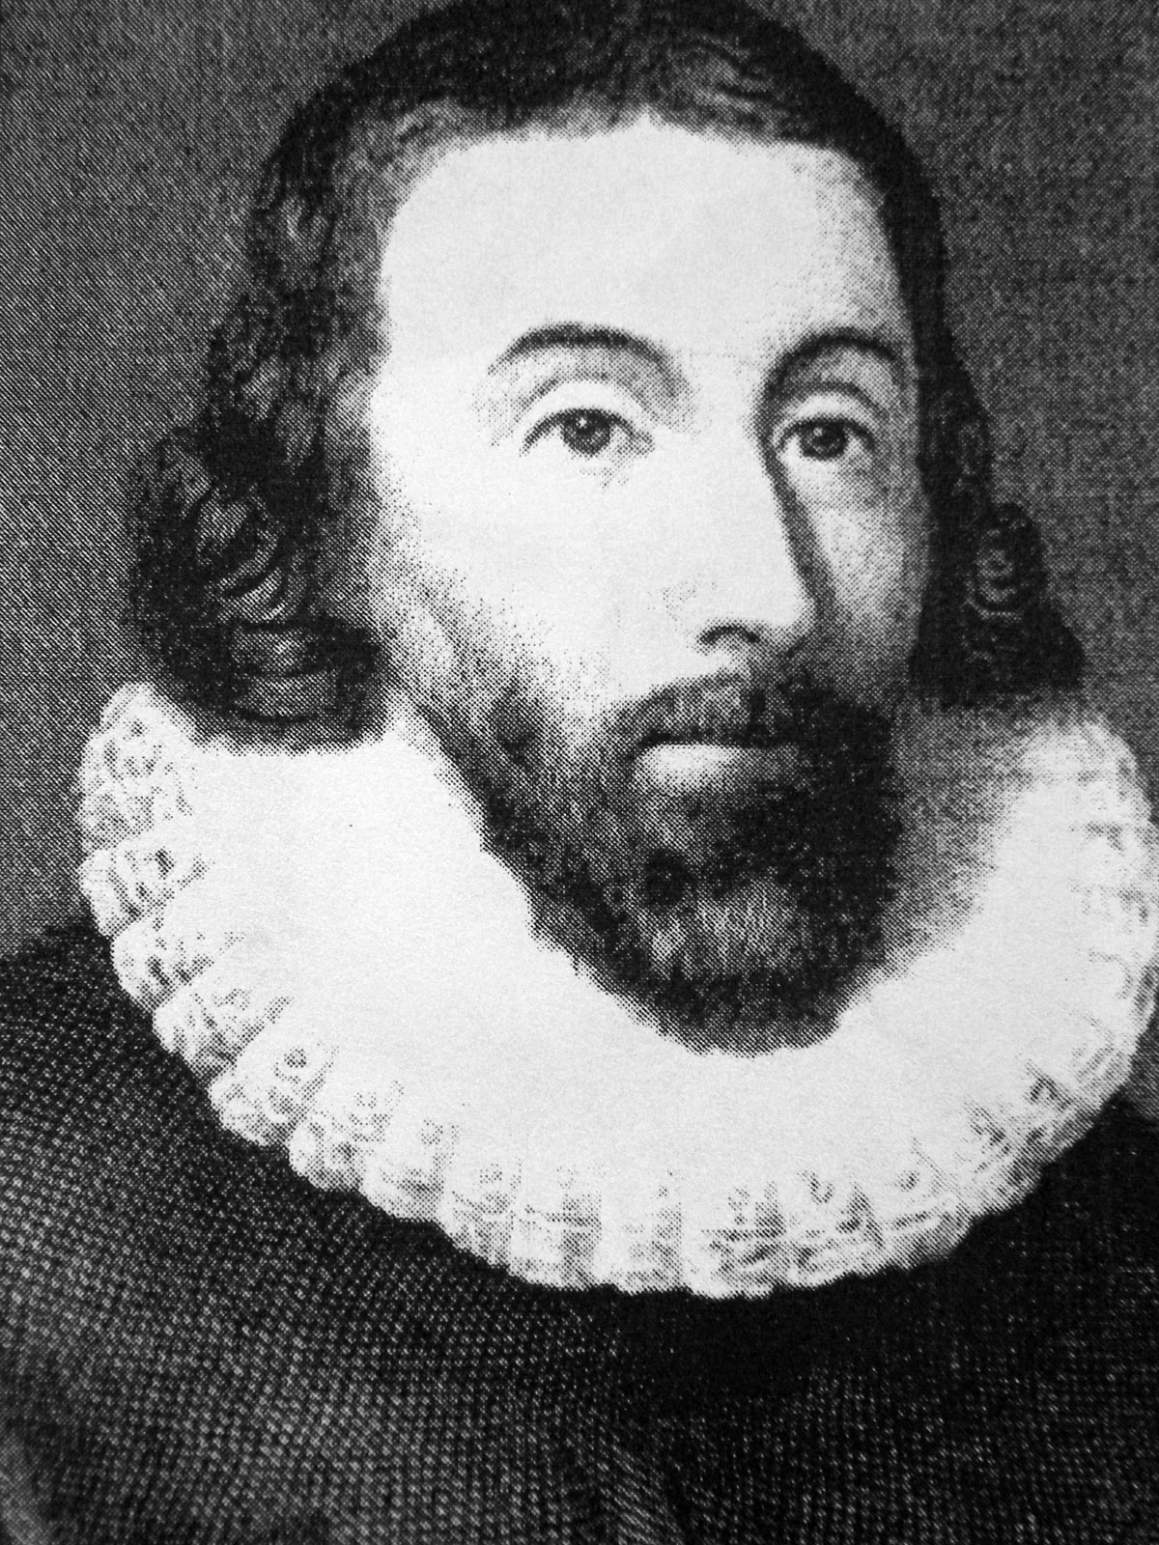

Slide 6
John Winthrop was an English Puritan lawyer and one of the leading figures in founding the Massachusetts Bay Colony, the second major settlement in New England, following Plymouth Colony. Winthrop led the first large wave of immigrants from England in 1630 and served as governor for 12 of the colony's first 20 years.

Slide 7
John Winthrop also had a prophetic voice and message for America. He was famous for his preaching as a born-again believer his famous speech of:

Slide 8
“A City Upon on a Hill”

Slide 9
Question:
What rule must we observe and walk by in cause of community of peril?

Slide 10
Answer:
We are entered into covenant with God for this work. We have taken out a commission. The Lord hath given us leave to draw our own articles. We have professed to enterprise these and those accounts, upon these and those ends. We have hereupon besought Him of favor and blessing.

Slide 11
Now if the Lord shall please to hear us, and bring us in peace to the place we desire, then hath He ratified this covenant and sealed our commission, and will expect a strict performance of the articles contained in it; but if we shall neglect the observation of these articles which are the ends we have propounded, and, dissembling with our God, shall fall to embrace this present world and prosecute our carnal intentions, seeking great things for ourselves and our posterity,

Slide 12
the Lord will surely break out in wrath against us, and be revenged of such a people, and make us know the price of the breach of such a covenant. Now the only way to avoid this shipwreck, and to provide for our posterity, is to follow the counsel of Micah, to do justly, to love mercy, to walk humbly with our God. For this end, we must be knit together, in this work, as one man.

Slide 13
We must entertain each other in brotherly affection. We must be willing to abridge ourselves of our superfluities, for the supply of others’ necessities. We must uphold a familiar commerce together in all meekness, gentleness, patience and liberality. We must delight in each other; make others’ conditions our own; rejoice together, mourn together, labor and suffer together, always having before our eyes our commission and community in the work,

Slide 14
as members of the same body. So shall we keep the unity of the spirit in the bond of peace. The Lord will be our God, and delight to dwell among us, as His own people, and will command a blessing upon us in all our ways, so that we shall see much more of His wisdom, power, goodness and truth, than formerly we have been acquainted with.

Slide 15
We shall find that the God of Israel is among us, when ten of us shall be able to resist a thousand of our enemies; when He shall make us a praise and glory that men shall say of succeeding plantations, “may the Lord make it like that of New England.” For we must consider that we shall be as a city upon a hill. The eyes of all people are upon us.

Slide 16
So that if we shall deal falsely with our God in this work we have undertaken, and so cause Him to withdraw His present help from us, we shall be made a story and a by-word through the world. We shall open the mouths of enemies to speak evil of the ways of God, and all professors for God’s sake. We shall shame the faces of many of God’s worthy servants, and cause their prayers to be turned into curses upon us till we be consumed out of the good land whither we are going.

Slide 17
And to shut this discourse with that exhortation of Moses, that faithful servant of the Lord, in his last farewell to Israel, Deut. 30. “Beloved, there is now set before us life and death, good and evil,” in that we are commanded this day to love the Lord our God, and to love one another, to walk in his ways and to keep his Commandments and his ordinance and his laws,

Slide 18
and the articles of our Covenant with Him, that we may live and be multiplied, and that the Lord our God may bless us in the land whither we go to possess it. But if our hearts shall turn away, so that we will not obey, but shall be seduced, and worship other Gods, our pleasure and profits, and serve them;

Slide 19
it is propounded unto us this day, we shall surely perish out of the good land whither we pass over this vast sea to possess it. Therefore let us choose life, that we and our seed may live, by obeying His voice and cleaving to Him, for He is our life and our prosperity.

Slide 20
Has America Dealt Falsely
Against God?

Slide 21
1. America Has Banished God from Our Culture

Slide 22
2. America has allowed Sexual Immorality to be the dominant force in our free society

Slide 23
3. America has slaughtered over 60 million babies through abortion

Slide 24
What Principalities are at Work in America Today?

Slide 25
Ecclesiastes 1:9
“Whatever has happened before will happen again. Whatever has been done before will be done again. There is nothing new under the sun.”

Slide 26
Ecclesiastes 3:15
That which is has already been, And what is to be has already been; And God requires an account of what is past.

Slide 27
Hebrews 13:8
Jesus Christ is the same yesterday, today, and forever.

Slide 28
1. The demon god Baal

Slide 29
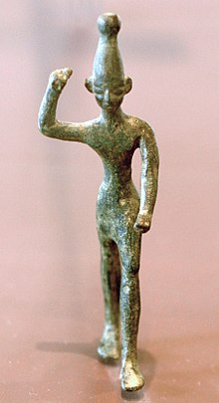
5. A Life Dependent on the
Holy Spirit

Slide 30
The name is drawn from the Canaanite deity Baal mentioned in the Hebrew Bible as the primary god of the Phoenicians. In this hierarchy, Baal (usually spelt "Bael" in this context; Baal is ranked as the first and principal king of Hell, ruling over the East.

Slide 31
Baal was the enemy to the one and only true God Yahweh, Elohim also known as Jehovah

Slide 32
Today the worship of Baal is in Humanism, Atheism, New Age, Religious Cults and Christian Prosperity Movements

Slide 33
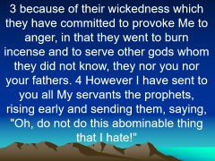

Jeremiah 44:2-7
2 "Thus says the LORD of hosts, the God of Israel: 'You have seen all the calamity that I have brought on Jerusalem and on all the cities of Judah; and behold, this day they are a desolation, and no one dwells in them,

Slide 34
3 because of their wickedness which they have committed to provoke Me to anger, in that they went to burn incense and to serve other gods whom they did not know, they nor you nor your fathers. 4 However I have sent to you all My servants the prophets, rising early and sending them, saying, "Oh, do not do this abominable thing that I hate!"

Slide 35
5'But they did not listen or incline their ear to turn from their wickedness, to burn no incense to other gods. 6 So My fury and My anger were poured out and kindled in the cities of Judah and in the streets of Jerusalem; and they are wasted and desolate, as it is this day.'

Slide 36
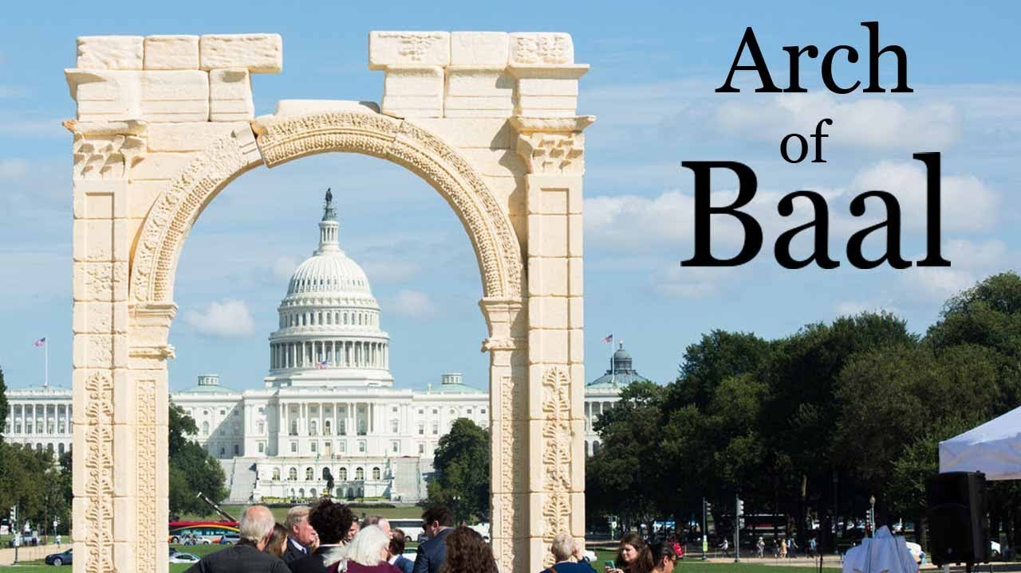
Ephesians 4:32
“And be kind to one another, tenderhearted, forgiving one another, just as God in Christ forgave you.”

Slide 37
2. The demon god Asherah

Slide 38
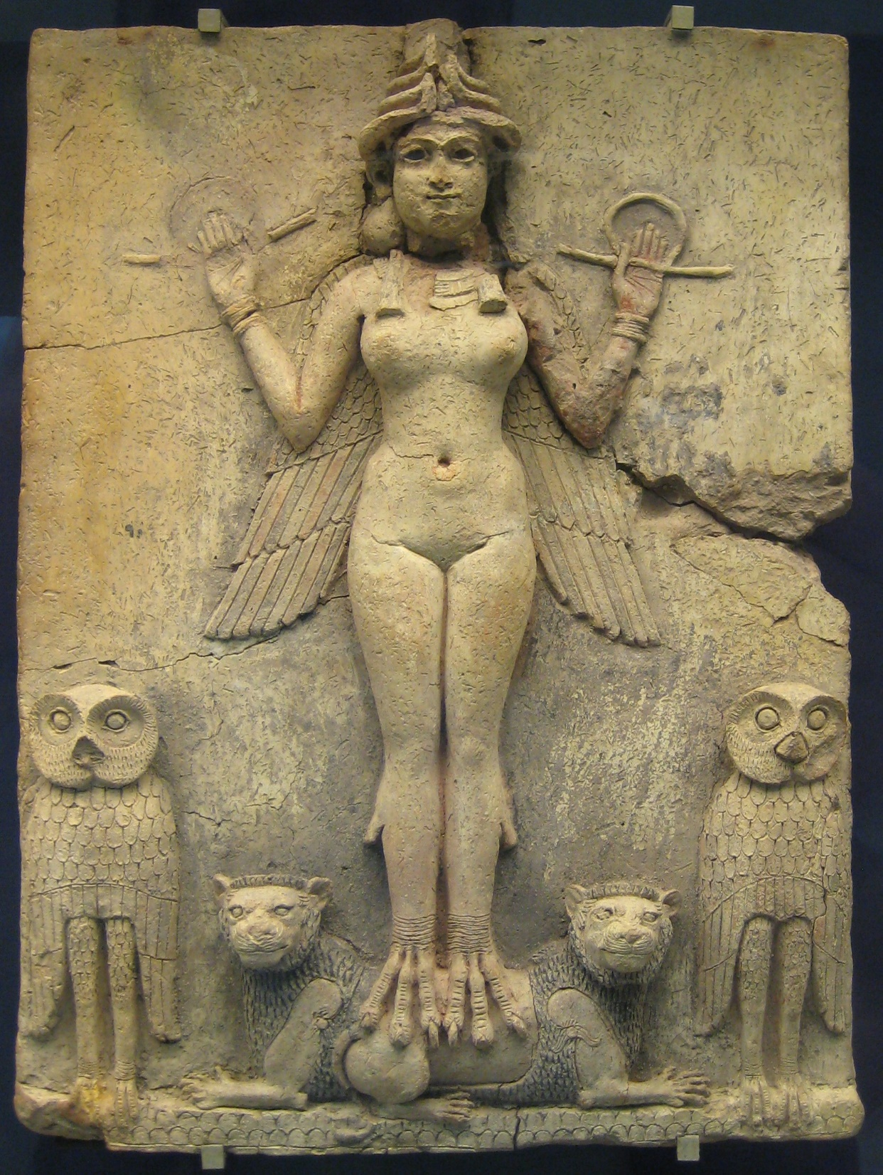
2. Which areas are the most challenging for you?

Slide 39
Asherah was also identified as the moon goddess who belonged to the family of gods associated with Baal the sun god. Worship to her included sexual immorality, prostitution, divination, and fortune telling. As a result, the Mosaic Law spoke specifically against Asherah worship.

Slide 40
Judges 3:7
“So the children of Israel did evil in the sight of the LORD. They forgot the LORD their God, and served the Baals and Asherahs.

Slide 41
America promotes and distributes the majority of pornographic material in the world. Simi Valley in California is a multibillion-dollar industry. Climbing to number 2 on the sexual crime ladder is sex trafficking and child pedophilia.

Slide 42
3. The demon god Molech

Slide 43
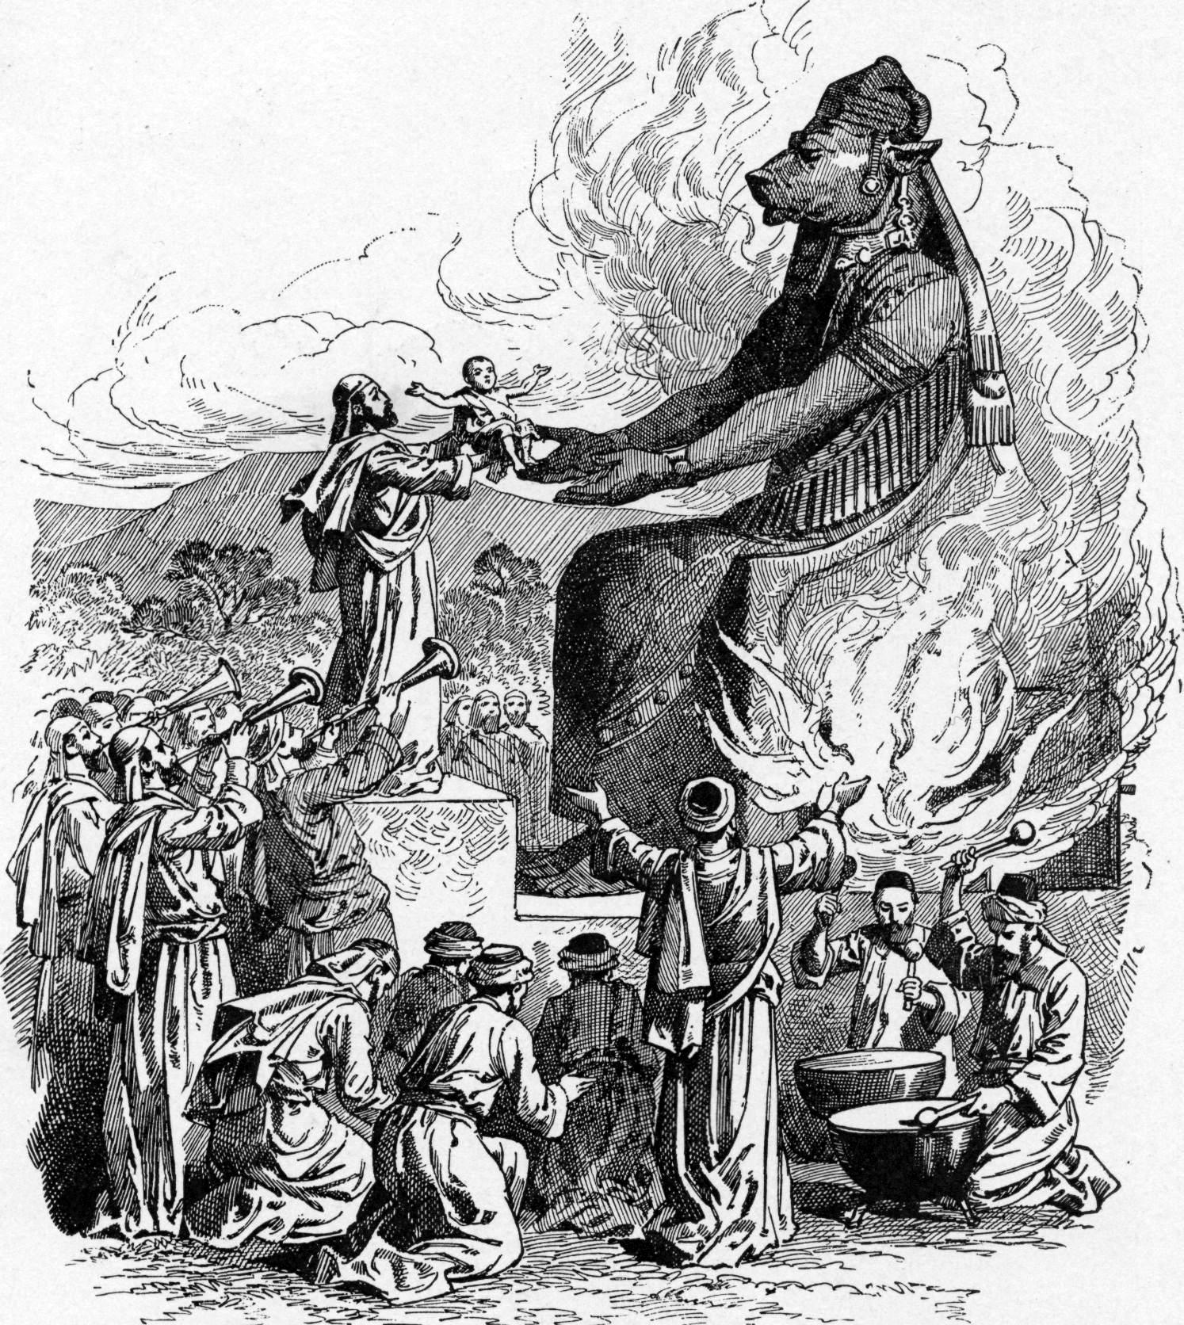
3.What obstacles will you need to overcome?

Slide 44
Worshipping the god of Molech were a group of people who inhabited Canaan (modern-day Lebanon, Syria, and Israel) between 1550 BC and 300 BC. In addition to sexual rituals, Molech worship included child sacrifice, or “passing children through the fire.”

Slide 45
It is believed that idols of Molech were giant metal statues of a man with a bull’s head. Each image had a hole in the abdomen and possibly outstretched forearms that made a kind of ramp to the hole. A fire was lit in or around the statue. Babies were placed in the statue’s arms or in the hole.

Slide 46
When a couple sacrificed their firstborn, they believed that Molech would ensure financial prosperity for the family and future children

Slide 47
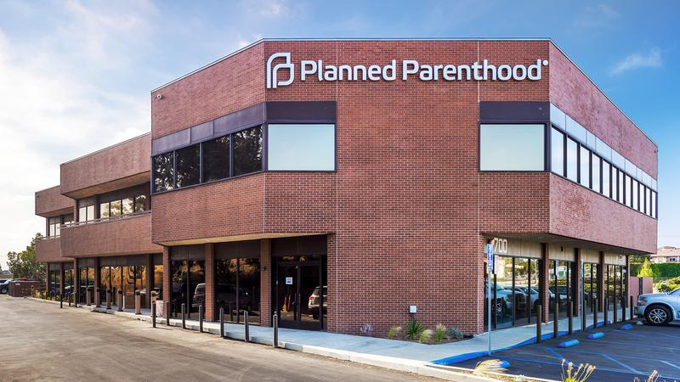
3.What obstacles will you need to overcome?

Slide 48
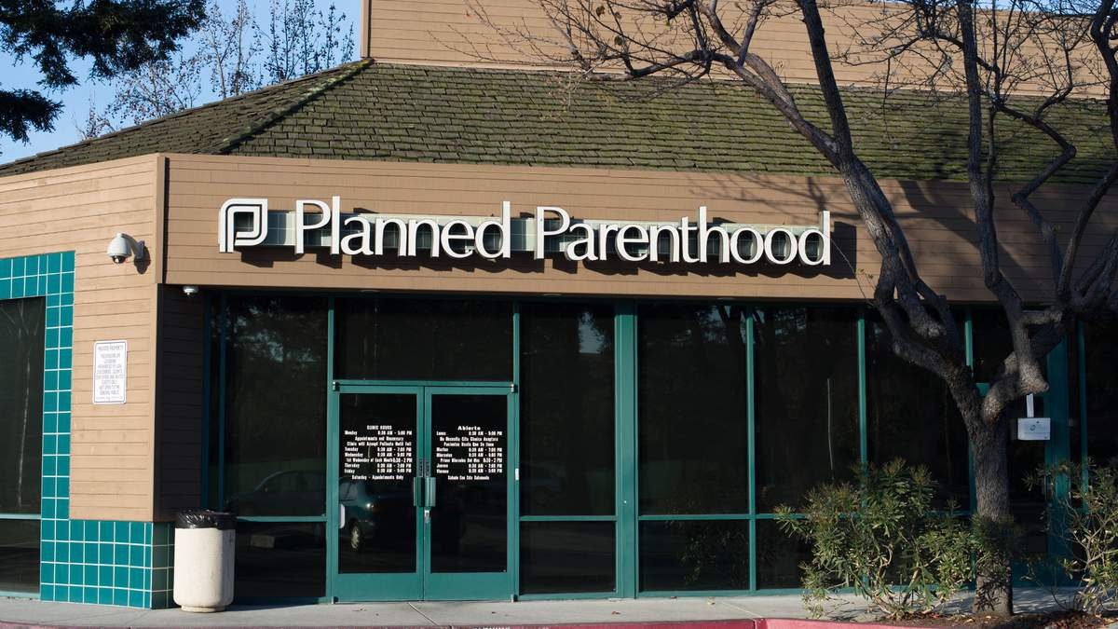
3.What obstacles will you need to overcome?

Slide 49

3.What obstacles will you need to overcome?

Slide 50
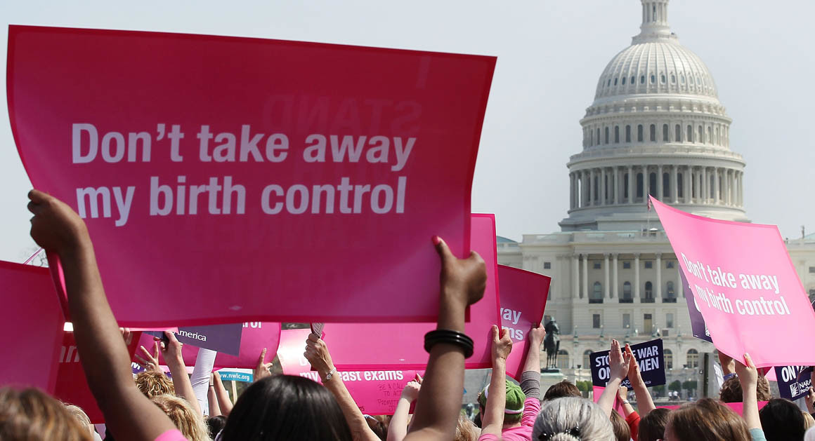
3.What obstacles will you need to overcome?

Slide 51
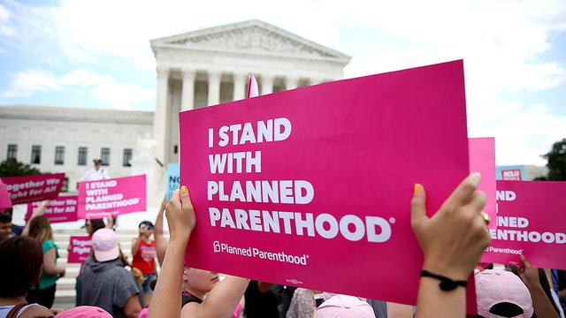
3.What obstacles will you need to overcome?

Slide 52
The United States marks 45 years of legalized abortion in all fifty states at any time for any reason throughout pregnancy on January 22nd, the anniversary of the Roe v. Wade Supreme Court decision. Since that time, there have been an estimated 60,069,971 abortions that have destroyed the lives of unborn children.

Slide 53
The number one reason that women get abortions is not the guilt or shame but “Financial Reasons” It will affect their false prosperity!

Slide 54
Principalities that Paul wrote about are being worshipped today!

Slide 55
Ephesians 6:10-13
10 Finally, my brethren, be strong in the Lord and in the power of His might. 11 Put on the whole armor of God, that you may be able to stand against the wiles of the devil. 12 For we do not wrestle against flesh and blood, but against principalities, against powers, against the rulers of the darkness of this age, against spiritual hosts of wickedness in the heavenly places. 13 Therefore take up the whole armor of God, that you may be able to withstand in the evil day, and having done all, to stand.

Slide 56
Church of the Living God
Must Stand!

Slide 57
Romans 1:18-20
18 For the wrath of God is revealed from heaven against all ungodliness and unrighteousness of men, who suppress the truth in unrighteousness, 19 because what may be known of God is manifest in them, for God has shown it to them. 20 For since the creation of the world His invisible attributes are clearly seen, being understood by the things that are made, even His eternal power and Godhead, so that they are without excuse…

Slide 58
Revelation 18:1-10
1 After these things I saw another angel coming down from heaven, having great authority, and the earth was illuminated with his glory. 2 And he cried mightily with a loud voice, saying, "Babylon the great is fallen, is fallen, and has become a dwelling place of demons, a prison for every foul spirit, and a cage for every unclean and hated bird!

Slide 59
3 For all the nations have drunk of the wine of the wrath of her fornication, the kings of the earth have committed fornication with her, and the merchants of the earth have become rich through the abundance of her luxury." 4 And I heard another voice from heaven saying, "Come out of her, my people, lest you share in her sins, and lest you receive of her plagues.

Slide 60
5 For her sins have reached to heaven, and God has remembered her iniquities. 6 Render to her just as she rendered to you, and repay her double according to her works; in the cup which she has mixed, mix double for her. 7 In the measure that she glorified herself and lived luxuriously, in the same measure give her torment and sorrow; for she says in her heart, 'I sit as queen, and am no widow, and will not see sorrow.'

Slide 61
8 "Therefore her plagues will come in one day--death and mourning and famine. And she will be utterly burned with fire, for strong is the Lord God who judges her. 9 "The kings of the earth who committed fornication and lived luxuriously with her will weep and lament for her, when they see the smoke of her burning, 10 standing at a distance for fear of her torment, saying, 'Alas, alas, that great city Babylon, that mighty city! For in one hour your judgment has come.'

Slide 62
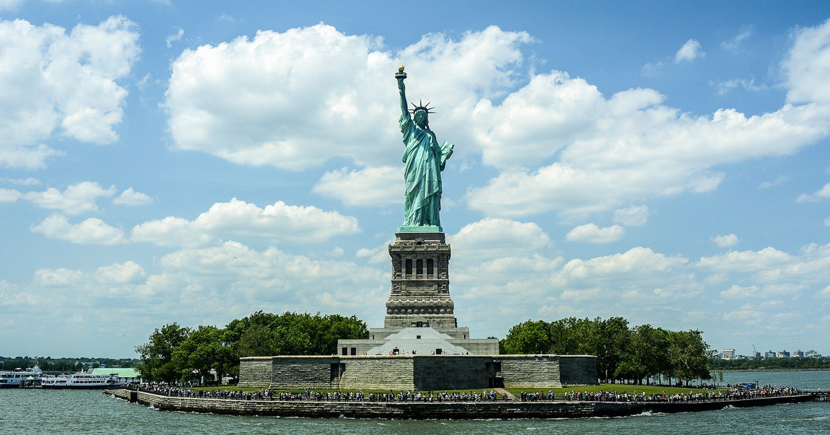
8 "Therefore her plagues will come in one day--death and mourning and famine. And she will be utterly burned with fire, for strong is the Lord God who judges her. 9 "The kings of the earth who committed fornication and lived luxuriously with her will weep and lament for her, when they see the smoke of her burning, 10 standing at a distance for fear of her torment, saying, 'Alas, alas, that great city Babylon, that mighty city! For in one hour your judgment has come.'

