Slide 1


Slide 2


Slide 3


The Miracle of the Five Loaves
by Pastor Fee Soliven
Mark 6:30-44
Wednesday Evening
December 12, 2018

Slide 4
30 Then the apostles gathered to Jesus and told Him all things, both what they had done and what they had taught. 31 And He said to them, "Come aside by yourselves to a deserted place and rest a while." For there were many coming and going, and they did not even have time to eat. 32 So they departed to a deserted place in the boat by themselves.

Slide 5
33 But the multitudes saw them departing, and many knew Him and ran there on foot from all the cities. They arrived before them and came together to Him. 34 And Jesus, when He came out, saw a great multitude and was moved with compassion for them, because they were like sheep not having a shepherd. So He began to teach them many things.

Slide 6
35 When the day was now far spent, His disciples came to Him and said, "This is a deserted place, and already the hour is late.36 Send them away, that they may go into the surrounding country and villages and buy themselves bread; for they have nothing to eat."

Slide 7
37 But He answered and said to them, "You give them something to eat." And they said to Him, "Shall we go and buy two hundred denarii worth of bread and give them something to eat?" 38 But He said to them, "How many loaves do you have? Go and see." And when they found out they said, "Five, and two fish." 39 Then He commanded them to make them all sit down in groups on the green grass.

Slide 8
40 So they sat down in ranks, in hundreds and in fifties. 41 And when He had taken the five loaves and the two fish, He looked up to heaven, blessed and broke the loaves, and gave them to His disciples to set before them; and the two fish He divided among them all. 42 So they all ate and were filled. 43 And they took up twelve baskets full of fragments and of the fish. 44 Now those who had eaten the loaves were about five thousand men.

Slide 9
30 Then the apostles gathered to Jesus and told Him all things, both what they had done and what they had taught.

Slide 10
“Apostle” means
“One Sent”
as a Messenger

Slide 11
Acts 1:24-26
24 And they prayed and said, "You, O Lord, who know the hearts of all, show which of these two You have chosen 25 to take part in this ministry and apostleship from which Judas by transgression fell, that he might go to his own place." 26 And they cast their lots, and the lot fell on Matthias. And he was numbered with the eleven apostles.

Slide 12
Ephesians 2:19-20
19 Now, therefore, you are no longer strangers and foreigners, but fellow citizens with the saints and members of the household of God, 20 having been built on the foundation of the apostles and prophets, Jesus Christ Himself being the chief cornerstone…

Slide 13
31 And He said to them, "Come aside by yourselves to a deserted place and rest a while." For there were many coming and going, and they did not even have time to eat. 32 So they departed to a deserted place in the boat by themselves.

Slide 14
Luke 9:10
10 And the apostles, when they had returned, told Him all that they had done. Then He took them and went aside privately into a deserted place belonging to the city called Bethsaida.

Slide 15
33 But the multitudes saw them departing, and many knew Him and ran there on foot from all the cities. They arrived before them and came together to Him.

Slide 16
Isaiah 2:12
“For the day of the LORD of hosts Shall come upon everything proud and lofty, Upon everything lifted up--And it shall be brought low…”

Slide 17
Matthew 6:1-2
1 “Beware of practicing your righteousness before other people in order to be seen by them, for then you will have no reward from your Father who is in heaven. 2 “Thus, when you give to the needy, sound no trumpet before you, as the hypocrites do in the synagogues and in the streets, that they may be praised by others. Truly, I say to you, they have received their reward.

Slide 18
James 4:6
But he gives more grace. Therefore it says, “God opposes the proud, but gives grace to the humble.”

Slide 19
34 And Jesus, when He came out, saw a great multitude and was moved with compassion for them, because they were like sheep not having a shepherd. So He began to teach them many things.

Slide 20
John 10:7-16
7 Then Jesus said to them again, "Most assuredly, I say to you, I am the door of the sheep. 8 All who ever came before Me are thieves and robbers, but the sheep did not hear them. 9 I am the door. If anyone enters by Me, he will be saved, and will go in and out and find pasture.

Slide 21
10 The thief does not come except to steal, and to kill, and to destroy. I have come that they may have life, and that they may have it more abundantly. 11 I am the good shepherd. The good shepherd gives His life for the sheep. 12 But a hireling, he who is not the shepherd, one who does not own the sheep, sees the wolf coming and leaves the sheep and flees; and the wolf catches the sheep and scatters them.

Slide 22
13 The hireling flees because he is a hireling and does not care about the sheep. 14 I am the good shepherd; and I know My sheep, and am known by My own. 15 As the Father knows Me, even so I know the Father; and I lay down My life for the sheep. 16 And other sheep I have which are not of this fold; them also I must bring, and they will hear My voice; and there will be one flock and one shepherd.

Slide 23
John 10:22-30
22 Now it was the Feast of Dedication in Jerusalem, and it was winter. 23 And Jesus walked in the temple, in Solomon's porch. 24 Then the Jews surrounded Him and said to Him, "How long do You keep us in doubt? If You are the Christ, tell us plainly."

Slide 24
25 Jesus answered them, "I told you, and you do not believe. The works that I do in My Father's name, they bear witness of Me. 26 But you do not believe, because you are not of My sheep, as I said to you. 27 My sheep hear My voice, and I know them, and they follow Me.

Slide 25
28 And I give them eternal life, and they shall never perish; neither shall anyone snatch them out of My hand. 29 My Father, who has given them to Me, is greater than all; and no one is able to snatch them out of My Father's hand. 30 I and My Father are one."

Slide 26
35 When the day was now far spent, His disciples came to Him and said, "This is a deserted place, and already the hour is late.36 Send them away, that they may go into the surrounding country and villages and buy themselves bread; for they have nothing to eat." 37 But He answered and said to them, "You give them something to eat." And they said to Him, "Shall we go and buy two hundred denarii worth of bread and give them something to eat?"

Slide 27
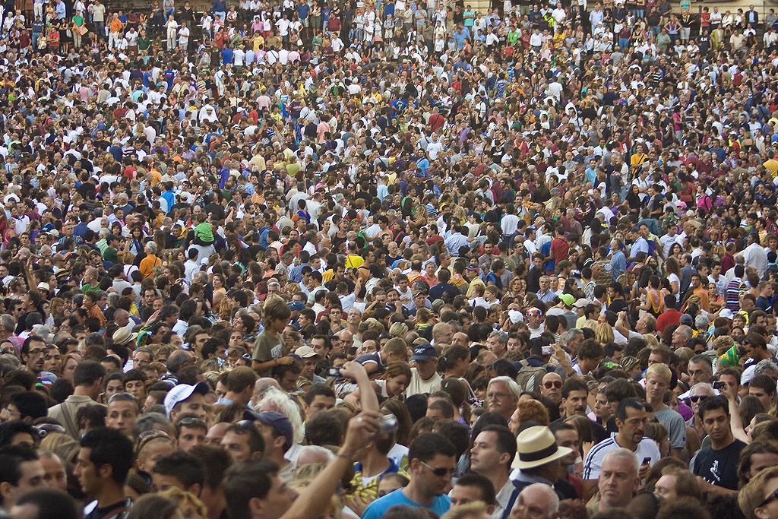
29 When his disciples heard of it, they came and took away his corpse and laid it in a tomb.

Slide 28
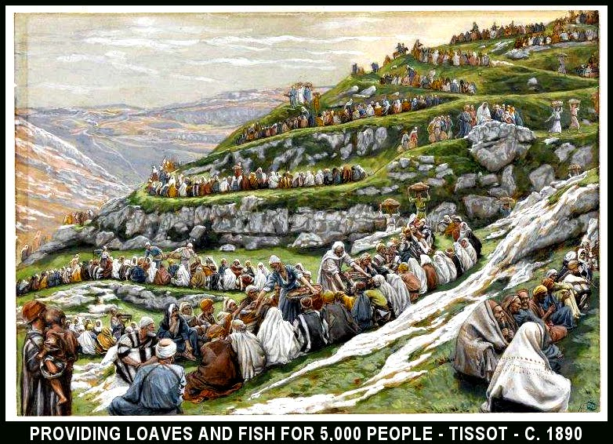
Acts 19:1-6
1 And it happened, while Apollos was at Corinth, that Paul, having passed through the upper regions, came to Ephesus. And finding some disciples 2 he said to them, "Did you receive the Holy Spirit when you believed?" So they said to him, "We have not so much as heard whether there is a Holy Spirit." 3 And he said to them, "Into what then were you baptized?" So they said, "Into John's baptism."

Slide 29
“You feed them.”

Slide 30
38 But He said to them, "How many loaves do you have? Go and see." And when they found out they said, "Five, and two fish."

Slide 31
John 6:9
There is a lad here who has five barley loaves and two small fish, but what are they among so many?"

Slide 32
Hebrews 11:1 (Living Bible Translation)
What is faith? It is the confident assurance that something we want is going to happen. It is the certainty that what we hope for is waiting for us, even though we cannot see it up ahead

Slide 33
Hebrews 11:1 (God’s Word Translation)
“Faith assures us of things we expect and convinces us of the existence of things we cannot see. 2 God accepted our ancestors because of their faith.”

Slide 34
39 Then He commanded them to make them all sit down in groups on the green grass. 40 So they sat down in ranks, in hundreds and in fifties.

Slide 35
41 And when He had taken the five loaves and the two fish, He looked up to heaven, blessed and broke the loaves, and gave them to His disciples to set before them; and the two fish He divided among them all.

Slide 36
The verbs in this verse are in different tenses in the Greek. The word breaking is in the aorist, implying an instantaneous act. The word giving is in the imperfect, implying a continuous act.

Slide 37
Exodus 16:14-15
14 And when the layer of dew lifted, there, on the surface of the wilderness, was a small round substance, as fine as frost on the ground. 15 So when the children of Israel saw it, they said to one another, "What is it?" For they did not know what it was. And Moses said to them, "This is the bread which the LORD has given you to eat.

Slide 38
1 Kings 17:14-16
14 For thus says the LORD God of Israel: 'The bin of flour shall not be used up, nor shall the jar of oil run dry, until the day the LORD sends rain on the earth.' " 15 So she went away and did according to the word of Elijah; and she and he and her household ate for many days. 16 The bin of flour was not used up, nor did the jar of oil run dry, according to the word of the LORD which He spoke by Elijah.

Slide 39
42 So they all ate and were filled. 43 And they took up twelve baskets full of fragments and of the fish. 44 Now those who had eaten the loaves were about five thousand men.

Slide 40
The Greek word for men is andres meaning not “people,” but “male individuals.” Therefore, there were five thousand men in addition to the women and children. The total number of people Jesus fed could have been over ten thousand.

