Slide 1


Slide 2


Slide 3
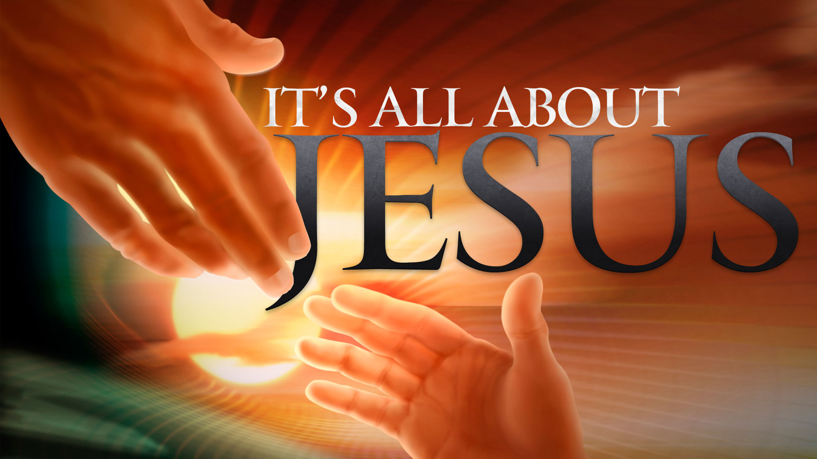

Be of Good Cheer
By Pastor Fee Soliven
Mark 6:45-56
Wednesday Evening
January 16, 2019

Slide 4
45 Immediately He made His disciples get into the boat and go before Him to the other side, to Bethsaida, while He sent the multitude away. 46 And when He had sent them away, He departed to the mountain to pray.

Slide 5
47 Now when evening came, the boat was in the middle of the sea; and He was alone on the land. 48 Then He saw them straining at rowing, for the wind was against them. Now about the fourth watch of the night He came to them, walking on the sea, and would have passed them by.

Slide 6
49 And when they saw Him walking on the sea, they supposed it was a ghost, and cried out; 50 for they all saw Him and were troubled. But immediately He talked with them and said to them, "Be of good cheer! It is I; do not be afraid."

Slide 7
51 Then He went up into the boat to them, and the wind ceased. And they were greatly amazed in themselves beyond measure, and marveled. 52 For they had not understood about the loaves, because their heart was hardened. 53 When they had crossed over, they came to the land of Gennesaret and anchored there.

Slide 8
54 And when they came out of the boat, immediately the people recognized Him, 55 ran through that whole surrounding region, and began to carry about on beds those who were sick to wherever they heard He was.

Slide 9
56 Wherever He entered, into villages, cities, or the country, they laid the sick in the marketplaces, and begged Him that they might just touch the hem of His garment. And as many as touched Him were made well.

Slide 10
45 Immediately He made His disciples get into the boat and go before Him to the other side, to Bethsaida, while He sent the multitude away.

Slide 11
John 6:15
“Therefore when Jesus perceived that they were about to come and take Him by force to make Him king, He departed again to the mountain by Himself alone.”

Slide 12
Unrepentant cities of Chorazin, Bethsaida and Capernaum

Slide 13
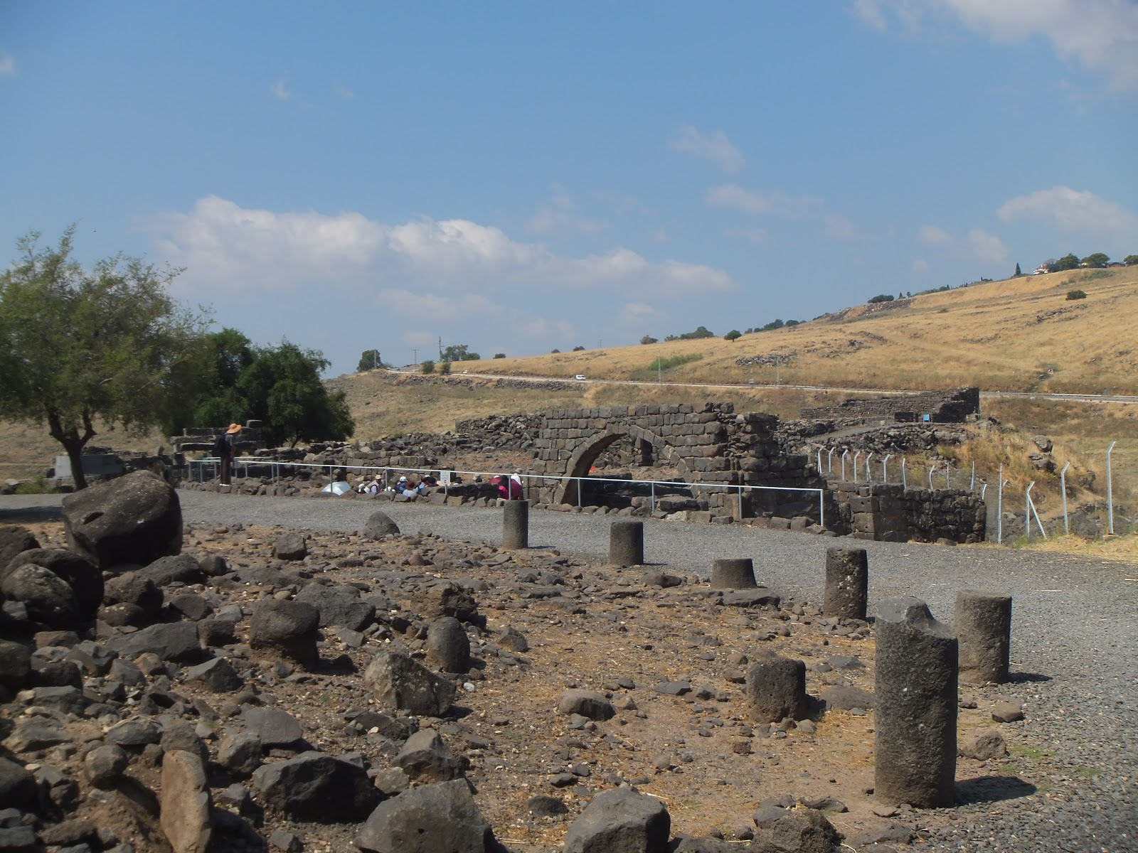
Luke 9:10
10 And the apostles, when they had returned, told Him all that they had done. Then He took them and went aside privately into a deserted place belonging to the city called Bethsaida.

Slide 14
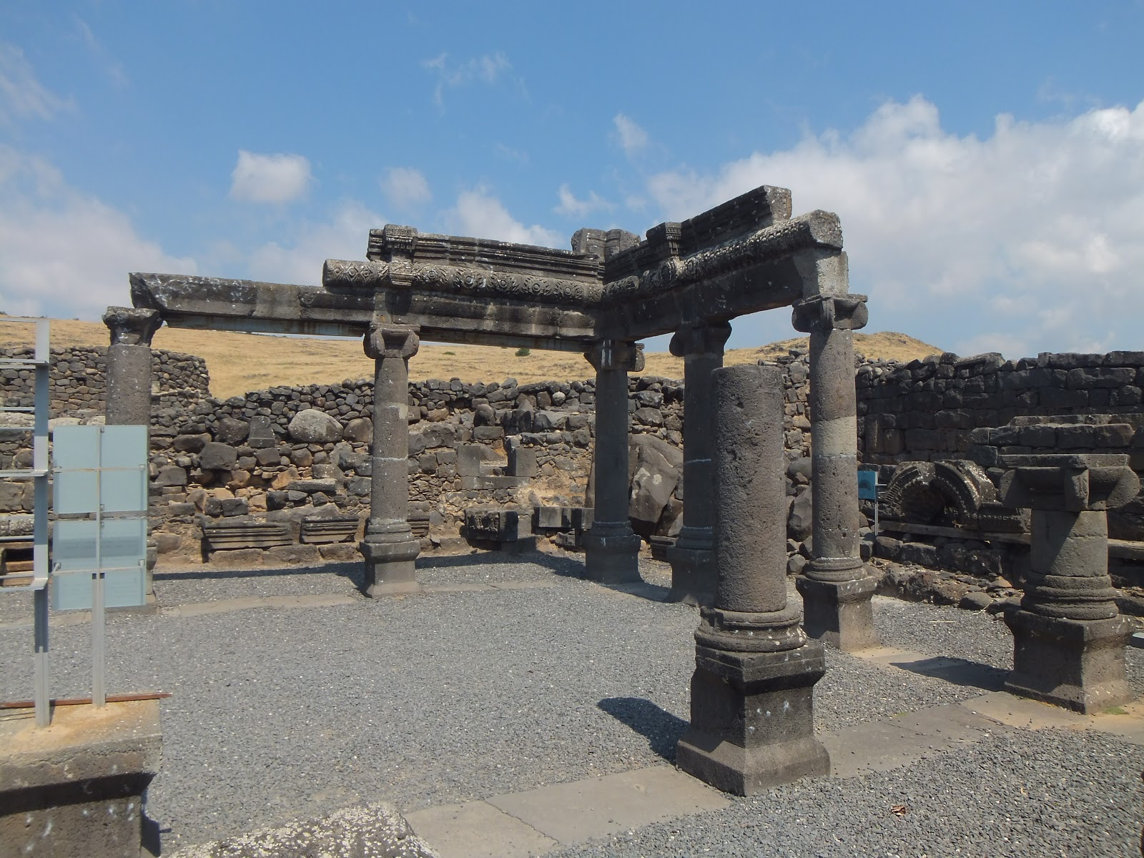
31 And He said to them, "Come aside by yourselves to a deserted place and rest a while." For there were many coming and going, and they did not even have time to eat. 32 So they departed to a deserted place in the boat by themselves.

Slide 15
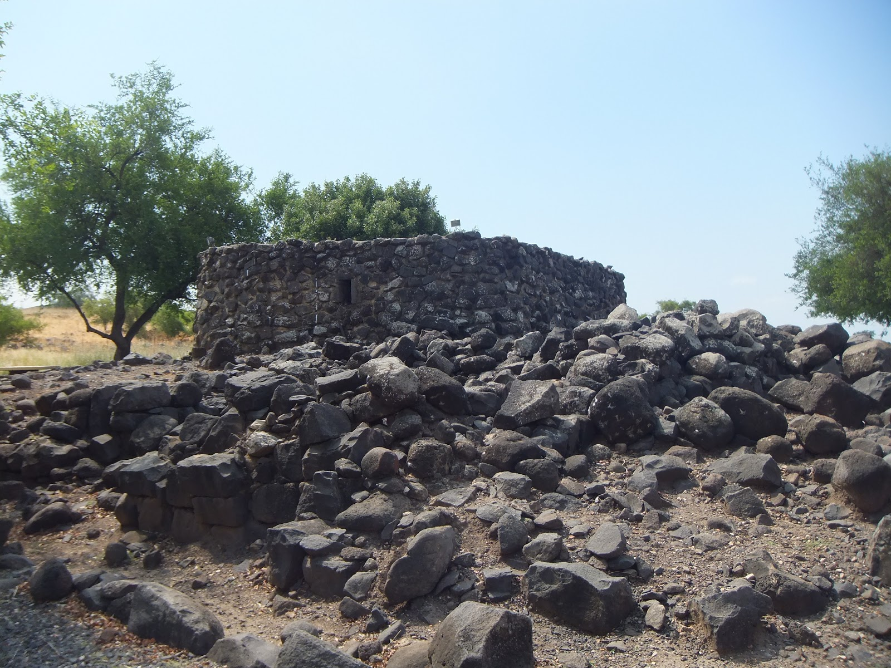
33 But the multitudes saw them departing, and many knew Him and ran there on foot from all the cities. They arrived before them and came together to Him.

Slide 16
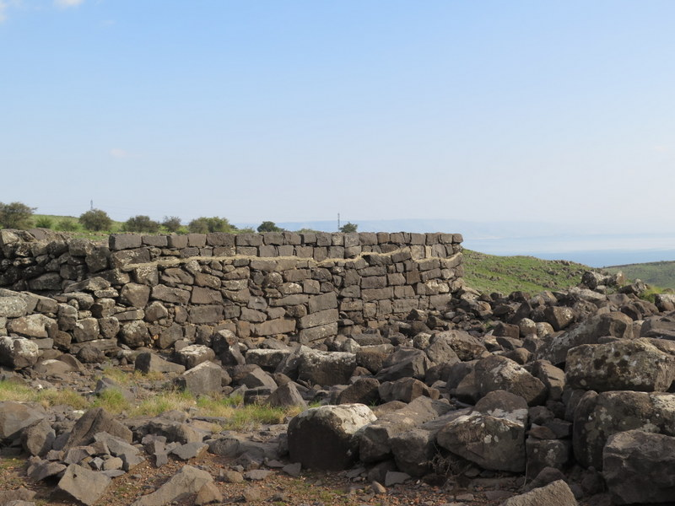
Isaiah 2:12
“For the day of the LORD of hosts Shall come upon everything proud and lofty, Upon everything lifted up--And it shall be brought low…”

Slide 17
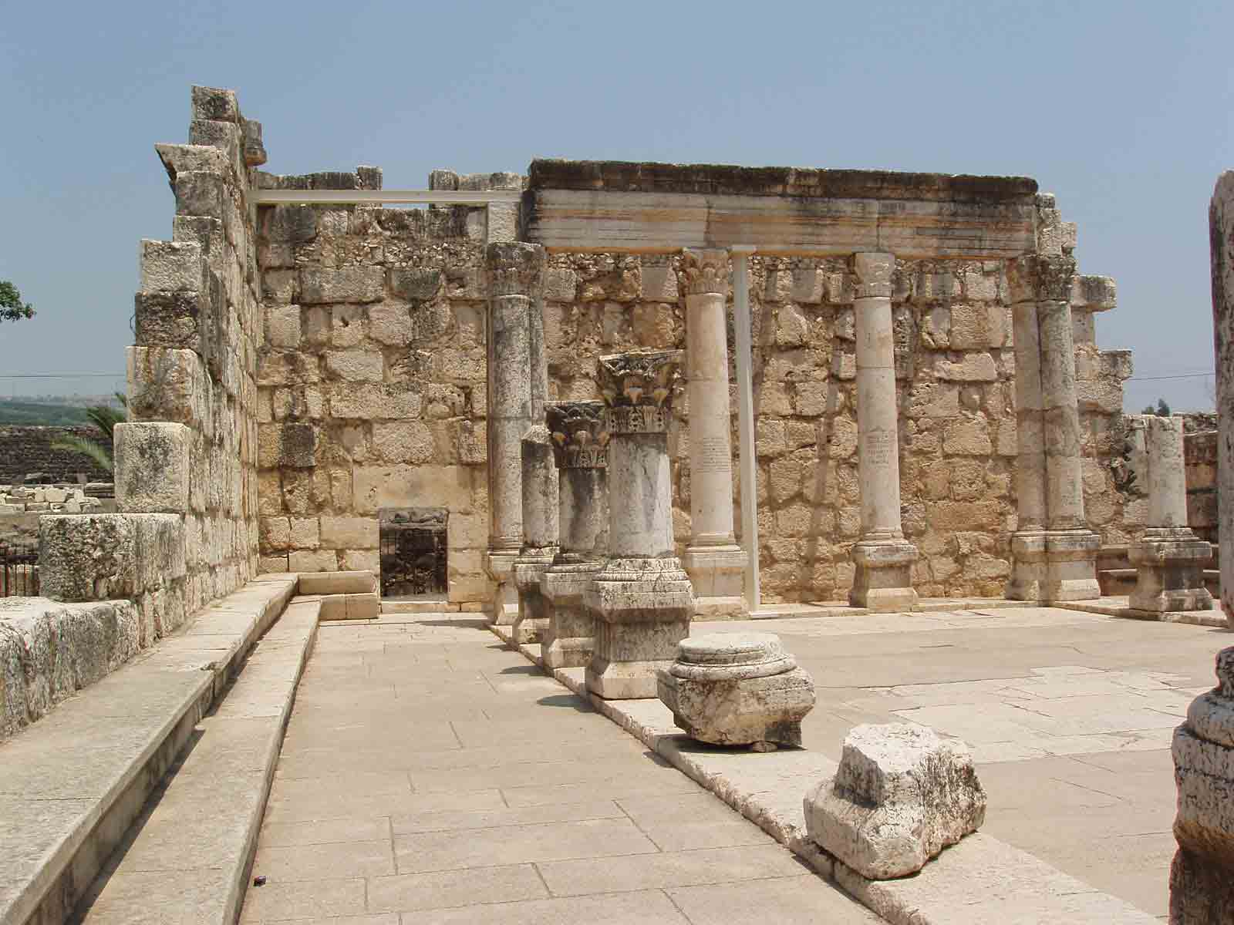
Matthew 6:1-2
1 “Beware of practicing your righteousness before other people in order to be seen by them, for then you will have no reward from your Father who is in heaven. 2 “Thus, when you give to the needy, sound no trumpet before you, as the hypocrites do in the synagogues and in the streets, that they may be praised by others. Truly, I say to you, they have received their reward.

Slide 18
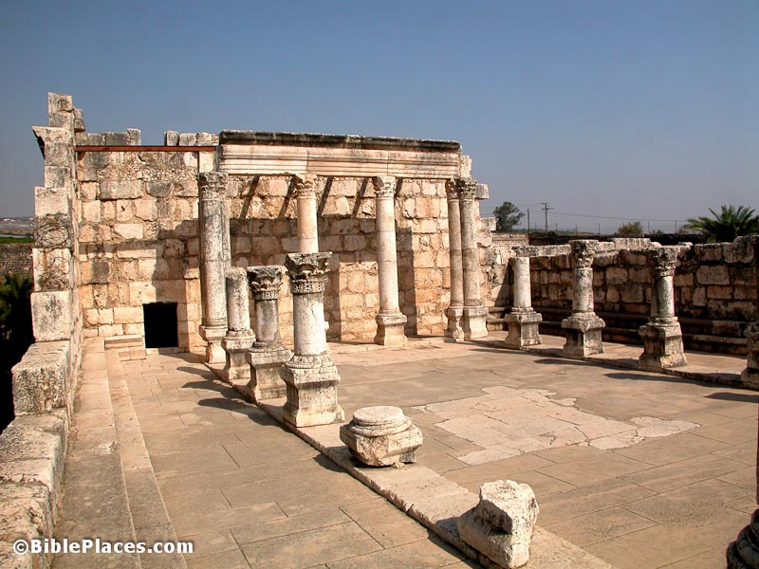
James 4:6
But he gives more grace. Therefore it says, “God opposes the proud, but gives grace to the humble.”

Slide 19
46 And when He had sent them away, He departed to the mountain to pray.

Slide 20
Psalm 66:16-20
16 Come and hear, all you who fear God, And I will declare what He has done for my soul. 17 I cried to Him with my mouth, And He was extolled with my tongue. 18 If I regard iniquity in my heart, The Lord will not hear. 19 But certainly God has heard me; He has attended to the voice of my prayer. 20 Blessed be God, Who has not turned away my prayer, Nor His mercy from me!

Slide 21
Philippians 1:3-6
3 I thank my God upon every remembrance of you, 4 always in every prayer of mine making request for you all with joy, 5 for your fellowship in the gospel from the first day until now, 6 being confident of this very thing, that He who has begun a good work in you will complete it until the day of Jesus Christ;

Slide 22
Hebrews 12:2
“looking unto Jesus, the author and finisher of our faith, who for the joy that was set before Him endured the cross, despising the shame, and has sat down at the right hand of the throne of God.”
Saints, Jesus constantly sought strength from God. Going into the wilderness, alone with the Father, helped Jesus focus on his task and gain strength for what he had to do.

Slide 23
Isaiah 40:31
“But those who wait on the LORD shall renew their strength; they shall mount up with wings like eagles, they shall run and not be weary, they shall walk and not faint.”

Slide 24
47 Now when evening came, the boat was in the middle of the sea; and He was alone on the land.

Slide 25
Matthew 14:22-24
22 Immediately Jesus made His disciples get into the boat and go before Him to the other side, while He sent the multitudes away.

Slide 26
23 And when He had sent the multitudes away, He went up on the mountain by Himself to pray. Now when evening came, He was alone there. 24 But the boat was now in the middle of the sea, tossed by the waves, for the wind was contrary

Slide 27
48 Then He saw them straining at rowing, for the wind was against them. Now about the fourth watch of the night He came to them, walking on the sea, and would have passed them by. 49 And when they saw Him walking on the sea, they supposed it was a ghost, and cried out; 50 for they all saw Him and were troubled. But immediately He talked with them and said to them, "Be of good cheer! It is I; do not be afraid."

Slide 28
John 6:18-19
18 Then the sea arose because a great wind was blowing. 19 So when they had rowed about three or four miles, they saw Jesus walking on the sea and drawing near the boat; and they were afraid.

Slide 29
1. Jesus “meant to pass beside” them as in providing a divine manifestation so to reveal to them his divine presence

Slide 30
2. Jesus “was about to pass by” as he waited for the disciples to see him and call out to him for help

Slide 31
3. The phrase was written from the disciples’ standpoint (from Peter’s eyewitness account) that, when they saw Jesus, it appeared to them that his intention was to “pass by them”

Slide 32
4. The phrase means Jesus “intended to pass their way,” that is, to go to them, which is exactly what he did. When they all saw Jesus walking on the water, the disciples thought he was a ghost; so they screamed in terror.

Slide 33
“I am here” is “I am”; it is the same as saying “the I AM is here” or “I, Yahweh, am here”

Slide 34
Exodus 3:14
“And God said to Moses, "I AM WHO I AM." And He said, "Thus you shall say to the children of Israel, 'I AM has sent me to you.”

Slide 35
Isaiah 41:4
“Who has performed and done it, Calling the generations from the beginning? 'I, the LORD, am the first; And with the last I am He.'"

Slide 36
Isaiah 43:10
"You are My witnesses," says the LORD, "And My servant whom I have chosen, That you may know and believe Me, And understand that I am He. Before Me there was no God formed, Nor shall there be after Me.”

Slide 37
Isaiah 52:6
“Therefore My people shall know My name; Therefore they shall know in that day That I am He who speaks: 'Behold, it is I.'"

Slide 38
51 Then He went up into the boat to them, and the wind ceased. And they were greatly amazed in themselves beyond measure, and marveled. 52 For they had not understood about the loaves, because their heart was hardened.

Slide 39
But why wouldn’t the disciples believe?

Slide 40
Hebrews 11:6
“But without faith it is impossible to please Him, for he who comes to God must believe that He is, and that He is a rewarder of those who diligently seek Him.”

Slide 41
53 When they had crossed over, they came to the land of Gennesaret and anchored there. 54 And when they came out of the boat, immediately the people recognized Him, 55 ran through that whole surrounding region, and began to carry about on beds those who were sick to wherever they heard He was.

Slide 42
Luke 4:17-19
17 And He was handed the book of the prophet Isaiah. And when He had opened the book, He found the place where it was written: 18 "The Spirit of the LORD is upon Me, Because He has anointed Me To preach the gospel to the poor; He has sent Me to heal the brokenhearted, To proclaim liberty to the captives And recovery of sight to the blind, To set at liberty those who are oppressed; 19 To proclaim the acceptable year of the LORD."

Slide 43
Luke 19:10
…or the Son of Man has come to seek and to save that which was lost."

Slide 44
56 Wherever He entered, into villages, cities, or the country, they laid the sick in the marketplaces, and begged Him that they might just touch the hem of His garment. And as many as touched Him were made well.

Slide 45
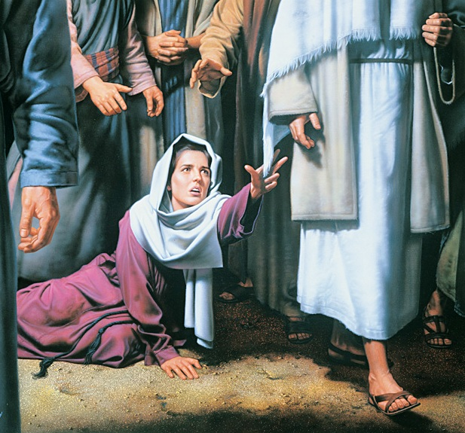
But why wouldn’t the disciples believe?

Slide 46
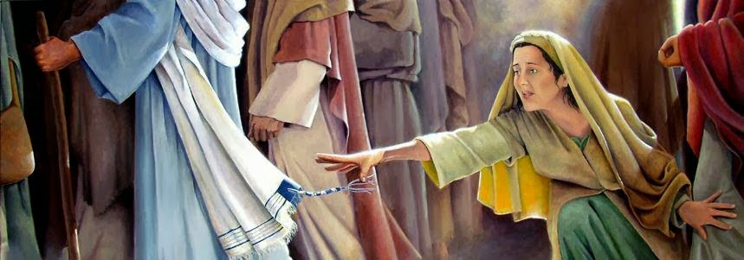
Touching The Hem of His Garment
“Tzitzit”
The Word of God

