Slide 1


Slide 2


Slide 3
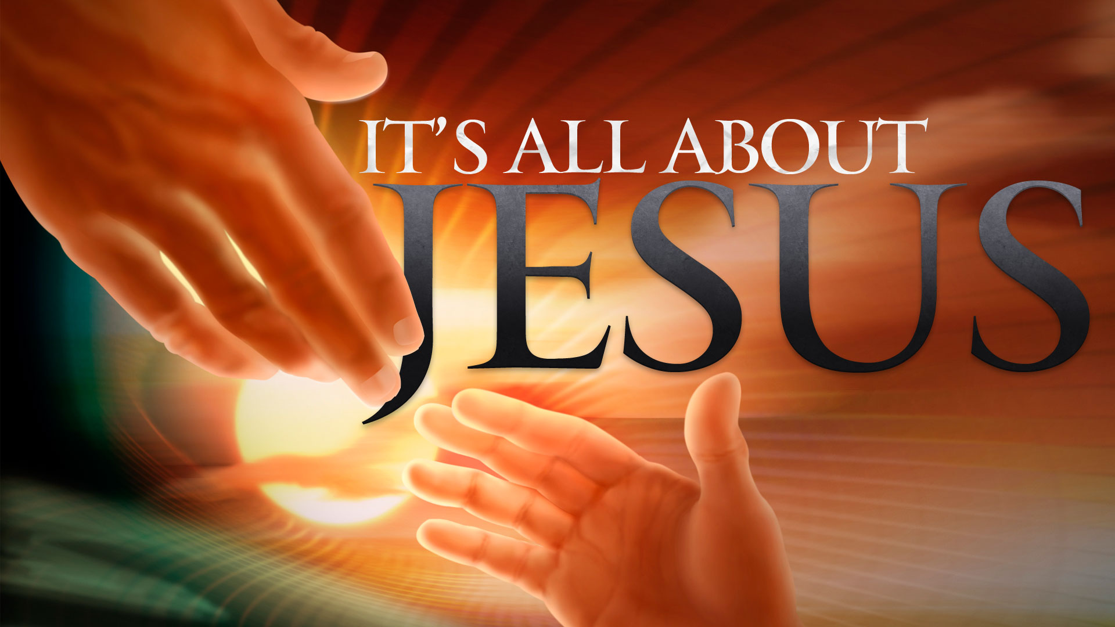

Honor God with Your Heart
By Pastor Fee Soliven
Mark 7:1-11
Wednesday Evening
January 30, 2019

Slide 4
1 Then the Pharisees and some of the scribes came together to Him, having come from Jerusalem. 2 Now when they saw some of His disciples eat bread with defiled, that is, with unwashed hands, they found fault. 3 For the Pharisees and all the Jews do not eat unless they wash their hands in a special way, holding the tradition of the elders.

Slide 5
4 When they come from the marketplace, they do not eat unless they wash. And there are many other things which they have received and hold, like the washing of cups, pitchers, copper vessels, and couches. 5 Then the Pharisees and scribes asked Him, "Why do Your disciples not walk according to the tradition of the elders, but eat bread with unwashed hands?"

Slide 6
6 He answered and said to them, "Well did Isaiah prophesy of you hypocrites, as it is written: 'This people honors Me with their lips, But their heart is far from Me. 7 And in vain they worship Me, Teaching as doctrines the commandments of men.' 8 "For laying aside the commandment of God, you hold the tradition of men--the washing of pitchers and cups, and many other such things you do."

Slide 7
9 And He said to them, "All too well you reject the commandment of God, that you may keep your tradition. 10 For Moses said, 'Honor your father and your mother'; and, 'He who curses father or mother, let him be put to death.' 11 But you say, 'If a man says to his father or mother, "Whatever profit you might have received from me is Corban"--' 12 then you no longer let him do anything for his father or his mother…

Slide 8
1 Then the Pharisees and some of the scribes came together to Him, having come from Jerusalem. 2 Now when they saw some of His disciples eat bread with defiled, that is, with unwashed hands, they found fault.

Slide 9
Colossians 2:7-12
8 Beware lest anyone cheat you through philosophy and empty deceit, according to the tradition of men, according to the basic principles of the world, and not according to Christ. 9 For in Him dwells all the fullness of the Godhead bodily; 10 and you are complete in Him, who is the head of all principality and power.

Slide 10
11 In Him you were also circumcised with the circumcision made without hands, by putting off the body of the sins of the flesh, by the circumcision of Christ, 12 buried with Him in baptism, in which you also were raised with Him through faith in the working of God, who raised Him from the dead.

Slide 11
Romans 8:29-31
29 For whom He foreknew, He also predestined to be conformed to the image of His Son, that He might be the firstborn among many brethren. 30 Moreover whom He predestined, these He also called; whom He called, these He also justified; and whom He justified, these He also glorified. 31 What then shall we say to these things? If God is for us, who can be against us?

Slide 12
3 For the Pharisees and all the Jews do not eat unless they wash their hands in a special way, holding the tradition of the elders.

Slide 13
Exodus 30:17-19
17 Then the LORD spoke to Moses, saying: 18 "You shall also make a laver of bronze, with its base also of bronze, for washing. You shall put it between the tabernacle of meeting and the altar. And you shall put water in it, 19 for Aaron and his sons shall wash their hands and their feet in water from it.

Slide 14
4 When they come from the marketplace, they do not eat unless they wash. And there are many other things which they have received and hold, like the washing of cups, pitchers, copper vessels, and couches.

Slide 15
Luke 18:10-14
10 Two men went up to the temple to pray, one a Pharisee and the other a tax collector. 11 The Pharisee stood and prayed thus with himself, 'God, I thank You that I am not like other men--extortioners, unjust, adulterers, or even as this tax collector. 12 I fast twice a week; I give tithes of all that I possess.'

Slide 16
13 And the tax collector, standing afar off, would not so much as raise his eyes to heaven, but beat his breast, saying, 'God, be merciful to me a sinner!' 14 I tell you, this man went down to his house justified rather than the other; for everyone who exalts himself will be humbled, and he who humbles himself will be exalted."

Slide 17
5 Then the Pharisees and scribes asked Him, "Why do Your disciples not walk according to the tradition of the elders, but eat bread with unwashed hands?"

Slide 18
6 He answered and said to them, "Well did Isaiah prophesy of you hypocrites, as it is written: 'This people honors Me with their lips, But their heart is far from Me. 7 And in vain they worship Me, Teaching as doctrines the commandments of men.' 8 "For laying aside the commandment of God, you hold the tradition of men--the washing of pitchers and cups, and many other such things you do." 9 And He said to them, "All too well you reject the commandment of God, that you may keep your tradition.

Slide 19
A hypocrite is one who makes judgment from under a cover

Slide 20
Isaiah 29:13
“Therefore the LORD said: "Inasmuch as these people draw near with their mouths And honor Me with their lips, But have removed their hearts far from Me, And their fear toward Me is taught by the commandment of men”

Slide 21
The Problem:
They replace God’s commands with their own man-made teachings and their own traditions. Their focus on minute rules of everyday life caused them to forget the scope of God’s law and what it meant for the people.

Slide 22
Matthew 23:13-33
13 But woe to you, scribes and Pharisees, hypocrites! For you shut up the kingdom of heaven against men; for you neither go in yourselves, nor do you allow those who are entering to go in.

Slide 23
14 Woe to you, scribes and Pharisees, hypocrites! For you devour widows' houses, and for a pretense make long prayers. Therefore you will receive greater condemnation. 15 Woe to you, scribes and Pharisees, hypocrites! For you travel land and sea to win one proselyte, and when he is won, you make him twice as much a son of hell as yourselves.

Slide 24
16 Woe to you, blind guides, who say, 'Whoever swears by the temple, it is nothing; but whoever swears by the gold of the temple, he is obliged to perform it.' 17 "Fools and blind! For which is greater, the gold or the temple that sanctifies the gold? 18 And, 'Whoever swears by the altar, it is nothing; but whoever swears by the gift that is on it, he is obliged to perform it.'

Slide 25
19 "Fools and blind! For which is greater, the gift or the altar that sanctifies the gift? 20 Therefore he who swears by the altar, swears by it and by all things on it. 21 He who swears by the temple, swears by it and by Him who dwells in it. 22 And he who swears by heaven, swears by the throne of God and by Him who sits on it.

Slide 26
23 Woe to you, scribes and Pharisees, hypocrites! For you pay tithe of mint and anise and cummin, and have neglected the weightier matters of the law: justice and mercy and faith. These you ought to have done, without leaving the others undone. 24 Blind guides, who strain out a gnat and swallow a camel! 25 Woe to you, scribes and Pharisees, hypocrites! For you cleanse the outside of the cup and dish, but inside they are full of extortion and self-indulgence.

Slide 27
26 Blind Pharisee, first cleanse the inside of the cup and dish, that the outside of them may be clean also. 27 Woe to you, scribes and Pharisees, hypocrites! For you are like whitewashed tombs which indeed appear beautiful outwardly, but inside are full of dead men's bones and all uncleanness.

Slide 28
28 Even so you also outwardly appear righteous to men, but inside you are full of hypocrisy and lawlessness. 29 Woe to you, scribes and Pharisees, hypocrites! Because you build the tombs of the prophets and adorn the monuments of the righteous, 30 and say, 'If we had lived in the days of our fathers, we would not have been partakers with them in the blood of the prophets.'

Slide 29
31 "Therefore you are witnesses against yourselves that you are sons of those who murdered the prophets. 32 Fill up, then, the measure of your fathers' guilt. 33 Serpents, brood of vipers! How can you escape the condemnation of hell?

Slide 30
Woe
Webster’s Dictionary Definition of Wow:
grievous distress, affliction, or trouble: an affliction: Interjection an exclamation of grief, distress, or lamentation.

Slide 31
10 For Moses said, 'Honor your father and your mother'; and, 'He who curses father or mother, let him be put to death.' 11 But you say, 'If a man says to his father or mother, "Whatever profit you might have received from me is Corban"--' 12 then you no longer let him do anything for his father or his mother…

Slide 32
Deuteronomy 4:14
“And the LORD commanded me at that time to teach you statutes and judgments, that you might observe them in the land which you cross over to possess”

