Slide 1


Slide 2


Slide 3
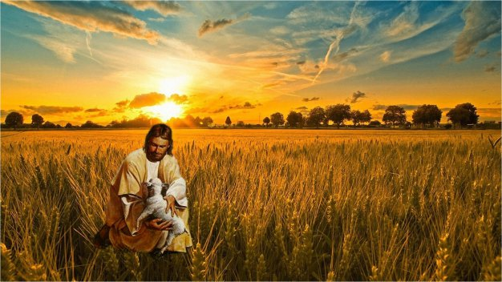

Jesus Keep Me from Going Astray
By Pastor Fee Soliven
Luke 15:11-24
Sunday Morning
January 27, 2019

Slide 4
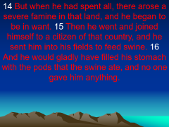
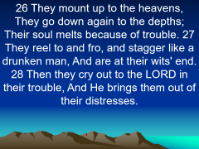
11 Then He said: "A certain man had two sons. 12 And the younger of them said to his father, 'Father, give me the portion of goods that falls to me.' So he divided to them his livelihood. 13 And not many days after, the younger son gathered all together, journeyed to a far country, and there wasted his possessions with loose living.

Slide 5
14 But when he had spent all, there arose a severe famine in that land, and he began to be in want. 15 Then he went and joined himself to a citizen of that country, and he sent him into his fields to feed swine. 16 And he would gladly have filled his stomach with the pods that the swine ate, and no one gave him anything.

Slide 6
17 But when he came to himself, he said, 'How many of my father's hired servants have bread enough and to spare, and I perish with hunger! 18 I will arise and go to my father, and will say to him, "Father, I have sinned against heaven and before you, 19 and I am no longer worthy to be called your son. Make me like one of your hired servants." '

Slide 7
The condition of your heart determines the direction of your life

Slide 8
Luke 15:1-2
1 Then all the tax collectors and the sinners drew near to Him to hear Him. 2 And the Pharisees and scribes murmured, saying, "This man receives sinners and eats with them."

Slide 9
A Lost Sheep
Luke 15:3-7
3 So He spoke this parable to them, saying: 4 What man of you, having a hundred sheep, if he loses one of them, does not leave the ninety-nine in the wilderness, and go after the one which is lost until he finds it? 5 And when he has found it, he lays it on his shoulders, rejoicing.

Slide 10
6 And when he comes home, he calls together his friends and neighbors, saying to them, 'Rejoice with me, for I have found my sheep which was lost!' 7 I say to you that likewise there will be more joy in heaven over one sinner who repents than over ninety-nine just persons who need no repentance.

Slide 11
A Lost Coin
Luke 15:8-10
8 "Or what woman, having ten silver coins, if she loses one coin, does not light a lamp, sweep the house, and search carefully until she finds it? 9 And when she has found it, she calls her friends and neighbors together, saying, 'Rejoice with me, for I have found the piece which I lost!' 10 Likewise, I say to you, there is joy in the presence of the angels of God over one sinner who repents."

Slide 12
A Lost Son
Luke 15:11-13
11 Then He said: "A certain man had two sons. 12 And the younger of them said to his father, 'Father, give me the portion of goods that falls to me.' So he divided to them his livelihood. 13 And not many days after, the younger son gathered all together, journeyed to a far country, and there wasted his possessions with prodigal living.

Slide 13
Matthew 7:13-14
13 "Enter by the narrow gate; for wide is the gate and broad is the way that leads to destruction, and there are many who go in by it. 14 Because narrow is the gate and difficult is the way which leads to life, and there are few who find it.

Slide 14
The Downward Steps of the Prodigal Son

Slide 15
1. Desire

Slide 16
2. Decision

Slide 17
Proverbs 14:12
“There is a way that seems right to a man, But its end is the way of death.”

Slide 18
Proverbs 19:21
“Many are the plans in a man's heart, but it is the LORD's purpose that prevails.”

Slide 19
3. Departure

Slide 20
John 10:10
“The thief does not come except to steal, and to kill, and to destroy. I have come that they may have life, and that they may have it more abundantly.”

Slide 21
Matthew 4:8-10
8 Again, the devil took Him up on an exceedingly high mountain, and showed Him all the kingdoms of the world and their glory. 9 And he said to Him, "All these things I will give You if You will fall down and worship me." 10 Then Jesus said to him, "Away with you, Satan! For it is written, 'You shall worship the LORD your God, and Him only you shall serve.' "

Slide 22
Hebrews 9:27
“It is appointed for men to die once and after this comes judgment”

Slide 23
4. Deception

Slide 24
Luke 15:13
“And not many days after, the younger son gathered all together, journeyed to a far country, and there wasted his possessions with loose living.”

Slide 25
1 Corinthians 6:9-11
9 Do you not know that the unrighteous will not inherit the kingdom of God? Do not be deceived. Neither fornicators, nor idolaters, nor adulterers, nor homosexuals, nor sodomites, 10 nor thieves, nor covetous, nor drunkards, nor revilers, nor extortioners will inherit the kingdom of God.

Slide 26
5. Wandering

Slide 27
James 4:17
“So whoever knows the right thing to do and fails to do it, for him it is sin.”

Slide 28
6. Wanting

Slide 29
Luke 4:18
"The Spirit of the LORD is upon Me, Because He has anointed Me To preach the gospel to the poor; He has sent Me to heal the brokenhearted, To proclaim liberty to the captives And recovery of sight to the blind, To set at liberty those who are oppressed”

Slide 30
Luke 15:17
But when he came to himself, he said, 'How many of my father's hired servants have bread enough and to spare, and I perish with hunger!

Slide 31
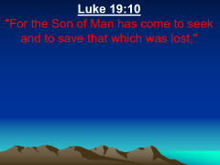
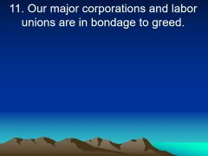
How could something that looked so good in the beginning
turn so bad?

Slide 32
Luke 19:10
"For the Son of Man has come to seek and to save that which was lost."

Slide 33
Ezekiel 34:16
“I will seek what was lost and bring back what was driven away, bind up the broken and strengthen what was sick; but I will destroy the fat and the strong, and feed them in judgment."

Slide 34
7. Make a Decision

Slide 35
Acts 3:19
“Repent therefore and be converted, that your sins may be blotted out, so that times of refreshing may come from the presence of the Lord…”

Slide 36
1. What is the condition of your heart today?

Slide 37
2. Are you drawing closer to God or running away from Him?

Slide 38
3. Have you ever been reluctant to return to the Lord after a season of wandering because you were embarrassed or feared that you had made too big a mess of your life?

Slide 39
4. How does the story of the prodigal son contradict that perception?

