Slide 1


Slide 2


Slide 3
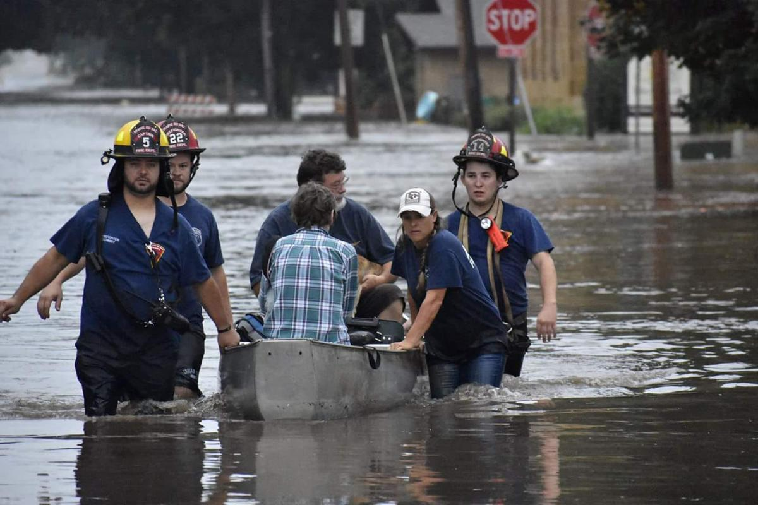

Jesus We Need You Now
By Pastor Fee Soliven
Psalm 107:23-31
Sunday Morning
January 6, 2019

Slide 4
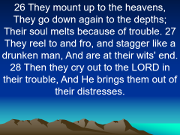
Psalm 107:23-31
23 Those who go down to the sea in ships, Who do business on great waters, 24 They see the works of the LORD, And His wonders in the deep. 25 For He commands and raises the stormy wind, Which lifts up the waves of the sea.

Slide 5
26 They mount up to the heavens, They go down again to the depths; Their soul melts because of trouble. 27 They reel to and fro, and stagger like a drunken man, And are at their wits' end. 28 Then they cry out to the LORD in their trouble, And He brings them out of their distresses.

Slide 6
29 He calms the storm, So that its waves are still. 30 Then they are glad because they are quiet; So He guides them to their desired haven. 31 Oh, that men would give thanks to the LORD for His goodness, And for His wonderful works to the children of men!

Slide 7
We all experience storms in our lives when those occasions will bring pain, suffering, or loss.

Slide 8
Where is God? Why has this happened? Was it something I did? Did God cause it? If so, why?

Slide 9
Psalm 103:19
“The Lord has established His throne in the heavens, and His sovereignty rules over all.”

Slide 10
Was God in the Storm?

Slide 11
Psalm 107:25
“For He commands and raises the stormy wind, Which lifts up the waves of the sea.”

Slide 12
There are three kinds of Storms

Slide 13
1. Natural Storms

Slide 14
2. Emotional Storms

Slide 15
Poor Health

Slide 16
Financial Struggles

Slide 17
Relationship Difficulties

Slide 18
3. Spiritual Storms

Slide 19
What are the Sources of
our Storms?

Slide 20
1. The Devil (Slew-Foot)

Slide 21
2 Samuel 11:1-5
1 It happened in the spring of the year, at the time when kings go out to battle, that David sent Joab and his servants with him, and all Israel; and they destroyed the people of Ammon and besieged Rabbah. But David remained at Jerusalem.

Slide 22
2 Then it happened one evening that David arose from his bed and walked on the roof of the king's house. And from the roof he saw a woman bathing, and the woman was very beautiful to behold. 3 So David sent and inquired about the woman. And someone said, "Is this not Bathsheba, the daughter of Eliam, the wife of Uriah the Hittite?"

Slide 23
4 Then David sent messengers, and took her; and she came to him, and he lay with her, for she was cleansed from her impurity; and she returned to her house. 5 And the woman conceived; so she sent and told David, and said, "I am with child."

Slide 24
2. God

Slide 25
Why does God allow Storms in our Lives?

Slide 26
To get our Attention

Slide 27
To bring us to Repentance

Slide 28
Jonah 1:1-5
1 Now the word of the LORD came to Jonah the son of Amittai, saying, 2 "Arise, go to Nineveh, that great city, and cry out against it; for their wickedness has come up before Me." 3 But Jonah arose to flee to Tarshish from the presence of the LORD. He went down to Joppa, and found a ship going to Tarshish; so he paid the fare, and went down into it, to go with them to Tarshish from the presence of the LORD.

Slide 29
4 But the LORD sent out a great wind on the sea, and there was a mighty tempest on the sea, so that the ship was about to be broken up. 5 Then the mariners were afraid; and every man cried out to his god, and threw the cargo that was in the ship into the sea, to lighten the load. But Jonah had gone down into the lowest parts of the ship, had lain down, and was fast asleep.

Slide 30
To Conform us to Christ’s Image

Slide 31
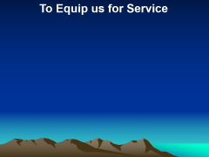

2 Corinthians 3:18
“But we all, with unveiled face, beholding as in a mirror the glory of the Lord, are being transformed into the same image from glory to glory, just as by the Spirit of the Lord.”

Slide 32
To Equip us for Service

Slide 33
To Demonstrate His power in
Our Lives

Slide 34
2 Corinthians 13:4-6
4 For though He was crucified in weakness, yet He lives by the power of God. For we also are weak in Him, but we shall live with Him by the power of God toward you. 5 Examine yourselves as to whether you are in the faith. Test yourselves. Do you not know yourselves, that Jesus Christ is in you?--unless indeed you are disqualified. 6 But I trust that you will know that we are not disqualified.

Slide 35
To Demonstrate His Love

Slide 36
Isaiah 55:8-9
8 "For My thoughts are not your thoughts, Nor are your ways My ways," says the LORD. 9 "For as the heavens are higher than the earth, So are My ways higher than your ways, And My thoughts than your thoughts.

Slide 37
To remind us Who is in control

Slide 38
1. How do you usually respond to the storms in your life?

Slide 39
2. How does it make you feel knowing that God is in control?

Slide 40
3. As you look back on past storms, what has the Lord taught you about Himself and His ways?

