Slide 1


Slide 2


Slide 3
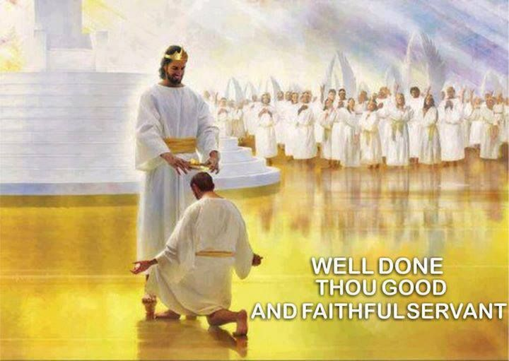

The Faithful Servant of God
By Pastor Fee Soliven
Psalm 86:1-5
Sunday Morning
February 17, 2019

Slide 4
Psalm 86:1-5
1 Bow down Your ear, O LORD, hear me; For I am poor and needy. 2 Preserve my life, for I am holy; You are my God; Save Your servant who trusts in You! 3 Be merciful to me, O Lord, For I cry to You all day long. 4 Rejoice the soul of Your servant, For to You, O Lord, I lift up my soul. 5 For You, Lord, are good, and ready to forgive, And abundant in mercy to all those who call upon You.

Slide 5
Faithfulness is one of the most important qualities in a Person’s Life

Slide 6
Genesis 32:9-10
“O God of my father Abraham and God of my father Isaac, O Lord, who said to me, ‘Return to your country and to your relatives, and I will prosper you,’ I am unworthy of all the lovingkindness and of all the faithfulness which You have shown to Your servant”

Slide 7
Scripture Affirms
God’s Faithfulness

Slide 8
Deuteronomy 7:9
“Know therefore that the Lord your God, He is God, the faithful God, who keeps His covenant and His lovingkindness to a thousandth generation with those who love Him and keep His commandments.”

Slide 9
Psalm 33:4
“For the word of the Lord is upright, and all His work is done in faithfulness.”

Slide 10
Psalm 36:5
“Your lovingkindness, O Lord, extends to the heavens, Your faithfulness reaches to the skies.”

Slide 11
Psalm 119:90
“Your faithfulness continues throughout all generations.”

Slide 12
Lamentations 3:22-23
“The Lord’s lovingkindnesses indeed never cease, for His compassions never fail. They are new every morning; great is Your faithfulness.”

Slide 13
2 Timothy 2:13
“If we are faithless, He remains faithful, for He cannot deny Himself.”

Slide 14
Hebrews 13:5
“I will never desert you, nor will I ever forsake you,”

Slide 15
Luke 24:49
“Behold, I send the Promise of My Father upon you; but tarry in the city of Jerusalem until you are endued with power from on high."

Slide 16
He will always Forgive Us

Slide 17
1 John 1:9
“If we confess our sins, He is faithful and righteous to forgive us our sins and to cleanse us from all unrighteousness”

Slide 18
God’s Faithfulness limits the
Power of our Temptation

Slide 19
1 Corinthian 10:13
“No temptation has overtaken you but such as is common to man; and God is faithful, who will not allow you to be tempted beyond what you are able, but with the temptation will provide the way of escape also, so that you will be able to endure it”.

Slide 20
We can have the Peace of God

Slide 21
Philippians 4:7
“And the peace of God, which surpasses all comprehension, will guard your hearts and your minds in Christ Jesus”

Slide 22
The Holy Spirit limits the power of Satan in our lives

Slide 23
2 Thessalonians 3:3
“But the Lord is faithful, and He will strengthen and protect you from the evil one”

Slide 24
Galatians 5:22-23
22 But the fruit of the Spirit is love, joy, peace, longsuffering, kindness, goodness, faithfulness, 23 gentleness, self-control. Against such there is no law.

Slide 25
When we Walk in the Spirit, we’ll have the Following Characteristics:

Slide 26
1. Devoted to God

Slide 27
Galatians 2:20
“I have been crucified with Christ. It is no longer I who live, but Christ who lives in me. And the life I now live in the flesh I live by faith in the Son of God, who loved me and gave himself for me”

Slide 28
2. Loyal

Slide 29
Matthew 24:12-13
12 And because lawlessness will abound, the love of many will grow cold. 13 But he who endures to the end shall be saved.

Slide 30
3.Unwavering

Slide 31
Hebrews 10:23
“Let us hold fast the confession of the hope unwavering, for he is faithful who has promised…”

Slide 32
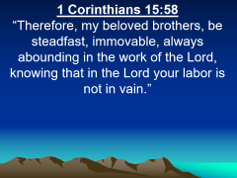
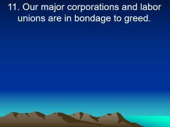
4. Steadfast

Slide 33
1 Corinthians 15:58
“Therefore, my beloved brothers, be steadfast, immovable, always abounding in the work of the Lord, knowing that in the Lord your labor is not in vain.”

Slide 34
5. Trustworthy

Slide 35
Zechariah 8:16-17
16 “These are the things that you shall do: Speak the truth to one another; render in your gates judgments that are true and make for peace; 17 do not devise evil in your hearts against one another, and love no false oath, for all these things I hate, declares the Lord.”

Slide 36
6. Dependable

Slide 37
1 John 2:5-6
5 But whoever keeps his word, in him truly the love of God is perfected. By this we may know that we are in him: 6 whoever says he abides in him ought to walk in the same way in which he walked.

Slide 38
7. Obedient

Slide 39
Acts 5:29-30
But Peter and the other apostles answered and said: "We ought to obey God rather than men.

Slide 40
8. Fruitful

Slide 41
Colossians 1:10
“So as to walk in a manner worthy of the Lord, fully pleasing to him, bearing fruit in every good work and increasing in the knowledge of God.”

Slide 42
9. Faithful

Slide 43
1 Samuel 12:24
“Only fear the Lord and serve him faithfully with all your heart. For consider what great things he has done for you.”

Slide 44
Luke 16:10
“One who is faithful in a very little is also faithful in much, and one who is dishonest in a very little is also dishonest in much.”

Slide 45
Proverbs 3:3
“Let not steadfast love and faithfulness forsake you; bind them around your neck; write them on the tablet of your heart.”

Slide 46
Proverbs 28:20
“A faithful man will abound with blessings, but whoever hastens to be rich will not go unpunished.”

Slide 47
1. How confident are you that you can trust the Lord in every circumstance?

Slide 48
2. In what ways has He demonstrated His faithfulness in your life?

Slide 49
3. How faithful are you to the Lord?

Slide 50
4. How faithful are you to others?

