Slide 1


Slide 2


Slide 3
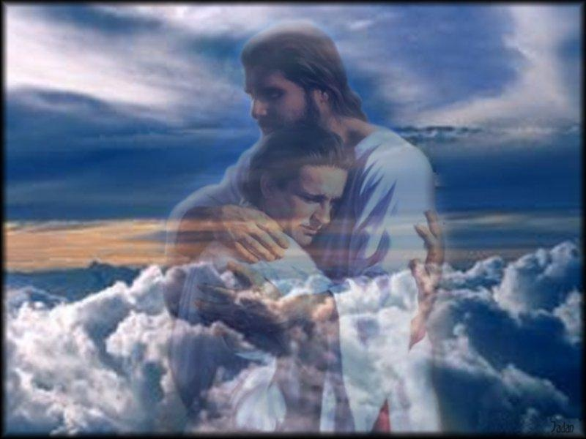

What a Glorious Father
By Pastor Fee Soliven
2 Corinthians 1:3-4
Sunday Morning
February 3, 2019

Slide 4
2 Corinthians 1:3-4
3 Blessed be the God and Father of our Lord Jesus Christ, the Father of mercies and God of all comfort, 4 who comforts us in all our affliction, so that we may be able to comfort those who are in any affliction, with the comfort with which we ourselves are comforted by God.

Slide 5
Jesus was a skillful storyteller, and perhaps His most Masterful Parable was that of the Prodigal Son

Slide 6
1 John 3:1-3
1 Behold what manner of love the Father has bestowed on us, that we should be called children of God! Therefore the world does not know us, because it did not know Him. 2 Beloved, now we are children of God; and it has not yet been revealed what we shall be, but we know that when He is revealed, we shall be like Him, for we shall see Him as He is. 3 And everyone who has this hope in Him purifies himself, just as He is pure.

Slide 7
The Older Son
Angry, Bitter, Resentful, Self-Righteous, Jealous, Rejection, Unforgiveness, Disrespect, Accusation, Caustic Biting and Piercing Words

Slide 8
The Younger Son
“The Prodigal Son”
Desires, Decision, Departure, Wandering and Wanting

Slide 9
God (Our Father)

Slide 10
The Steps of the Father to His Son

Slide 11
1. Wounded Heart

Slide 12
2. Wondered about him Continually

Slide 13
3. Waited Patiently

Slide 14
4. Watched for him

Slide 15
5. Wanted his son to Return Soon

Slide 16
6. Welcomed him Home

Slide 17
Matthew 18:11-14
11 For the Son of Man has come to save that which was lost. 12 What do you think? If a man has a hundred sheep, and one of them goes astray, does he not leave the ninety-nine and go to the mountains to seek the one that is straying?

Slide 18
13 And if he should find it, assuredly, I say to you, he rejoices more over that sheep than over the ninety-nine that did not go astray. 14 Even so it is not the will of your Father who is in heaven that one of these little ones should perish.

Slide 19
Isaiah 33:22
“(For the LORD is our Judge, The LORD is our Lawgiver, The LORD is our King; He will save us);”

Slide 20
Romans 10:9-13
9 that if you confess with your mouth the Lord Jesus and believe in your heart that God has raised Him from the dead, you will be saved. 10 For with the heart one believes unto righteousness, and with the mouth confession is made unto salvation.

Slide 21
11 For the Scripture says, "Whoever believes on Him will not be put to shame." 12 For there is no distinction between Jew and Greek, for the same Lord over all is rich to all who call upon Him. 13 For "whoever calls on the name of the LORD shall be saved."

Slide 22
2 Peter 3:9
“The Lord is not slack concerning His promise, as some count slackness, but is longsuffering toward us, not willing that any should perish but that all should come to repentance.”

Slide 23
Hebrews 9:27-28
27 And as it is appointed for men to die once, but after this the judgment, 28 so Christ was offered once to bear the sins of many. To those who eagerly wait for Him He will appear a second time, apart from sin, for salvation.

Slide 24
What God Offers
Repentant Prodigals

Slide 25
1. Forgiveness

Slide 26
Ephesians 4:30-32
30 And do not grieve the Holy Spirit of God, by whom you were sealed for the day of redemption. 31 Let all bitterness, wrath, anger, clamor, and evil speaking be put away from you, with all malice. 32 And be kind to one another, tenderhearted, forgiving one another, just as God in Christ forgave you.

Slide 27
1 John 1:9
“If we’ll confess our sins, God will be faithful to forgive us and cleanse us from all unrighteousness”

Slide 28
2. Acceptance

Slide 29
Ephesians 1:3-6
3 Blessed be the God and Father of our Lord Jesus Christ, who has blessed us with every spiritual blessing in the heavenly places in Christ, 4 just as He chose us in Him before the foundation of the world, that we should be holy and without blame before Him in love,

Slide 30
5 having predestined us to adoption as sons by Jesus Christ to Himself, according to the good pleasure of His will, 6 to the praise of the glory of His grace, by which He has made us accepted in the Beloved.

Slide 31
3. Restoration

Slide 32
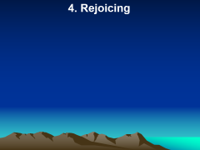
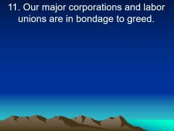
1 Peter 5:10
“And the God of all grace, who called you to his eternal glory in Christ, after you have suffered a little while, will himself restore you and make you strong, firm and steadfast.”

Slide 33
4. Rejoicing

Slide 34
Luke 15:7
“I say to you that likewise there will be more joy in heaven over one sinner who repents than over ninety-nine just persons who need no repentance.”

Slide 35
John 10:27-30
27 My sheep hear My voice, and I know them, and they follow Me. 28 And I give them eternal life, and they shall never perish; neither shall anyone snatch them out of My hand. 29 My Father, who has given them to Me, is greater than all; and no one is able to snatch them out of My Father's hand. 30 I and My Father are one."

Slide 36
Ephesians 1:11-14
11 In Him also we have obtained an inheritance, being predestined according to the purpose of Him who works all things according to the counsel of His will, 12 that we who first trusted in Christ should be to the praise of His glory.

Slide 37
13 In Him you also trusted, after you heard the word of truth, the gospel of your salvation; in whom also, having believed, you were sealed with the Holy Spirit of promise, 14 who is the guarantee of our inheritance until the redemption of the purchased possession, to the praise of His glory.

Slide 38
Romans 8:38-39
38 For I am persuaded that neither death nor life, nor angels nor principalities nor powers, nor things present nor things to come, 39 nor height nor depth, nor any other created thing, shall be able to separate us from the love of God which is in Christ Jesus our Lord.

Slide 39
Hebrews 13:5-6
5 Let your conduct be without covetousness; be content with such things as you have. For He Himself has said, "I will never leave you nor forsake you." 6 So we may boldly say: "The LORD is my helper; I will not fear. What can man do to me?"

Slide 40
1. Has there ever been a time in your life when you’ve come in humble repentance to God, confessing that you’ve messed up your life and need His forgiveness?

Slide 41
2. If so, how have you seen the Lord’s restoration in your life?

Slide 42
3. If not, why are you delaying?

Slide 43
4. How has the representation of the earthly father in this story enriched your understanding of your heavenly Father?

