Slide 3
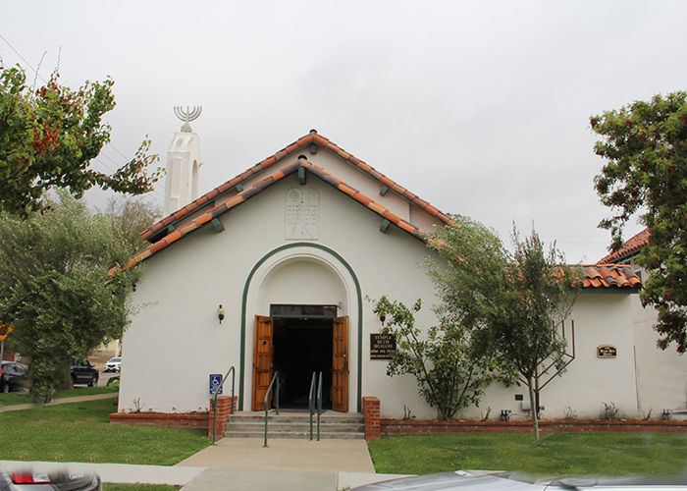

Slide 4
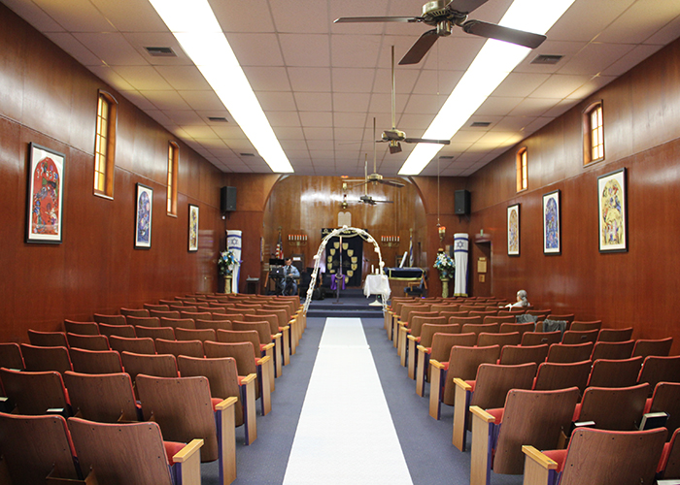
We Owe God Everything
By Pastor Fee Soliven
Ephesians 1:1-8
Sunday Morning
July 14, 2019

Slide 5
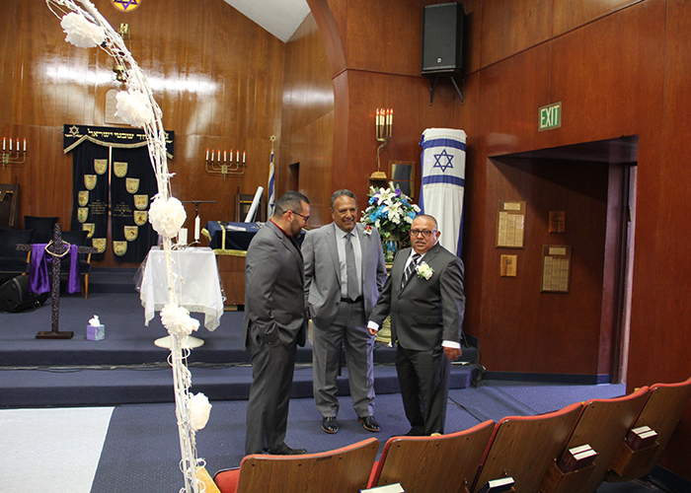
Ephesians 1:1-8
1 Paul, an apostle of Jesus Christ by the will of God, To the saints who are in Ephesus, and faithful in Christ Jesus: 2 Grace to you and peace from God our Father and the Lord Jesus Christ. 3 Blessed be the God and Father of our Lord Jesus Christ, who has blessed us with every spiritual blessing in the heavenly places in Christ,

Slide 6
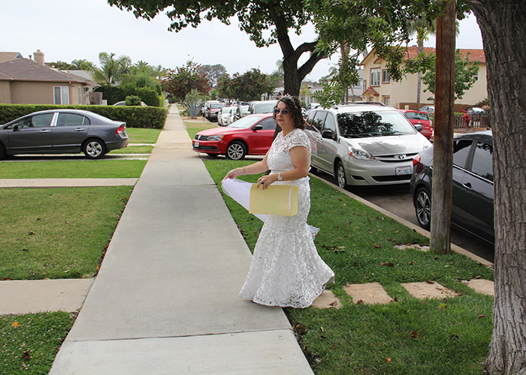
4 just as He chose us in Him before the foundation of the world, that we should be holy and without blame before Him in love, 5 having predestined us to adoption as sons by Jesus Christ to Himself, according to the good pleasure of His will, 6 to the praise of the glory of His grace, by which He has made us accepted in the Beloved.

Slide 7
7 In Him we have redemption through His blood, the forgiveness of sins, according to the riches of His grace 8 which He made to abound toward us in all wisdom and prudence…

Slide 8
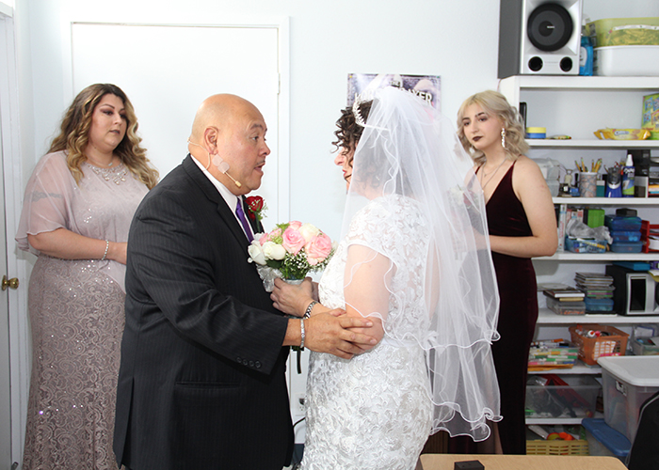
Although there are many reasons to be grateful to God, when was the last time you stopped to count your blessings?

Slide 9
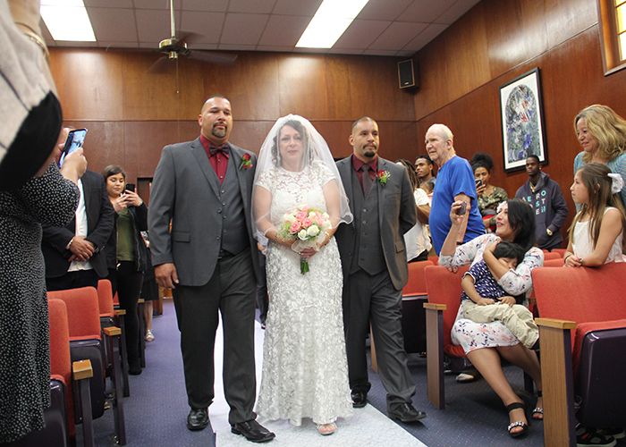
Philemon 4-7
4 I thank my God, making mention of you always in my prayers, 5 hearing of your love and faith which you have toward the Lord Jesus and toward all the saints, 6 that the sharing of your faith may become effective by the acknowledgment of every good thing which is in you in Christ Jesus. 7 For we have great joy and consolation in your love, because the hearts of the saints have been refreshed by you, brother.

Slide 10
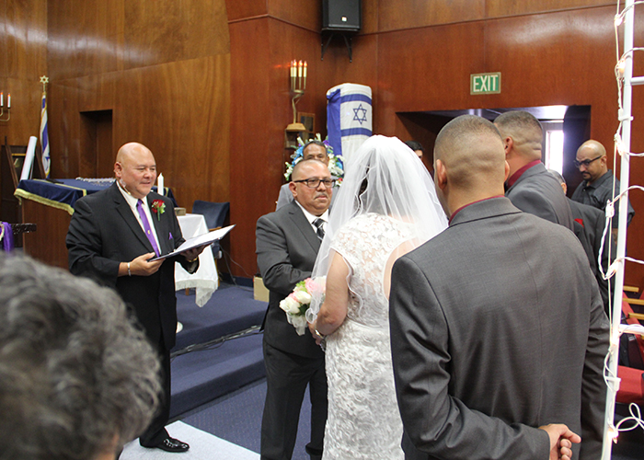
God chose us in Christ Jesus before the foundation of the world.

Slide 11
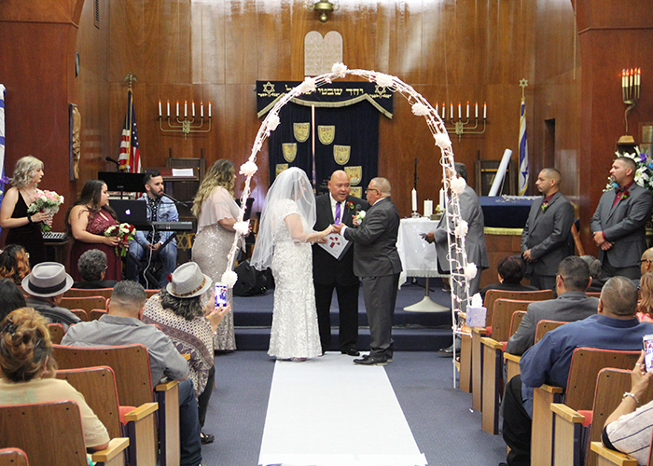
Ephesians 1:3-4
3 Blessed be the God and Father of our Lord Jesus Christ, who has blessed us with every spiritual blessing in the heavenly places in Christ, 4 just as He chose us in Him before the foundation of the world, that we should be holy and without blame before Him in love…

Slide 12
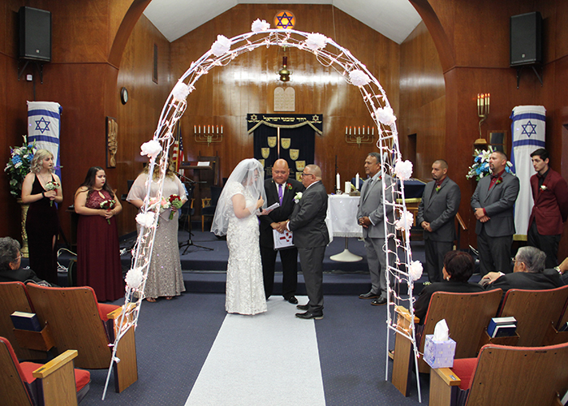
1. “That we would be holy and blameless before Him”

Slide 13
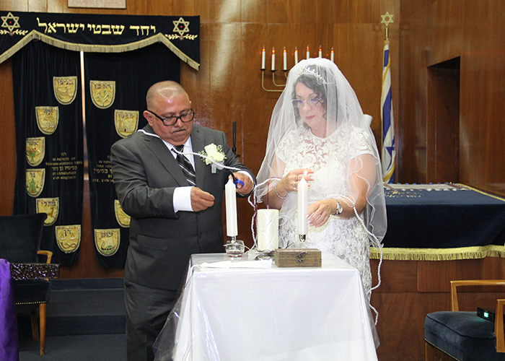
2. That we would be adopted “as sons through Jesus Christ to Himself”

Slide 14
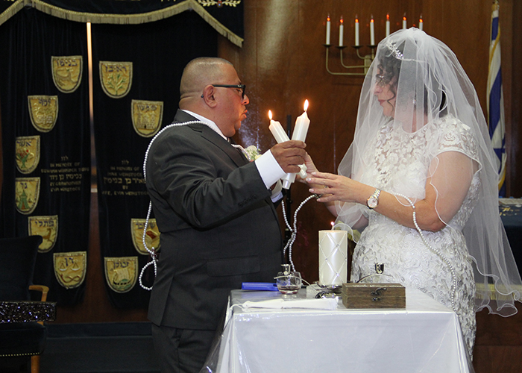
3. That we would be “to the praise of the glory of His grace, which He freely bestowed on us in the Beloved”

Slide 15
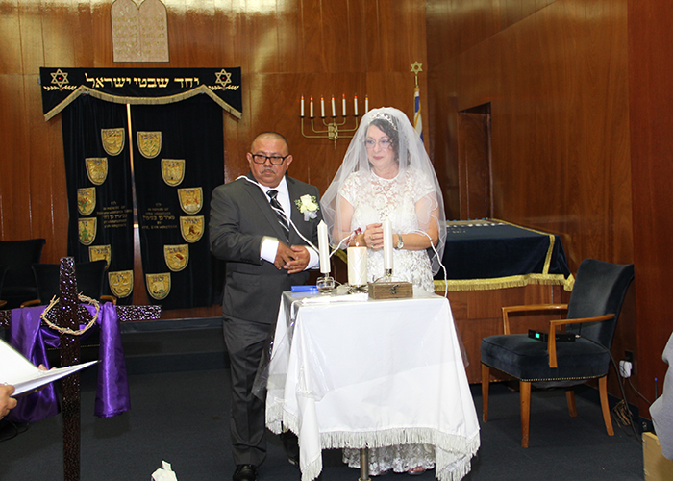
Ephesians 1:7-8
7 In Him we have redemption through His blood, the forgiveness of sins, according to the riches of His grace 8 which He made to abound toward us in all wisdom and prudence…

Slide 16
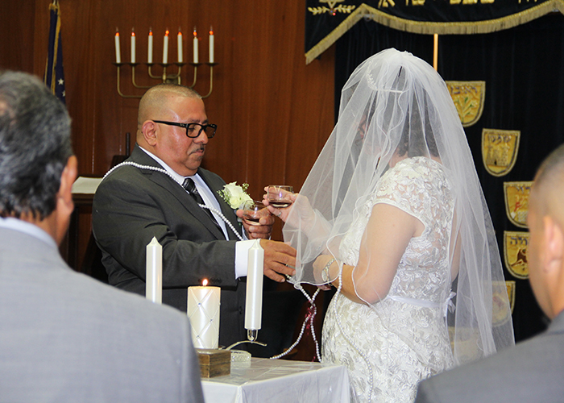
We have been Sealed as
Children of God

Slide 17
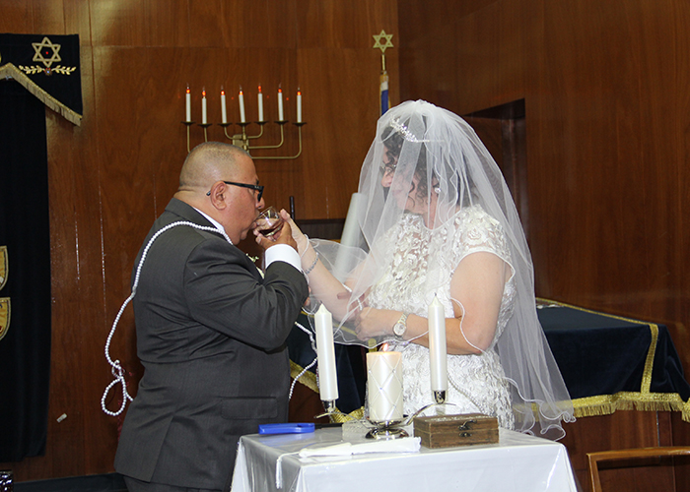
Ephesians 1:13-14
13 In Him you also trusted, after you heard the word of truth, the gospel of your salvation; in whom also, having believed, you were sealed with the Holy Spirit of promise, 14 who is the guarantee of our inheritance until the redemption of the purchased possession, to the praise of His glory.

Slide 18
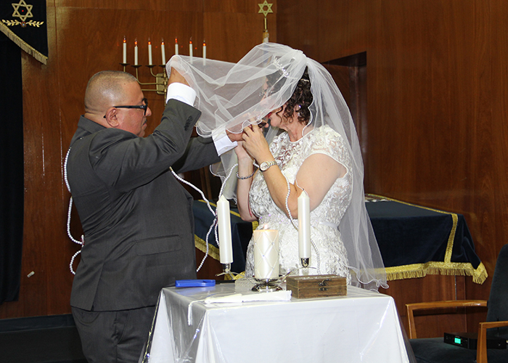
The Holy Spirit Has Gifted Us

Slide 19
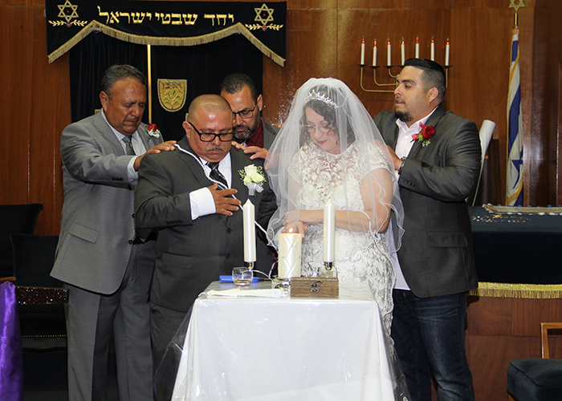
1 Corinthians 12:4
“Now there are varieties of gifts, but the same Spirit”

Slide 20
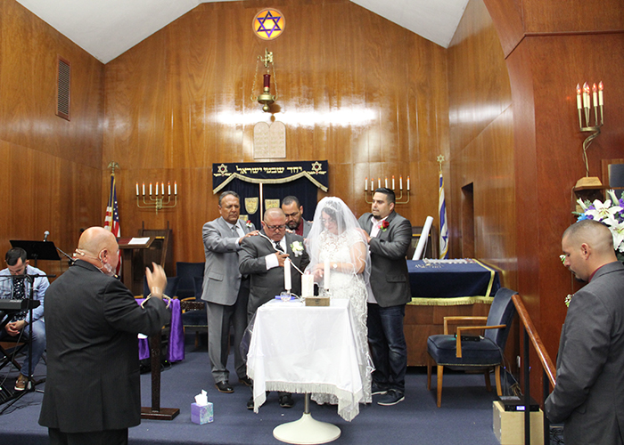
Romans 12:6-8
6 Having then gifts differing according to the grace that is given to us, let us use them: if prophecy, let us prophesy in proportion to our faith; 7 or ministry, let us use it in our ministering; he who teaches, in teaching; 8 he who exhorts, in exhortation; he who gives, with liberality; he who leads, with diligence; he who shows mercy, with cheerfulness.

Slide 21
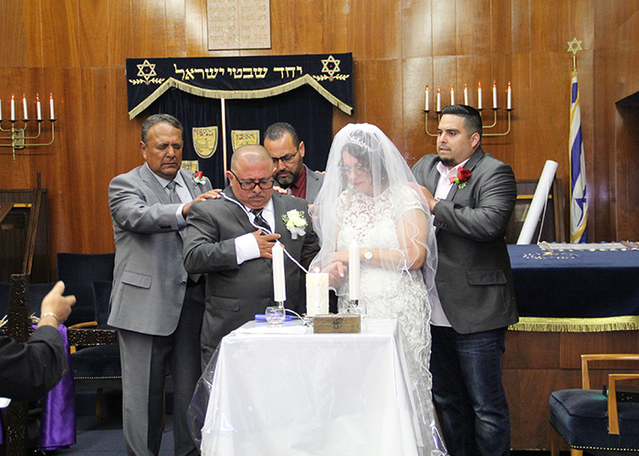
1 Corinthians 12:8-11
8 for to one is given the word of wisdom through the Spirit, to another the word of knowledge through the same Spirit, 9 to another faith by the same Spirit, to another gifts of healings by the same Spirit, 10 to another the working of miracles, to another prophecy, to another discerning of spirits, to another different kinds of tongues, to another the interpretation of tongues. 11 But one and the same Spirit works all these things, distributing to each one individually as He wills.

Slide 22
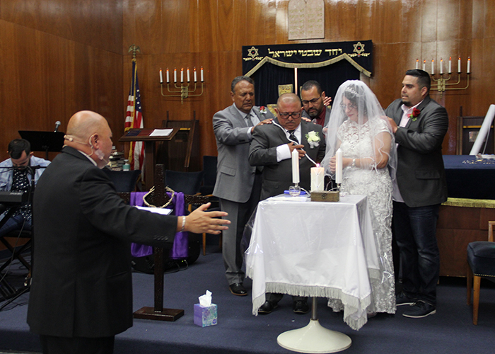
God Loves Us

Slide 23
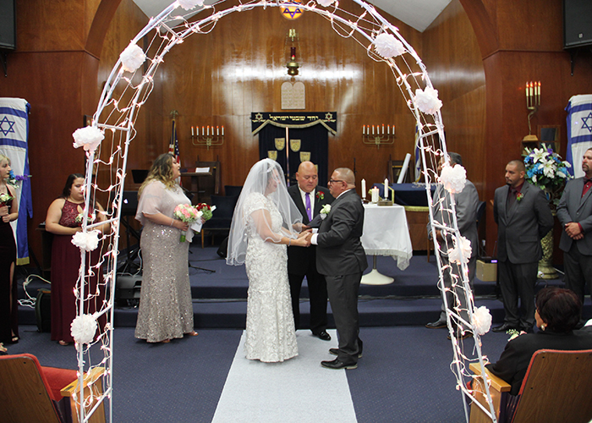
John 14:21
“He who has My commandments and keeps them is the one who loves Me; and he who loves Me will be loved by My Father, and I will love him and will disclose Myself to him”

Slide 24
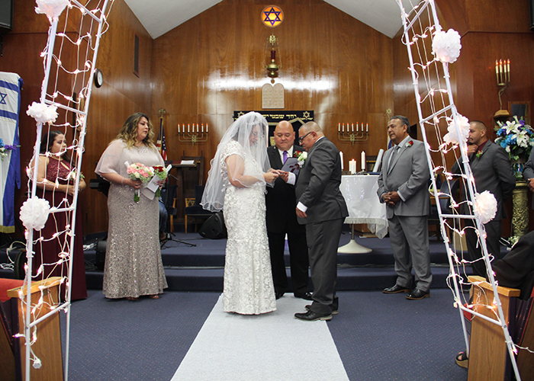
Jeremiah 31:3
“I have loved you with an everlasting love; therefore I have drawn you with lovingkindness”

Slide 25
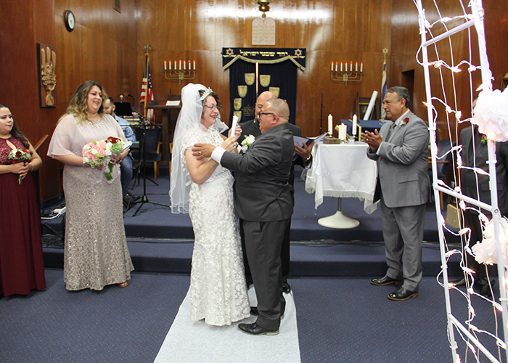
Christ Gives Us His Peace

Slide 26
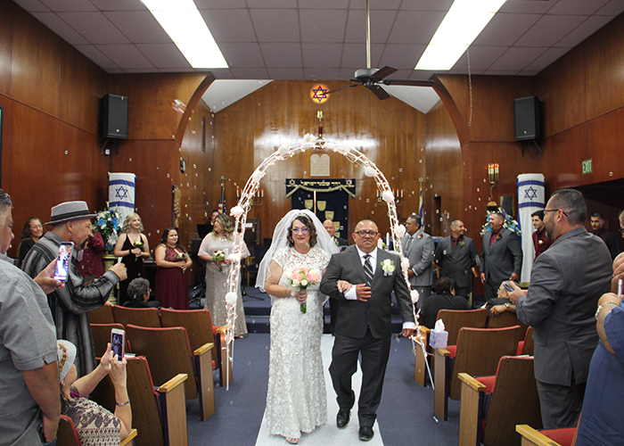
John 14:27
“Peace I leave with you; My peace I give to you; not as the world gives do I give to you. Do not let your heart be troubled, nor let it be fearful”

Slide 27
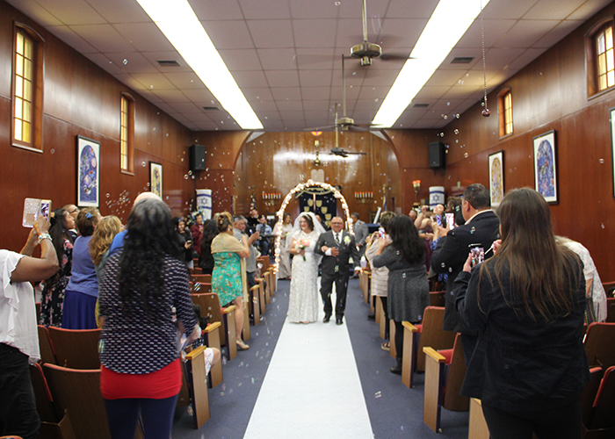
God Promises to Supply Our Needs

Slide 28
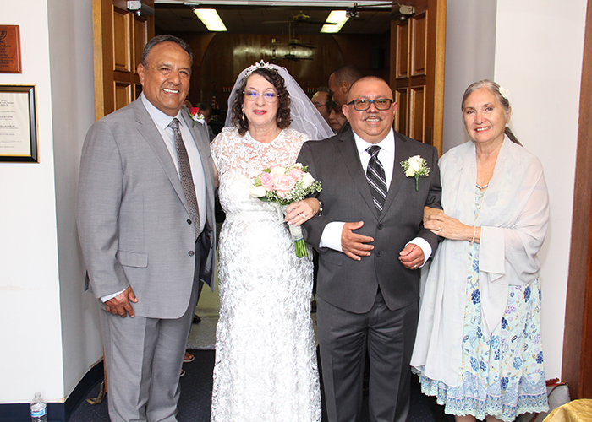
Philippians 4:19
“And my God will supply all your needs according to His riches in glory in Christ Jesus”

Slide 29
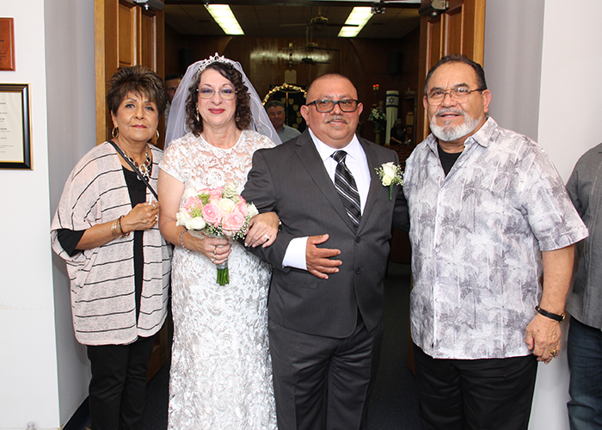
Isaiah 41:10
“Do not fear, for I am with you; do not anxiously look about you, for I am your God. I will strengthen you, surely I will help you, surely I will uphold you with My righteous right hand.”

Slide 30
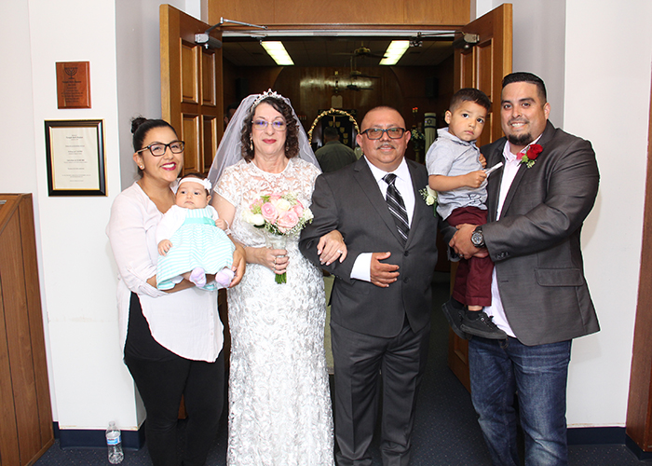
We have been Given the
Privilege of Prayer

Slide 31
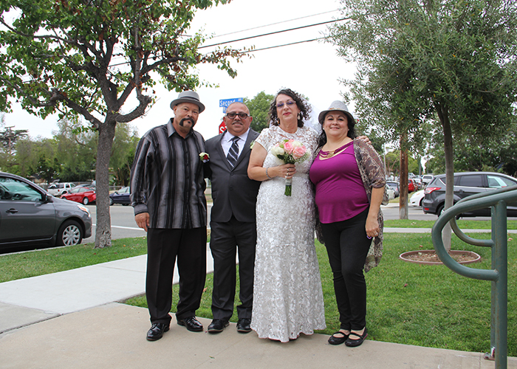
There is a Coming Resurrection for every Child of God

Slide 32
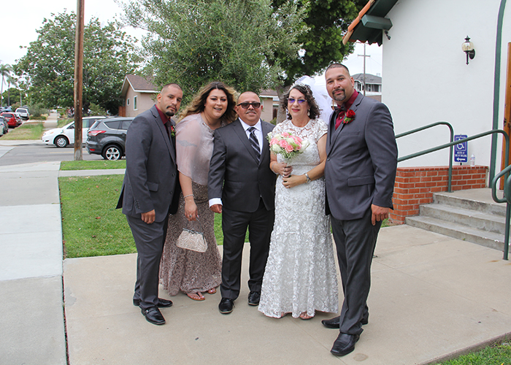
1 Corinthians 15:51-52
51 “Behold, I tell you a mystery; we will not all sleep, but we will all be changed, 52 in a moment, in the twinkling of an eye, at the last trumpet; for the trumpet will sound, and the dead will be raised imperishable, and we will be changed”

Slide 33
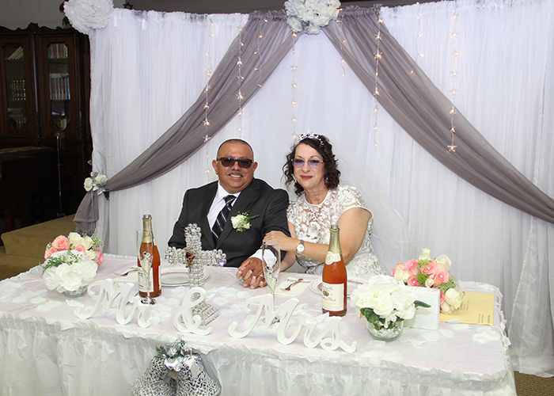
Jesus is Preparing a Place for
Us in Heaven

Slide 34
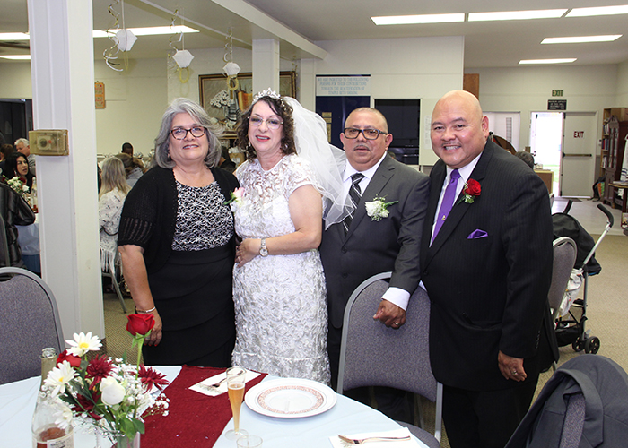
John 14:2-3
2 “In my Father’s house are many dwelling places; if it were not so, I would have told you; for I go to prepare a place for you. 3 If I go and prepare a place for you, I will come again and receive you to Myself, that where I am, there you may be also”

Slide 35
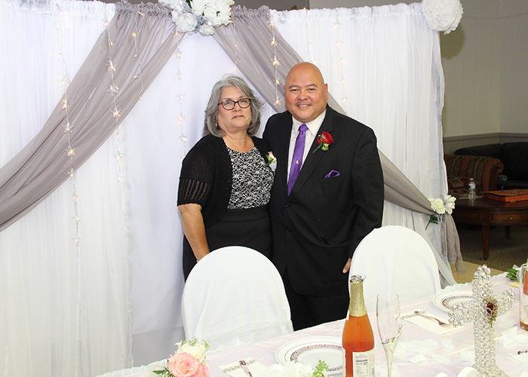
We Have the Word of God

Slide 36
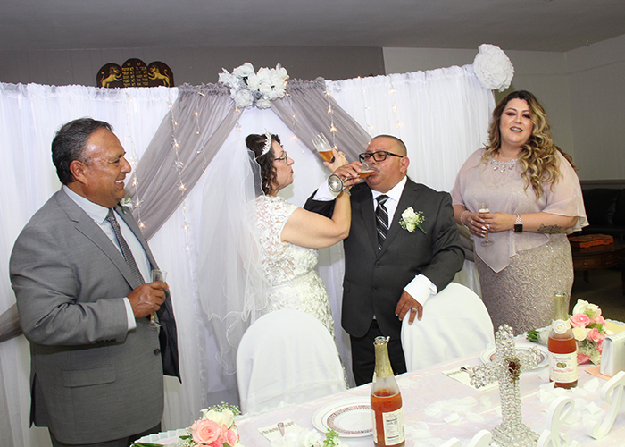
Isaiah 40:8
“The grass withers, the flower fades, but the word of our God stands forever”

Slide 37
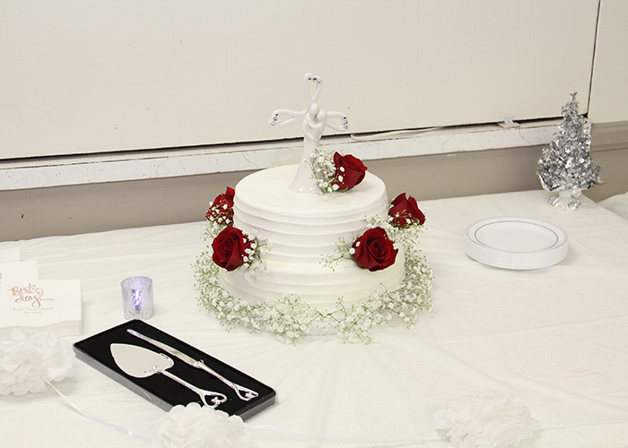
1. What are the typical things you usually count as your blessings?

Slide 38
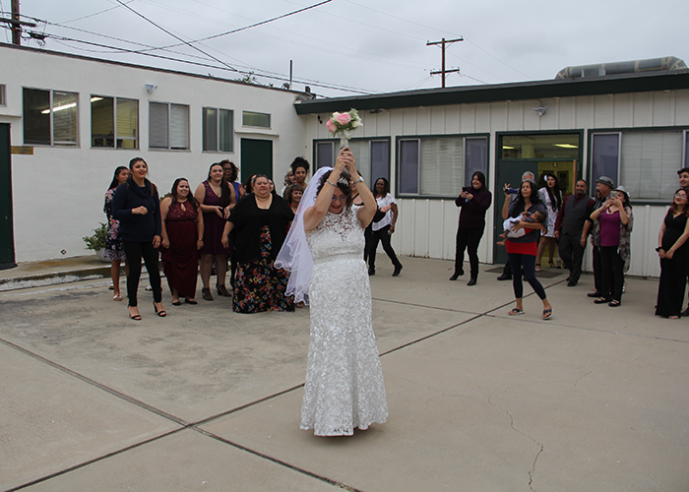
2. How often do spiritual blessings come to mind?

Slide 39
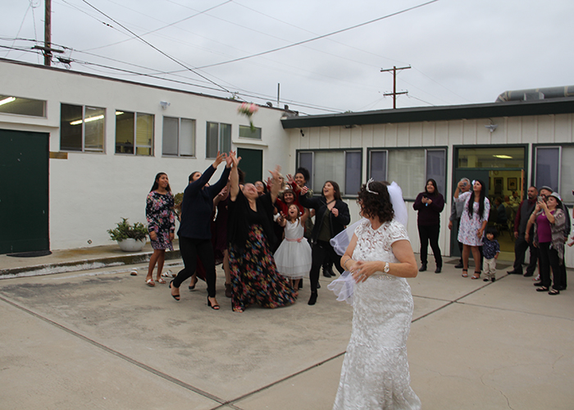
3. What can you do to make God’s abundant spiritual blessings a frequent part of your prayers and thoughts?

Slide 40
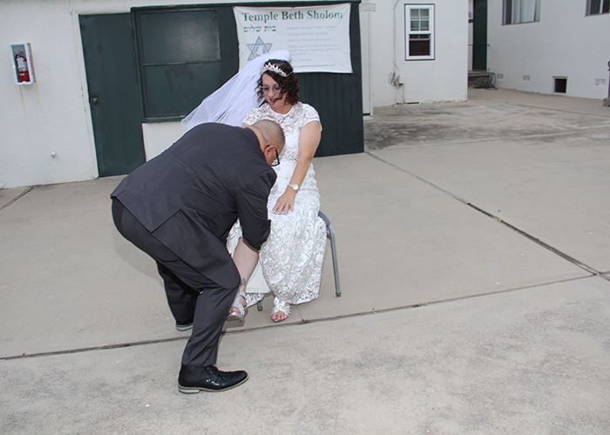
3. What can you do to make God’s abundant spiritual blessings a frequent part of your prayers and thoughts?

Slide 41
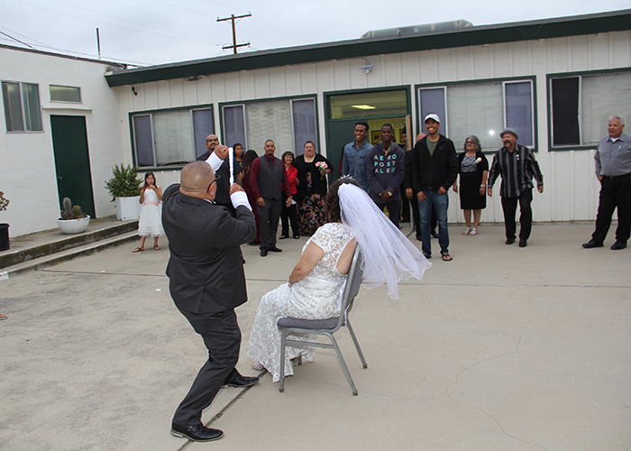
3. What can you do to make God’s abundant spiritual blessings a frequent part of your prayers and thoughts?

Slide 42
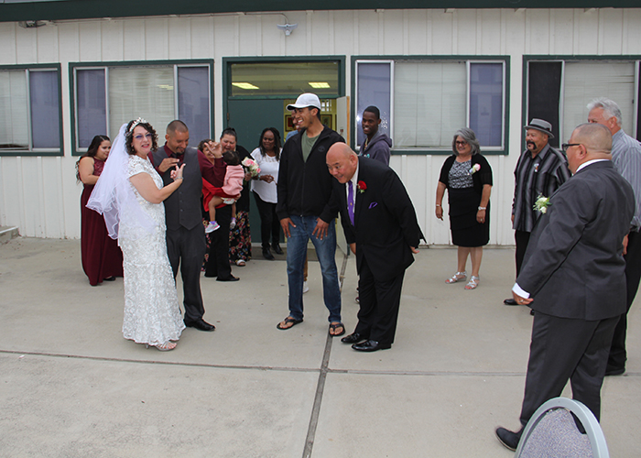
3. What can you do to make God’s abundant spiritual blessings a frequent part of your prayers and thoughts?

Slide 43
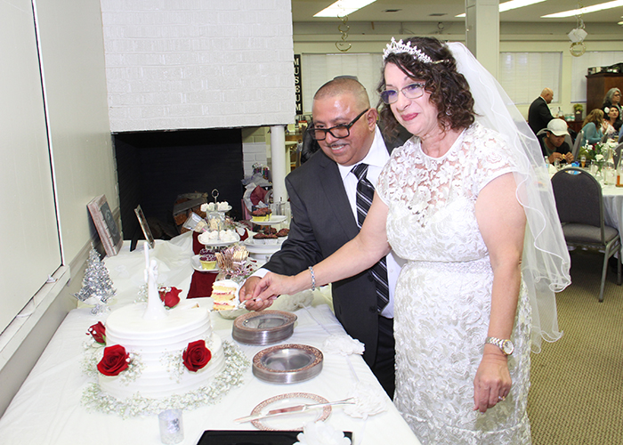
3. What can you do to make God’s abundant spiritual blessings a frequent part of your prayers and thoughts?

Slide 44
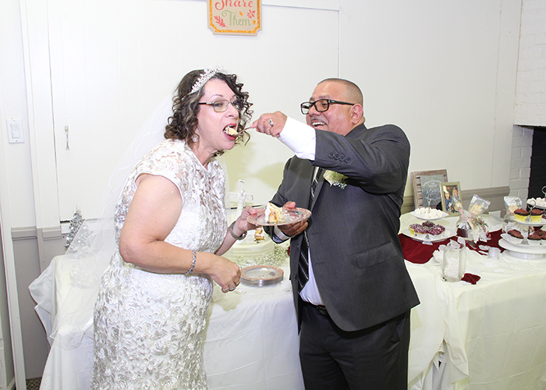
3. What can you do to make God’s abundant spiritual blessings a frequent part of your prayers and thoughts?

Slide 45
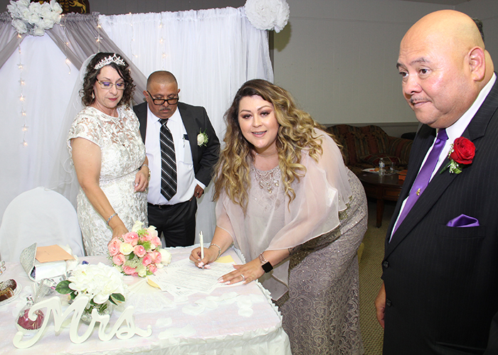
3. What can you do to make God’s abundant spiritual blessings a frequent part of your prayers and thoughts?

Slide 46
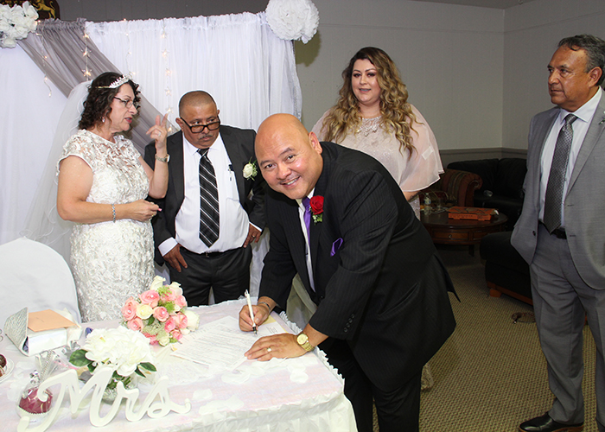
3. What can you do to make God’s abundant spiritual blessings a frequent part of your prayers and thoughts?

Slide 47
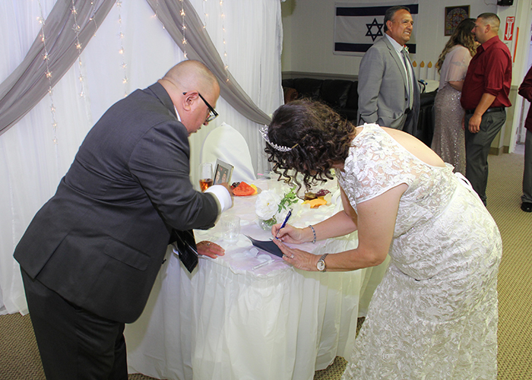
3. What can you do to make God’s abundant spiritual blessings a frequent part of your prayers and thoughts?

Slide 48
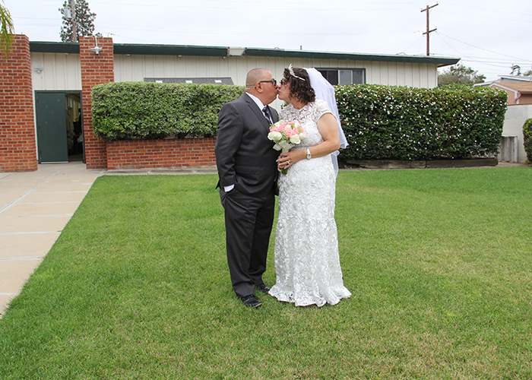
3. What can you do to make God’s abundant spiritual blessings a frequent part of your prayers and thoughts?

Slide 49
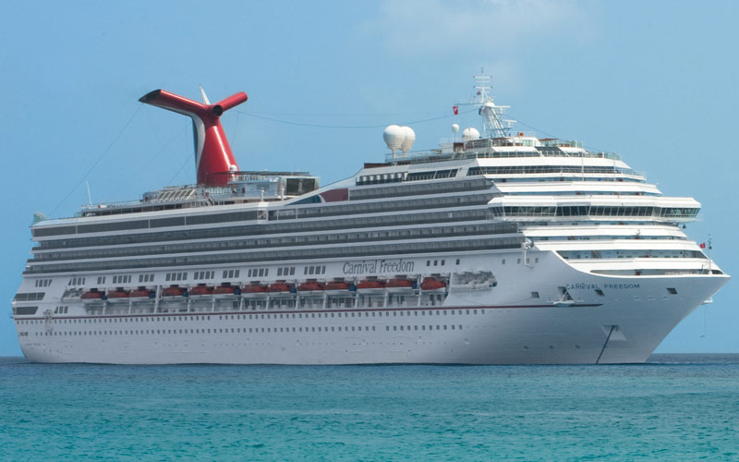
3. What can you do to make God’s abundant spiritual blessings a frequent part of your prayers and thoughts?

Slide 50
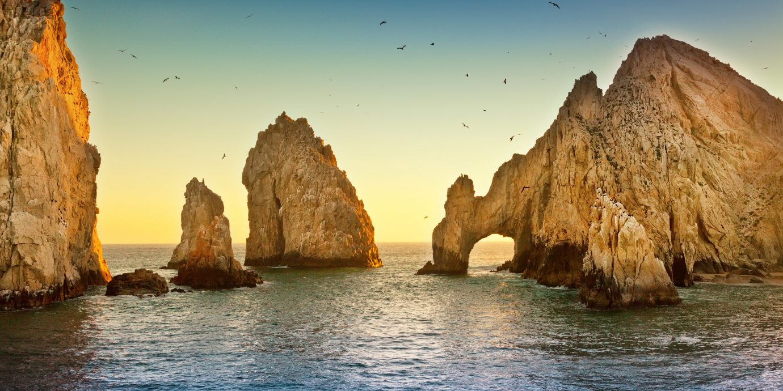
3. What can you do to make God’s abundant spiritual blessings a frequent part of your prayers and thoughts?

Slide 51
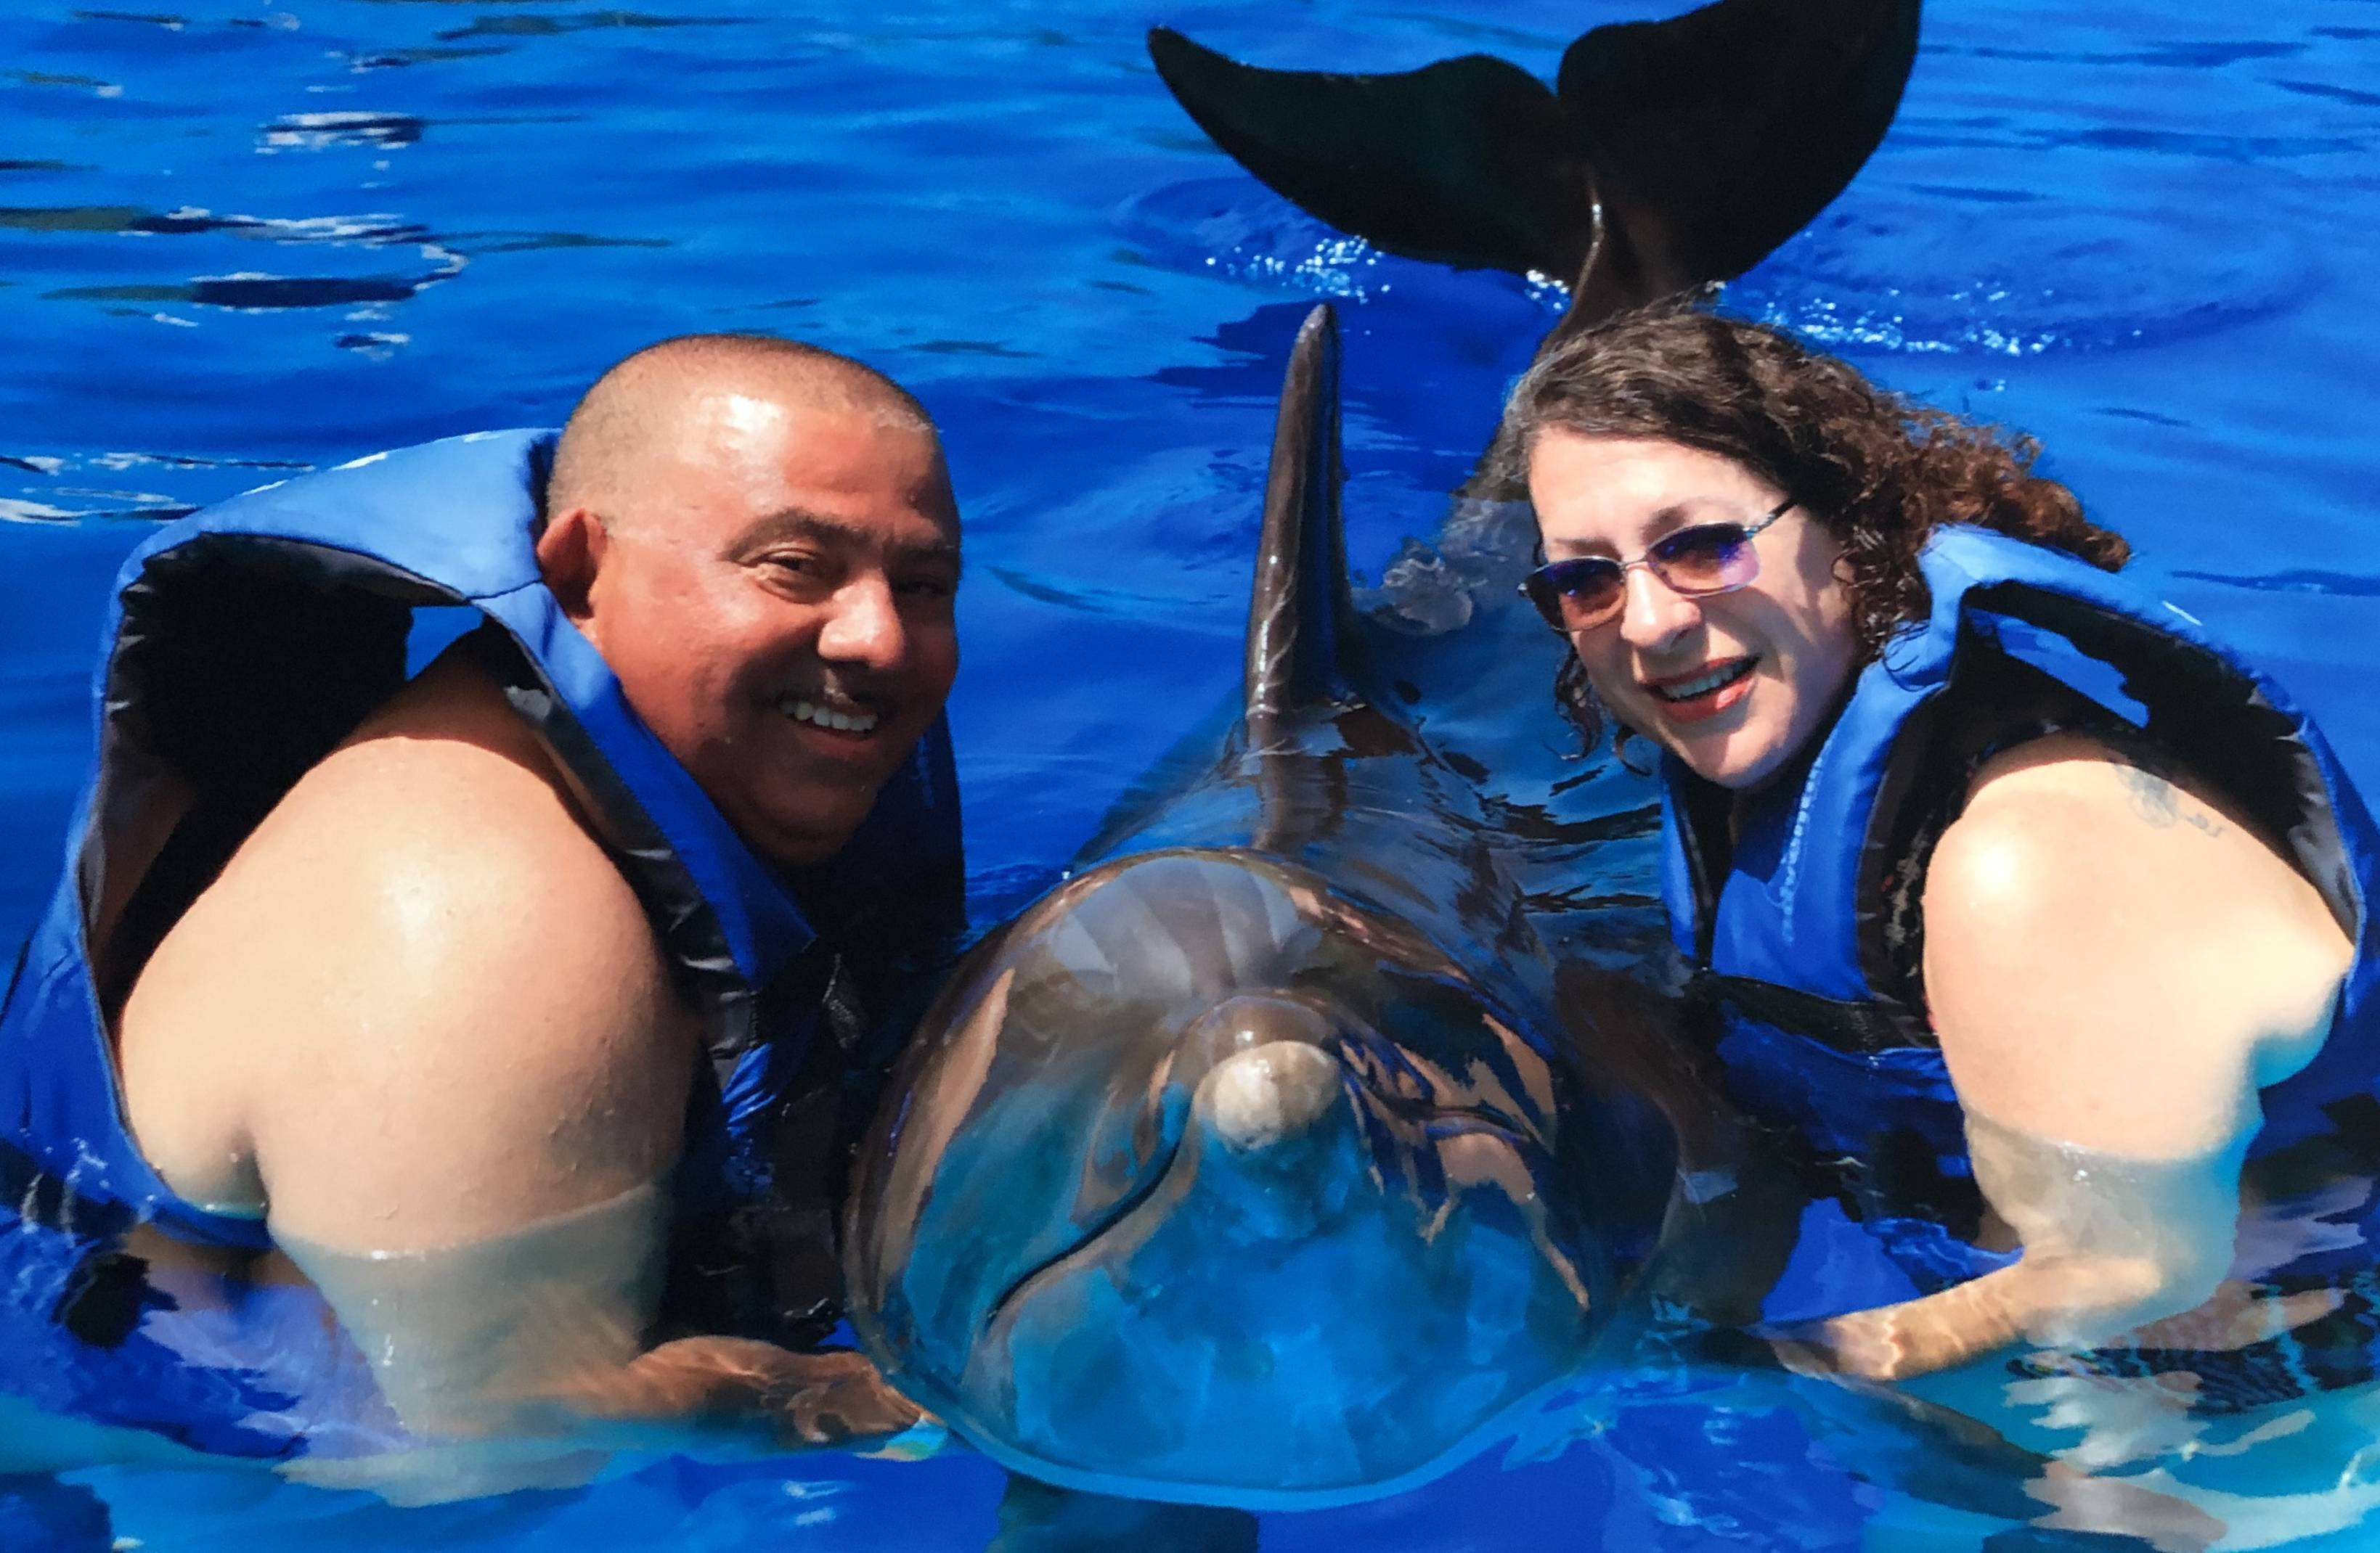
3. What can you do to make God’s abundant spiritual blessings a frequent part of your prayers and thoughts?

Slide 52
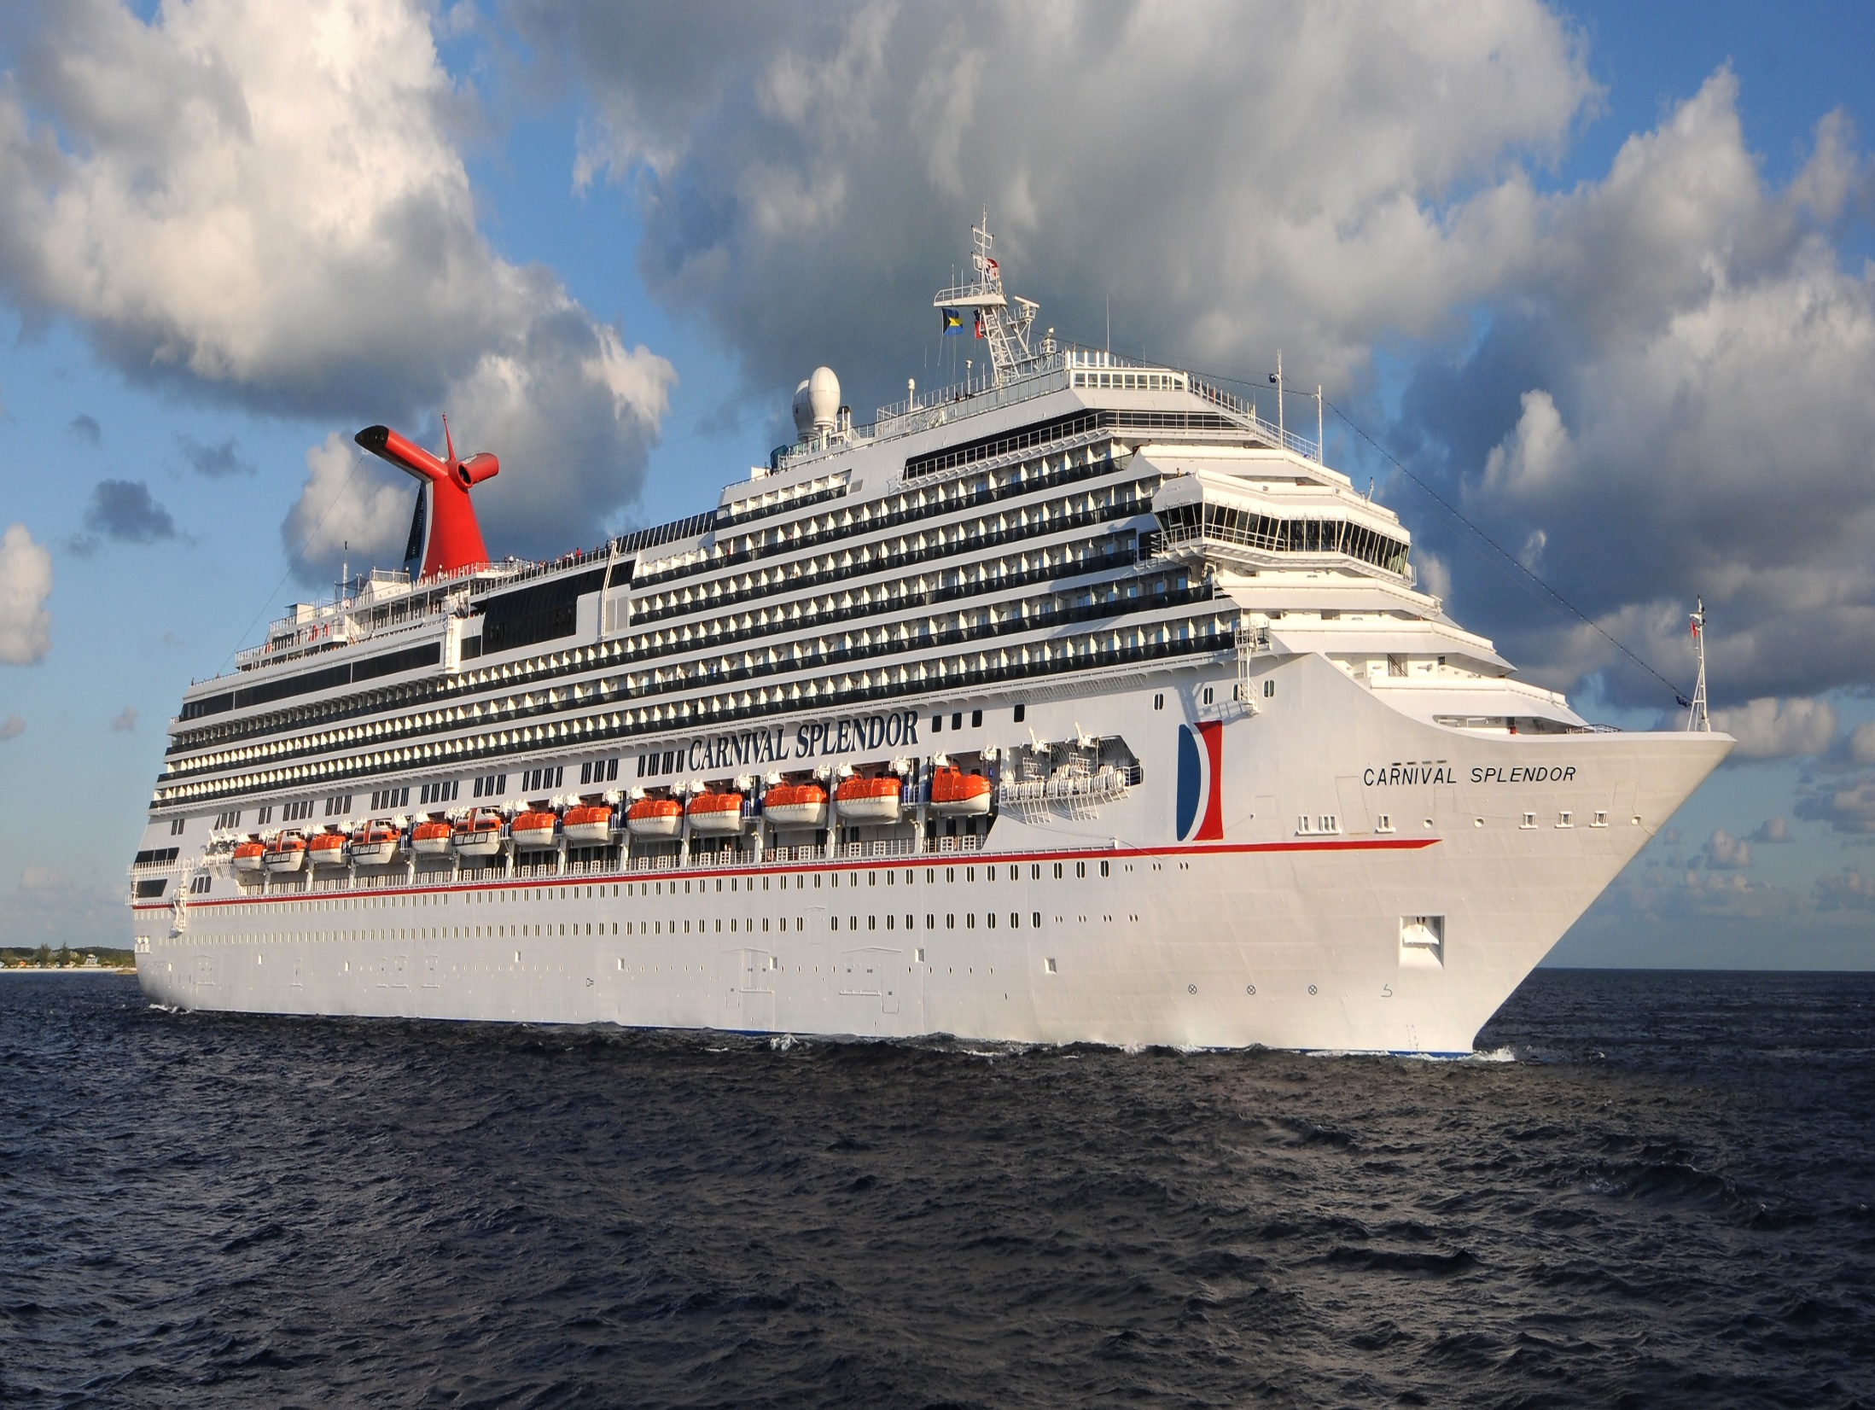
3. What can you do to make God’s abundant spiritual blessings a frequent part of your prayers and thoughts?

