Slide 1


Slide 2


Slide 3


Are You a Memorial to God
By Pastor Fee Soliven
Mark 14:1-16
Wednesday Evening
August 21, 2019

Slide 4
1 After two days it was the Passover and the Feast of Unleavened Bread. And the chief priests and the scribes sought how they might take Him by trickery and put Him to death. 2 But they said, "Not during the feast, lest there be an uproar of the people." 3 And being in Bethany at the house of Simon the leper, as He sat at the table, a woman came having an alabaster flask of very costly oil of spikenard. Then she broke the flask and poured it on His head.

Slide 5
4 But there were some who were indignant among themselves, and said, "Why was this fragrant oil wasted? 5 For it might have been sold for more than three hundred denarii and given to the poor." And they criticized her sharply. 6 But Jesus said, "Let her alone. Why do you trouble her? She has done a good work for Me.

Slide 6
7 For you have the poor with you always, and whenever you wish you may do them good; but Me you do not have always. 8 She has done what she could. She has come beforehand to anoint My body for burial. 9 Assuredly, I say to you, wherever this gospel is preached in the whole world, what this woman has done will also be told as a memorial to her."

Slide 7
10 Then Judas Iscariot, one of the twelve, went to the chief priests to betray Him to them. 11 And when they heard it, they were glad, and promised to give him money. So he sought how he might conveniently betray Him. 12 Now on the first day of Unleavened Bread, when they killed the Passover lamb, His disciples said to Him, "Where do You want us to go and prepare, that You may eat the Passover?"

Slide 8
13 And He sent out two of His disciples and said to them, "Go into the city, and a man will meet you carrying a pitcher of water; follow him. 14 Wherever he goes in, say to the master of the house, 'The Teacher says, "Where is the guest room in which I may eat the Passover with My disciples?" ' 15 "Then he will show you a large upper room, furnished and prepared; there make ready for us." 16 So His disciples went out, and came into the city, and found it just as He had said to them; and they prepared the Passover.

Slide 9
1 After two days it was the Passover and the Feast of Unleavened Bread. And the chief priests and the scribes sought how they might take Him by trickery and put Him to death. 2 But they said, "Not during the feast, lest there be an uproar of the people."

Slide 10
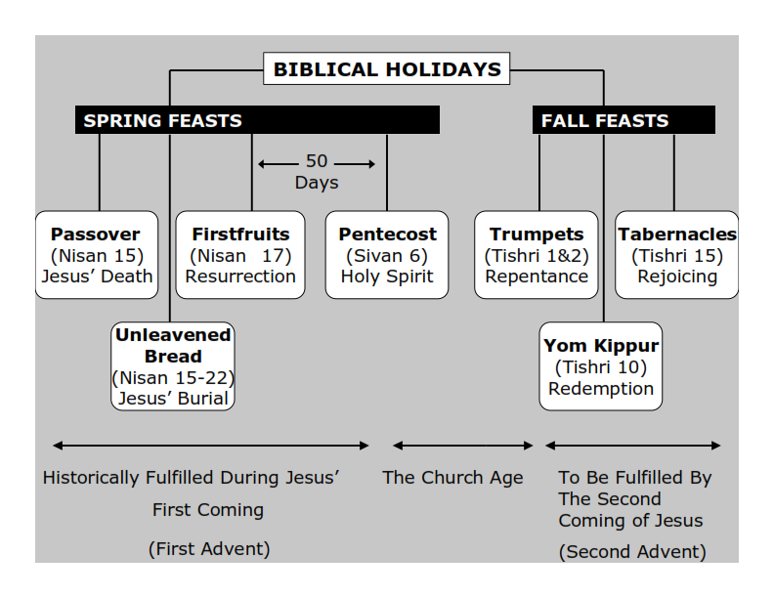
Philippians 3:20-21
20 For our citizenship is in heaven, from which we also eagerly wait for the Savior, the Lord Jesus Christ, 21 who will transform our lowly body that it may be conformed to His glorious body, according to the working by which He is able even to subdue all things to Himself.

Slide 11
Deuteronomy 16:5-6
5 You may not sacrifice the Passover within any of your gates which the LORD your God gives you; 6 but at the place where the LORD your God chooses to make His name abide, there you shall sacrifice the Passover at twilight, at the going down of the sun, at the time you came out of Egypt.

Slide 12
John 11:47-53
47 Then the chief priests and the Pharisees gathered a council and said, "What shall we do? For this Man works many signs. 48 If we let Him alone like this, everyone will believe in Him, and the Romans will come and take away both our place and nation." 49 And one of them, Caiaphas, being high priest that year, said to them, "You know nothing at all,

Slide 13
50 nor do you consider that it is expedient for us that one man should die for the people, and not that the whole nation should perish." 51 Now this he did not say on his own authority; but being high priest that year he prophesied that Jesus would die for the nation, 52 and not for that nation only, but also that He would gather together in one the children of God who were scattered abroad. 53 Then, from that day on, they plotted to put Him to death.

Slide 14
3 And being in Bethany at the house of Simon the leper, as He sat at the table, a woman came having an alabaster flask of very costly oil of spikenard. Then she broke the flask and poured it on His head.

Slide 15
John 11:2
“It was that Mary who anointed the Lord with fragrant oil and wiped His feet with her hair, whose brother Lazarus was sick.”

Slide 16
John 12:1-3
1 Then, six days before the Passover, Jesus came to Bethany, where Lazarus was who had been dead, whom He had raised from the dead. 2 There they made Him a supper; and Martha served, but Lazarus was one of those who sat at the table with Him. 3 Then Mary took a pound of very costly oil of spikenard, anointed the feet of Jesus, and wiped His feet with her hair. And the house was filled with the fragrance of the oil.

Slide 17
Luke 7:44-47
44 Then He turned to the woman and said to Simon, "Do you see this woman? I entered your house; you gave Me no water for My feet, but she has washed My feet with her tears and wiped them with the hair of her head. 45 You gave Me no kiss, but this woman has not ceased to kiss My feet since the time I came in.

Slide 18
46 You did not anoint My head with oil, but this woman has anointed My feet with fragrant oil. 47 Therefore I say to you, her sins, which are many, are forgiven, for she loved much. But to whom little is forgiven, the same loves little."

Slide 19
4 But there were some who were indignant among themselves, and said, "Why was this fragrant oil wasted? 5 For it might have been sold for more than three hundred denarii and given to the poor." And they criticized her sharply.

Slide 20
John 12:4-5
4 Then one of His disciples, Judas Iscariot, Simon's son, who would betray Him, said, 5 Why was this fragrant oil not sold for three hundred denarii and given to the poor?"

Slide 21
John 12:6
“This he said, not that he cared for the poor, but because he was a thief, and had the money box; and he used to take what was put in it.”

Slide 22
6 But Jesus said, "Let her alone. Why do you trouble her? She has done a good work for Me. 7 For you have the poor with you always, and whenever you wish you may do them good; but Me you do not have always. 8 She has done what she could. She has come beforehand to anoint My body for burial.

Slide 23
Matthew 6:20-21
20 but lay up for yourselves treasures in heaven, where neither moth nor rust destroys and where thieves do not break in and steal. 21 For where your treasure is, there your heart will be also.

Slide 24
Luke 14:13-14
13 But when you give a feast, invite the poor, the maimed, the lame, the blind. 14 And you will be blessed, because they cannot repay you; for you shall be repaid at the resurrection of the just."

Slide 25
9 Assuredly, I say to you, wherever this gospel is preached in the whole world, what this woman has done will also be told as a memorial to her."

Slide 26
Matthew 10:40-42
40 "He who receives you receives Me, and he who receives Me receives Him who sent Me. 41 He who receives a prophet in the name of a prophet shall receive a prophet's reward. And he who receives a righteous man in the name of a righteous man shall receive a righteous man's reward. 42 And whoever gives one of these little ones only a cup of cold water in the name of a disciple, assuredly, I say to you, he shall by no means lose his reward."

Slide 27
Colossians 3:23-24
23 And whatever you do, do it heartily, as to the Lord and not to men, 24 knowing that from the Lord you will receive the reward of the inheritance; for you serve the Lord Christ.

Slide 28
Matthew 16:27-28
27 For the Son of Man will come in the glory of His Father with His angels, and then He will reward each according to his works. 28 Assuredly, I say to you, there are some standing here who shall not taste death till they see the Son of Man coming in His kingdom."

Slide 29
10 Then Judas Iscariot, one of the twelve, went to the chief priests to betray Him to them.

Slide 30
11 And when they heard it, they were glad, and promised to give him money. So he sought how he might conveniently betray Him.

Slide 31
12 Now on the first day of Unleavened Bread, when they killed the Passover lamb, His disciples said to Him, "Where do You want us to go and prepare, that You may eat the Passover?"

Slide 32
John 1:29-30
29 The next day John saw Jesus coming toward him, and said, "Behold! The Lamb of God who takes away the sin of the world! 30 This is He of whom I said, 'After me comes a Man who is preferred before me, for He was before me.'

Slide 33
13 And He sent out two of His disciples and said to them, "Go into the city, and a man will meet you carrying a pitcher of water; follow him.

Slide 34
Luke 22:8
“And He sent Peter and John, saying, "Go and prepare the Passover for us, that we may eat."

Slide 35
14 Wherever he goes in, say to the master of the house, 'The Teacher says, "Where is the guest room in which I may eat the Passover with My disciples?" ' 15 "Then he will show you a large upper room, furnished and prepared; there make ready for us." 16 So His disciples went out, and came into the city, and found it just as He had said to them; and they prepared the Passover.

