Slide 1


Slide 2


Slide 3
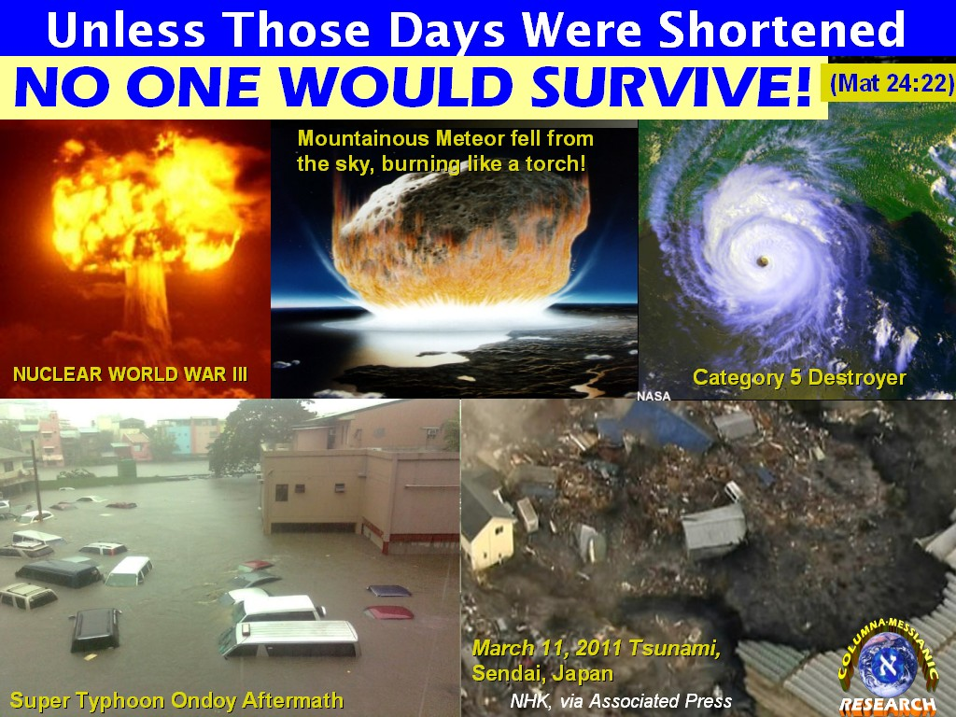

Unless Those Days Be Shortened
By Pastor Fee Soliven
Mark 13:12-27
Sunday Morning
August 11, 2019

Slide 4
12 Now brother will betray brother to death, and a father his child; and children will rise up against parents and cause them to be put to death. 13 And you will be hated by all men for My name's sake. But he who endures to the end shall be saved. 14 "So when you see the 'abomination of desolation,' spoken of by Daniel the prophet, standing where it ought not" (let the reader understand), "then let those who are in Judea flee to the mountains.

Slide 5
15 Let him who is on the housetop not go down into the house, nor enter to take anything out of his house. 16 And let him who is in the field not go back to get his garment. 17 But woe to those who are pregnant and to those who are nursing babies in those days! 18 And pray that your flight may not be in winter. 19 For in those days there will be tribulation, such as has not been from the beginning of creation which God created until this time, nor ever shall be.

Slide 6
20 And unless the Lord had shortened those days, no flesh would be saved; but for the elect's sake, whom He chose, He shortened the days. 21 Then if anyone says to you, 'Look, here is the Christ!' or, 'Look, He is there!' do not believe it. 22 For false christs and false prophets will rise and show signs and wonders to deceive, if possible, even the elect. 23 But take heed; see, I have told you all things beforehand.

Slide 7
24 "But in those days, after that tribulation, the sun will be darkened, and the moon will not give its light; 25 the stars of heaven will fall, and the powers in heaven will be shaken. 26 Then they will see the Son of Man coming in the clouds with great power and glory. 27 And then He will send His angels, and gather together His elect from the four winds, from the farthest part of earth to the farthest part of heaven.

Slide 8
12 Now brother will betray brother to death, and a father his child; and children will rise up against parents and cause them to be put to death.

Slide 9
Luke 12:49-53
49 "I came to send fire on the earth, and how I wish it were already kindled! 50 But I have a baptism to be baptized with, and how distressed I am till it is accomplished! 51 Do you suppose that I came to give peace on earth? I tell you, not at all, but rather division.

Slide 10
52 For from now on five in one house will be divided: three against two, and two against three. 53 Father will be divided against son and son against father, mother against daughter and daughter against mother, mother-in-law against her daughter-in-law and daughter-in-law against her mother-in-law."

Slide 11
13 And you will be hated by all men for My name's sake. But he who endures to the end shall be saved.

Slide 12
2 Timothy 2:9-13
9 for which I suffer trouble as an evildoer, even to the point of chains; but the word of God is not chained. 10 Therefore I endure all things for the sake of the elect, that they also may obtain the salvation which is in Christ Jesus with eternal glory.

Slide 13
11 This is a faithful saying: For if we died with Him, We shall also live with Him. 12 If we endure, We shall also reign with Him. If we deny Him, He also will deny us. 13 If we are faithless, He remains faithful; He cannot deny Himself.

Slide 14
14 "So when you see the 'abomination of desolation,' spoken of by Daniel the prophet, standing where it ought not" (let the reader understand), "then let those who are in Judea flee to the mountains. 15 Let him who is on the housetop not go down into the house, nor enter to take anything out of his house. 16 And let him who is in the field not go back to get his garment. 17 But woe to those who are pregnant and to those who are nursing babies in those days! 18 And pray that your flight may not be in winter.

Slide 15
Daniel 9:27
“Then he shall confirm a covenant with many for one week; But in the middle of the week He shall bring an end to sacrifice and offering. And on the wing of abominations shall be one who makes desolate, Even until the consummation, which is determined, Is poured out on the desolate."

Slide 16
Daniel 11:31
“And forces shall be mustered by him, and they shall defile the sanctuary fortress; then they shall take away the daily sacrifices, and place there the abomination of desolation.”

Slide 17
1 Kings 16:1-4
1 Then the word of the LORD came to Jehu the son of Hanani, against Baasha, saying: 2 "Inasmuch as I lifted you out of the dust and made you ruler over My people Israel, and you have walked in the way of Jeroboam, and have made My people Israel sin, to provoke Me to anger with their sins,

Slide 18
3 surely I will take away the posterity of Baasha and the posterity of his house, and I will make your house like the house of Jeroboam the son of Nebat. 4 The dogs shall eat whoever belongs to Baasha and dies in the city, and the birds of the air shall eat whoever dies in the fields."

Slide 19
2 Thessalonians 2:1-12
1 Now, brethren, concerning the coming of our Lord Jesus Christ and our gathering together to Him, we ask you, 2 not to be soon shaken in mind or troubled, either by spirit or by word or by letter, as if from us, as though the day of Christ had come.

Slide 20
3 Let no one deceive you by any means; for that Day will not come unless the falling away comes first, and the man of sin is revealed, the son of perdition, 4 who opposes and exalts himself above all that is called God or that is worshiped, so that he sits as God in the temple of God, showing himself that he is God.

Slide 21
5 Do you not remember that when I was still with you I told you these things? 6 And now you know what is restraining, that he may be revealed in his own time. 7 For the mystery of lawlessness is already at work; only He who now restrains will do so until He is taken out of the way.

Slide 22
8 And then the lawless one will be revealed, whom the Lord will consume with the breath of His mouth and destroy with the brightness of His coming. 9 The coming of the lawless one is according to the working of Satan, with all power, signs, and lying wonders,

Slide 23
10 and with all unrighteous deception among those who perish, because they did not receive the love of the truth, that they might be saved. 11 And for this reason God will send them strong delusion, that they should believe the lie, 12 that they all may be condemned who did not believe the truth but had pleasure in unrighteousness.

Slide 24
19 For in those days there will be tribulation, such as has not been from the beginning of creation which God created until this time, nor ever shall be.

Slide 25
Revelation 16:14-16
14 For they are spirits of demons, performing signs, which go out to the kings of the earth and of the whole world, to gather them to the battle of that great day of God Almighty. 15 Behold, I am coming as a thief. Blessed is he who watches, and keeps his garments, lest he walk naked and they see his shame." 16 And they gathered them together to the place called in Hebrew, Armageddon.

Slide 26
20 And unless the Lord had shortened those days, no flesh would be saved; but for the elect's sake, whom He chose, He shortened the days.

Slide 27
1 Peter 1:2
“elect according to the foreknowledge of God the Father, in sanctification of the Spirit, for obedience and sprinkling of the blood of Jesus Christ:”

Slide 28
Ephesians 1:4-5
“just as He chose us in Him before the foundation of the world, that we should be holy and without blame before Him in love, 5 having predestined us to adoption as sons by Jesus Christ to Himself, according to the good pleasure of His will”

Slide 29
1 Thessalonians 1:4
“knowing, beloved brethren, your election by God.”

Slide 30
John 15:16
“You did not choose Me, but I chose you and appointed you that you should go and bear fruit, and that your fruit should remain, that whatever you ask the Father in My name He may give you.”

Slide 31
21 Then if anyone says to you, 'Look, here is the Christ!' or, 'Look, He is there!' do not believe it. 22 For false christs and false prophets will rise and show signs and wonders to deceive, if possible, even the elect. 23 But take heed; see, I have told you all things beforehand.

Slide 32
Jeremiah 23:16-22
16 Thus says the LORD of hosts: "Do not listen to the words of the prophets who prophesy to you. They make you worthless; They speak a vision of their own heart, Not from the mouth of the LORD.

Slide 33
17 They continually say to those who despise Me, 'The LORD has said, "You shall have peace" '; And to everyone who walks according to the dictates of his own heart, they say, 'No evil shall come upon you.' " 18 For who has stood in the counsel of the LORD, And has perceived and heard His word? Who has marked His word and heard it?

Slide 34
19 Behold, a whirlwind of the LORD has gone forth in fury--A violent whirlwind! It will fall violently on the head of the wicked. 20 The anger of the LORD will not turn back Until He has executed and performed the thoughts of His heart. In the latter days you will understand it perfectly.

Slide 35
21 "I have not sent these prophets, yet they ran. I have not spoken to them, yet they prophesied. 22 But if they had stood in My counsel, And had caused My people to hear My words, Then they would have turned them from their evil way And from the evil of their doings.

Slide 36
Revelation 13:11-13
11 Then I saw another beast coming up out of the earth, and he had two horns like a lamb and spoke like a dragon. 12 And he exercises all the authority of the first beast in his presence, and causes the earth and those who dwell in it to worship the first beast, whose deadly wound was healed. 13 He performs great signs, so that he even makes fire come down from heaven on the earth in the sight of men.

Slide 37
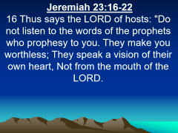
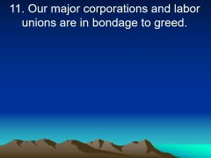
Galatians 3:1
“O foolish Galatians! Who has bewitched you that you should not obey the truth, before whose eyes Jesus Christ was clearly portrayed among you as crucified?”

Slide 38
24 "But in those days, after that tribulation, the sun will be darkened, and the moon will not give its light; 25 the stars of heaven will fall, and the powers in heaven will be shaken. 26 Then they will see the Son of Man coming in the clouds with great power and glory.

Slide 39
Isaiah 13:10
“For the stars of heaven and their constellations Will not give their light; The sun will be darkened in its going forth, And the moon will not cause its light to shine.”

Slide 40
Joel 2:10-11
10 The earth quakes before them, The heavens tremble; The sun and moon grow dark, And the stars diminish their brightness. 11 The LORD gives voice before His army, For His camp is very great; For strong is the One who executes His word. For the day of the LORD is great and very terrible; Who can endure it?

Slide 41
Revelation 6:12-17
12 I looked when He opened the sixth seal, and behold, there was a great earthquake; and the sun became black as sackcloth of hair, and the moon became like blood. 13 And the stars of heaven fell to the earth, as a fig tree drops its late figs when it is shaken by a mighty wind.

Slide 42
14 Then the sky receded as a scroll when it is rolled up, and every mountain and island was moved out of its place. 15 And the kings of the earth, the great men, the rich men, the commanders, the mighty men, every slave and every free man, hid themselves in the caves and in the rocks of the mountains,

Slide 43
16 and said to the mountains and rocks, "Fall on us and hide us from the face of Him who sits on the throne and from the wrath of the Lamb! 17 For the great day of His wrath has come, and who is able to stand?"

Slide 44
27 And then He will send His angels, and gather together His elect from the four winds, from the farthest part of earth to the farthest part of heaven.

