Slide 1


Slide 2
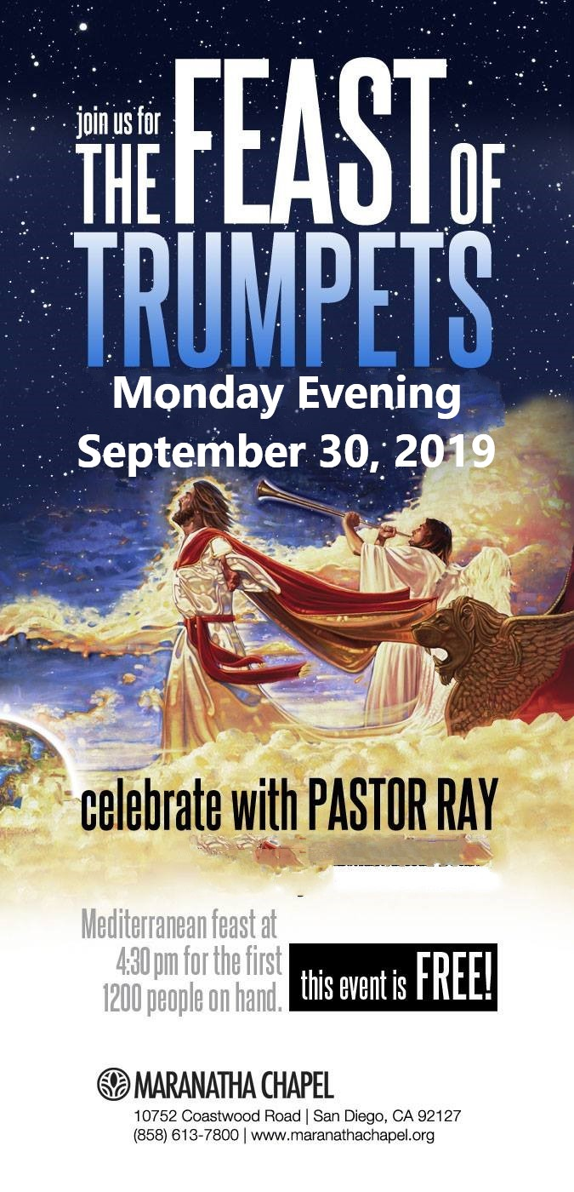

Slide 3


Slide 4
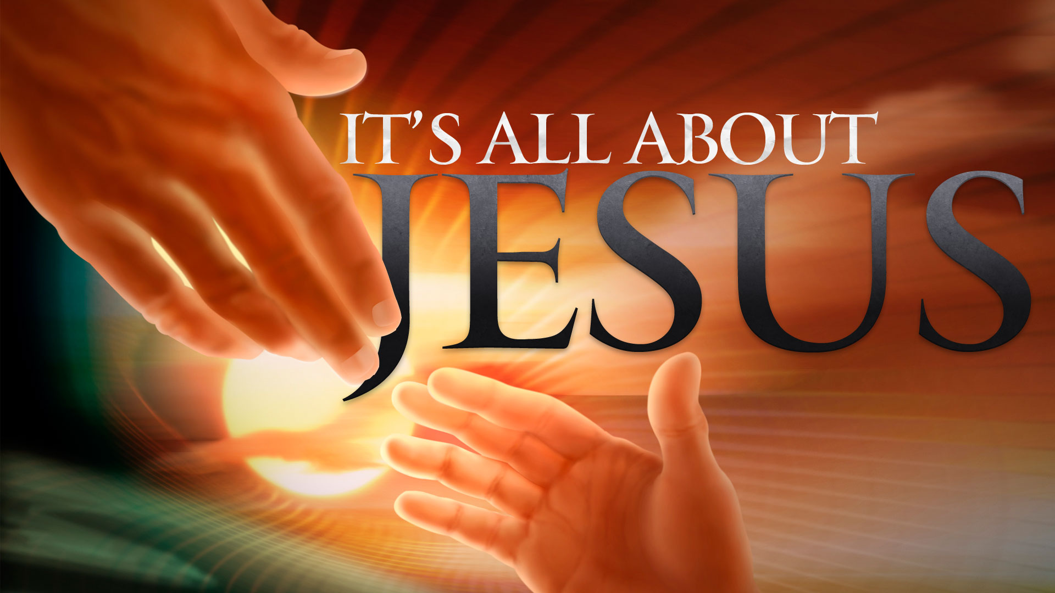

Father Take This Cup
By Pastor Fee Soliven
Mark 14:31-46
Wednesday Evening
September 4, 2019

Slide 5
32 Then they came to a place which was named Gethsemane; and He said to His disciples, "Sit here while I pray." 33 And He took Peter, James, and John with Him, and He began to be troubled and deeply distressed. 34 Then He said to them, "My soul is exceedingly sorrowful, even to death. Stay here and watch."

Slide 6
35 He went a little farther, and fell on the ground, and prayed that if it were possible, the hour might pass from Him. 36 And He said, "Abba, Father, all things are possible for You. Take this cup away from Me; nevertheless, not what I will, but what You will."

Slide 7
37 Then He came and found them sleeping, and said to Peter, "Simon, are you sleeping? Could you not watch one hour? 38 Watch and pray, lest you enter into temptation. The spirit truly is willing, but the flesh is weak." 39 Again He went away and prayed, and spoke the same words.

Slide 8
40 And when He returned, He found them asleep again, for their eyes were heavy; and they did not know what to answer Him. 41 Then He came the third time and said to them, "Are you still sleeping and resting? It is enough! The hour has come; behold, the Son of Man is being betrayed into the hands of sinners.

Slide 9
42 Rise up, let us go. See, My betrayer is at hand." 43 And immediately, while He was still speaking, Judas, one of the twelve, with a great multitude with swords and clubs, came from the chief priests and the scribes and the elders.

Slide 10
44 Now His betrayer had given them a signal, saying, "Whomever I kiss, He is the One; take Him and lead Him away safely." 45 And as soon as He had come, immediately he went up to Him and said to Him, "Rabbi, Rabbi!" and kissed Him.

Slide 11
32 Then they came to a place which was named Gethsemane; and He said to His disciples, "Sit here while I pray."

Slide 12
John 18:1-2
1 When Jesus had spoken these words, He went out with His disciples over the Brook Kidron, where there was a garden, which He and His disciples entered. 2 And Judas, who betrayed Him, also knew the place; for Jesus often met there with His disciples.

Slide 13
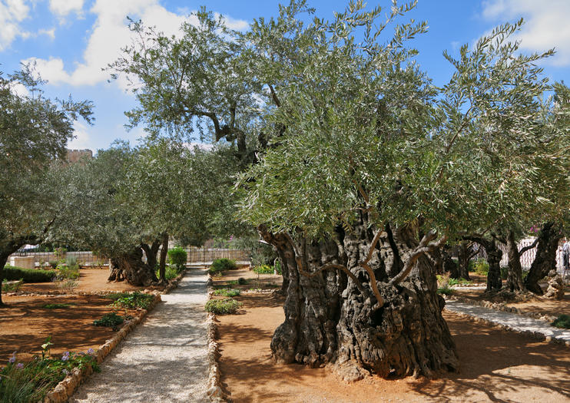
John 12:4-6
4 Then one of His disciples, Judas Iscariot, Simon's son, who would betray Him, said, 5 Why was this fragrant oil not sold for three hundred denarii and given to the poor?" 6 This he said, not that he cared for the poor, but because he was a thief, and had the money box; and he used to take what was put in it.

Slide 14
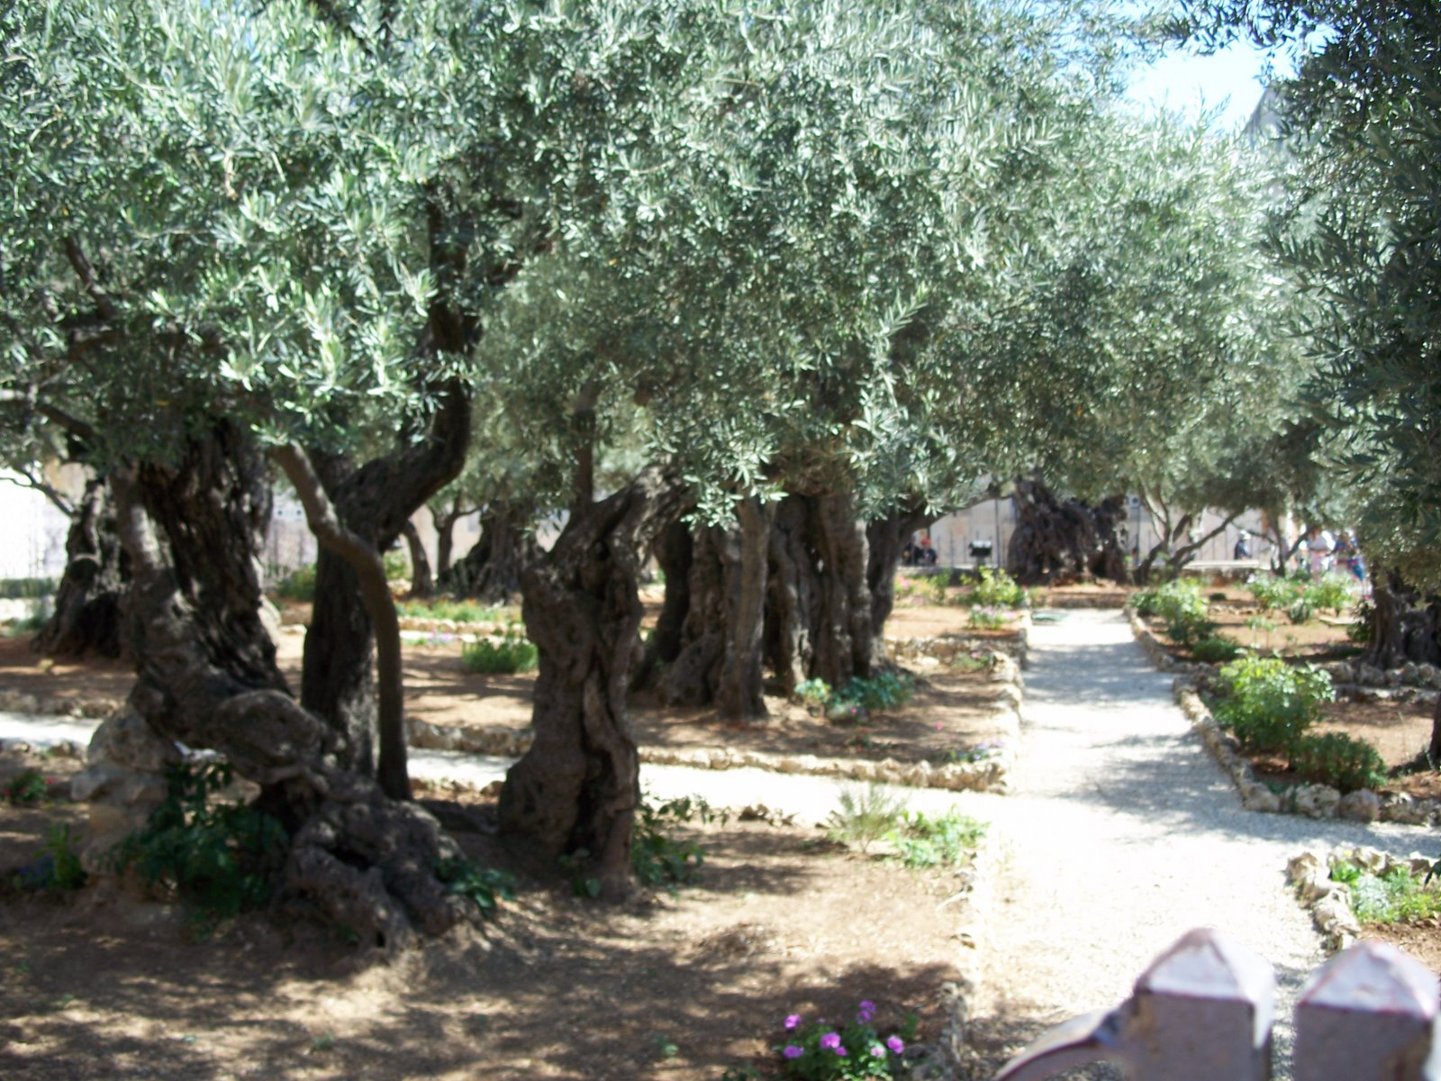
I’m not the one, am I?”

Slide 15
33 And He took Peter, James, and John with Him, and He began to be troubled and deeply distressed. 34 Then He said to them, "My soul is exceedingly sorrowful, even to death. Stay here and watch."

Slide 16
Hebrews 5:7-9
7 who, in the days of His flesh, when He had offered up prayers and supplications, with vehement cries and tears to Him who was able to save Him from death, and was heard because of His godly fear, 8 though He was a Son, yet He learned obedience by the things which He suffered. 9 And having been perfected, He became the author of eternal salvation to all who obey Him…

Slide 17
35 He went a little farther, and fell on the ground, and prayed that if it were possible, the hour might pass from Him.

Slide 18
Isaiah 53:3-5
3 He is despised and rejected by men, A Man of sorrows and acquainted with grief. And we hid, as it were, our faces from Him; He was despised, and we did not esteem Him. 4 Surely He has borne our griefs And carried our sorrows; Yet we esteemed Him stricken, Smitten by God, and afflicted.

Slide 19
5 But He was wounded for our transgressions, He was bruised for our iniquities; The chastisement for our peace was upon Him, And by His stripes we are healed.

Slide 20
Isaiah 53:10-11
10 Yet it pleased the LORD to bruise Him; He has put Him to grief. When You make His soul an offering for sin, He shall see His seed, He shall prolong His days, And the pleasure of the LORD shall prosper in His hand. 11 He shall see the labor of His soul, and be satisfied. By His knowledge My righteous Servant shall justify many, For He shall bear their iniquities.

Slide 21
36 And He said, "Abba, Father, all things are possible for You. Take this cup away from Me; nevertheless, not what I will, but what You will."

Slide 22
Romans 8:15-17
15 For you did not receive the spirit of bondage again to fear, but you received the Spirit of adoption by whom we cry out, "Abba, Father." 16 The Spirit Himself bears witness with our spirit that we are children of God, 17 and if children, then heirs--heirs of God and joint heirs with Christ, if indeed we suffer with Him, that we may also be glorified together.

Slide 23
Galatians 4:6-7
6 And because you are sons, God has sent forth the Spirit of His Son into your hearts, crying out, "Abba, Father!" 7 Therefore you are no longer a slave but a son, and if a son, then an heir of God through Christ.

Slide 24
Hebrews 5:7-9
7 who, in the days of His flesh, when He had offered up prayers and supplications, with vehement cries and tears to Him who was able to save Him from death, and was heard because of His godly fear, 8 though He was a Son, yet He learned obedience by the things which He suffered. 9 And having been perfected, He became the author of eternal salvation to all who obey Him…

Slide 25
37 Then He came and found them sleeping, and said to Peter, "Simon, are you sleeping? Could you not watch one hour? 38 Watch and pray, lest you enter into temptation. The spirit truly is willing, but the flesh is weak."

Slide 26
John 1:42
“And he brought him to Jesus. Now when Jesus looked at him, He said, "You are Simon the son of Jonah. You shall be called Cephas" (which is translated, A Stone).”

Slide 27
39 Again He went away and prayed, and spoke the same words. 40 And when He returned, He found them asleep again, for their eyes were heavy; and they did not know what to answer Him.

Slide 28
41 Then He came the third time and said to them, "Are you still sleeping and resting? It is enough! The hour has come; behold, the Son of Man is being betrayed into the hands of sinners. 42 Rise up, let us go. See, My betrayer is at hand."

Slide 29
43 And immediately, while He was still speaking, Judas, one of the twelve, with a great multitude with swords and clubs, came from the chief priests and the scribes and the elders.

Slide 30
Revelation 13:8
“All who dwell on the earth will worship him, whose names have not been written in the Book of Life of the Lamb slain from the foundation of the world.”

Slide 31
Acts 2:23
“Him, being delivered by the determined purpose and foreknowledge of God, you have taken by lawless hands, have crucified, and put to death”

Slide 32
44 Now His betrayer had given them a signal, saying, "Whomever I kiss, He is the One; take Him and lead Him away safely."

Slide 33
45 And as soon as He had come, immediately he went up to Him and said to Him, "Rabbi, Rabbi!" and kissed Him.

Slide 34
Psalm 41:9
“Even my own familiar friend in whom I trusted, Who ate my bread, Has lifted up his heel against me”

Slide 35
Psalm 55:12-14
12 For it is not an enemy who reproaches me; Then I could bear it. Nor is it one who hates me who has exalted himself against me; Then I could hide from him. 13 But it was you, a man my equal, My companion and my acquaintance. 14 We took sweet counsel together, And walked to the house of God in the throng.

Slide 36
Romans 12:14-19
14 Bless those who persecute you; bless and do not curse. 15 Rejoice with those who rejoice, and weep with those who weep. 16 Be of the same mind toward one another. Do not set your mind on high things, but associate with the humble. Do not be wise in your own opinion.

Slide 37
17 Repay no one evil for evil. Have regard for good things in the sight of all men. 18 If it is possible, as much as depends on you, live peaceably with all men. 19 Beloved, do not avenge yourselves, but rather give place to wrath; for it is written, "Vengeance is Mine, I will repay," says the Lord.

