Slide 1


Slide 2


Slide 3
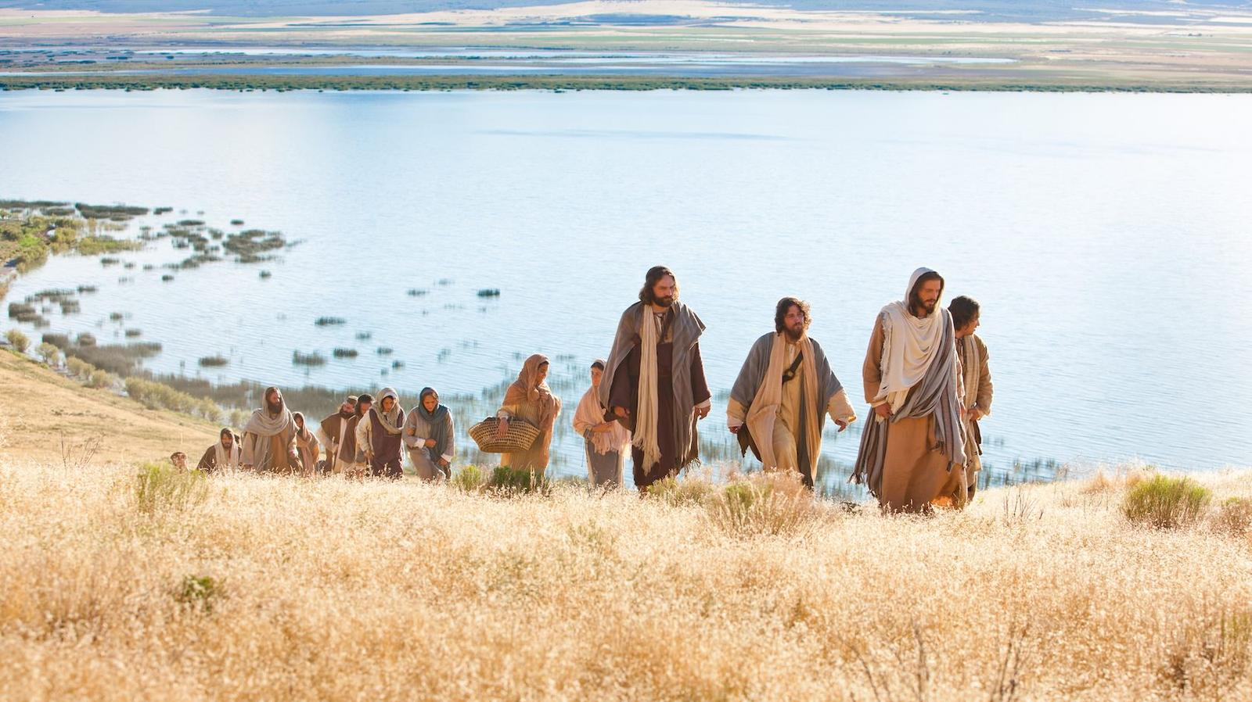

Is Jesus Leading Your Life
By Pastor Fee Soliven
Romans 8:12-17
Sunday Morning
September 8, 2019

Slide 4
Romans 8:12-17
12 Therefore, brethren, we are debtors--not to the flesh, to live according to the flesh. 13 For if you live according to the flesh you will die; but if by the Spirit you put to death the deeds of the body, you will live. 14 For as many as are led by the Spirit of God, these are sons of God. 15 For you did not receive the spirit of bondage again to fear, but you received the Spirit of adoption by whom we cry out, "Abba, Father."

Slide 5
16 The Spirit Himself bears witness with our spirit that we are children of God, 17 and if children, then heirs--heirs of God and joint heirs with Christ, if indeed we suffer with Him, that we may also be glorified together.

Slide 6
Do you ask the Lord to show you His will, or do you decide each day how you want to live and what you will do?

Slide 7
The will of God is the principle by which we should live
every single day

Slide 8
1. Allow God to Sanctify You

Slide 9
1 Peter 3:15-17
15 But sanctify the Lord God in your hearts, and always be ready to give a defense to everyone who asks you a reason for the hope that is in you, with meekness and fear; 16 having a good conscience, that when they defame you as evildoers, those who revile your good conduct in Christ may be ashamed. 17 For it is better, if it is the will of God, to suffer for doing good than for doing evil.

Slide 10
2. Allow God to Transform You

Slide 11
Romans 12:1-2
1 I beseech you therefore, brethren, by the mercies of God, that you present your bodies a living sacrifice, holy, acceptable to God, which is your reasonable service. 2 And do not be conformed to this world, but be transformed by the renewing of your mind, that you may prove what is that good and acceptable and perfect will of God.

Slide 12
3. Allow God to Purify Our Hearts towards God and Man

Slide 13
Psalm 51:10-13
10 Create in me a clean heart, O God, And renew a steadfast spirit within me. 11 Do not cast me away from Your presence, And do not take Your Holy Spirit from me. 12 Restore to me the joy of Your salvation, And uphold me by Your generous Spirit. 13 Then I will teach transgressors Your ways, And sinners shall be converted to You.

Slide 14
4. Allow God to Teach us His Ways

Slide 15
Psalm 143:10
“Teach me to do Your will, For You are my God; Your Spirit is good. Lead me in the land of uprightness.”

Slide 16
Psalm 25:12
“Who is the man that fears the LORD? Him shall He teach in the way He chooses.”

Slide 17
John 6:45
“It is written in the prophets, 'And they shall all be taught by God.' Therefore everyone who has heard and learned from the Father comes to Me.”

Slide 18
1 Thessalonians 4:9
“But concerning brotherly love you have no need that I should write to you, for you yourselves are taught by God to love one another…”

Slide 19
Jesus Christ our Savior is our
example to follow

Slide 20
Luke 22:39-42
39 Coming out, He went to the Mount of Olives, as He was accustomed, and His disciples also followed Him. 40 When He came to the place, He said to them, "Pray that you may not enter into temptation."

Slide 21
41 And He was withdrawn from them about a stone's throw, and He knelt down and prayed, 42 saying, "Father, if it is Your will, take this cup away from Me; nevertheless not My will, but Yours, be done."

Slide 22
The will of God is that which He approves and determines to bring about

Slide 23
1 John 3:20
“For if our heart condemns us, God is greater than our heart, and knows all things.”

Slide 24
Living in God’s will is our Protection

Slide 25
2 Peter 3:17-18
17 You therefore, beloved, since you know this beforehand, beware lest you also fall from your own steadfastness, being led away with the error of the wicked; 18 but grow in the grace and knowledge of our Lord and Savior Jesus Christ. To Him be the glory both now and forever. Amen.

Slide 26
What is God’s will?

Slide 27
Hebrews 13:20-22
20 Now may the God of peace who brought up our Lord Jesus from the dead, that great Shepherd of the sheep, through the blood of the everlasting covenant, 21 make you complete in every good work to do His will, working in you what is well pleasing in His sight, through Jesus Christ, to whom be glory forever and ever. Amen.

Slide 28
Ephesians 5:15-21
15 See then that you walk circumspectly, not as fools but as wise, 16 redeeming the time, because the days are evil. 17 Therefore do not be unwise, but understand what the will of the Lord is. 18 And do not be drunk with wine, in which is dissipation; but be filled with the Spirit,

Slide 29
19 speaking to one another in psalms and hymns and spiritual songs, singing and making melody in your heart to the Lord, 20 giving thanks always for all things to God the Father in the name of our Lord Jesus Christ, 21 submitting to one another in the fear of God.

Slide 30
We need the Lord for every aspect of our Lives

Slide 31
Jesus is the Bread of Life
John 6:35
"Then Jesus declared, 'I am the bread of life. He who comes to me will never go hungry, and he who believes in me will never be thirsty'"

Slide 32
Jesus offers us Living Water
John 4:10
“If you knew the gift of God and who it is that asks you for a drink, you would have asked him and he would have given you living water”

Slide 33
Jesus is the Way, the Truth,
and the Life
John 14:6
“Jesus answered, ‘I am the way, the truth, and the life. No one comes to the Father except through me”

Slide 34
Jesus is our Savior and Lord
Philippians 2:9-11
9 “For this reason also, God highly exalted Him, and bestowed on Him the name which is above every name, 10 so that at the name of Jesus every knee will bow, of those who are in heaven and on earth, and under the earth, 11 and that every tongue will confess that Jesus Christ is Lord to the glory of God the Father”

Slide 35
Jesus is our Rock
1 Corinthians 10:4
“For they drank from the spiritual rock that followed them, and the rock was Christ”

Slide 36
Jesus is our Redeemer
Job 19:25
“And as for me, I know that my Redeemer lives, and at the last will take His stand on the earth”

Slide 37
Jesus is the Light of the world
John 18:12
“I am the light of the world. Whoever follows me will never walk in darkness, but will have the light of life”

Slide 38
Jesus is our Peace
Ephesians 2:14
“For he himself is our peace…”

Slide 39
Jesus is the Beginning and the End
Revelation 22:13
“I am the Alpha and the Omega, the First and the Last, the Beginning and the End”

Slide 40
Jesus is our Deliverer
1 Thessalonians 1:10
“And to wait for his Son from heaven, whom he raised from the dead, Jesus delivers us from the wrath to come”

Slide 41
Jesus is the Good Shepherd
John 10:11
“I am the good shepherd. The good shepherd lays down his life for the sheep”

Slide 42
Those who don’t know Christ as Savior are living without God

Slide 43
Hebrews 9:27
“And as it is appointed for men to die once, but after this the judgment”

