Slide 1


Slide 2


Slide 3
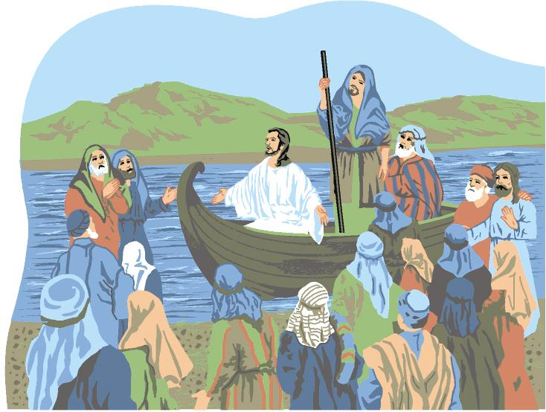

Is Jesus in Your Boat
By Pastor Fee Soliven
Matthew 8:23-27
Sunday Morning
September 1, 2019

Slide 4
Matthew 8:23-27
23 Now when He got into a boat, His disciples followed Him. 24 And suddenly a great tempest arose on the sea, so that the boat was covered with the waves. But He was asleep. 25 Then His disciples came to Him and awoke Him, saying, "Lord, save us! We are perishing!"
26 But He said to them, "Why are you fearful, O you of little faith?" Then He arose and rebuked the winds and the sea, and there was a great calm. 27 So the men marveled, saying, "Who can this be, that even the winds and the sea obey Him?"

Slide 5
26 But He said to them, "Why are you fearful, O you of little faith?" Then He arose and rebuked the winds and the sea, and there was a great calm. 27 So the men marveled, saying, "Who can this be, that even the winds and the sea obey Him?"

Slide 6
We all experience Storms in our lives. Those occasions that bring pain, suffering, or loss

Slide 7
Where is God?
Why has this happened?
Was it something I did?
Did God cause it?

Slide 8
God’s Word!

Slide 9
Psalm 103:19
“The Lord has established His throne in the heavens, and His sovereignty rules over all.”

Slide 10
Psalm 107:23-32
23 Those who go down to the sea in ships, Who do business on great waters, 24 They see the works of the LORD, And His wonders in the deep. 25 For He commands and raises the stormy wind, Which lifts up the waves of the sea.

Slide 11
26 They mount up to the heavens, They go down again to the depths; Their soul melts because of trouble. 27 They reel to and fro, and stagger like a drunken man, And are at their wits' end. 28 Then they cry out to the LORD in their trouble, And He brings them out of their distresses. 29 He calms the storm, So that its waves are still.

Slide 12
30 Then they are glad because they are quiet; So He guides them to their desired haven. 31 Oh, that men would give thanks to the LORD for His goodness, And for His wonderful works to the children of men! 32 Let them exalt Him also in the assembly of the people, And praise Him in the company of the elders.

Slide 13
Was God in the storm?

Slide 14
Psalm 107:25
“For He commands and raises the stormy wind, which lifts up the waves of the sea.”

Slide 15
There are three kinds of Storms

Slide 16
Natural Storms

Slide 17
Emotional Storms

Slide 18
1. Poor Health

Slide 19
2. Financial Struggles

Slide 20
3. Relationship Difficulties

Slide 21
Spiritual Storms

Slide 22
What are the Sources of our Storms?

Slide 23
1. Ourselves

Slide 24
2. The Devil

Slide 25
2 Samuel 11:1-5
1 It happened in the spring of the year, at the time when kings go out to battle, that David sent Joab and his servants with him, and all Israel; and they destroyed the people of Ammon and besieged Rabbah. But David remained at Jerusalem.

Slide 26
2 Then it happened one evening that David arose from his bed and walked on the roof of the king's house. And from the roof he saw a woman bathing, and the woman was very beautiful to behold. 3 So David sent and inquired about the woman. And someone said, "Is this not Bathsheba, the daughter of Eliam, the wife of Uriah the Hittite?"

Slide 27
4 Then David sent messengers, and took her; and she came to him, and he lay with her, for she was cleansed from her impurity; and she returned to her house. 5 And the woman conceived; so she sent and told David, and said, "I am with child."

Slide 28
David’s Progression

Slide 29
1. David was where he shouldn’t have been

Slide 30
2. David saw what he should not have seen

Slide 31
3. David’s look turned to lust, and he sent for her

Slide 32
4. David’s lust gave birth to an act of sin

Slide 33
God

Slide 34
Why does God allow Storms in our lives?

Slide 35
1. To get Our Attention

Slide 36
2. To bring Us to Repentance

Slide 37
Jonah 1:1-17
1 Now the word of the LORD came to Jonah the son of Amittai, saying, 2 "Arise, go to Nineveh, that great city, and cry out against it; for their wickedness has come up before Me." 3 But Jonah arose to flee to Tarshish from the presence of the LORD. He went down to Joppa, and found a ship going to Tarshish; so he paid the fare, and went down into it, to go with them to Tarshish from the presence of the LORD.

Slide 38
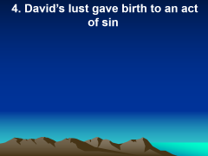
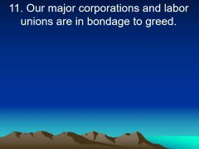
4 But the LORD sent out a great wind on the sea, and there was a mighty tempest on the sea, so that the ship was about to be broken up. 5 Then the mariners were afraid; and every man cried out to his god, and threw the cargo that was in the ship into the sea, to lighten the load. But Jonah had gone down into the lowest parts of the ship, had lain down, and was fast asleep.

Slide 39
6 So the captain came to him, and said to him, "What do you mean, sleeper? Arise, call on your God; perhaps your God will consider us, so that we may not perish." 7 And they said to one another, "Come, let us cast lots, that we may know for whose cause this trouble has come upon us." So they cast lots, and the lot fell on Jonah.

Slide 40
8 Then they said to him, "Please tell us! For whose cause is this trouble upon us? What is your occupation? And where do you come from? What is your country? And of what people are you?" 9 And he said to them, "I am a Hebrew; and I fear the LORD, the God of heaven, who made the sea and the dry land."

Slide 41
10 Then the men were exceedingly afraid, and said to him, "Why have you done this?" For the men knew that he fled from the presence of the LORD, because he had told them. 11 Then they said to him, "What shall we do to you that the sea may be calm for us?"--for the sea was growing more tempestuous.

Slide 42
12 And he said to them, "Pick me up and throw me into the sea; then the sea will become calm for you. For I know that this great tempest is because of me." 13 Nevertheless the men rowed hard to return to land, but they could not, for the sea continued to grow more tempestuous against them.

Slide 43
14 Therefore they cried out to the LORD and said, "We pray, O LORD, please do not let us perish for this man's life, and do not charge us with innocent blood; for You, O LORD, have done as it pleased You." 15 So they picked up Jonah and threw him into the sea, and the sea ceased from its raging.

Slide 44
16 Then the men feared the LORD exceedingly, and offered a sacrifice to the LORD and made vows. 17 Now the LORD had prepared a great fish to swallow Jonah. And Jonah was in the belly of the fish three days and three nights.

Slide 45
3. To conform us to Christ’s Image

Slide 46
4. To equip us for Service

Slide 47
5. To demonstrate His Power in our Lives

Slide 48
6. To reveal Himself to Us

Slide 49
7. To demonstrate His Love

Slide 50
8. To remind us who is in Control

