Slide 1


Slide 2


Slide 3
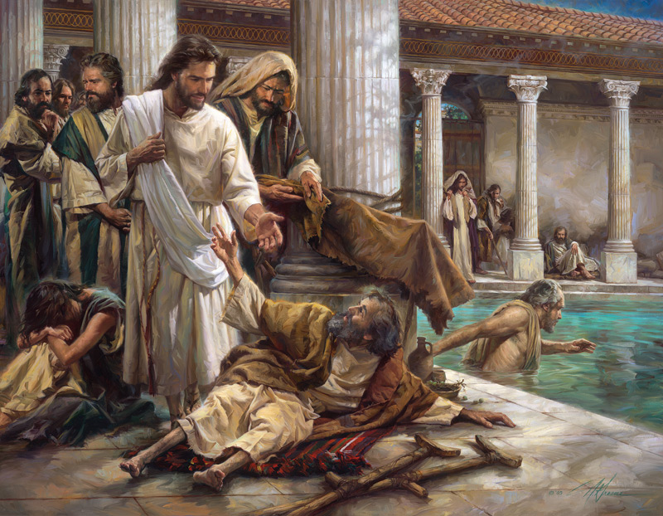

By His Stripes We Are Healed Pt. 1
By Pastor Fee Soliven
Isaiah 53:4-4
Sunday Morning
October 6, 2019

Slide 4
Isaiah 53:4-6
4 Surely He has borne our griefs And carried our sorrows; Yet we esteemed Him stricken, Smitten by God, and afflicted. 5 But He was wounded for our transgressions, He was bruised for our iniquities; The chastisement for our peace was upon Him, And by His stripes we are healed. 6 All we like sheep have gone astray; We have turned, every one, to his own way; And the LORD has laid on Him the iniquity of us all.

Slide 5
Healing is God’s will for Mankind

Slide 6
3 John 2
“Beloved, I pray that you may prosper in all things and be in health, just as your soul prospers”

Slide 7
Hosea 4:6
“My people are destroyed for a lack of knowledge…”

Slide 8
1 Peter 2:24
“who Himself bore our sins in His own body on the tree, that we, having died to sins, might live for righteousness—by whose stripes you were healed.”

Slide 9
Hebrews 1:3
“who being the brightness of His glory and the express image of His person, and upholding all things by the word of His power, when He had by Himself purged our sins, sat down at the right hand of the Majesty on high”

Slide 10
“The Perfect Representation”

Slide 11
Luke 6:17-19
17 And He came down with them and stood on a level place with a crowd of His disciples and a great multitude of people from all Judea and Jerusalem, and from the seacoast of Tyre and Sidon, who came to hear Him and be healed of their diseases,

Slide 12
18 as well as those who were tormented with unclean spirits. And they were healed. 19 And the whole multitude sought to touch Him, for power went out from Him and healed them all.

Slide 13
1. Grace

Slide 14
2 Peter 1:1-3
1 Simon Peter, a bondservant and apostle of Jesus Christ, To those who have obtained like precious faith with us by the righteousness of our God and Savior Jesus Christ: 2 Grace and peace be multiplied to you in the knowledge of God and of Jesus our Lord, 3 as His divine power has given to us all things that pertain to life and godliness, through the knowledge of Him who called us by glory and virtue…

Slide 15
”all things that pertain to life”

Slide 16
2. God’s Medicine

Slide 17
Proverbs 4:20-22
20 My son, give attention to my words; Incline your ear to my sayings. 21 Do not let them depart from your eyes; Keep them in the midst of your heart; 22 For they are life to those who find them, And health to all their flesh.

Slide 18
Exodus 15:26 (American Standard Version
“and he said, If thou wilt diligently hearken to the voice of Jehovah thy God, and wilt do that which is right in his eyes, and wilt give ear to his commandments, and keep all his statutes, I will put none of the diseases upon thee, which I have put upon the Egyptians: for I am Jehovah that healeth thee.

Slide 19
3. God’s Plan

Slide 20
John 10:10
The thief does not come except to steal, and to kill, and to destroy. I have come that they may have life, and that they may have it more abundantly.

Slide 21
Matthew 6:10
“Your kingdom come. Your will be done on earth as it is in heaven.”

Slide 22
4. God’s Report

Slide 23
Isaiah 53:1-5
1 Who has believed our report? And to whom has the arm of the LORD been revealed? 2 For He shall grow up before Him as a tender plant, And as a root out of dry ground. He has no form or comeliness; And when we see Him, There is no beauty that we should desire Him.

Slide 24
3 He is despised and rejected by men, A Man of sorrows and acquainted with grief. And we hid, as it were, our faces from Him; He was despised, and we did not esteem Him. 4 Surely He has borne our griefs And carried our sorrows; Yet we esteemed Him stricken, Smitten by God, and afflicted.

Slide 25
5 But He was wounded for our transgressions, He was bruised for our iniquities; The chastisement for our peace was upon Him, And by His stripes we are healed.

Slide 26
“Who has Believed our Report?”

Slide 27
Are you going to believe the symptoms in your body and the report from your doctor?

Slide 28
Will you believe the Word of God?

Slide 29
Isaiah 53:1
1 Who has believed our report? And to whom has the arm of the LORD been revealed?

Slide 30
Isaiah 53:4
Surely He has borne our griefs And carried our sorrows; Yet we esteemed Him stricken, Smitten by God, and afflicted.

Slide 31
The Hebrew words for griefs and sorrows are choliy and mak’ob. The literal translation for these words is “sickness and pain.”

Slide 32
The Hebrew word for borne is nasá. It means “to lift up; to carry.”

Slide 33
5. God’s Redemption

Slide 34
Galatians 3:11-14
11 But that no one is justified by the law in the sight of God is evident, for "the just shall live by faith." 12 Yet the law is not of faith, but "the man who does them shall live by them." 13 Christ has redeemed us from the curse of the law, having become a curse for us (for it is written, "Cursed is everyone who hangs on a tree"), 14 that the blessing of Abraham might come upon the Gentiles in Christ Jesus, that we might receive the promise of the Spirit through faith.

Slide 35
Galatians 3:11
“But that no one is justified by the law in the sight of God is evident, for "the just shall live by faith."

Slide 36
2 Corinthians 5:21
“For He made Him who knew no sin to be sin for us, that we might become the righteousness of God in Him.”

Slide 37
Romans 10:3-4
3 For they being ignorant of God's righteousness, and seeking to establish their own righteousness, have not submitted to the righteousness of God. 4 For Christ is the end of the law for righteousness to everyone who believes.

Slide 38
6. God’s Blessing

Slide 39
Deuteronomy 28:1-6
1 "Now it shall come to pass, if you diligently obey the voice of the LORD your God, to observe carefully all His commandments which I command you today, that the LORD your God will set you high above all nations of the earth.

Slide 40
2 And all these blessings shall come upon you and overtake you, because you obey the voice of the LORD your God: 3 Blessed shall you be in the city, and blessed shall you be in the country. 4 Blessed shall be the fruit of your body, the produce of your ground and the increase of your herds, the increase of your cattle and the offspring of your flocks.

Slide 41
5 Blessed shall be your basket and your kneading bowl. 6 Blessed shall you be when you come in, and blessed shall you be when you go out.

Slide 42
Galatians 3:13
“Christ has redeemed us from the curse of the law, having become a curse for us…”

Slide 43
Declaration of Faith
Jesus redeemed me from the curse of the Law, and I walk in all of the blessings of God. These blessings include divine health. I refuse to allow sickness to come on me. I overcome all sickness and disease through the blood of Jesus.

