Slide 3
Golgotha Place of the Skull
By Pastor Fee Soliven
Mark 15:17-32
Wednesday Evening
October 30, 2019

Slide 4
17 And they clothed Him with purple; and they twisted a crown of thorns, put it on His head, 18 and began to salute Him, "Hail, King of the Jews!" 19 Then they struck Him on the head with a reed and spat on Him; and bowing the knee, they worshiped Him.

Slide 5
20 And when they had mocked Him, they took the purple off Him, put His own clothes on Him, and led Him out to crucify Him. 21 Then they compelled a certain man, Simon a Cyrenian, the father of Alexander and Rufus, as he was coming out of the country and passing by, to bear His cross.

Slide 6
22 And they brought Him to the place Golgotha, which is translated, Place of a Skull. 23 Then they gave Him wine mingled with myrrh to drink, but He did not take it. 24 And when they crucified Him, they divided His garments, casting lots for them to determine what every man should take.

Slide 7
25 Now it was the third hour, and they crucified Him. 26 And the inscription of His accusation was written above: THE KING OF THE JEWS. 27 With Him they also crucified two robbers, one on His right and the other on His left. 28 So the Scripture was fulfilled which says, "And He was numbered with the transgressors."

Slide 8
29 And those who passed by blasphemed Him, wagging their heads and saying, "Aha! You who destroy the temple and build it in three days, 30 save Yourself, and come down from the cross!"

Slide 9
31 Likewise the chief priests also, mocking among themselves with the scribes, said, "He saved others; Himself He cannot save. 32 Let the Christ, the King of Israel, descend now from the cross, that we may see and believe." Even those who were crucified with Him reviled Him.

Slide 10
17 And they clothed Him with purple; and they twisted a crown of thorns, put it on His head, 18 and began to salute Him, "Hail, King of the Jews!" 19 Then they struck Him on the head with a reed and spat on Him; and bowing the knee, they worshiped Him.

Slide 11
Matthew 27:29
“When they had twisted a crown of thorns, they put it on His head, and a reed in His right hand. And they bowed the knee before Him and mocked Him, saying, "Hail, King of the Jews!"

Slide 12
Isaiah 50:6
I gave My back to those who struck Me, And My cheeks to those who plucked out the beard; I did not hide My face from shame and spitting.

Slide 13
Isaiah 52:14
“Just as many were astonished at you, So His visage was marred more than any man, And His form more than the sons of men”

Slide 14
Isaiah 53:6
“All we like sheep have gone astray; We have turned, every one, to his own way; And the LORD has laid on Him the iniquity of us all.

Slide 15
20 And when they had mocked Him, they took the purple off Him, put His own clothes on Him, and led Him out to crucify Him.

Slide 16
John 19:23
“Then the soldiers, when they had crucified Jesus, took His garments and made four parts, to each soldier a part, and also the tunic. Now the tunic was without seam, woven from the top in one piece.”

Slide 17
Purple- Priesthood, Kingship, Royalty, mediator, wealth,

Slide 18
Judges 8:26
“Now the weight of the gold earrings that he requested was one thousand seven hundred shekels of gold, besides the crescent ornaments, pendants, and purple robes which were on the kings of Midian…”

Slide 19
21 Then they compelled a certain man, Simon a Cyrenian, the father of Alexander and Rufus, as he was coming out of the country and passing by, to bear His cross.

Slide 20
Acts 2:10
“Phrygia and Pamphylia, Egypt and the parts of Libya adjoining Cyrene, visitors from Rome, both Jews and proselytes…”

Slide 21
Romans 16:13
“Greet Rufus, chosen in the Lord, and his mother and mine”

Slide 22
22 And they brought Him to the place Golgotha, which is translated, Place of a Skull.

Slide 23
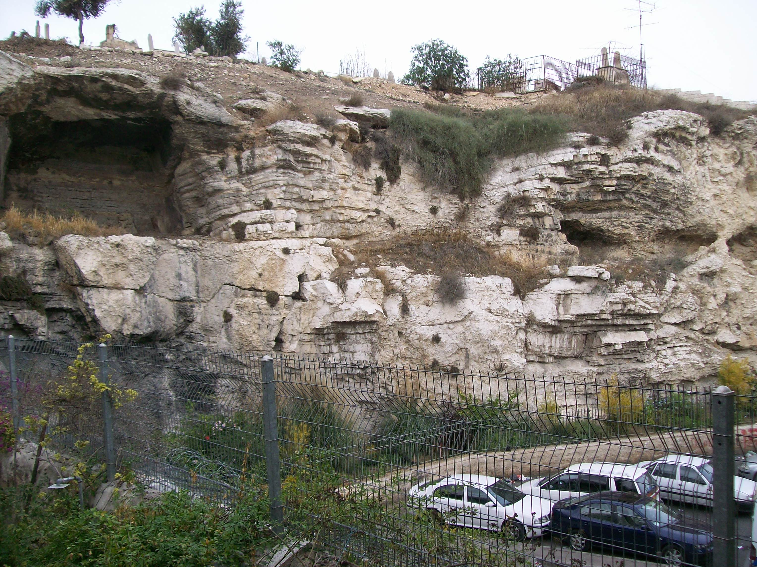
Mark 15:2
Then Pilate asked Him, "Are You the King of the Jews?"

Slide 24
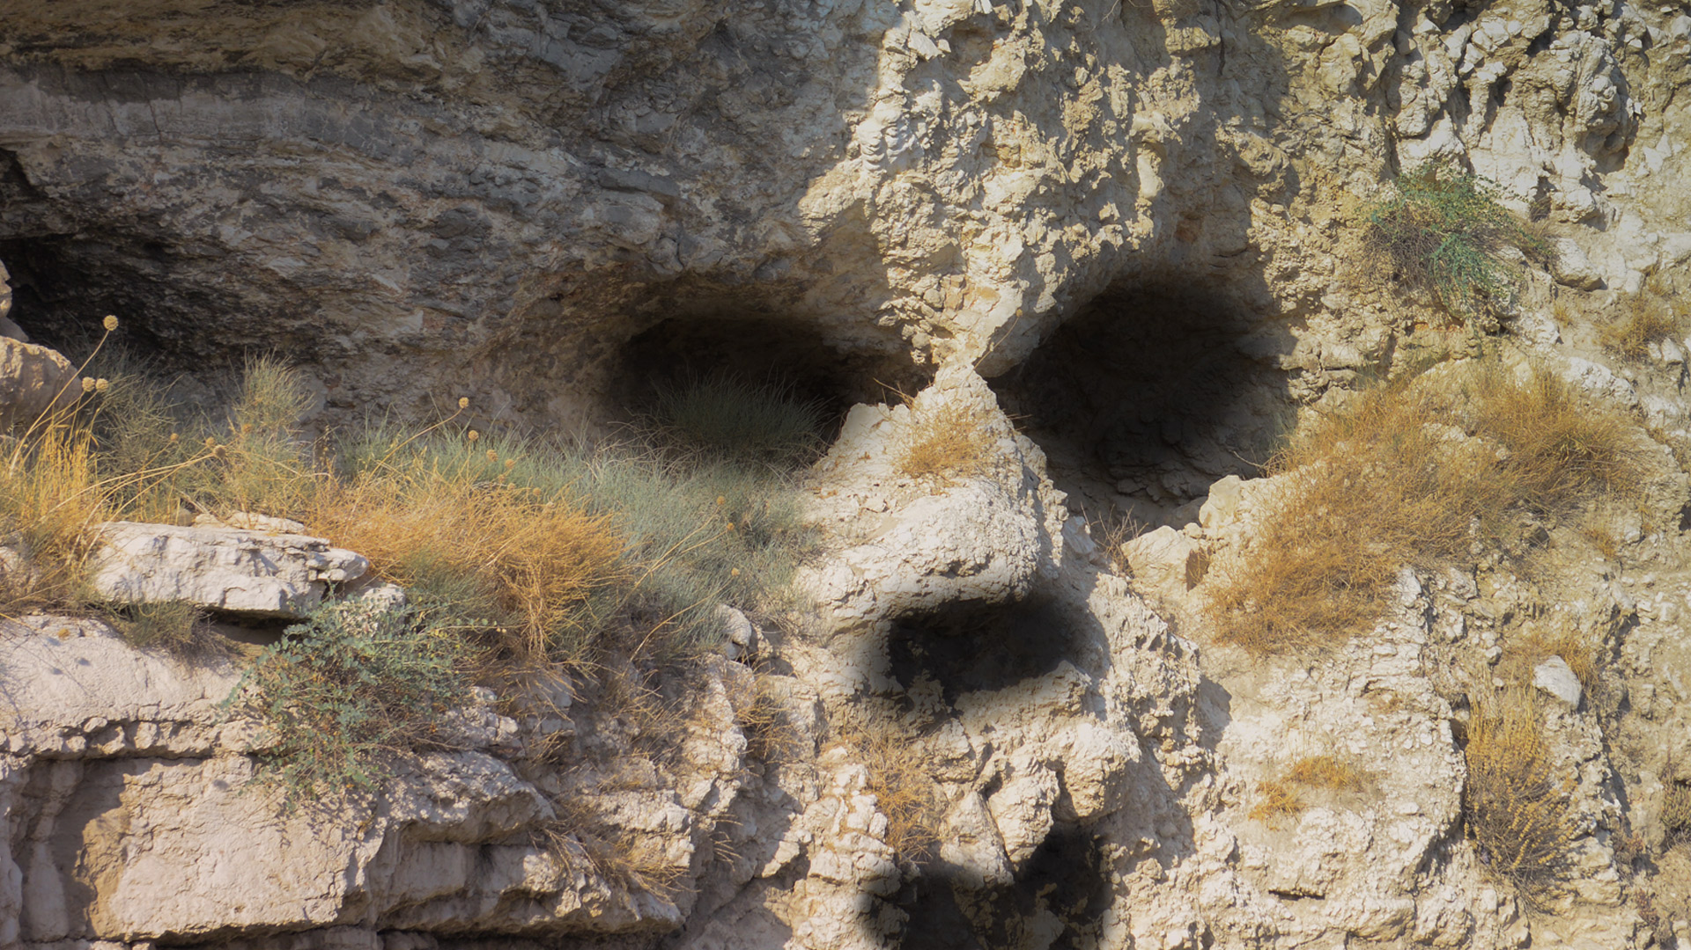
Mark 15:12
Pilate answered and said to them again, "What then do you want me to do with Him whom you call the King of the Jews?"

Slide 25
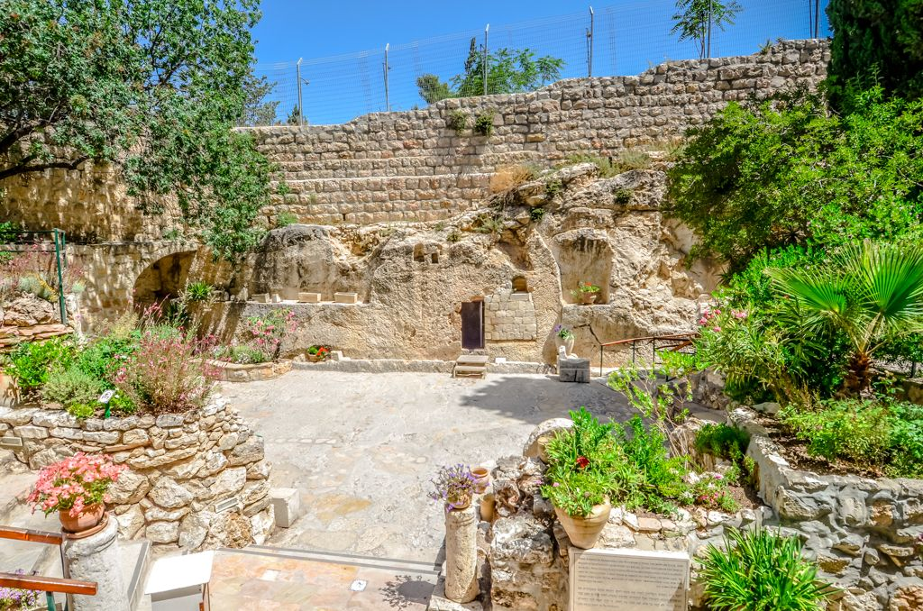
23 Then they gave Him wine mingled with myrrh to drink, but He did not take it.

Slide 26
23 Then they gave Him wine mingled with myrrh to drink, but He did not take it.

Slide 27
Psalm 69:21
“They also gave me gall for my food, And for my thirst they gave me vinegar to drink”

Slide 28
24 And when they crucified Him, they divided His garments, casting lots for them to determine what every man should take.

Slide 29
Psalm 22:18
“They divide My garments among them, And for My clothing they cast lots”

Slide 30
25 Now it was the third hour, and they crucified Him. 26 And the inscription of His accusation was written above: THE KING OF THE JEWS.

Slide 31
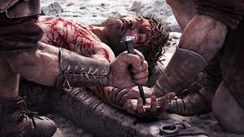
Luke 11:47-52
47 Woe to you! For you build the tombs of the prophets, and your fathers killed them. 48 In fact, you bear witness that you approve the deeds of your fathers; for they indeed killed them, and you build their tombs.

Slide 32
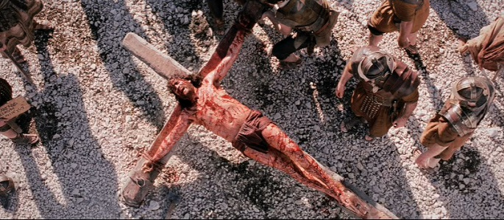
49 Therefore the wisdom of God also said, 'I will send them prophets and apostles, and some of them they will kill and persecute,' 50 that the blood of all the prophets which was shed from the foundation of the world may be required of this generation,

Slide 33
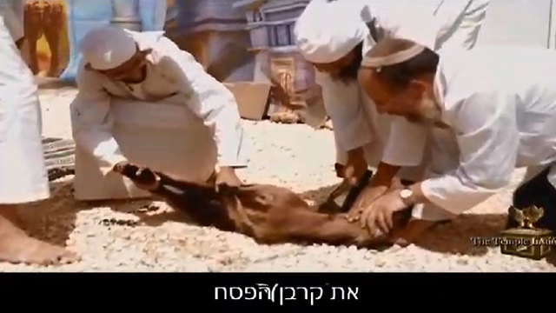
51 from the blood of Abel to the blood of Zechariah who perished between the altar and the temple. Yes, I say to you, it shall be required of this generation.

Slide 34
13 So they cried out again, "Crucify Him!"

Slide 35
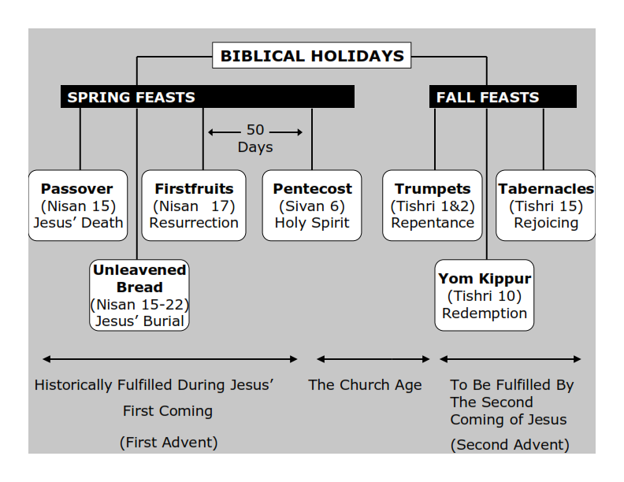
Philippians 3:20-21
20 For our citizenship is in heaven, from which we also eagerly wait for the Savior, the Lord Jesus Christ, 21 who will transform our lowly body that it may be conformed to His glorious body, according to the working by which He is able even to subdue all things to Himself.

Slide 36
27 With Him they also crucified two robbers, one on His right and the other on His left. 28 So the Scripture was fulfilled which says, "And He was numbered with the transgressors."

Slide 37
Isaiah 53:12
“Therefore will I divide him a portion with the great, and he shall divide the spoil with the strong; because he hath poured out his soul unto death: and he was numbered with the transgressors; and he bare the sin of many, and made intercession for the transgressors.”

Slide 38
Mark 10:35-40
35 Then James and John, the sons of Zebedee, came to Him, saying, "Teacher, we want You to do for us whatever we ask." 36 And He said to them, "What do you want Me to do for you?" 37 They said to Him, "Grant us that we may sit, one on Your right hand and the other on Your left, in Your glory."

Slide 39
38 But Jesus said to them, "You do not know what you ask. Can you drink the cup that I drink, and be baptized with the baptism that I am baptized with?" 39 They said to Him, "We are able." So Jesus said to them, "You will indeed drink the cup that I drink, and with the baptism I am baptized with you will be baptized; 40 but to sit on My right hand and on My left is not Mine to give, but it is for those for whom it is prepared."

Slide 40
29 And those who passed by blasphemed Him, wagging their heads and saying, "Aha! You who destroy the temple and build it in three days, 30 save Yourself, and come down from the cross!"

Slide 41
Mark 14:58
"We heard Him say, 'I will destroy this temple that is made with hands, and within three days I will build another made without hands.' "

Slide 42
31 Likewise the chief priests also, mocking among themselves with the scribes, said, "He saved others; Himself He cannot save. 32 Let the Christ, the King of Israel, descend now from the cross, that we may see and believe." Even those who were crucified with Him reviled Him.

Slide 43
Luke 23:39-43
39 Then one of the criminals who were hanged blasphemed Him, saying, "If You are the Christ, save Yourself and us." 40 But the other, answering, rebuked him, saying, "Do you not even fear God, seeing you are under the same condemnation?

Slide 44
41 And we indeed justly, for we receive the due reward of our deeds; but this Man has done nothing wrong." 42 Then he said to Jesus, "Lord, remember me when You come into Your kingdom." 43 And Jesus said to him, "Assuredly, I say to you, today you will be with Me in Paradise."

Slide 45
Romans 10:9-13
9 that if you confess with your mouth the Lord Jesus and believe in your heart that God has raised Him from the dead, you will be saved. 10 For with the heart one believes unto righteousness, and with the mouth confession is made unto salvation. 11 For the Scripture says, "Whoever believes on Him will not be put to shame." 12 For there is no distinction between Jew and Greek, for the same Lord over all is rich to all who call upon Him. 13 For "whoever calls on the name of the LORD shall be saved."

Slide 46
Acts 2:38-39
38 Then Peter said to them, "Repent, and let every one of you be baptized in the name of Jesus Christ for the remission of sins; and you shall receive the gift of the Holy Spirit. 39 For the promise is to you and to your children, and to all who are afar off, as many as the Lord our God will call."

Slide 47
Acts 3:18-19
18 But those things which God foretold by the mouth of all His prophets, that the Christ would suffer, He has thus fulfilled. 19 Repent therefore and be converted, that your sins may be blotted out, so that times of refreshing may come from the presence of the Lord…

