Slide 3
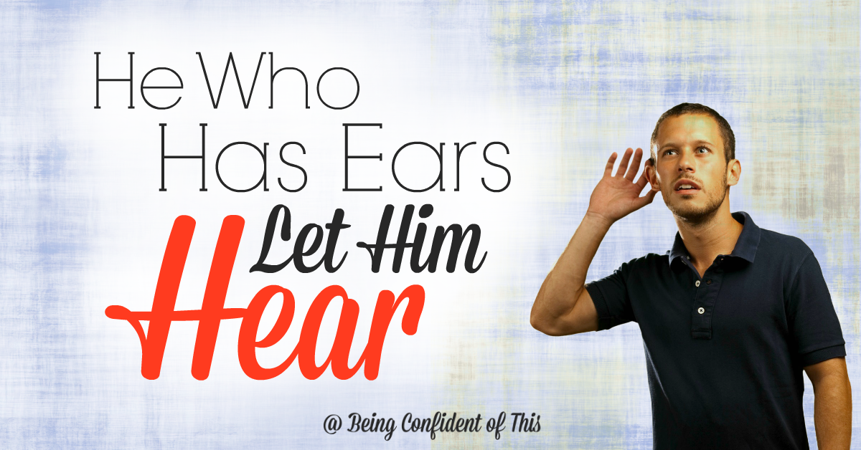
Jesus Give Me Ears to Hear
By Pastor Fee Soliven
Romans 10:10-17
Sunday Morning
October 27, 2019

Slide 4
Romans 10:10-17
10 For with the heart one believes unto righteousness, and with the mouth confession is made unto salvation. 11 For the Scripture says, "Whoever believes on Him will not be put to shame."

Slide 5
12 For there is no distinction between Jew and Greek, for the same Lord over all is rich to all who call upon Him. 13 For "whoever calls on the name of the LORD shall be saved." 14 How then shall they call on Him in whom they have not believed? And how shall they believe in Him of whom they have not heard? And how shall they hear without a preacher?

Slide 6
15 And how shall they preach unless they are sent? As it is written: "How beautiful are the feet of those who preach the gospel of peace, Who bring glad tidings of good things!" 16 But they have not all obeyed the gospel. For Isaiah says, "Lord, who has believed our report?" 17 So then faith comes by hearing, and hearing by the word of God.

Slide 7
Would you read the Bible more if you could understand it better?

Slide 8
Surprise

Slide 9
Exodus 3:1-4
1 Now Moses was tending the flock of Jethro his father-in-law, the priest of Midian. And he led the flock to the back of the desert, and came to Horeb, the mountain of God. 2 And the Angel of the LORD appeared to him in a flame of fire from the midst of a bush. So he looked, and behold, the bush was burning with fire, but the bush was not consumed.

Slide 10
3 Then Moses said, "I will now turn aside and see this great sight, why the bush does not burn." 4 So when the LORD saw that he turned aside to look, God called to him from the midst of the bush and said, "Moses, Moses!" And he said, "Here I am."

Slide 11
Personal

Slide 12
Exodus 3:10
“Come now, therefore, and I will send you to Pharaoh that you may bring My people, the children of Israel, out of Egypt."

Slide 13
Specific

Slide 14
Encouragement

Slide 15
“I will send you to Pharaoh”

Slide 16
Serious

Slide 17
Psalm 139:13-18
13 For You formed my inward parts; You covered me in my mother's womb. 14 I will praise You, for I am fearfully and wonderfully made; Marvelous are Your works, And that my soul knows very well. 15 My frame was not hidden from You, When I was made in secret, And skillfully wrought in the lowest parts of the earth.

Slide 18
16 Your eyes saw my substance, being yet unformed. And in Your book they all were written, The days fashioned for me, When as yet there were none of them. 17 How precious also are Your thoughts to me, O God! How great is the sum of them! 18 If I should count them, they would be more in number than the sand; When I awake, I am still with You.

Slide 19
Command

Slide 20
Exodus 3:11
But Moses said to God, "Who am I that I should go to Pharaoh, and that I should bring the children of Israel out of Egypt?"

Slide 21
2 Corinthians 5:7
“For we walk by faith, not by sight”

Slide 22
Acts 5:29
But Peter and the apostles answered, “We must obey God rather than men.

Slide 23
Inescapable

Slide 24
Ephesians 1:9-14
9 having made known to us the mystery of His will, according to His good pleasure which He purposed in Himself, 10 that in the dispensation of the fullness of the times He might gather together in one all things in Christ, both which are in heaven and which are on earth--in Him.

Slide 25
11 In Him also we have obtained an inheritance, being predestined according to the purpose of Him who works all things according to the counsel of His will, 12 that we who first trusted in Christ should be to the praise of His glory. 13 In Him you also trusted, after you heard the word of truth, the gospel of your salvation; in whom also, having believed, you were sealed with the Holy Spirit of promise,

Slide 26
14 who is the guarantee of our inheritance until the redemption of the purchased possession, to the praise of His glory.

Slide 27
Frightening

Slide 28
Exodus 3:14
“And God said to Moses, "I AM WHO I AM." And He said, "Thus you shall say to the children of Israel, 'I AM has sent me to you.”

Slide 29
1 Peter 2:9-10
9 But you are a chosen generation, a royal priesthood, a holy nation, His own special people, that you may proclaim the praises of Him who called you out of darkness into His marvelous light; 10 who once were not a people but are now the people of God, who had not obtained mercy but now have obtained mercy.

Slide 30
Promise

Slide 31
Exodus 3:12
“So He said, "I will certainly be with you. And this shall be a sign to you that I have sent you: When you have brought the people out of Egypt, you shall serve God on this mountain."

Slide 32
Hebrews 13:5
“Let your conduct be without covetousness; be content with such things as you have. For He Himself has said, "I will never leave you nor forsake you."

Slide 33
Assurance

Slide 34
Exodus 3:19-20
19 “But I know that the king of Egypt will not permit you to go, except under compulsion. 20 So I will stretch out My hand and strike Egypt with all My miracles which I shall do in the midst of it; and after that he will let you go”

Slide 35
Circumstances

Slide 36
1 Peter 5:7-10
7 casting all your care upon Him, for He cares for you. 8 Be sober, be vigilant; because your adversary the devil walks about like a roaring lion, seeking whom he may devour. 9 Resist him, steadfast in the faith, knowing that the same sufferings are experienced by your brotherhood in the world. 10 But may the God of all grace, who called us to His eternal glory by Christ Jesus, after you have suffered a while, perfect, establish, strengthen, and settle you.

Slide 37
Goal

Slide 38
Luke 4:18-19
18 "The Spirit of the LORD is upon Me, Because He has anointed Me To preach the gospel to the poor; He has sent Me to heal the brokenhearted, To proclaim liberty to the captives And recovery of sight to the blind, To set at liberty those who are oppressed; 19 To proclaim the acceptable year of the LORD."

Slide 39
Unforgettable

Slide 40
Exodus 3:15
“This is My name forever, and this is My memorial-name to all generations”

Slide 41
Reassuring

Slide 42
Exodus 3:21-22
21 And I will give this people favor in the sight of the Egyptians; and it shall be, when you go, that you shall not go empty-handed. 22 But every woman shall ask of her neighbor, namely, of her who dwells near her house, articles of silver, articles of gold, and clothing; and you shall put them on your sons and on your daughters. So you shall plunder the Egyptians."

Slide 43
John 10:27-30
27 My sheep hear My voice, and I know them, and they follow Me. 28 And I give them eternal life, and they shall never perish; neither shall anyone snatch them out of My hand. 29 My Father, who has given them to Me, is greater than all; and no one is able to snatch them out of My Father's hand. 30 I and My Father are one."

Slide 44
1. Do you find the Bible rather uninteresting?

Slide 45
2. If so, use the words listed above to help you find personal applications as you read.

Slide 46
3. Do you tend to open your Bible more frequently when you need help?

Slide 47
4. Although this is good, what are the advantages of reading Scripture regularly?

Slide 48
5. How would this help you learn to know, trust, and obey God more?

