Slide 3
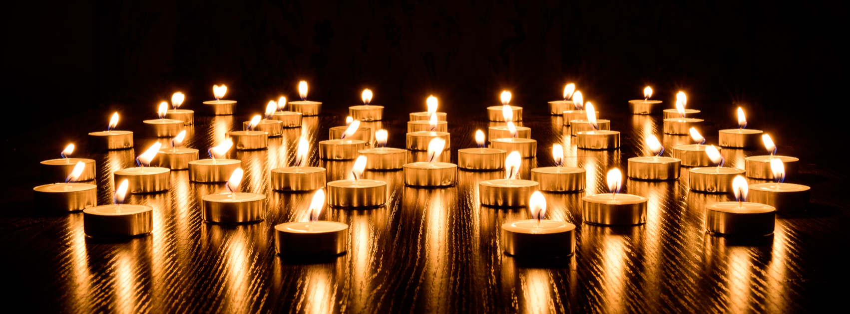
Jesus Keep My Fire Lit
By Pastor Fee Soliven
Romans 12:9-17
Sunday Morning
October 20, 2019

Slide 4
Romans 12:9-17
9 Love must be honest and true. Hate what is evil. Hold on to what is good. 10 Love each other deeply. Honor others more than yourselves. 11 Never let the fire in your heart go out. Keep it alive. Serve the Lord. 12 When you hope, be joyful. When you suffer, be patient. When you pray, be faithful. 13 Share with God's people who are in need. Welcome others into your homes.

Slide 5
14 Bless those who hurt you. Bless them, and do not call down curses on them. 15 Be joyful with those who are joyful. Be sad with those who are sad. 16 Agree with each other. Don't be proud. Be willing to be a friend of people who aren't considered important. Don't think that you are better than others. 17 Don't pay back evil with evil. Be careful to do what everyone thinks is right.

Slide 6
Psalm 25:8
“Good and upright is the LORD; Therefore He teaches sinners in the way.”

Slide 7
2 Timothy 3:16-17
16 All Scripture is given by inspiration of God, and is profitable for doctrine, for reproof, for correction, for instruction in righteousness, 17 that the man of God may be complete, thoroughly equipped for every good work.

Slide 8
Matthew 24:35
“Heaven and earth will pass away, but My words will by no means pass away.”

Slide 9
Ephesians 2:10
“For we are His workmanship, created in Christ Jesus for good works, which God prepared beforehand so that we would walk in them.”

Slide 10
Have you ever sensed you were hearing from God?

Slide 11
Exodus 3:4-6
4 So when the LORD saw that he turned aside to look, God called to him from the midst of the bush and said, "Moses, Moses!" And he said, "Here I am." 5 Then He said, "Do not draw near this place. Take your sandals off your feet, for the place where you stand is holy ground." 6 Moreover He said, "I am the God of your father--the God of Abraham, the God of Isaac, and the God of Jacob." And Moses hid his face, for he was afraid to look upon God.

Slide 12
It will be unexpected

Slide 13
It will be unique to us

Slide 14
It will challenge us to trust and Obey Him

Slide 15
It will prompt an Emotional Response

Slide 16
It will have a Powerful and Lasting Effect

Slide 17
A “burning bush” experience might be preceded by:

Slide 18
Circumstances not Working Out

Slide 19
Crisis

Slide 20
Discomfort

Slide 21
Proverbs 3:5-6
“Trust in the Lord with all your heart, and lean not on your own understanding; In all your ways acknowledge Him, and He shall direct your paths.”

Slide 22
We carry His Spirit within us and have access to His guidance, if we’re willing to listen

Slide 23
1. Stay Close to Jesus

Slide 24
James 4:8
“Draw near to God and He will draw near to you…”

Slide 25
2. Ask

Slide 26
Matthew 7:7-8
7 "Ask, and it will be given to you; seek, and you will find; knock, and it will be opened to you. 8 For everyone who asks receives, and he who seeks finds, and to him who knocks it will be opened.

Slide 27
James 4:2
“…Yet you do not have because you do not ask God…”

Slide 28
3. Be Patient

Slide 29
1 Thessalonians 5:14-15
14 Now we exhort you, brethren, warn those who are unruly, comfort the fainthearted, uphold the weak, be patient with all. 15 See that no one renders evil for evil to anyone, but always pursue what is good both for yourselves and for all.

Slide 30
4. Practice Surrender and Trust God Always

Slide 31
Proverbs 28:13
“Whoever conceals their sins does not prosper, but the one who confesses and renounces them finds mercy.”

Slide 32
Psalm 33:18-22
18 The Lord watches over those who obey him, those who trust in his constant love. 19 He saves them from death; he keeps them alive in times of famine. 20 We put our hope in the Lord; he is our protector and our help. 21 We are glad because of him; we trust in his holy name. 22 May your constant love be with us, Lord, as we put our hope in you.

Slide 33
5. Pay attention to your spirit

Slide 34
James 1:19
“Know this, my beloved brothers: let every person be quick to hear, slow to speak, slow to anger;”

Slide 35
Proverbs 20:27
“The spirit of man is the lamp of the Lord, searching all his innermost parts.”

Slide 36
6. Expect an Answer

Slide 37
1 John 5:14-15
14 And this is the confidence that we have toward him, that if we ask anything according to his will he hears us. 15 And if we know that he hears us in whatever we ask, we know that we have the requests that we have asked of him

Slide 38
7. If you’ve made a mistake in following God’s will, ask Him for help

Slide 39
Why should we seek God’s will for the life-path decisions we make?

Slide 40
He’s God

Slide 41
He’s omnipotent

Slide 42
He loves us

Slide 43
1 John 4:10-11
10 In this is love, not that we loved God, but that He loved us and sent His Son to be the propitiation for our sins. 11 Beloved, if God so loved us, we also ought to love one another.

Slide 44
It Glorifies Him

Slide 45
It becomes a Witness for Others

Slide 46
1. Has God ever spoken to you through a “burning bush” experience?

Slide 47
2. If so, what changed in your life as a result?

Slide 48
3. Why do you think God involves Himself in our lives at a personal level?

Slide 49
Ephesians 3:20
“Now to Him who is able to do exceedingly abundantly above all that we ask or think, according to the power that works in us…”

Slide 50
Romans 11:36
“For of Him and through Him and to Him are all things, to whom be glory forever. Amen.”

