Slide 3
They Chose Barabbas Over Jesus
By Pastor Fee Soliven
Mark 15:1-16
Wednesday Evening
October 23, 2019

Slide 4
1 Immediately, in the morning, the chief priests held a consultation with the elders and scribes and the whole council; and they bound Jesus, led Him away, and delivered Him to Pilate. 2 Then Pilate asked Him, "Are You the King of the Jews?" And He answered and said to him, "It is as you say."

Slide 5
3 And the chief priests accused Him of many things, but He answered nothing. 4 Then Pilate asked Him again, saying, "Do You answer nothing? See how many things they testify against You!" 5 But Jesus still answered nothing, so that Pilate marveled. 6 Now at the feast he was accustomed to releasing one prisoner to them, whomever they requested.

Slide 6
7 And there was one named Barabbas, who was chained with his fellow rebels; they had committed murder in the rebellion. 8 Then the multitude, crying aloud, began to ask him to do just as he had always done for them. 9 But Pilate answered them, saying, "Do you want me to release to you the King of the Jews?"

Slide 7
10 For he knew that the chief priests had handed Him over because of envy. 11 But the chief priests stirred up the crowd, so that he should rather release Barabbas to them. 12 Pilate answered and said to them again, "What then do you want me to do with Him whom you call the King of the Jews?"

Slide 8
13 So they cried out again, "Crucify Him!" 14 Then Pilate said to them, "Why, what evil has He done?" But they cried out all the more, "Crucify Him!" 15 So Pilate, wanting to gratify the crowd, released Barabbas to them; and he delivered Jesus, after he had scourged Him, to be crucified.

Slide 9
16 Then the soldiers led Him away into the hall called Praetorium, and they called together the whole garrison.

Slide 10
1 Immediately, in the morning, the chief priests held a consultation with the elders and scribes and the whole council; and they bound Jesus, led Him away, and delivered Him to Pilate.

Slide 11
2 Then Pilate asked Him, "Are You the King of the Jews?" And He answered and said to him, "It is as you say."

Slide 12
John 18:36
Jesus answered, "My kingdom is not of this world. If My kingdom were of this world, My servants would fight, so that I should not be delivered to the Jews; but now My kingdom is not from here."

Slide 13
Mark 14:62
And Jesus said, "I am. And you will see the Son of Man sitting at the right hand of the Power, and coming with the clouds of heaven."

Slide 14
3 And the chief priests accused Him of many things, but He answered nothing. 4 Then Pilate asked Him again, saying, "Do You answer nothing? See how many things they testify against You!" 5 But Jesus still answered nothing, so that Pilate marveled.

Slide 15
Luke 23:1-3
1 Then the whole multitude of them arose and led Him to Pilate. 2 And they began to accuse Him, saying, "We found this fellow perverting the nation, and forbidding to pay taxes to Caesar, saying that He Himself is Christ, a King." 3 Then Pilate asked Him, saying, "Are You the King of the Jews?" He answered him and said,
"It is as you say."

Slide 16
Isaiah 53:7
“He was oppressed and He was afflicted, Yet He opened not His mouth; He was led as a lamb to the slaughter, And as a sheep before its shearers is silent, So He opened not His mouth.

Slide 17
Luke 23:6-12
6 When Pilate heard of Galilee, he asked if the Man were a Galilean. 7 And as soon as he knew that He belonged to Herod's jurisdiction, he sent Him to Herod, who was also in Jerusalem at that time.

Slide 18
8 Now when Herod saw Jesus, he was exceedingly glad; for he had desired for a long time to see Him, because he had heard many things about Him, and he hoped to see some miracle done by Him. 9 Then he questioned Him with many words, but He answered him nothing.

Slide 19
10 And the chief priests and scribes stood and vehemently accused Him. 11 Then Herod, with his men of war, treated Him with contempt and mocked Him, arrayed Him in a gorgeous robe, and sent Him back to Pilate. 12 That very day Pilate and Herod became friends with each other, for previously they had been at enmity with each other.

Slide 20
6 Now at the feast he was accustomed to releasing one prisoner to them, whomever they requested. 7 And there was one named Barabbas, who was chained with his fellow rebels; they had committed murder in the rebellion.

Slide 21
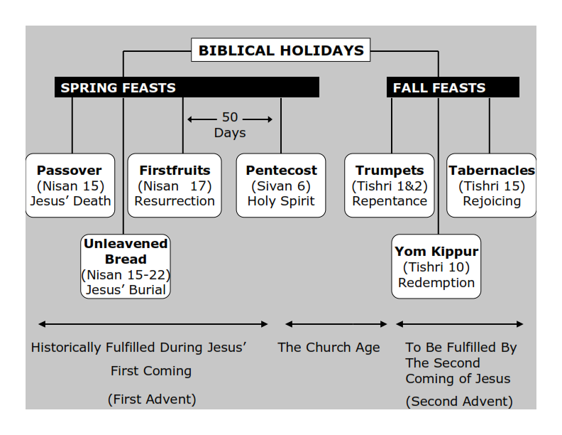
Philippians 3:20-21
20 For our citizenship is in heaven, from which we also eagerly wait for the Savior, the Lord Jesus Christ, 21 who will transform our lowly body that it may be conformed to His glorious body, according to the working by which He is able even to subdue all things to Himself.

Slide 22
8 Then the multitude, crying aloud, began to ask him to do just as he had always done for them.

Slide 23
9 But Pilate answered them, saying, "Do you want me to release to you the King of the Jews?" 10 For he knew that the chief priests had handed Him over because of envy.

Slide 24
Mark 15:2
Then Pilate asked Him, "Are You the King of the Jews?"

Slide 25
Mark 15:12
Pilate answered and said to them again, "What then do you want me to do with Him whom you call the King of the Jews?"

Slide 26
Mark 15:18
and began to salute Him, "Hail, King of the Jews!"

Slide 27
Mark 15:26
And the inscription of His accusation was written above: THE KING OF THE JEWS.

Slide 28
Mathew 23:29-33
29 Woe to you, scribes and Pharisees, hypocrites! Because you build the tombs of the prophets and adorn the monuments of the righteous, 30 and say, 'If we had lived in the days of our fathers, we would not have been partakers with them in the blood of the prophets.'

Slide 29
31 "Therefore you are witnesses against yourselves that you are sons of those who murdered the prophets. 32 Fill up, then, the measure of your fathers' guilt. 33 Serpents, brood of vipers! How can you escape the condemnation of hell?

Slide 30
11 But the chief priests stirred up the crowd, so that he should rather release Barabbas to them. 12 Pilate answered and said to them again, "What then do you want me to do with Him whom you call the King of the Jews?"

Slide 31
Luke 11:47-52
47 Woe to you! For you build the tombs of the prophets, and your fathers killed them. 48 In fact, you bear witness that you approve the deeds of your fathers; for they indeed killed them, and you build their tombs.

Slide 32
49 Therefore the wisdom of God also said, 'I will send them prophets and apostles, and some of them they will kill and persecute,' 50 that the blood of all the prophets which was shed from the foundation of the world may be required of this generation,

Slide 33
51 from the blood of Abel to the blood of Zechariah who perished between the altar and the temple. Yes, I say to you, it shall be required of this generation.

Slide 34
13 So they cried out again, "Crucify Him!"

Slide 35
John 10:14-18
14 I am the good shepherd; and I know My sheep, and am known by My own. 15 As the Father knows Me, even so I know the Father; and I lay down My life for the sheep. 16 And other sheep I have which are not of this fold; them also I must bring, and they will hear My voice; and there will be one flock and one shepherd.

Slide 36
17 Therefore My Father loves Me, because I lay down My life that I may take it again. 18 No one takes it from Me, but I lay it down of Myself. I have power to lay it down, and I have power to take it again. This command I have received from My Father."

Slide 37
14 Then Pilate said to them, "Why, what evil has He done?" But they cried out all the more, "Crucify Him!"

Slide 38
John 19:12
From then on Pilate sought to release Him, but the Jews cried out, saying, "If you let this Man go, you are not Caesar's friend. Whoever makes himself a king speaks against Caesar."

Slide 39
15 So Pilate, wanting to gratify the crowd, released Barabbas to them; and he delivered Jesus, after he had scourged Him, to be crucified.

Slide 40
Matthew 27:24
“When Pilate saw that he could not prevail at all, but rather that a tumult was rising, he took water and washed his hands before the multitude, saying, "I am innocent of the blood of this just Person. You see to it."

Slide 41
16 Then the soldiers led Him away into the hall called Praetorium, and they called together the whole garrison.

