Slide 3
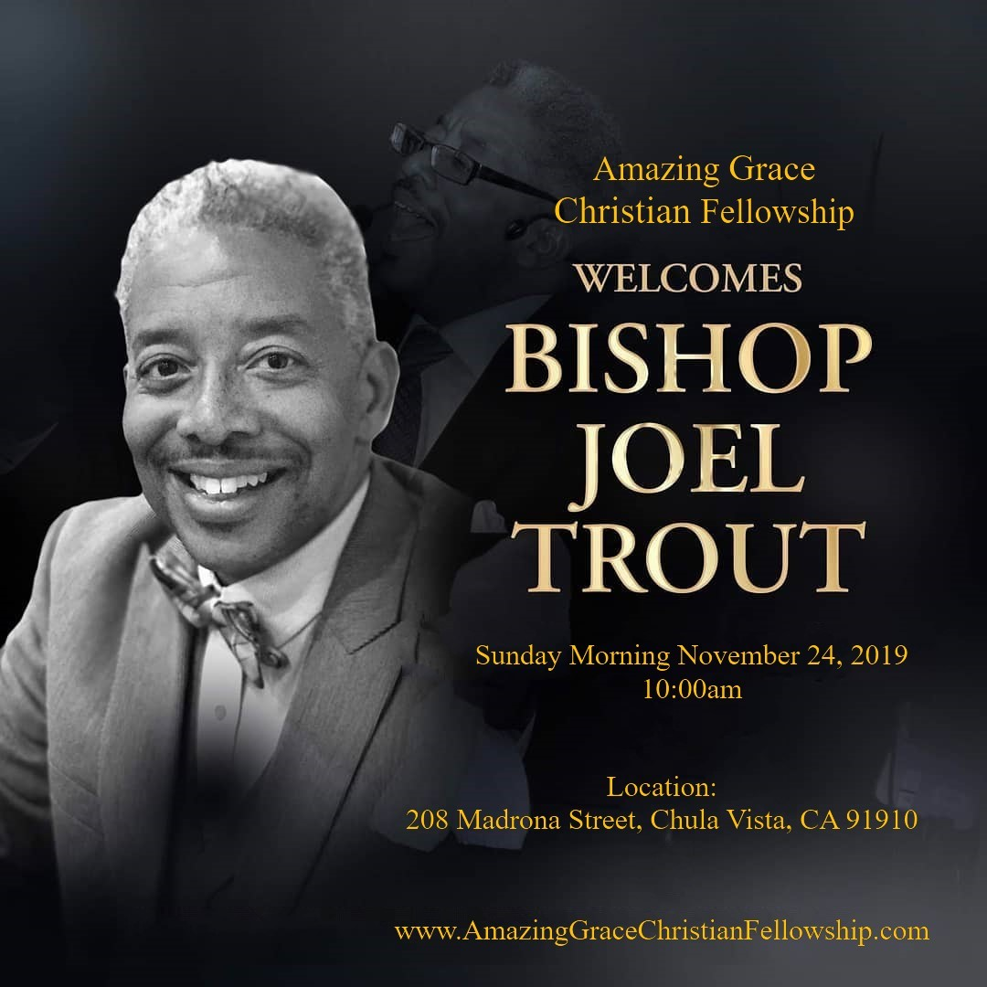

Slide 4
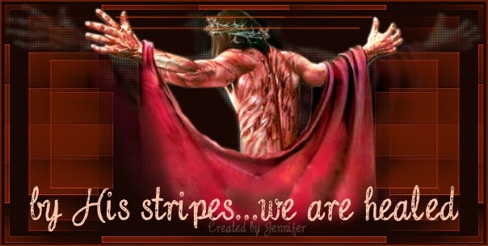
By His Stripes We Are Healed Pt. 2
By Pastor Fee Soliven
Isaiah 53:4-4
Sunday Morning
November 3, 2019

Slide 5
Isaiah 53:4-6
4 Surely He has borne our griefs And carried our sorrows; Yet we esteemed Him stricken, Smitten by God, and afflicted. 5 But He was wounded for our transgressions, He was bruised for our iniquities; The chastisement for our peace was upon Him, And by His stripes we are healed. 6 All we like sheep have gone astray; We have turned, every one, to his own way; And the LORD has laid on Him the iniquity of us all.

Slide 6
Healing is God’s will for Mankind

Slide 7
3 John 2
“Beloved, I pray that you may prosper in all things and be in health, just as your soul prospers”

Slide 8
Hosea 4:6
“My people are destroyed for a lack of knowledge…”

Slide 9
1 Peter 2:24
“who Himself bore our sins in His own body on the tree, that we, having died to sins, might live for righteousness—by whose stripes you were healed.”

Slide 10
Hebrews 1:3
“who being the brightness of His glory and the express image of His person, and upholding all things by the word of His power, when He had by Himself purged our sins, sat down at the right hand of the Majesty on high”

Slide 11
“The Perfect Representation”

Slide 12
Luke 6:17-19
17 And He came down with them and stood on a level place with a crowd of His disciples and a great multitude of people from all Judea and Jerusalem, and from the seacoast of Tyre and Sidon, who came to hear Him and be healed of their diseases,

Slide 13
18 as well as those who were tormented with unclean spirits. And they were healed. 19 And the whole multitude sought to touch Him, for power went out from Him and healed them all.

Slide 14
God’s Grace, God’s Medicine,
God’s Plan, God’s Report,
God’s Redemption, God’s Blessing

Slide 15
God’s Perfect Peace

Slide 16
John 14:1-6
1 "Let not your heart be troubled; you believe in God, believe also in Me. 2 In My Father's house are many mansions; if it were not so, I would have told you. I go to prepare a place for you. 3 And if I go and prepare a place for you, I will come again and receive you to Myself; that where I am, there you may be also.

Slide 17
4 And where I go you know, and the way you know." 5 Thomas said to Him, "Lord, we do not know where You are going, and how can we know the way?" 6 Jesus said to him, "I am the way, the truth, and the life. No one comes to the Father except through Me.

Slide 18
Isaiah 53:5
But He was wounded for our transgressions, He was bruised for our iniquities; The chastisement for our peace was upon Him, And by His stripes we are healed.

Slide 19
Romans 8:37-39
37 Yet in all these things we are more than conquerors through Him who loved us. 38 For I am persuaded that neither death nor life, nor angels nor principalities nor powers, nor things present nor things to come, 39 nor height nor depth, nor any other created thing, shall be able to separate us from the love of God which is in Christ Jesus our Lord.

Slide 20
God’s Works

Slide 21
John 14:12-14
12 "Most assuredly, I say to you, he who believes in Me, the works that I do he will do also; and greater works than these he will do, because I go to My Father. 13 And whatever you ask in My name, that I will do, that the Father may be glorified in the Son. 14 If you ask anything in My name, I will do it.

Slide 22
“If you ask anything in My name,
I will do it.”

Slide 23
John 15:7-8
7 If you abide in Me, and My words abide in you, you will ask what you desire, and it shall be done for you. 8 By this My Father is glorified, that you bear much fruit; so you will be My disciples.

Slide 24
John 16:24
“Until now you have asked nothing in My name. Ask, and you will receive, that your joy may be full.”

Slide 25
God’s Confidence

Slide 26
Hebrews 10:35-39
35 Therefore do not cast away your confidence, which has great reward. 36 For you have need of endurance, so that after you have done the will of God, you may receive the promise: 37 "For yet a little while, And He who is coming will come and will not tarry.

Slide 27
38 Now the just shall live by faith; But if anyone draws back, My soul has no pleasure in him." 39 But we are not of those who draw back to perdition, but of those who believe to the saving of the soul.

Slide 28
Matthew 6:7-8
7 And when you pray, do not use vain repetitions as the heathen do. For they think that they will be heard for their many words. 8 Therefore do not be like them. For your Father knows the things you have need of before you ask Him

Slide 29
Mark 11:24
“Therefore, I say to you, whatever things you ask when you pray, believe that you receive them, and you will have them.”

Slide 30
God’s Eternal Instruction

Slide 31
James 5:13-15
13 Is anyone among you suffering? Let him pray. Is anyone cheerful? Let him sing psalms. 14 Is anyone among you sick? Let him call for the elders of the church, and let them pray over him, anointing him with oil in the name of the Lord. 15 And the prayer of faith will save the sick, and the Lord will raise him up. And if he has committed sins, he will be forgiven.

Slide 32
“if it be Thy will” prayers

Slide 33
“If it be Thy will” prayers are only disguises for doubt and unbelief

Slide 34
“Father, I know that You have provided for my healing, and I know that You want me to recover fully. I ask for and receive by faith Your healing power into my body.”

Slide 35
God’s Price

Slide 36
Isaiah 53:5
“But He was wounded for our transgressions, He was bruised for our iniquities; The chastisement for our peace was upon Him, And by His stripes we are healed”

Slide 37
1 Peter 2:23-24
23 “when He was reviled, did not revile in return; when He suffered, He did not threaten, but committed Himself to Him who judges righteously; 24 who Himself bore our sins in His own body on the tree, that we, having died to sins, might live for righteousness--by whose stripes you were healed.”

Slide 38
Psalm 34:19
“Many are the afflictions of the righteous, But the LORD delivers him out of them all”

Slide 39
Psalm 103:1-5
1 Bless the LORD, O my soul; And all that is within me, bless His holy name! 2 Bless the LORD, O my soul, And forget not all His benefits: 3 Who forgives all your iniquities, Who heals all your diseases, 4 Who redeems your life from destruction, Who crowns you with lovingkindness and tender mercies, 5 Who satisfies your mouth with good things, So that your youth is renewed like the eagle's.

Slide 40
God’s Plan

Slide 41
1 John 3:8
“He who sins is of the devil, for the devil has sinned from the beginning. For this purpose the Son of God was manifested, that He might destroy the works of the devil.”

Slide 42
God’s Promise

Slide 43
James 4:7
“Therefore, submit to God. Resist the devil and he will flee from you”

Slide 44
God’s Ultimate Protection for Us!

Slide 45
Psalm 91:1-11
1 He who dwells in the secret place of the Most High Shall abide under the shadow of the Almighty. 2 I will say of the LORD, "He is my refuge and my fortress; My God, in Him I will trust." 3 Surely He shall deliver you from the snare of the fowler And from the perilous pestilence.

Slide 46
4 He shall cover you with His feathers, And under His wings you shall take refuge; His truth shall be your shield and buckler. 5 You shall not be afraid of the terror by night, Nor of the arrow that flies by day, 6 Nor of the pestilence that walks in darkness, Nor of the destruction that lays waste at noonday.

Slide 47
7 A thousand may fall at your side, And ten thousand at your right hand; But it shall not come near you. 8 Only with your eyes shall you look, And see the reward of the wicked. 9 Because you have made the LORD, who is my refuge, Even the Most High, your dwelling place, 10 No evil shall befall you, Nor shall any plague come near your dwelling; 11 For He shall give His angels charge over you, To keep you in all your ways.

Slide 48
Declaration of Faith
Jesus redeemed me from the curse of the Law, and I walk in all of the blessings of God. These blessings include divine health. I refuse to allow sickness to come on me. I overcome all sickness and disease through the blood of Jesus.

