Slide 1


Slide 2


Slide 3
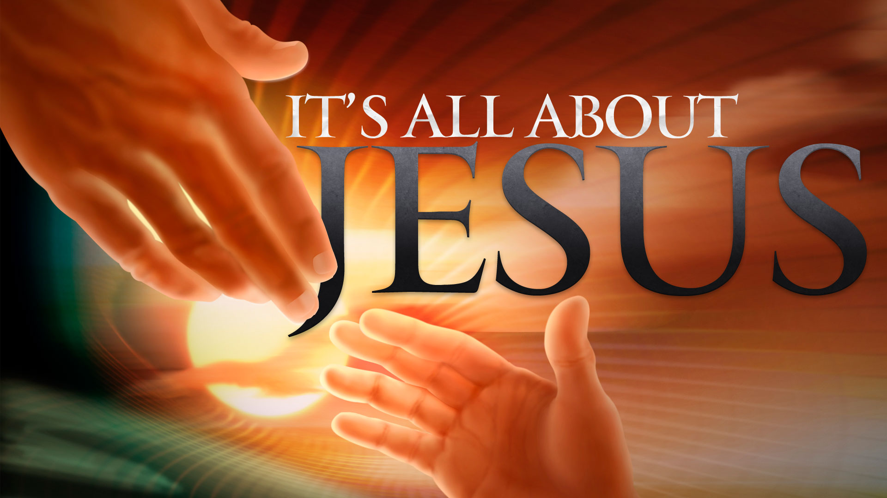

2 Thessalonians Introduction
By Pastor Fee Soliven
Wednesday Evening
February 26, 2020

Slide 4
Purpose
To clear the purpose of the second coming of Christ
Author
Paul

Slide 5
Audience
The Church at Thessalonica and all believers everywhere
Date Written
Approximately A.D. 51 from Corinth 2nd of Paul’s letters to this Church

Slide 6
Setting
The Church at Thessalonica was a very young Church only been established only a few short years after this Church was established. The Thessalonians Christians had to mature in their faith. In addition there was a misunderstanding on the second coming of Christ. Some thought Christ would return immediately and thus were so confused when their loved ones died before hand. Also they were heavily persecuted.

Slide 7
Key Verse
2 Thessalonians 3:5
“Now may the Lord direct your hearts into the love of God and into the patience of Christ”

Slide 8
Key People
Paul, Silas and Timothy
Special Features
This is a follow up second letter from
1 Thessalonians. In this letter, Paul indicates various events that must precede the second coming of Christ.

Slide 9
Introduction
“BUT I thought he said . . . ,” “I’m sure he meant . . . ,” “It is clear to me that we should . . . ,” “I disagree. I think we must . . .”

Slide 10
God Will Repay
by Pastor Fee Soliven
2 Thessalonians 1:1-12
Wednesday Evening
February 26, 2020

Slide 11
1 Paul, Silvanus, and Timothy, To the church of the Thessalonians in God our Father and the Lord Jesus Christ: 2 Grace to you and peace from God our Father and the Lord Jesus Christ. 3 We are bound to thank God always for you, brethren, as it is fitting, because your faith grows exceedingly, and the love of every one of you all abounds toward each other,

Slide 12
4 so that we ourselves boast of you among the churches of God for your patience and faith in all your persecutions and tribulations that you endure, 5 which is manifest evidence of the righteous judgment of God, that you may be counted worthy of the kingdom of God, for which you also suffer;

Slide 13
6 since it is a righteous thing with God to repay with tribulation those who trouble you, 7 and to give you who are troubled rest with us when the Lord Jesus is revealed from heaven with His mighty angels, 8 in flaming fire taking vengeance on those who do not know God, and on those who do not obey the gospel of our Lord Jesus Christ.

Slide 14
9 These shall be punished with everlasting destruction from the presence of the Lord and from the glory of His power, 10 when He comes, in that Day, to be glorified in His saints and to be admired among all those who believe, because our testimony among you was believed.

Slide 15
11 Therefore we also pray always for you that our God would count you worthy of this calling, and fulfill all the good pleasure of His goodness and the work of faith with power, 12 that the name of our Lord Jesus Christ may be glorified in you, and you in Him, according to the grace of our God and the Lord Jesus Christ.

Slide 16
1 Paul, Silvanus, and Timothy, To the church of the Thessalonians in God our Father and the Lord Jesus Christ:

Slide 17
Acts 15:32
“Now Judas and Silas, themselves being prophets also, exhorted and strengthened the brethren with many words”

Slide 18
Acts 15:40
“but Paul chose Silas and departed, being commended by the brethren to the grace of God”

Slide 19
2 Corinthians 1:19
“For the Son of God, Jesus Christ, who was preached among you by us--by me, Silvanus, and Timothy--was not Yes and No, but in Him was Yes”

Slide 20
Acts 18:5
“When Silas and Timothy had come from Macedonia, Paul was compelled by the Spirit, and testified to the Jews that Jesus is the Christ”

Slide 21
2 Grace to you and peace from God our Father and the Lord Jesus Christ.

Slide 22
“Grace” is God’s unmerited favor bestowed upon sinful people; “peace” refers to the peace that Christ made between believers and God through his death on the cross.

Slide 23
3 We are bound to thank God always for you, brethren, as it is fitting, because your faith grows exceedingly, and the love of every one of you all abounds toward each other,

Slide 24
1 Thessalonians 3:9-13
9 For what thanks can we render to God for you, for all the joy with which we rejoice for your sake before our God, 10 night and day praying exceedingly that we may see your face and perfect what is lacking in your faith?

Slide 25
11 Now may our God and Father Himself, and our Lord Jesus Christ, direct our way to you. 12 And may the Lord make you increase and abound in love to one another and to all, just as we do to you, 13 so that He may establish your hearts blameless in holiness before our God and Father at the coming of our Lord Jesus Christ with all His saints

Slide 26
4 so that we ourselves boast of you among the churches of God for your patience and faith in all your persecutions and tribulations
that you endure,

Slide 27
1 Thessalonians 1:7-10
7 so that you became examples to all in Macedonia and Achaia who believe. 8 For from you the word of the Lord has sounded forth, not only in Macedonia and Achaia, but also in every place. Your faith toward God has gone out, so that we do not need to say anything.

Slide 28
9 For they themselves declare concerning us what manner of entry we had to you, and how you turned to God from idols to serve the living and true God, 10 and to wait for His Son from heaven, whom He raised from the dead, even Jesus who delivers us from the wrath to come.

Slide 29
5 which is manifest evidence of the righteous judgment of God, that you may be counted worthy of the kingdom of God, for which you also suffer; 6 since it is a righteous thing with God to repay with tribulation those who trouble you,

Slide 30
John 15:20-21
20 Remember the word that I said to you, 'A servant is not greater than his master.' If they persecuted Me, they will also persecute you. If they kept My word, they will keep yours also. 21 But all these things they will do to you for My name's sake, because they do not know Him who sent Me.

Slide 31
Psalm 94:23
“He has brought on them their own iniquity, And shall cut them off in their own wickedness; The LORD our God shall cut them off”

Slide 32
Psalm 37:9-11
9 For evildoers shall be cut off; But those who wait on the LORD, They shall inherit the earth. 10 For yet a little while and the wicked shall be no more; Indeed, you will look carefully for his place, But it shall be no more. 11 But the meek shall inherit the earth, And shall delight themselves in the abundance of peace.

Slide 33
7 and to give you who are troubled rest with us when the Lord Jesus is revealed from heaven with His mighty angels, 8 in flaming fire taking vengeance on those who do not know God, and on those who do not obey the gospel of our Lord Jesus Christ.

Slide 34
So, when will this happen?

Slide 35
Exodus 13:21
“And the LORD went before them by day in a pillar of cloud to lead the way, and by night in a pillar of fire to give them light, so as to go by day and night”

Slide 36
Isaiah 66:15
“For behold, the LORD will come with fire And with His chariots, like a whirlwind, To render His anger with fury, And His rebuke with flames of fire”

Slide 37
Matthew 25:31-34
31 "When the Son of Man comes in His glory, and all the holy angels with Him, then He will sit on the throne of His glory. 32 All the nations will be gathered before Him, and He will separate them one from another, as a shepherd divides his sheep from the goats.

Slide 38
33 And He will set the sheep on His right hand, but the goats on the left. 34 Then the King will say to those on His right hand, 'Come, you blessed of My Father, inherit the kingdom prepared for you from the foundation of the world:

Slide 39
Matthew 25:41-46
41 "Then He will also say to those on the left hand, 'Depart from Me, you cursed, into the everlasting fire prepared for the devil and his angels: 42 for I was hungry and you gave Me no food; I was thirsty and you gave Me no drink; 43 I was a stranger and you did not take Me in, naked and you did not clothe Me, sick and in prison and you did not visit Me.'

Slide 40
44 "Then they also will answer Him, saying, 'Lord, when did we see You hungry or thirsty or a stranger or naked or sick or in prison, and did not minister to You?' 45 "Then He will answer them, saying, 'Assuredly, I say to you, inasmuch as you did not do it to one of the least of these, you did not do it to Me.' 46 "And these will go away into everlasting punishment, but the righteous into eternal life."

Slide 41
9 These shall be punished with everlasting destruction from the presence of the Lord and from the glory of His power, 10 when He comes, in that Day, to be glorified in His saints and to be admired among all those who believe, because our testimony among you was believed.

Slide 42
11 Therefore we also pray always for you that our God would count you worthy of this calling, and fulfill all the good pleasure of His goodness and the work of faith with power, 12 that the name of our Lord Jesus Christ may be glorified in you, and you in Him, according to the grace of our God and the Lord Jesus Christ.

Slide 43
1 Thessalonians 1:4-5
4 knowing, beloved brethren, your election by God. 5 For our gospel did not come to you in word only, but also in power, and in the Holy Spirit and in much assurance, as you know what kind of men we were among you for your sake.

Slide 44
Romans 8:29
“For whom He foreknew, He also predestined to be conformed to the image of His Son, that He might be the firstborn among many brethren”

