Slide 1


Slide 2
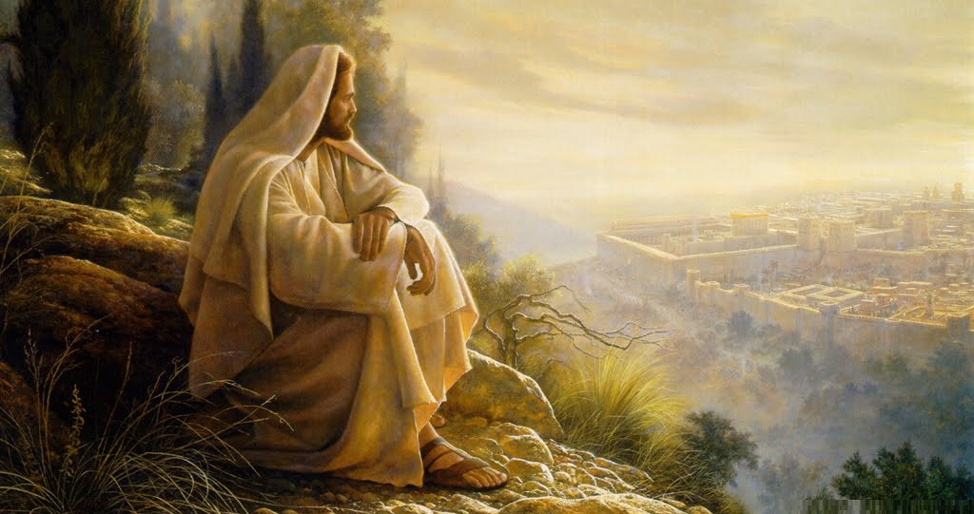

God Take Away My Fears
By Pastor Fee Soliven
Matthew 14:22-27
Sunday Morning
March 22, 2020

Slide 3
Matthew 14:22-27
22 Immediately Jesus made His disciples get into the boat and go before Him to the other side, while He sent the multitudes away. 23 And when He had sent the multitudes away, He went up on the mountain by Himself to pray. Now when evening came, He was alone there. 24 But the boat was now in the middle of the sea, tossed by the waves, for the wind was contrary.

Slide 4
25 Now in the fourth watch of the night Jesus went to them, walking on the sea. 26 And when the disciples saw Him walking on the sea, they were troubled, saying, "It is a ghost!" And they cried out for fear. 27 But immediately Jesus spoke to them, saying, "Be of good cheer! It is I; do not be afraid."

Slide 5
Stress is a killer, but we can’t escape it since we’re surrounded by distressing situations of all kinds

Slide 6
How are we going to handle it?

Slide 7
Philippians 4:6-7
6 Be anxious for nothing, but in everything by prayer and supplication, with thanksgiving, let your requests be made known to God; 7 and the peace of God, which surpasses all understanding, will guard your hearts and minds through Christ Jesus.

Slide 8
Jesus also experienced stress, but He knew exactly how to handle it

Slide 9
Matthew 14:22-23
22 Immediately Jesus made His disciples get into the boat and go before Him to the other side, while He sent the multitudes away. 23 And when He had sent the multitudes away, He went up on the mountain by Himself to pray. Now when evening came, He was alone there.

Slide 10
Galatians 1:15-17
15 But when it pleased God, who separated me from my mother's womb and called me through His grace, 16 to reveal His Son in me, that I might preach Him among the Gentiles, I did not immediately confer with flesh and blood,

Slide 11
17 nor did I go up to Jerusalem to those who were apostles before me; but I went to Arabia, and returned again to Damascus.

Slide 12
1. The Practice of Solitude

Slide 13
Psalm 51:1-13
1 Have mercy upon me, O God, According to Your lovingkindness;
According to the multitude of Your tender mercies, Blot out my transgressions. 2 Wash me thoroughly from my iniquity, And cleanse me from my sin.

Slide 14
3 For I acknowledge my transgressions, And my sin is always before me. 4 Against You, You only, have I sinned, And done this evil in Your sight--That You may be found just when You speak, And blameless when You judge.

Slide 15
5 Behold, I was brought forth in iniquity, And in sin my mother conceived me. 6 Behold, You desire truth in the inward parts, And in the hidden part You will make me to know wisdom.

Slide 16
7 Purge me with hyssop, and I shall be clean; Wash me, and I shall be whiter than snow. 8 Make me to hear joy and gladness, That the bones You have broken may rejoice. 9 Hide Your face from my sins, And blot out all my iniquities.

Slide 17
10 Create in me a clean heart, O God, And renew a steadfast spirit within me. 11 Do not cast me away from Your presence, And do not take Your Holy Spirit from me. 12 Restore to me the joy of Your salvation, And uphold me by Your generous Spirit. 13 Then I will teach transgressors Your ways, And sinners shall be converted to You.

Slide 18
2. Reasons for Solitude

Slide 19
For a Relationship

Slide 20
Genesis 1:26
26 Then God said, "Let Us make man in Our image, according to Our likeness; let them have dominion over the fish of the sea, over the birds of the air, and over the cattle, over all the earth and over every creeping thing that creeps on the earth."

Slide 21
Romans 5:7-8
7 For scarcely for a righteous man will one die; yet perhaps for a good man someone would even dare to die. 8 But God demonstrates His own love toward us, in that while we were still sinners, Christ died for us.

Slide 22
For Preparation

Slide 23
Experiencing Solitude

Slide 24
By opening God’s Word to focus on Him

Slide 25
Joshua 1:8
“This Book of the Law shall not depart from your mouth, but you shall meditate in it day and night, that you may observe to do according to all that is written in it. For then you will make your way prosperous, and then you will have good success”

Slide 26
Psalm 16:11
“You will show me the path of life; In Your presence is fullness of joy; At Your right hand are pleasures forevermore.”

Slide 27
By Eliminating Distractions

Slide 28
2 Corinthians 10:4-6
4 For the weapons of our warfare are not carnal but mighty in God for pulling down strongholds, 5 casting down arguments and every high thing that exalts itself against the knowledge of God, bringing every thought into captivity to the obedience of Christ, 6 and being ready to punish all disobedience when your obedience is fulfilled.

Slide 29
Benefits of Solitude

Slide 30
1. Makes our Busy Days More Fruitful

Slide 31
Colossians 1:10
“that you may have a walk worthy of the Lord, fully pleasing Him, being fruitful in every good work and increasing in the knowledge of God”

Slide 32
2. Repairs Damage

Slide 33
Acts 3:19
“Repent therefore and be converted, that your sins may be blotted out, so that times of refreshing may come from the presence of the Lord”

Slide 34
3. Equips us to Face the Tough Days

Slide 35
4. Creates Surprising Moments

Slide 36
5. Strips us of Pride

Slide 37
6. Protects Health

Slide 38
7. Makes a Difference in Relationships

Slide 39
8. Gives Peace and Joy

Slide 40
9. Gives Greater Strength from the Lord

Slide 41
10. Produces Greater Trust in God

Slide 42
11. Develops a Deeper Relationship with the Lord

Slide 43
1. How do you normally handle stress in your life?

Slide 44
2. In what way is solitude different from another form of stress relief you’ve experienced?

Slide 45
3. Have you ever practiced solitude with God as a solution to stress?

Slide 46
4. What benefits have become evident from your practice of solitude?

Slide 47
5. Would you recommend it to others who are dealing with stress?

Slide 48
Donate at:
www.paypal.com
amazing_grace@cox.net

