Slide 1

“For the Joy of the Lord is your Strength”
Nehemiah 8:10

Slide 2


Slide 3
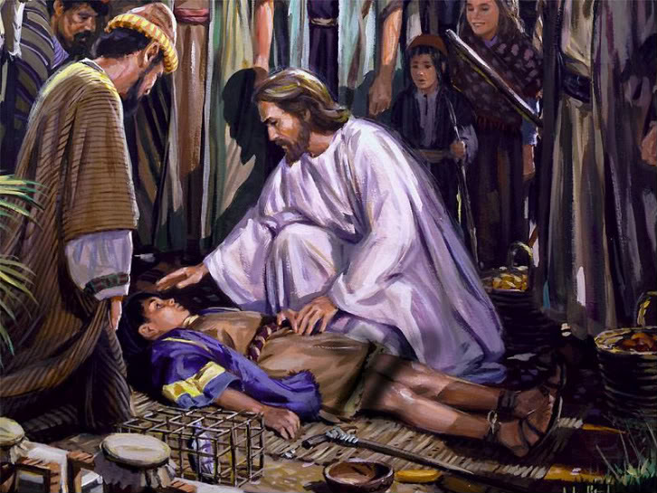

Jesus Comfort Us During This Affliction
by Pastor Fee Soliven
Isaiah 40:1-2
Wednesday Evening
March 25, 2020

Slide 4
Isaiah 40:1-2
1 "Comfort, yes, comfort My people!" Says your God. 2 "Speak comfort to Jerusalem, and cry out to her, That her warfare is ended, That her iniquity is pardoned; For she has received from the LORD's hand Double for all her sins."

Slide 5
Many people today are crying out for comfort but don’t know where to find it or how to receive it.

Slide 6
The Lord comforts His people by reminding them of His promises, attributes, and love

Slide 7
1. Although situations constantly change, the Word of God stands forever

Slide 8
Isaiah 40:8
"The grass withers, the flower fades, But the word of our God stands forever."

Slide 9
2. Like a shepherd, the Lord tends, gathers, carries, and gently leads His people

Slide 10
Isaiah 40:11
He will feed His flock like a shepherd; He will gather the lambs with His arm, And carry them in His bosom, And gently lead those who are with young.

Slide 11
3. The greatness of God’s power and knowledge are displayed in His creation

Slide 12
Isaiah 40:12-13
12 Who has measured the waters in the hollow of His hand, Measured heaven with a span And calculated the dust of the earth in a measure? Weighed the mountains in scales And the hills in a balance? 13 Who has directed the Spirit of the LORD, Or as His counselor has taught Him?

Slide 13
4. Jesus is sovereign over all the events on earth

Slide 14
Isaiah 40:21-23
21 Have you not known? Have you not heard? Has it not been told you from the beginning? Have you not understood from the foundations of the earth?

Slide 15
22 It is He who sits above the circle of the earth, And its inhabitants are like grasshoppers, Who stretches out the heavens like a curtain, And spreads them out like a tent to dwell in. 23 He brings the princes to nothing; He makes the judges of the earth useless.

Slide 16
5. He gives strength to those who are weary.

Slide 17
Isaiah 40:29-31
29 He gives power to the weak, And to those who have no might He increases strength. 30 Even the youths shall faint and be weary, And the young men shall utterly fall, 31 But those who wait on the LORD Shall renew their strength; They shall mount up with wings like eagles, They shall run and not be weary, They shall walk and not faint.

Slide 18
2 Corinthians 1:3-7
3 Blessed be the God and Father of our Lord Jesus Christ, the Father of mercies and God of all comfort, 4 who comforts us in all our tribulation, that we may be able to comfort those who are in any trouble, with the comfort with which we ourselves are comforted by God.

Slide 19
5 For as the sufferings of Christ abound in us, so our consolation also abounds through Christ.
6 Now if we are afflicted, it is for your consolation and salvation, which is effective for enduring the same sufferings which we also suffer. Or if we are comforted, it is for your consolation and salvation.

Slide 20
7 And our hope for you is steadfast, because we know that as you are partakers of the sufferings, so also you will partake of the consolation.

Slide 21
What is Comfort?

Slide 22
John 14:16
"And I will pray the Father, and he shall give you another Comforter, that he may abide with you forever"

Slide 23
John 14:26
"But the Comforter, which is the Holy Ghost, whom the Father will send in my name, he shall teach you all things, and bring all things to your remembrance, whatsoever I have said unto you."

Slide 24
The Holy Spirit Seals Believers

Slide 25
Ephesians 1:11-14
11 In Him also we have obtained an inheritance, being predestined according to the purpose of Him who works all things according to the counsel of His will, 12 that we who first trusted in Christ should be to the praise of His glory.

Slide 26
13 In Him you also trusted, after you heard the word of truth, the gospel of your salvation; in whom also, having believed, you were sealed with the Holy Spirit of promise, 14 who is the guarantee of our inheritance until the redemption of the purchased possession, to the praise of His glory.

Slide 27
What is the Source of our Comfort?

Slide 28
1 Corinthians 10:12-13
12 Therefore let him who thinks he stands take heed lest he fall. 13 No temptation has overtaken you except such as is common to man; but God is faithful, who will not allow you to be tempted beyond what you are able, but with the temptation will also make the way of escape, that you may be able to bear it.

Slide 29
Romans 8:28
"And we know that all things work together for good to those who love God, to those who are the called according to His purpose."

Slide 30
How Does God Comfort Us?

Slide 31
Psalm 119:49-50
49 Remember the word to Your servant, Upon which You have caused me to hope. 50 This is my comfort in my affliction, For Your word has given me life.

Slide 32
How can we find comforting Scripture verses?

Slide 33
1. Read the Bible Daily

Slide 34
Psalm 119:105
"Thy word is a lamp unto my feet, and a light unto my path."

Slide 35
Isaiah 41:9-10
9 You whom I have taken from the ends of the earth, And called from its farthest regions, And said to you, 'You are My servant, I have chosen you and have not cast you away: 10 Fear not, for I am with you; Be not dismayed, for I am your God. I will strengthen you, Yes, I will help you, I will uphold you with My righteous right hand.'

Slide 36
2. Ask God for Help!

Slide 37
Psalm 46:1-4
1 God is our refuge and strength, A very present help in trouble. 2 Therefore we will not fear, Even though the earth be removed, And though the mountains be carried into the midst of the sea; 3 Though its waters roar and be troubled, Though the mountains shake with its swelling.

Slide 38
4 There is a river whose streams shall make glad the city of God, The holy place of the tabernacle of the Most High

Slide 39
3. Choose to memorize God's Word and Hide it in your Heart!

Slide 40
Psalm 119:9-16
9 How can a young man cleanse his way? By taking heed according to Your word. 10 With my whole heart I have sought You; Oh, let me not wander from Your commandments! 11 Your word I have hidden in my heart, That I might not sin against You!

Slide 41
12 Blessed are You, O LORD! Teach me Your statutes! 13 With my lips I have declared All the judgments of Your mouth. 14 I have rejoiced in the way of Your testimonies, As much as in all riches. 15 I will meditate on Your precepts, And contemplate Your ways. 16 I will delight myself in Your statutes; I will not forget Your word.

Slide 42
4. You have to Believe God Does Care For Us!

Slide 43
Psalm 55:22
“Cast your burden on the LORD, And He shall sustain you; He shall never permit the righteous to be moved”

Slide 44
1 Peter 5:6-11
6 Therefore humble yourselves under the mighty hand of God, that He may exalt you in due time, 7 casting all your care upon Him, for He cares for you. 8 Be sober, be vigilant; because your adversary the devil walks about like a roaring lion, seeking whom he may devour.

Slide 45
9 Resist him, steadfast in the faith, knowing that the same sufferings are experienced by your brotherhood in the world. 10 But may the God of all grace, who called us to His eternal glory by Christ Jesus, after you have suffered a while, perfect, establish, strengthen, and settle you. 11 To Him be the glory and the dominion forever and ever. Amen

Slide 46
5. God Will Stick Closer Than A Brother!

Slide 47
Proverbs 18:24
“A man who has friends must himself be friendly, But there is a friend who sticks closer than a brother”

Slide 48
Hebrews 13:5-6
5 Let your conduct be without covetousness; be content with such things as you have. For He Himself has said, "I will never leave you nor forsake you." 6 So we may boldly say: "The LORD is my helper; I will not fear. What can man do to me?"

Slide 49
6. Jesus Will Comfort Us!

Slide 50
1 Thessalonians 3:7-13
7 therefore, brethren, in all our affliction and distress we were comforted concerning you by your faith. 8 For now we live, if you stand fast in the Lord. 9 For what thanks can we render to God for you, for all the joy with which we rejoice for your sake before our God,

Slide 51
10 night and day praying exceedingly that we may see your face and perfect what is lacking in your faith? 11 Now may our God and Father Himself, and our Lord Jesus Christ, direct our way to you. 12 And may the Lord make you increase and abound in love to one another and to all, just as we do to you,

Slide 52
13 so that He may establish your hearts blameless in holiness before our God and Father at the coming of our Lord Jesus Christ with all His saints.

Slide 53
“For the Joy of the Lord is your Strength”
Nehemiah 8:10

