Slide 1


Slide 2


Slide 3
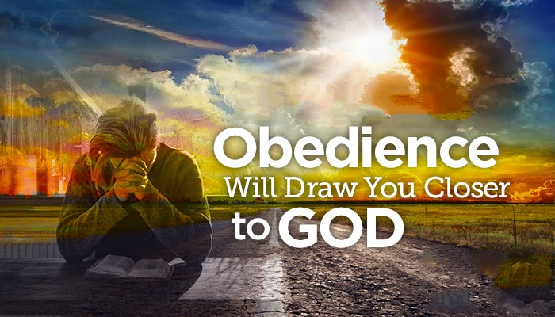

Obey God or Rebel Your Choice
By Pastor Fee Soliven
Hebrews 13:15-17
Sunday Morning
March 8, 2020

Slide 4
Hebrews 13:15-17
15 Therefore by Him let us continually offer the sacrifice of praise to God, that is, the fruit of our lips, giving thanks to His name. 16 But do not forget to do good and to share, for with such sacrifices God is well pleased. 17 Obey those who rule over you, and be submissive, for they watch out for your souls, as those who must give account. Let them do so with joy and not with grief, for that would be unprofitable for you.

Slide 5
To the best of your knowledge, are you fully surrendered to Our Lord Jesus Christ?

Slide 6
A Surrendered life begins at Salvation

Slide 7
Proverbs 22:4-5
“By humility and the fear of the LORD Are riches and honor and life. 5 Thorns and snares are in the way of the perverse; He who guards his soul will be far from them”

Slide 8
Romans 6:12-14
12 Therefore do not let sin reign in your mortal body, that you should obey it in its lusts. 13 And do not present your members as instruments of unrighteousness to sin, but present yourselves to God as being alive from the dead, and your members as instruments of righteousness to God. 14 For sin shall not have dominion over you, for you are not under law but under grace.

Slide 9
Ephesians 2:8-10
8 For by grace you have been saved through faith, and that not of yourselves; it is the gift of God, 9 not of works, lest anyone should boast. 10 For we are His workmanship, created in Christ Jesus for good works, which God prepared beforehand that we should walk in them.

Slide 10
1 Peter 4:17-19
17 For the time has come for judgment to begin at the house of God; and if it begins with us first, what will be the end of those who do not obey the gospel of God? 18 Now "If the righteous one is scarcely saved, Where will the ungodly and the sinner appear?" 19 Therefore let those who suffer according to the will of God commit their souls to Him in doing good, as to a faithful Creator.

Slide 11
Full Surrender is God’s perfect will for our Lives

Slide 12
Romans 12:1-2
1 I beseech you therefore, brethren, by the mercies of God, that you present your bodies a living sacrifice, holy, acceptable to God, which is your reasonable service. 2 And do not be conformed to this world, but be transformed by the renewing of your mind, that you may prove what is that good and acceptable and perfect will of God.

Slide 13
Jesus Christ is the perfect example of Full Surrender

Slide 14
Luke 22:42
“Father, if you are willing, remove this cup from Me; yet not My will, but Yours be done”

Slide 15
2 Corinthians 5:21
“For He made Him who knew no sin to be sin for us, that we might become the righteousness of God in Him”

Slide 16
Philippians 2:5-8
5 Let this mind be in you which was also in Christ Jesus, 6 who, being in the form of God, did not consider it robbery to be equal with God, 7 but made Himself of no reputation, taking the form of a bondservant, and coming in the likeness of men. 8 And being found in appearance as a man, He humbled Himself and became obedient to the point of death, even the death of the cross.

Slide 17
This is the same kind of attitude we should have—not my will, but Yours be done

Slide 18
2 Corinthians 13:4-6
4 For though He was crucified in weakness, yet He lives by the power of God. For we also are weak in Him, but we shall live with Him by the power of God toward you. 5 Examine yourselves as to whether you are in the faith. Test yourselves. Do you not know yourselves, that Jesus Christ is in you?--unless indeed you are disqualified. 6 But I trust that you will know that we are not disqualified.
“

Slide 19
This one little thing isn’t that important. After all, no one is perfect. We all have our weaknesses so God will understand.”

Slide 20
What does it mean to yield ourselves to God?

Slide 21
1 John 1:5-10
5 This is the message which we have heard from Him and declare to you, that God is light and in Him is no darkness at all. 6 If we say that we have fellowship with Him, and walk in darkness, we lie and do not practice the truth.

Slide 22
7 But if we walk in the light as He is in the light, we have fellowship with one another, and the blood of Jesus Christ His Son cleanses us from all sin. 8 If we say that we have no sin, we deceive ourselves, and the truth is not in us.

Slide 23
9 If we confess our sins, He is faithful and just to forgive us our sins and to cleanse us from all unrighteousness. 10 If we say that we have not sinned, we make Him a liar, and His word is not in us.

Slide 24
John 14:15-18
15 "If you love Me, keep My commandments. 16 And I will pray the Father, and He will give you another Helper, that He may abide with you forever-- 17 the Spirit of truth, whom the world cannot receive, because it neither sees Him nor knows Him; but you know Him, for He dwells with you and will be in you. 18 I will not leave you orphans; I will come to you.

Slide 25
John 15:4-8
4 Abide in Me, and I in you. As the branch cannot bear fruit of itself, unless it abides in the vine, neither can you, unless you abide in Me.

Slide 26
5 I am the vine, you are the branches. He who abides in Me, and I in him, bears much fruit; for without Me you can do nothing. 6 If anyone does not abide in Me, he is cast out as a branch and is withered; and they gather them and throw them into the fire, and they are burned.

Slide 27
7 If you abide in Me, and My words abide in you, you will ask what you desire, and it shall be done for you. 8 By this My Father is glorified, that you bear much fruit; so you will be My disciples.

Slide 28
What would happen if we gave ourselves fully to God?

Slide 29
Galatians 5:22-25
22 But the fruit of the Spirit is love, joy, peace, longsuffering, kindness, goodness, faithfulness, 23 gentleness, self-control. Against such there is no law. 24 And those who are Christ's have crucified the flesh with its passions and desires. 25 If we live in the Spirit, let us also walk in the Spirit.

Slide 30
How would God respond if we yielded ourselves to Him?

Slide 31
2 Timothy 1:7
“For God has not given us a spirit of fear, but of power and of love and of a sound mind”

Slide 32
John 6:37-40
37 All that the Father gives Me will come to Me, and the one who comes to Me I will by no means cast out. 38 For I have come down from heaven, not to do My own will, but the will of Him who sent Me.

Slide 33
39 This is the will of the Father who sent Me, that of all He has given Me I should lose nothing, but should raise it up at the last day. 40 And this is the will of Him who sent Me, that everyone who sees the Son and believes in Him may have everlasting life; and I will raise him up at the last day."

Slide 34
John 10:26-30
26 But you do not believe, because you are not of My sheep, as I said to you. 27 My sheep hear My voice, and I know them, and they follow Me. 28 And I give them eternal life, and they shall never perish; neither shall anyone snatch them out of My hand.

Slide 35
29 My Father, who has given them to Me, is greater than all; and no one is able to snatch them out of My Father's hand. 30 I and My Father are one."

Slide 36
What is hindering total surrender?

Slide 37
Is it a person, a possession, a way of life, a habit?

Slide 38
32 Corinthians 5:7
“For we walk by faith, not by sight”

Slide 39
What changes do we need to make?

Slide 40
1. We must stop rationalizing and excusing our lack of submission to God.

Slide 41
2. Trust God. He only does what is best and always keeps His word. He will not deny us anything He’s promised.

Slide 42
3. Remember that the safest place to be is in subjection to Him.

Slide 43
4. Surrender today, tomorrow, and every day because it’s a lifelong practice that will continue until we meet the Lord in heaven.

Slide 44
1. What are you holding onto that God is asking you to release?

Slide 45
2. What’s keeping you from surrendering it?

Slide 46
3. Are you afraid to surrender to God? If so, why?

Slide 47
4. What could you lose by surrendering?

Slide 48
5. What could you gain?

Slide 49
6. Which one has eternal ramifications?

