Slide 1


Slide 2


Slide 3
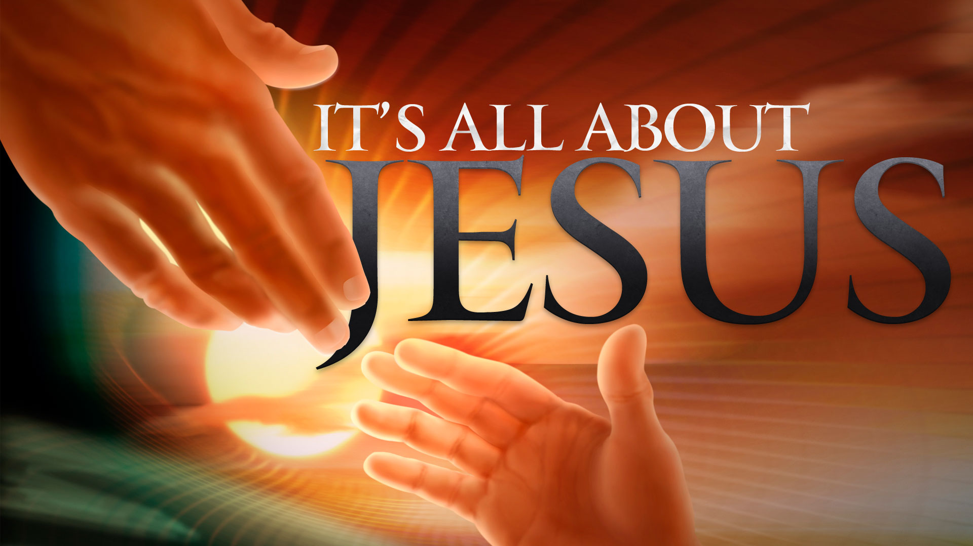

The Lawless One Will Be Revealed
by Pastor Fee Soliven
2 Thessalonians 2:7-17
Wednesday Evening
March 11, 2020

Slide 4
7 For the mystery of lawlessness is already at work; only He who now restrains will do so until He is taken out of the way. 8 And then the lawless one will be revealed, whom the Lord will consume with the breath of His mouth and destroy with the brightness of His coming.

Slide 5
9 The coming of the lawless one is according to the working of Satan, with all power, signs, and lying wonders, 10 and with all unrighteous deception among those who perish, because they did not receive the love of the truth, that they might be saved. 11 And for this reason God will send them strong delusion, that they should believe the lie,

Slide 6
12 that they all may be condemned who did not believe the truth but had pleasure in unrighteousness. 13 But we are bound to give thanks to God always for you, brethren beloved by the Lord, because God from the beginning chose you for salvation through sanctification by the Spirit and belief in the truth,

Slide 7
14 to which He called you by our gospel, for the obtaining of the glory of our Lord Jesus Christ. 15 Therefore, brethren, stand fast and hold the traditions which you were taught, whether by word or our epistle.

Slide 8
16 Now may our Lord Jesus Christ Himself, and our God and Father, who has loved us and given us everlasting consolation and good hope by grace, 17 comfort your hearts and establish you in every good word and work.

Slide 9
7 For the mystery of lawlessness is already at work; only He who now restrains will do so until He is taken out of the way.

Slide 10
Matthew 15:10-11
10 When He had called the multitude to Himself, He said to them, "Hear and understand: 11 Not what goes into the mouth defiles a man; but what comes out of the mouth, this defiles a man."

Slide 11
Jeremiah 17:9-10
9 "The heart is deceitful above all things, And desperately wicked; Who can know it? 10 I, the LORD, search the heart, I test the mind, Even to give every man according to his ways, According to the fruit of his doings.

Slide 12
Matthew 24:12-14
12 And because lawlessness will abound, the love of many will grow cold. 13 But he who endures to the end shall be saved. 14 And this gospel of the kingdom will be preached in all the world as a witness to all the nations, and then the end will come.

Slide 13
1. Government and Law, which help to Curb Evil
2. The Ministry and Activity of the Church and the effects of the Good News
3. The Holy Spirit

Slide 14
Why will God allow this evil man to act with unrestrained wickedness?

Slide 15
8 And then the lawless one will be revealed, whom the Lord will consume with the breath of His mouth and destroy with the brightness of His coming.

Slide 16
Isaiah 11:4
“He will rule against the wicked and destroy them with the breath of his mouth.”

Slide 17
Revelation 19:20-21
20 Then the beast was captured, and with him the false prophet who worked signs in his presence, by which he deceived those who received the mark of the beast and those who worshiped his image. These two were cast alive into the lake of fire burning with brimstone. 21 And the rest were killed with the sword which proceeded from the mouth of Him who sat on the horse. And all the birds were filled with their flesh.

Slide 18
9 The coming of the lawless one is according to the working of Satan, with all power, signs, and lying wonders, 10 and with all unrighteous deception among those who perish, because they did not receive the love of the truth, that they might be saved.

Slide 19
How will this one man become so powerful?

Slide 20
How will he attain such notoriety and loyalty from the masses?

Slide 21
Matthew 24:24-25
24 For false christs and false prophets will rise and show great signs and wonders to deceive, if possible, even the elect. 25 See, I have told you beforehand.

Slide 22
1 John 2:18
“Little children, it is the last hour; and as you have heard that the Antichrist is coming, even now many antichrists have come, by which we know that it is the last hour”

Slide 23
Revelation 13:13-14
13 He performs great signs, so that he even makes fire come down from heaven on the earth in the sight of men. 14 And he deceives those who dwell on the earth by those signs which he was granted to do in the sight of the beast, telling those who dwell on the earth to make an image to the beast who was wounded by the sword and lived.

Slide 24
Revelation 16:14
“For they are spirits of demons, performing signs, which go out to the kings of the earth and of the whole world, to gather them to the battle of that great day of God Almighty”

Slide 25
Revelation 19:20
“Then the beast was captured, and with him the false prophet who worked signs in his presence, by which he deceived those who received the mark of the beast and those who worshiped his image. These two were cast alive into the lake of fire burning with brimstone”

Slide 26
11 And for this reason God will send them strong delusion, that they should believe the lie, 12 that they all may be condemned who did not believe the truth but had pleasure in unrighteousness.

Slide 27
Joshua 11:20
For it was of the LORD to harden their hearts, that they should come against Israel in battle, that He might utterly destroy them, and that they might receive no mercy, but that He might destroy them, as the LORD had commanded Moses.

Slide 28
Romans 9:13-26
13 As it is written, "Jacob I have loved, but Esau I have hated." 14 What shall we say then? Is there unrighteousness with God? Certainly not! 15 For He says to Moses, "I will have mercy on whomever I will have mercy, and I will have compassion on whomever I will have compassion."

Slide 29
16 So then it is not of him who wills, nor of him who runs, but of God who shows mercy. 17 For the Scripture says to Pharaoh, "For this very purpose I have raised you up, that I may show My power in you, and that My name may be declared in all the earth." 18 Therefore He has mercy on whom He wills, and whom He wills He hardens.

Slide 30
19 You will say to me then, "Why does He still find fault? For who has resisted His will?" 20 But indeed, O man, who are you to reply against God? Will the thing formed say to him who formed it, "Why have you made me like this?" 21 Does not the potter have power over the clay, from the same lump to make one vessel for honor and another for dishonor?

Slide 31
22 What if God, wanting to show His wrath and to make His power known, endured with much longsuffering the vessels of wrath prepared for destruction, 23 and that He might make known the riches of His glory on the vessels of mercy, which He had prepared beforehand for glory, 24 even us whom He called, not of the Jews only, but also of the Gentiles?

Slide 32
25 As He says also in Hosea: "I will call them My people, who were not My people, And her beloved, who was not beloved." 26 "And it shall come to pass in the place where it was said to them, 'You are not My people,' There they shall be called sons of the living God."

Slide 33
Revelation 17:17
“For God has put it into their hearts to fulfill His purpose, to be of one mind, and to give their kingdom to the beast, until the words of God are fulfilled”

Slide 34
13 But we are bound to give thanks to God always for you, brethren beloved by the Lord, because God from the beginning chose you for salvation through sanctification by the Spirit and belief in the truth,

Slide 35
John 15:16-17
16 You did not choose Me, but I chose you and appointed you that you should go and bear fruit, and that your fruit should remain, that whatever you ask the Father in My name He may give you. 17 These things I command you, that you love one another.

Slide 36
14 to which He called you by our gospel, for the obtaining of the glory of our Lord Jesus Christ.

Slide 37
1 Peter 1:13-16
13 Therefore gird up the loins of your mind, be sober, and rest your hope fully upon the grace that is to be brought to you at the revelation of Jesus Christ; 14 as obedient children, not conforming yourselves to the former lusts, as in your ignorance; 15 but as He who called you is holy, you also be holy in all your conduct, 16 because it is written, "Be holy, for I am holy."

Slide 38
15 Therefore, brethren, stand fast and hold the traditions which you were taught, whether by word or our epistle.

Slide 39
Galatians 5:1
“Stand fast therefore in the liberty by which Christ has made us free, and do not be entangled again with a yoke of bondage”

Slide 40
16 Now may our Lord Jesus Christ Himself, and our God and Father, who has loved us and given us everlasting consolation and good hope by grace, 17 comfort your hearts and establish you in every good word and work.

Slide 41
1 Peter 5:6-11
6 Therefore humble yourselves under the mighty hand of God, that He may exalt you in due time, 7 casting all your care upon Him, for He cares for you. 8 Be sober, be vigilant; because your adversary the devil walks about like a roaring lion, seeking whom he may devour.

Slide 42
9 Resist him, steadfast in the faith, knowing that the same sufferings are experienced by your brotherhood in the world. 10 But may the God of all grace, who called us to His eternal glory by Christ Jesus, after you have suffered a while, perfect, establish, strengthen, and settle you. 11 To Him be the glory and the dominion forever and ever. Amen.

