Slide 1


Slide 2


Slide 3
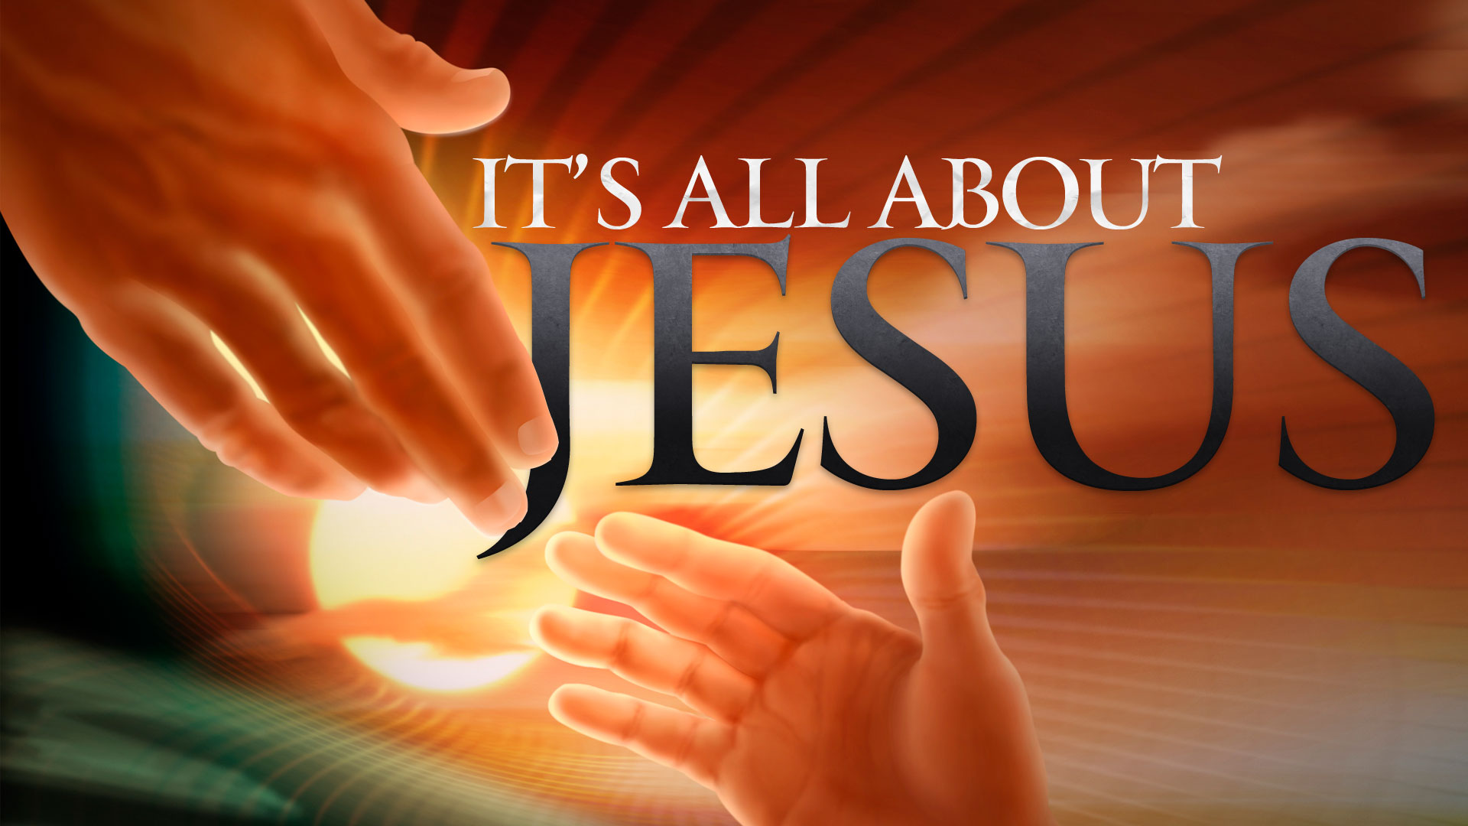

He Has Risen
By Pastor Fee Soliven
Mark 16:1-20
Wednesday Evening
November 13, 2019

Slide 4
1 Now when the Sabbath was past, Mary Magdalene, Mary the mother of James, and Salome bought spices, that they might come and anoint Him. 2 Very early in the morning, on the first day of the week, they came to the tomb when the sun had risen.

Slide 5
3 And they said among themselves, "Who will roll away the stone from the door of the tomb for us?" 4 But when they looked up, they saw that the stone had been rolled away--for it was very large.

Slide 6
5 And entering the tomb, they saw a young man clothed in a long white robe sitting on the right side; and they were alarmed. 6 But he said to them, "Do not be alarmed. You seek Jesus of Nazareth, who was crucified. He is risen! He is not here. See the place where they laid Him.

Slide 7
7 But go, tell His disciples--and Peter--that He is going before you into Galilee; there you will see Him, as He said to you.“ 8 So they went out quickly and fled from the tomb, for they trembled and were amazed. And they said nothing to anyone, for they were afraid.

Slide 8
9 Now when He rose early on the first day of the week, He appeared first to Mary Magdalene, out of whom He had cast seven demons. 10 She went and told those who had been with Him, as they mourned and wept.

Slide 9
11 And when they heard that He was alive and had been seen by her, they did not believe. 12 After that, He appeared in another form to two of them as they walked and went into the country. 13 And they went and told it to the rest, but they did not believe them either.

Slide 10
14 Later He appeared to the eleven as they sat at the table; and He rebuked their unbelief and hardness of heart, because they did not believe those who had seen Him after He had risen. 15 And He said to them, "Go into all the world and preach the gospel to every creature.

Slide 11
16 He who believes and is baptized will be saved; but he who does not believe will be condemned. 17 And these signs will follow those who believe: In My name they will cast out demons; they will speak with new tongues; 18 they will take up serpents; and if they drink anything deadly, it will by no means hurt them; they will lay hands on the sick, and they will recover."

Slide 12
19 So then, after the Lord had spoken to them, He was received up into heaven, and sat down at the right hand of God. 20 And they went out and preached everywhere, the Lord working with them and confirming the word through the accompanying signs. Amen.

Slide 13
1 Now when the Sabbath was past, Mary Magdalene, Mary the mother of James, and Salome bought spices, that they might come and anoint Him.

Slide 14
2 Very early in the morning, on the first day of the week, they came to the tomb when the sun had risen.

Slide 15
3 And they said among themselves, "Who will roll away the stone from the door of the tomb for us?"

Slide 16
Matthew 27:62-66
62 On the next day, which followed the Day of Preparation, the chief priests and Pharisees gathered together to Pilate, 63 saying, "Sir, we remember, while He was still alive, how that deceiver said, 'After three days I will rise.'

Slide 17
64 "Therefore command that the tomb be made secure until the third day, lest His disciples come by night and steal Him away, and say to the people, 'He has risen from the dead.' So the last deception will be worse than the first." 65 Pilate said to them, "You have a guard; go your way, make it as secure as you know how." 66 So they went and made the tomb secure, sealing the stone and setting the guard.

Slide 18
4 But when they looked up, they saw that the stone had been rolled away--for it was very large.

Slide 19
5 And entering the tomb, they saw a young man clothed in a long white robe sitting on the right side; and they were alarmed. 6 But he said to them, "Do not be alarmed. You seek Jesus of Nazareth, who was crucified. He is risen! He is not here. See the place where they laid Him.

Slide 20
John 20:6-7
6 Then Simon Peter came, following him, and went into the tomb; and he saw the linen cloths lying there, 7 and the handkerchief that had been around His head, not lying with the linen cloths, but folded together in a place by itself.

Slide 21
7 But go, tell His disciples--and Peter--that He is going before you into Galilee; there you will see Him, as He said to you."

Slide 22
Hebrews 13:2
“Be not forgetful to entertain strangers: for thereby some have entertained angels unawares.”

Slide 23
2 Kings 6:16-17
16 So he answered, "Do not fear, for those who are with us are more than those who are with them." 17 And Elisha prayed, and said, "LORD, I pray, open his eyes that he may see." Then the LORD opened the eyes of the young man, and he saw. And behold, the mountain was full of horses and chariots of fire all around Elisha.

Slide 24
8 So they went out quickly and fled from the tomb, for they trembled and were amazed. And they said nothing to anyone, for they were afraid.

Slide 25
Luke 24:11
“And their words seemed to them like idle tales, and they did not believe them.”

Slide 26
9 Now when He rose early on the first day of the week, He appeared first to Mary Magdalene, out of whom He had cast seven demons. 10 She went and told those who had been with Him, as they mourned and wept. 11 And when they heard that He was alive and had been seen by her, they did not believe.

Slide 27
Hebrews 11:6
“But without faith it is impossible to please Him, for he who comes to God must believe that He is, and that He is a rewarder of those who diligently seek Him.”

Slide 28
John 20:3-9
3 Peter therefore went out, and the other disciple, and were going to the tomb. 4 So they both ran together, and the other disciple outran Peter and came to the tomb first. 5 And he, stooping down and looking in, saw the linen cloths lying there; yet he did not go in.

Slide 29
6 Then Simon Peter came, following him, and went into the tomb; and he saw the linen cloths lying there, 7 and the handkerchief that had been around His head, not lying with the linen cloths, but folded together in a place by itself. 8 Then the other disciple, who came to the tomb first, went in also; and he saw and believed. 9 For as yet they did not know the Scripture, that He must rise again from the dead.

Slide 30
John 20:11
“But Mary stood outside by the tomb weeping, and as she wept she stooped down and looked into the tomb.”

Slide 31
12 After that, He appeared in another form to two of them as they walked and went into the country. 13 And they went and told it to the rest, but they did not believe them either.

Slide 32
Luke 24:31
“Then their eyes were opened and they knew Him; and He vanished from their sight.”

Slide 33
14 Later He appeared to the eleven as they sat at the table; and He rebuked their unbelief and hardness of heart, because they did not believe those who had seen Him after He had risen.

Slide 34
Matthew 16:21
“From that time Jesus began to show to His disciples that He must go to Jerusalem, and suffer many things from the elders and chief priests and scribes, and be killed, and be raised the third day.”

Slide 35
15 And He said to them, "Go into all the world and preach the gospel to every creature.

Slide 36
16 He who believes and is baptized will be saved; but he who does not believe will be condemned.

Slide 37
Acts 10:40-48
40 Him God raised up on the third day, and showed Him openly, 41 not to all the people, but to witnesses chosen before by God, even to us who ate and drank with Him after He arose from the dead. 42 And He commanded us to preach to the people, and to testify that it is He who was ordained by God to be Judge of the living and the dead.

Slide 38
43 To Him all the prophets witness that, through His name, whoever believes in Him will receive remission of sins." 44 While Peter was still speaking these words, the Holy Spirit fell upon all those who heard the word. 45 And those of the circumcision who believed were astonished, as many as came with Peter, because the gift of the Holy Spirit had been poured out on the Gentiles also.

Slide 39
46 For they heard them speak with tongues and magnify God. Then Peter answered, 47 Can anyone forbid water, that these should not be baptized who have received the Holy Spirit just as we have?" 48 And he commanded them to be baptized in the name of the Lord. Then they asked him to stay a few days.

Slide 40
17 And these signs will follow those who believe: In My name they will cast out demons; they will speak with new tongues; 18 they will take up serpents; and if they drink anything deadly, it will by no means hurt them; they will lay hands on the sick, and they will recover."

Slide 41
19 So then, after the Lord had spoken to them, He was received up into heaven, and sat down at the right hand of God.

Slide 42
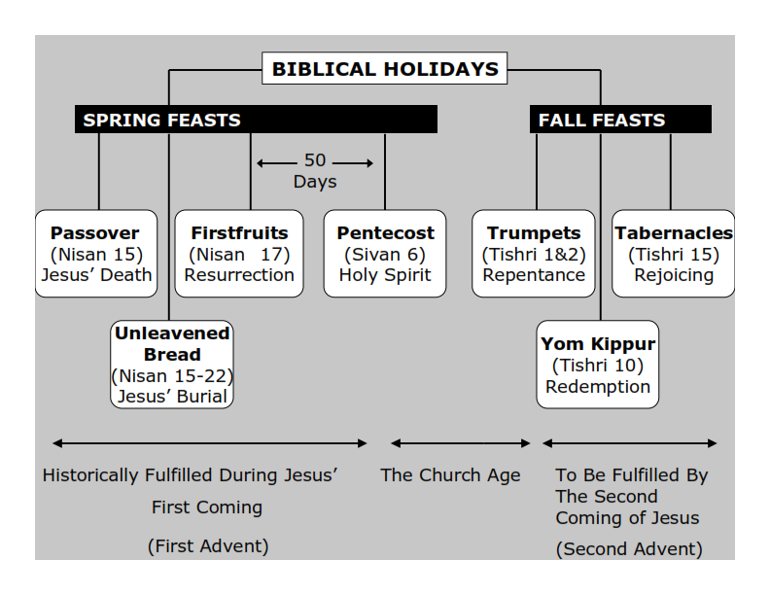
Webster’s Dictionary defines the word tribulation as: 1. grievous trouble; severe trial or suffering. 2. an instance of this; an affliction, trouble, etc.

Slide 43
Acts 2:1-4
1 Now when the Day of Pentecost had fully come, they were all with one accord in one place. 2 And suddenly there came a sound from heaven, as of a rushing mighty wind, and it filled the whole house where they were sitting. 3 Then there appeared to them divided tongues, as of fire, and one sat upon each of them. 4 And they were all filled with the Holy Spirit and began to speak with other tongues, as the Spirit gave them utterance.

Slide 44
Romans 8:34
Who is he who condemns? It is Christ who died, and furthermore is also risen, who is even at the right hand of God, who also makes intercession for us.

Slide 45
Hebrews 1:3
“who being the brightness of His glory and the express image of His person, and upholding all things by the word of His power, when He had by Himself purged our sins, sat down at the right hand of the Majesty on high…”

Slide 46
Hebrews 8:1
“Now this is the main point of the things we are saying: We have such a High Priest, who is seated at the right hand of the throne of the Majesty in the heavens”

Slide 47
20 And they went out and preached everywhere, the Lord working with them and confirming the word through the accompanying signs. Amen.

Slide 48
Hebrews 2:4
“God also bearing witness both with signs and wonders, with various miracles, and gifts of the Holy Spirit, according to His own will”

