Slide 1
“For the Joy of the Lord is your Strength”
Nehemiah 8:10

Slide 2
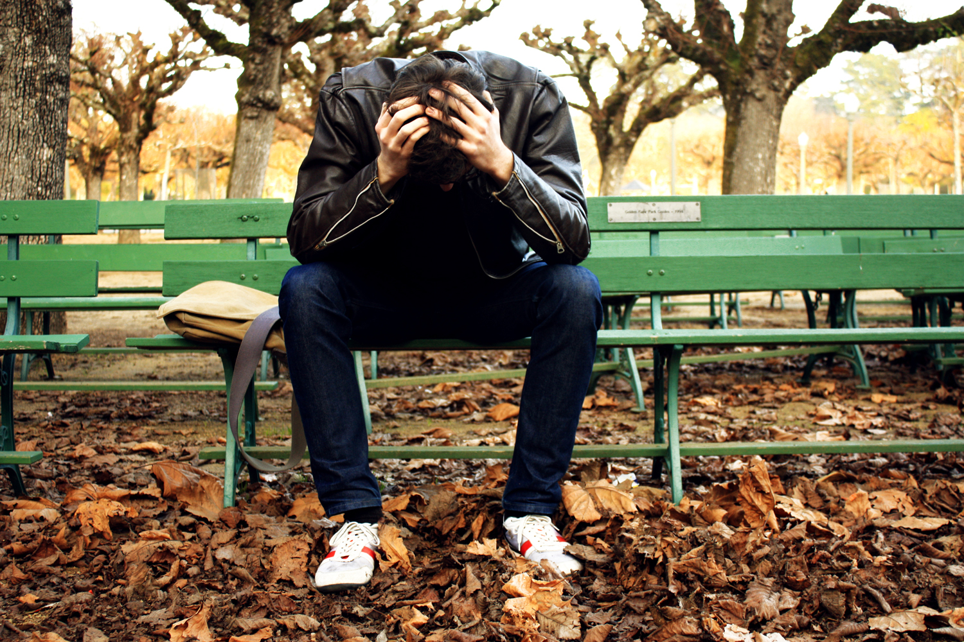
Help Me Go Through This Lord
by Pastor Fee Soliven
1 Peter 5:6-10
Wednesday Evening
April 29, 2020

Slide 3
1 Peter 5:6-10
6 Therefore humble yourselves under the mighty hand of God, that He may exalt you in due time, 7 casting all your care upon Him, for He cares for you. 8 Be sober, be vigilant; because your adversary the devil walks about like a roaring lion, seeking whom he may devour.

Slide 4
9 Resist him, steadfast in the faith, knowing that the same sufferings are experienced by your brotherhood in the world. 10 But may the God of all grace, who called us to His eternal glory by Christ Jesus, after you have suffered a while, perfect, establish, strengthen, and settle you.

Slide 5
Trials, Difficulties, and Suffering bring out a variety of Attitudes and Responses

Slide 6
What is the Purpose?

Slide 7
Why Me, My Child, or My Family?

Slide 8
When you don’t understand why something has happened, remember these Basic Truths.

Slide 9
Lord’s Perspective is Complete

Slide 10
Jeremiah 29:11-13
11 For I know the thoughts that I think toward you, says the LORD, thoughts of peace and not of evil, to give you a future and a hope. 12 Then you will call upon Me and go and pray to Me, and I will listen to you. 13 And you will seek Me and find Me, when you search for Me with all your heart.

Slide 11
Lord is Full of Love

Slide 12
Psalm 23:6
Surely goodness and mercy shall follow me All the days of my life; And I will dwell in the house of the LORD Forever.

Slide 13
God’s Thoughts and ways are Higher than Ours

Slide 14
Isaiah 55:8-9
8 "For My thoughts are not your thoughts, Nor are your ways My ways," says the LORD. 9 "For as the heavens are higher than the earth, So are My ways higher than your ways, And My thoughts than your thoughts.

Slide 15
Lamentations 3:22-23
22 Through the LORD's mercies we are not consumed, Because His compassions fail not. 23 They are new every morning; Great is Your faithfulness. 24 "The LORD is my portion," says my soul, "Therefore I hope in Him!"

Slide 16
1 Peter 5:6-10
6 Therefore humble yourselves under the mighty hand of God, that He may exalt you in due time, 7 casting all your care upon Him, for He cares for you. 8 Be sober, be vigilant; because your adversary the devil walks about like a roaring lion, seeking whom he may devour.

Slide 17
9 Resist him, steadfast in the faith, knowing that the same sufferings are experienced by your brotherhood in the world. 10 But may the God of all grace, who called us to His eternal glory by Christ Jesus, after you have suffered a while, perfect, establish, strengthen, and settle you.

Slide 18
Whenever you experience Pain, Disappointment, or Distress, how do you respond?

Slide 19
1. Do you see it as God’s way of getting your attention?

Slide 20
Psalm 9:9-10
9 The LORD also will be a refuge for the oppressed, A refuge in times of trouble. 10 And those who know Your name will put their trust in You; For You, LORD, have not forsaken those who seek You.

Slide 21
2. Is God using this to remind you to be Totally Dependent Upon Him?

Slide 22
Proverbs 3:5-6
5 Trust in the Lord with all your heart, And lean not on your own understanding; 6 In all your ways acknowledge Him, And He shall direct your paths.

Slide 23
3. Could this be a satanic attack?

Slide 24
1 Peter 5:8
“Be sober, be vigilant; because your adversary the devil walks about like a roaring lion, seeking whom he may devour”

Slide 25
Ephesians 6:10-13
10 Finally, my brethren, be strong in the Lord and in the power of His might. 11 Put on the whole armor of God, that you may be able to stand against the wiles of the devil.

Slide 26
12 For we do not wrestle against flesh and blood, but against principalities, against powers, against the rulers of the darkness of this age, against spiritual hosts of wickedness in the heavenly places.

Slide 27
Is God Testing your Faith?

Slide 28
James 1:2-4
2 My brethren, count it all joy when you fall into various trials, 3 knowing that the testing of your faith produces patience. 4 But let patience have its perfect work, that you may be perfect and complete, lacking nothing.

Slide 29
Do you have the right to ask God why you’re going through Pain or Difficulty?

Slide 30
1. It’s a Natural Response

Slide 31
2. God is under no Obligation to Answer our Question

Slide 32
Colossians 1:24-25
24 I now rejoice in my sufferings for you, and fill up in my flesh what is lacking in the afflictions of Christ, for the sake of His body, which is the church, 25 of which I became a minister according to the stewardship from God which was given to me for you, to fulfill the word of God…

Slide 33
3. But sometimes the Lord will give Us a Reason

Slide 34
2 Corinthians 12:7
“And lest I should be exalted above measure by the abundance of the revelations, a thorn in the flesh was given to me, a messenger of Satan to buffet me, lest I be exalted above measure.”

Slide 35
How should you respond to suffering and pain when you don’t understand why God allowed it?

Slide 36
1. Remember that you are a child of God and He’s watching over you.

Slide 37
2. Recall that the Lord is always with you

Slide 38
Hebrews 13:5-6
5 Let your conduct be without covetousness; be content with such things as you have. For He Himself has said, "I will never leave you nor forsake you." 6 So we may boldly say: "The LORD is my helper; I will not fear. What can man do to me?"

Slide 39
3. Acknowledge that God has allowed the situation for His divine purpose.

Slide 40
Romans 8:28
And we know that all things work together for good to those who love God, to those who are the called according to His purpose.

Slide 41
4. Thank the Lord in the midst of the situation

Slide 42
1 Thessalonians 5:18
“in everything give thanks; for this is the will of God in Christ Jesus for you”

Slide 43
5. Recall the Lord’s Promises

Slide 44
1 Peter 5:10
“After you have suffered for a little while, the God of all grace, who called you to His eternal glory in Christ, will Himself perfect, confirm, strengthen and establish you.”

Slide 45
1. Why is it so hard to let go of our desire to know why certain events happen to us?

Slide 46
2. Do you think this displays a lack of trust in God? Why or why not?

Slide 47
3. The right response to trials is to immediately direct our thoughts toward God.
Is this your first reaction? If so, what benefits have you discovered with this mindset?
If not, what keeps you from focusing on the Lord?

Slide 48
1 Thessalonians 4:13-18
13 But I do not want you to be ignorant, brethren, concerning those who have fallen asleep, lest you sorrow as others who have no hope. 14 For if we believe that Jesus died and rose again, even so God will bring with Him those who sleep in Jesus.

Slide 49
15 For this we say to you by the word of the Lord, that we who are alive and remain until the coming of the Lord will by no means precede those who are asleep. 16 For the Lord Himself will descend from heaven with a shout, with the voice of an archangel, and with the trumpet of God. And the dead in Christ will rise first.

Slide 50
17 Then we who are alive and remain shall be caught up together with them in the clouds to meet the Lord in the air. And thus we shall always be with the Lord. 18 Therefore comfort one another with these words.

Slide 51
Acts 2:38-39
38 Then Peter said to them, "Repent, and let every one of you be baptized in the name of Jesus Christ for the remission of sins; and you shall receive the gift of the Holy Spirit. 39 For the promise is to you and to your children, and to all who are afar off, as many as the
Lord our God will call."

Slide 52
“For the Joy of the Lord is your Strength”
Nehemiah 8:10

