Slide 1


Slide 2
www.PayPal.com
www.Amazing_Grace@cox.net

Slide 3
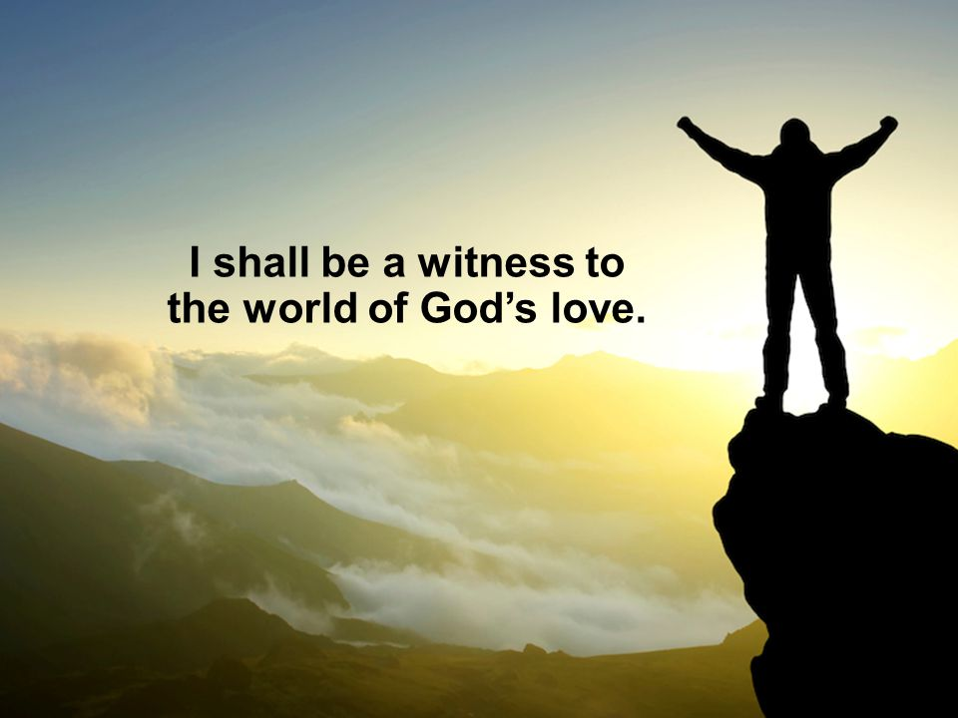

Jesus Help Me Be A Witness
By Pastor Fee Soliven
Matthew 5:13-16
Wednesday Evening
April 15, 2020

Slide 4
Matthew 5:13-16
13 "You are the salt of the earth; but if the salt loses its flavor, how shall it be seasoned? It is then good for nothing but to be thrown out and trampled underfoot by men. 14 You are the light of the world. A city that is set on a hill cannot be hidden.

Slide 5
15 Nor do they light a lamp and put it under a basket, but on a lampstand, and it gives light to all who are in the house. 16 Let your light so shine before men, that they may see your good works and glorify your Father in heaven.

Slide 6
If there’s one story in the Bible most people know, it’s the one about Noah and the ark—even children’s books are written about it.

Slide 7
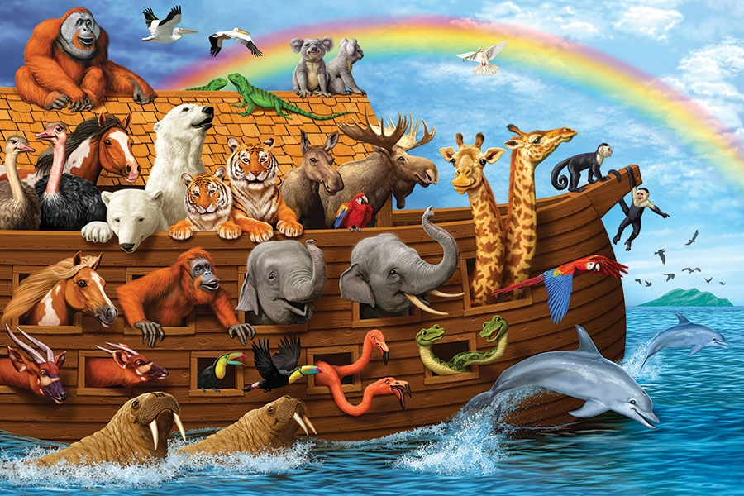
Jude 14-15
14 Now Enoch, the seventh from Adam, prophesied about these men also, saying, "Behold, the Lord comes with ten thousands of His saints, 15 to execute judgment on all, to convict all who are ungodly among them of all their ungodly deeds which they have committed in an ungodly way, and of all the harsh things which ungodly sinners have spoken against Him."

Slide 8
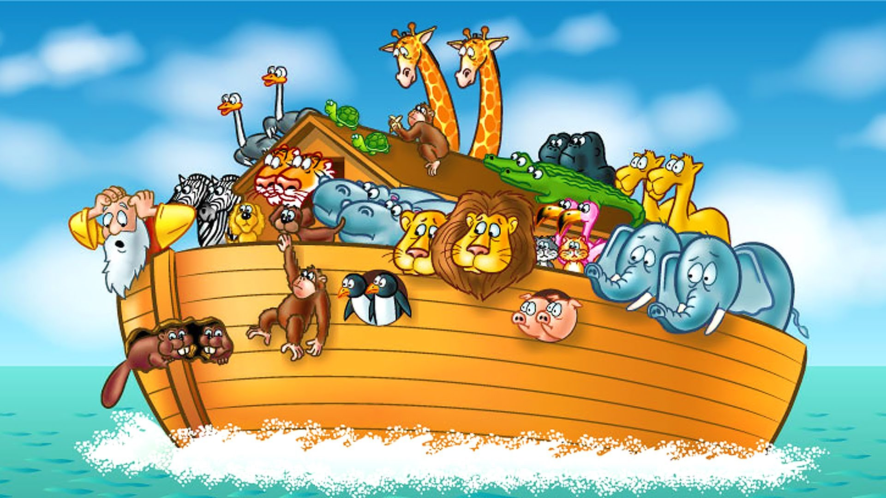
Genesis 6:5
“the Lord saw that the wickedness of man was great on the earth, and that every intent of the thoughts of his heart was only evil continually”

Slide 9
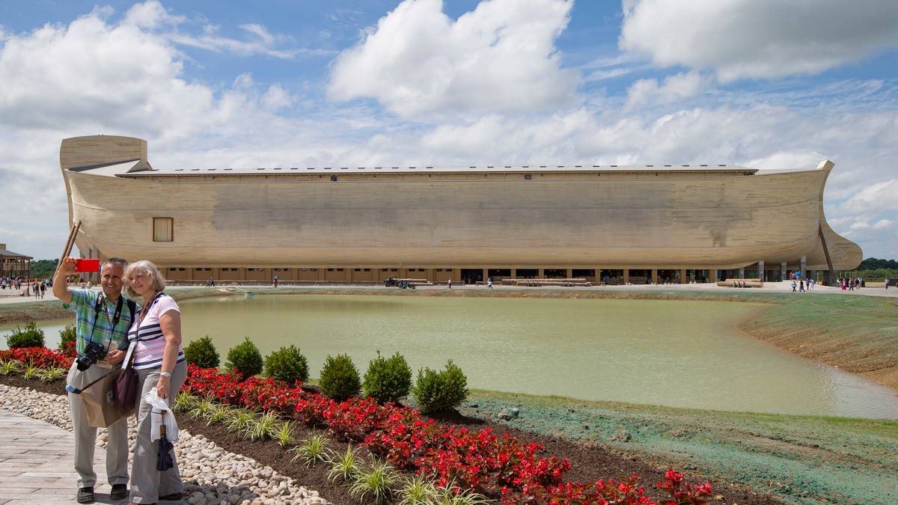
2 Timothy 3:1-7
1 But know this, that in the last days perilous times will come: 2 For men will be lovers of themselves, lovers of money, boasters, proud, blasphemers, disobedient to parents, unthankful, unholy,

Slide 10
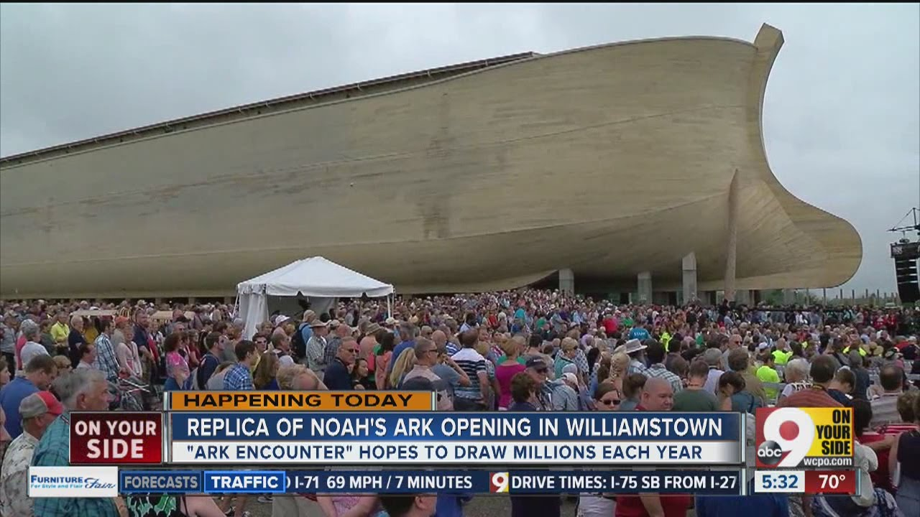
3 unloving, unforgiving, slanderers, without self-control, brutal, despisers of good, 4 traitors, headstrong, haughty, lovers of pleasure rather than lovers of God, 5 having a form of godliness but denying its power. And from such people turn away!
Kentucky

Slide 11
Genesis 6:5-13
5 Then the LORD saw that the wickedness of man was great in the earth, and that every intent of the thoughts of his heart was only evil continually. 6 And the LORD was sorry that He had made man on the earth, and He was grieved in His heart.

Slide 12
7 So the LORD said, "I will destroy man whom I have created from the face of the earth, both man and beast, creeping thing and birds of the air, for I am sorry that I have made them." 8 But Noah found grace in the eyes of the LORD. 9 This is the genealogy of Noah. Noah was a just man, perfect in his generations. Noah walked with God.

Slide 13
10 And Noah begot three sons: Shem, Ham, and Japheth. 11 The earth also was corrupt before God, and the earth was filled with violence. 12 So God looked upon the earth, and indeed it was corrupt; for all flesh had corrupted their way on the earth.

Slide 14
13 And God said to Noah, "The end of all flesh has come before Me, for the earth is filled with violence through them; and behold, I will destroy them with the earth.

Slide 15
The Character of Noah

Slide 16
Genesis 6:9
This is the genealogy of Noah. Noah was a just man, perfect in his generations. Noah walked with God.

Slide 17
Genesis 6:8
But Noah found grace in the eyes of the LORD.

Slide 18
Matthew 24:37-39
37 But as the days of Noah were, so also will the coming of the Son of Man be. 38 For as in the days before the flood, they were eating and drinking, marrying and giving in marriage, until the day that Noah entered the ark, 39 and did not know until the flood came and took them all away, so also will the coming of the Son of Man be.

Slide 19
The World in Noah’s Day

Slide 20
Genesis 6:5-6
“Then the Lord saw that the wickedness of man was great on the earth, and that every intent of the thoughts of his heart was only evil continually. The Lord was sorry that He had made man on the earth, and He was grieved in His heart.”

Slide 21
Genesis 6:13
"The end of all flesh has come before Me, for the earth is filled with violence through them; and behold, I will destroy them with the earth…

Slide 22
Genesis 1:31
“God saw all that He had made, and behold, it was very good”

Slide 23
What had happened?

Slide 24
The answer is
Sin

Slide 25
Noah’s Assignment from God

Slide 26
Genesis 6:13-14
“Then God said to Noah, ‘The end of all flesh has come before Me; for the earth is filled with violence because of them; and behold, I am about to destroy them with the earth. Make for yourself an ark of gopher wood’”

Slide 27
The Ark

Slide 28
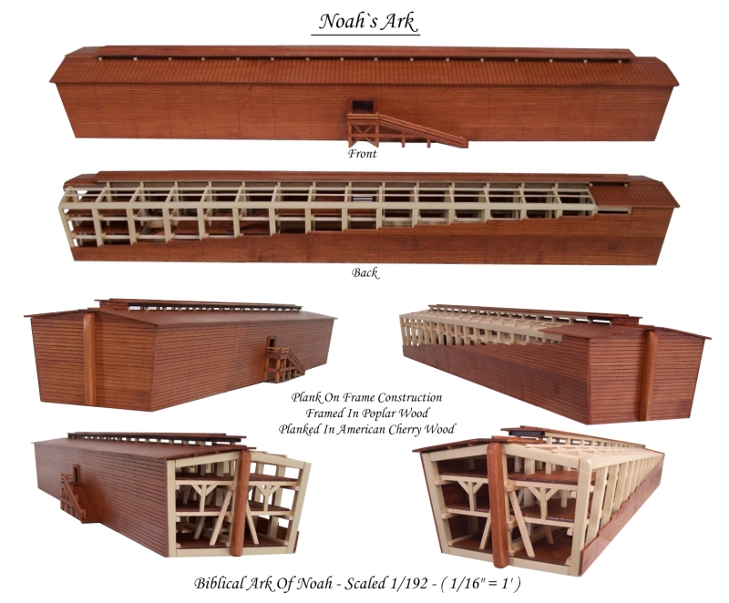
Luke 11:28
But He said, "More than that, blessed are those who hear the word of God and keep it!"

Slide 29
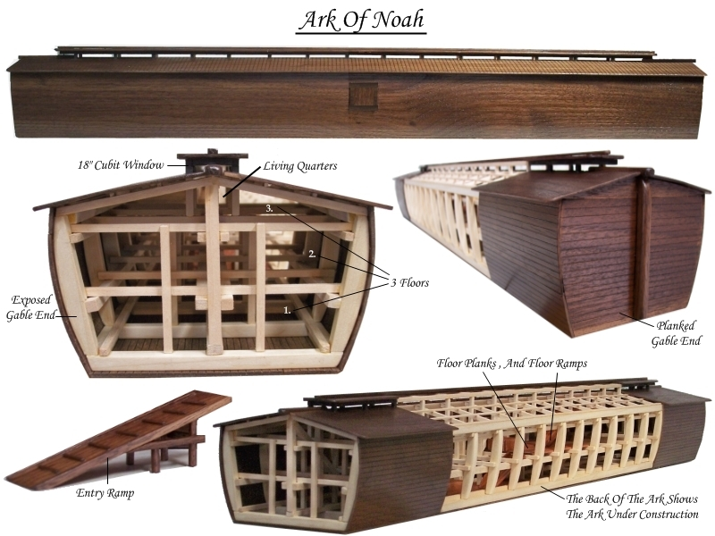
Psalm 119:1-4
1 Blessed are the undefiled in the way, Who walk in the law of the LORD! 2 Blessed are those who keep His testimonies, Who seek Him with the whole heart! 3 They also do no iniquity; They walk in His ways. 4 You have commanded us To keep Your precepts diligently.

Slide 30
The Flood

Slide 31
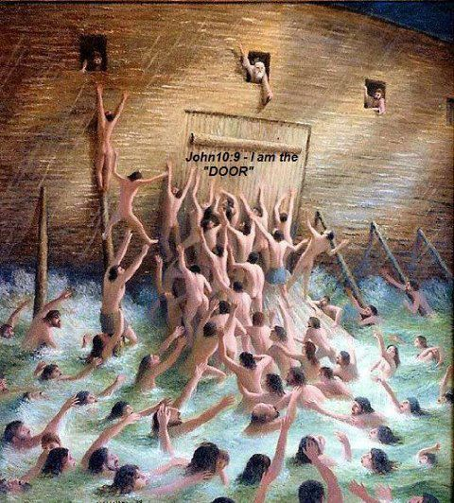
Matthew 6:33-34
33 But seek first the kingdom of God and His righteousness, and all these things shall be added to you. 34 Therefore do not worry about tomorrow, for tomorrow will worry about its own things. Sufficient for the day is its own trouble.

Slide 32
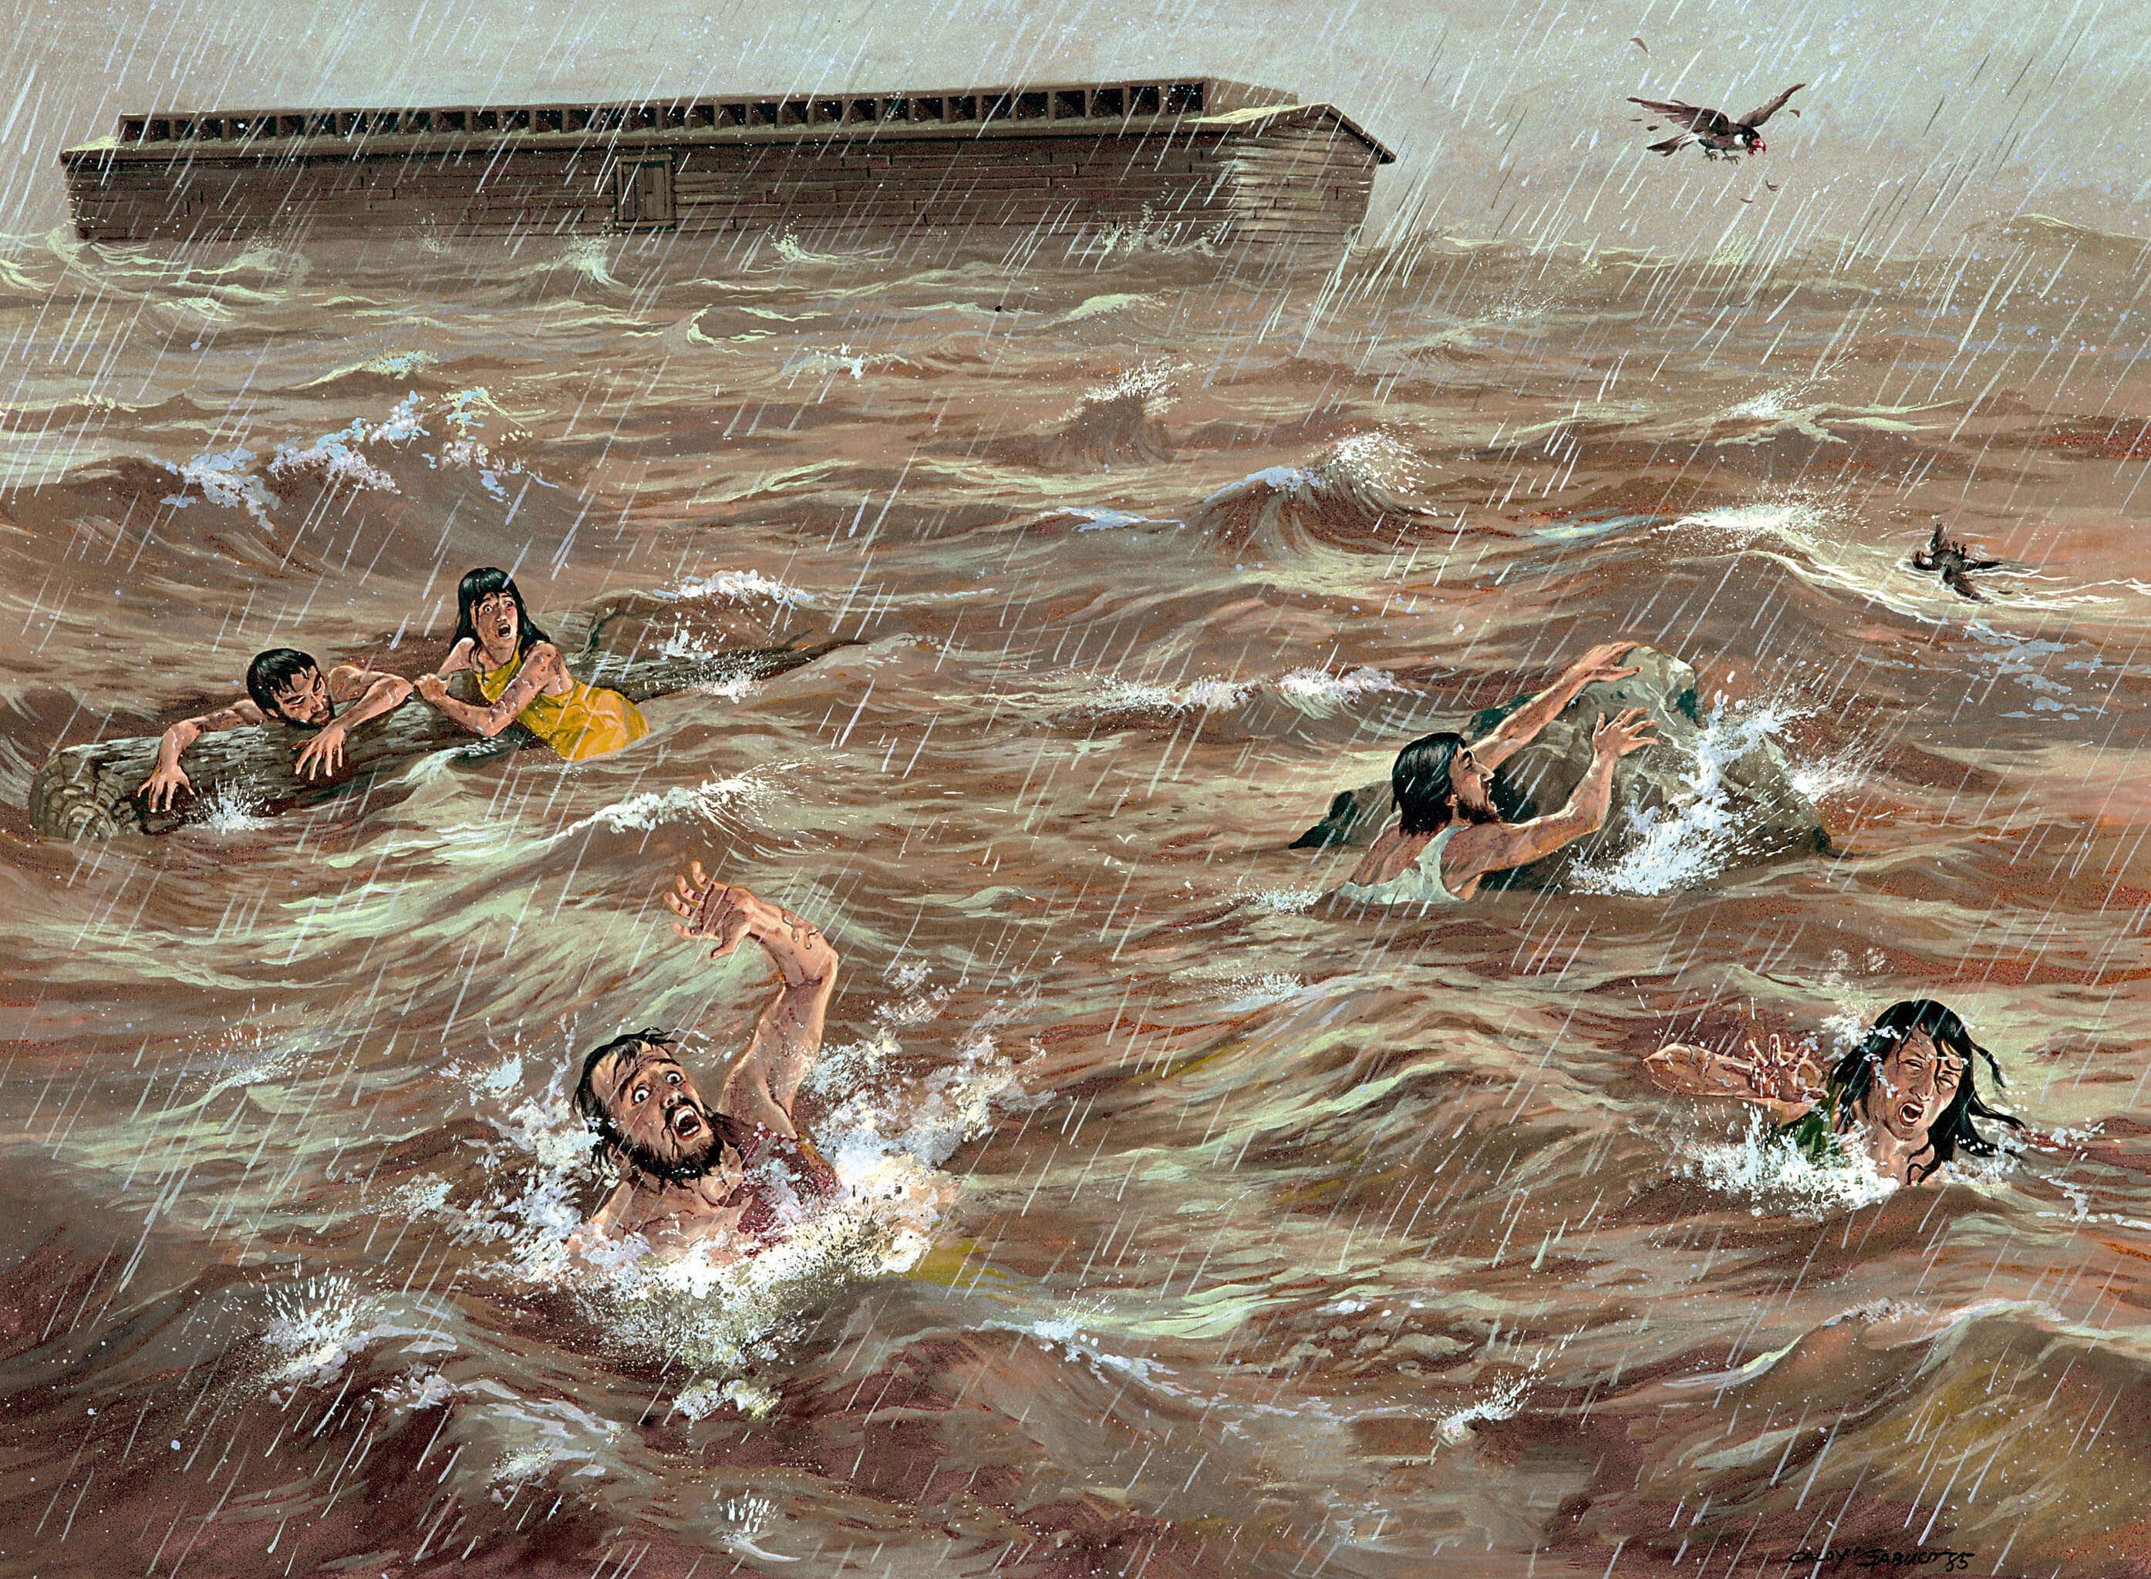
7. We must Stay in
Step with the Lord

Slide 33
A New Start

Slide 34
Genesis 8:20
“Then Noah built an altar to the LORD, and took of every clean animal and of every clean bird, and offered burnt offerings on the altar.”

Slide 35
Genesis 9:11-14
11 Thus I establish My covenant with you: Never again shall all flesh be cut off by the waters of the flood; never again shall there be a flood to destroy the earth." 12 And God said: "This is the sign of the covenant which I make between Me and you, and every living creature that is with you, for perpetual generations:

Slide 36
13 I set My rainbow in the cloud, and it shall be for the sign of the covenant between Me and the earth. 14 It shall be, when I bring a cloud over the earth, that the rainbow shall be seen in the cloud…

Slide 37
Noah’s Example

Slide 38
Hebrews 11:7
“By faith Noah, being divinely warned of things not yet seen, moved with godly fear, prepared an ark for the saving of his household, by which he condemned the world and became heir of the righteousness which is according to faith.”

Slide 39
How do you suppose what the reaction will be when
Jesus comes back again?

Slide 40
2 Peter 3:1-13
1 Beloved, I now write to you this second epistle (in both of which I stir up your pure minds by way of reminder), 2 that you may be mindful of the words which were spoken before by the holy prophets, and of the commandment of us, the apostles of the Lord and Savior,

Slide 41
3 knowing this first: that scoffers will come in the last days, walking according to their own lusts, 4 and saying, "Where is the promise of His coming? For since the fathers fell asleep, all things continue as they were from the beginning of creation." 5 For this they willfully forget: that by the word of God the heavens were of old, and the earth standing out of water and in the water,

Slide 42
6 by which the world that then existed perished, being flooded with water. 7 But the heavens and the earth which are now preserved by the same word, are reserved for fire until the day of judgment and perdition of ungodly men. 8 But, beloved, do not forget this one thing, that with the Lord one day is as a thousand years, and a thousand years as one day.

Slide 43
9 The Lord is not slack concerning His promise, as some count slackness, but is longsuffering toward us, not willing that any should perish but that all should come to repentance. 10 But the day of the Lord will come as a thief in the night, in which the heavens will pass away with a great noise, and the elements will melt with fervent heat; both the earth and the works that are in it will be burned up.

Slide 44
11 Therefore, since all these things will be dissolved, what manner of persons ought you to be in holy conduct and godliness, 12 looking for and hastening the coming of the day of God, because of which the heavens will be dissolved, being on fire, and the elements will melt with fervent heat? 13 Nevertheless we, according to His promise, look for new heavens and a new earth in which righteousness dwells.

Slide 45
1. Have you ever felt that God required you to do something that seemed unreasonable or beyond your abilities?

Slide 46
2. If you followed Noah’s example, how would you respond?

Slide 47
3. When you read a promise in God’s Word, are you confident that He will do what He said?

Slide 48
4. If not, what causes you to doubt Him?

Slide 49
5. How does Noah’s example motivate you to believe and trust the Lord?

Slide 50
God’s Door is About to Close!

Slide 51
1 Thessalonians 4:13-18
13 But I do not want you to be ignorant, brethren, concerning those who have fallen asleep, lest you sorrow as others who have no hope. 14 For if we believe that Jesus died and rose again, even so God will bring with Him those who sleep in Jesus.

Slide 52
15 For this we say to you by the word of the Lord, that we who are alive and remain until the coming of the Lord will by no means precede those who are asleep. 16 For the Lord Himself will descend from heaven with a shout, with the voice of an archangel, and with the trumpet of God. And the dead in Christ will rise first.

Slide 53
17 Then we who are alive and remain shall be caught up together with them in the clouds to meet the Lord in the air. And thus we shall always be with the Lord. 18 Therefore comfort one another with these words.

Slide 54
Acts 2:38-39
38 Then Peter said to them, "Repent, and let every one of you be baptized in the name of Jesus Christ for the remission of sins; and you shall receive the gift of the Holy Spirit. 39 For the promise is to you and to your children, and to all who are afar off, as many as the Lord our God will call."

