Slide 2
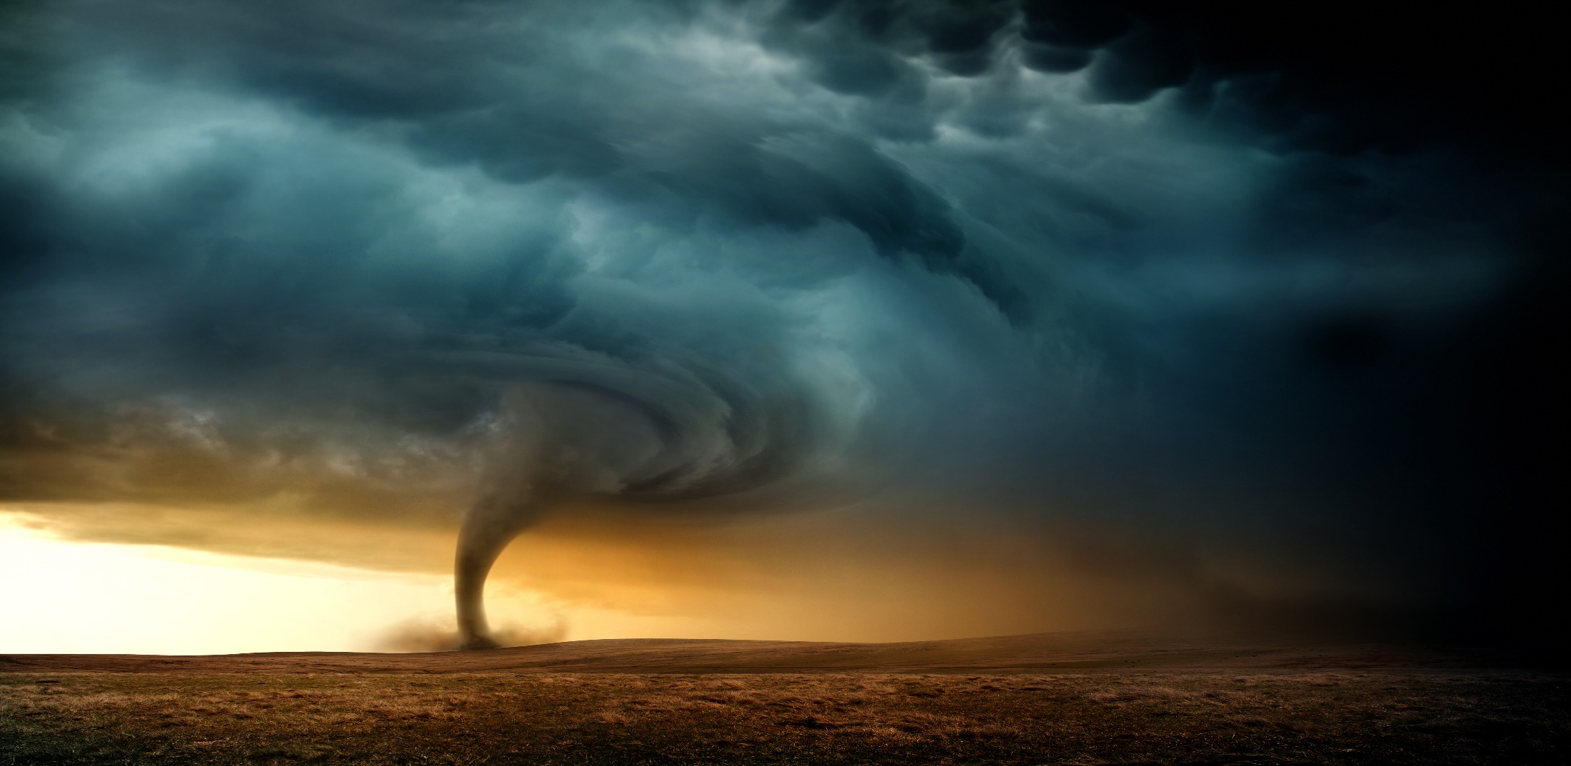
Jesus Help Me Through This Storm
By Pastor Fee Soliven
Psalm 107:23-32
Sunday Morning
April 22, 2020

Slide 3
23 Those who go down to the sea in ships, Who do business on great waters, 24 They see the works of the LORD, And His wonders in the deep. 25 For He commands and raises the stormy wind, Which lifts up the waves of the sea.

Slide 4
26 They mount up to the heavens, They go down again to the depths; Their soul melts because of trouble. 27 They reel to and fro, and stagger like a drunken man, And are at their wits' end. 28 Then they cry out to the LORD in their trouble, And He brings them out of their distresses. 29 He calms the storm, So that its waves are still.

Slide 5
30 Then they are glad because they are quiet; So He guides them to their desired haven. 31 Oh, that men would give thanks to the LORD for His goodness, And for His wonderful works to the children of men! 32 Let them exalt Him also in the assembly of the people, And praise Him in the company of the elders.

Slide 6
We all experience storms in our lives, those occasions that bring pain, suffering, or loss.

Slide 7
Where is God?
Why has this happened?
Was it something I did?
Did God cause it?
If so, why?

Slide 8
Psalm 103:19
“The Lord has established His throne in the heavens, and His sovereignty rules over all.”

Slide 9
1 Peter 4:12-13
12 Beloved, do not think it strange concerning the fiery trial which is to try you, as though some strange thing happened to you; 13 but rejoice to the extent that you partake of Christ's sufferings, that when His glory is revealed, you may also be glad with exceeding joy.

Slide 10
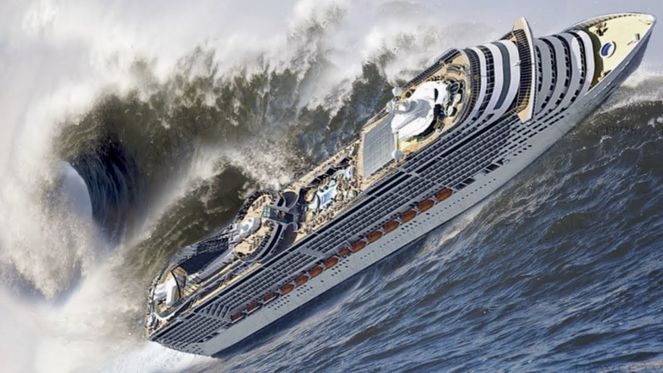
Romans 3:18
“There is no fear of God before their eyes.”

Slide 11
Was God in the storm?

Slide 12
Psalm 107:25
“For He commands and raises the stormy wind, Which lifts up the waves of the sea”

Slide 13
Proverbs 16:1-4
(Living Bible Translation)
1 We can make our plans, but the final outcome is in God's hands. 2 We can always "prove" that we are right, but is the Lord convinced? 3 Commit your work to the Lord, then it will succeed. 4 The Lord has made everything for his own purposes-even the wicked, for punishment.

Slide 14
There are three kinds of storms

Slide 15
1. Natural Storms

Slide 16
2. Emotional Storms

Slide 17
3. Spiritual storms

Slide 18
1. Natural Storms

Slide 19
2. Emotional Storms

Slide 20
Poor Health

Slide 21
Financial Struggles

Slide 22
Relationship Difficulties

Slide 23
3. Spiritual Storms

Slide 24
What are the sources of
our Storms?

Slide 25
1. Ourselves

Slide 26
2. The devil

Slide 27
2 Samuel 11:1-5
1 It happened in the spring of the year, at the time when kings go out to battle, that David sent Joab and his servants with him, and all Israel; and they destroyed the people of Ammon and besieged Rabbah. But David remained at Jerusalem. 2 Then it happened one evening that David arose from his bed and walked on the roof of the king's house. And from the roof he saw a woman bathing, and the woman was very beautiful to behold.

Slide 28
3 So David sent and inquired about the woman. And someone said, "Is this not Bathsheba, the daughter of Eliam, the wife of Uriah the Hittite?" 4 Then David sent messengers, and took her; and she came to him, and he lay with her, for she was cleansed from her impurity; and she returned to her house. 5 And the woman conceived; so she sent and told David, and said, "I am with child."

Slide 29
David was where he shouldn’t have been

Slide 30
He saw what he should
not have seen

Slide 31
His look turned to lust, and he sent for her

Slide 32
His lust gave birth to an act of sin

Slide 33
3. God

Slide 34
Why does God allow storms in our lives?

Slide 35
1. To get our Attention

Slide 36
2. To bring us to Repentance

Slide 37
Why does God allow storms in
our lives?

Slide 38
3. To conform us to Christ’s Image

Slide 39
4. To Equip us for Service

Slide 40
5. To demonstrate His Power in our Lives

Slide 41
6. To reveal Himself to Us

Slide 42
7. To Demonstrate His Love

Slide 43
8. To Remind us who is in Control

Slide 44
1. How do you usually respond to the storms in your life?

Slide 45
2. How does it make you feel knowing that God is in control?

Slide 46
3. As you look back on past storms, what has the Lord taught you about Himself and His ways?

Slide 47
1 Corinthians 15:50-58
50 Now this I say, brethren, that flesh and blood cannot inherit the kingdom of God; nor does corruption inherit incorruption. 51 Behold, I tell you a mystery: We shall not all sleep, but we shall all be changed-- 52 in a moment, in the twinkling of an eye, at the last trumpet. For the trumpet will sound, and the dead will be raised incorruptible, and we shall be changed.

Slide 48
53 For this corruptible must put on incorruption, and this mortal must put on immortality. 54 So when this corruptible has put on incorruption, and this mortal has put on immortality, then shall be brought to pass the saying that is written: "Death is swallowed up in victory." 55 "O Death, where is your sting? O Hades, where is your victory?"

Slide 49
56 The sting of death is sin, and the strength of sin is the law. 57 But thanks be to God, who gives us the victory through our Lord Jesus Christ. 58 Therefore, my beloved brethren, be steadfast, immovable, always abounding in the work of the Lord, knowing that your labor is not in vain in the Lord.

Slide 50
Acts 2:38-39
38 Then Peter said to them, "Repent, and let every one of you be baptized in the name of Jesus Christ for the remission of sins; and you shall receive the gift of the Holy Spirit. 39 For the promise is to you and to your children, and to all who are afar off, as many as the Lord our God will call."

