Slide 1


Slide 2
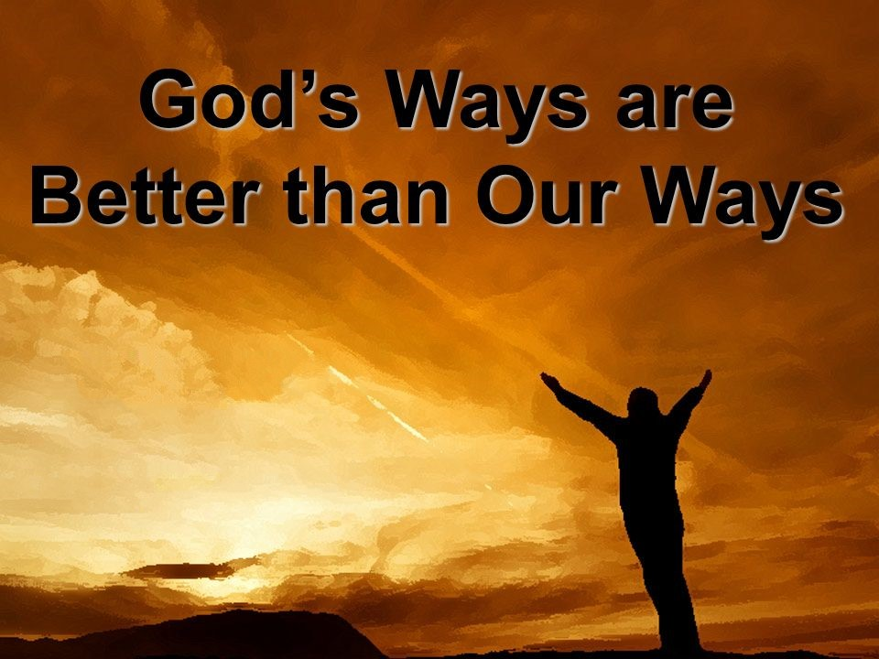

Show Me Your Ways Jesus
By Pastor Fee Soliven
Psalm 27:11-14
Sunday Morning
April 19, 2020

Slide 3
Psalm 27:11-14
11 Teach me Your way, O LORD, And lead me in a smooth path, because of my enemies. 12 Do not deliver me to the will of my adversaries; For false witnesses have risen against me, And such as breathe out violence.

Slide 4
13 I would have lost heart, unless I had believed That I would see the goodness of the LORD In the land of the living. 14 Wait on the LORD; Be of good courage, And He shall strengthen your heart; Wait, I say, on the LORD!

Slide 5
Knowing Biblical Principles is essential for living the Christian life as God Desires

Slide 6
To keep in step with God’s perfect will, we must guard against jumping ahead of Him.

Slide 7
Psalm 27:14
“Wait for the Lord; be strong and let your heart take courage; yes, wait for the Lord.”

Slide 8
God’s Timing isn’t just Good; it’s Perfect!

Slide 9
1 John 3:20-21
“For if our heart condemns us, God is greater than our heart, and knows all things.”

Slide 10
Matthew 10:29-30
29 Are not two sparrows sold for a copper coin? And not one of them falls to the ground apart from your Father's will. 30 But the very hairs of your head are all numbered.

Slide 11
Psalm 139:4
“For there is not a word on my tongue, But behold, O LORD, You know it altogether.”

Slide 12
Isaiah 46:9-10
9 Remember the former things of old, For I am God, and there is no other; I am God, and there is none like Me, 10 Declaring the end from the beginning, And from ancient times things that are not yet done, Saying, 'My counsel shall stand, And I will do all My pleasure,'

Slide 13
Psalm 139:1-3
1 O LORD, You have searched me and known me. 2 You know my sitting down and my rising up; You understand my thought afar off. 3 You comprehend my path and my lying down, And are acquainted with all my ways.

Slide 14
Psalm 139:15-16
15 My frame was not hidden from You, When I was made in secret, And skillfully wrought in the lowest parts of the earth. 16 Your eyes saw my substance, being yet unformed. And in Your book they all were written, The days fashioned for me, When as yet there were none of them.

Slide 15
When God says “Wait,” that’s exactly what He means for us to do.

Slide 16
What are the requirements for Waiting upon God?

Slide 17
Trust

Slide 18
Matthew 7:7
"Ask, and it will be given to you; seek, and you will find; knock, and it will be opened to you.”

Slide 19
Romans 12:9-12
9 Let love be without hypocrisy. Abhor what is evil. Cling to what is good. 10 Be kindly affectionate to one another with brotherly love, in honor giving preference to one another; 11 not lagging in diligence, fervent in spirit, serving the Lord; 12 rejoicing in hope, patient in tribulation, continuing steadfastly in prayer…

Slide 20
1. Patience

Slide 21
Psalm 37:7-9
7 Rest in the LORD, and wait patiently for Him; Do not fret because of him who prospers in his way, Because of the man who brings wicked schemes to pass. 8 Cease from anger, and forsake wrath; Do not fret--it only causes harm. 9 For evildoers shall be cut off; But those who wait on the LORD, They shall inherit the earth.

Slide 22
2. Courage

Slide 23
Psalm 31:23-24
23 Oh, love the LORD, all you His saints! For the LORD preserves the faithful, And fully repays the proud person. 24 Be of good courage, And He shall strengthen your heart, All you who hope in the LORD.

Slide 24
3. Determination

Slide 25
1 Corinthians 9:24-27
24 Do you not know that those who run in a race all run, but one receives the prize? Run in such a way that you may obtain it. 25 And everyone who competes for the prize is temperate in all things. Now they do it to obtain a perishable crown, but we for an imperishable crown.

Slide 26
26 Therefore I run thus: not with uncertainty. Thus I fight: not as one who beats the air. 27 But I discipline my body and bring it into subjection, lest, when I have preached to others, I myself should become disqualified.

Slide 27
Zephaniah 3:8
8 "Therefore wait for Me," says the LORD, "Until the day I rise up for plunder; My determination is to gather the nations To My assembly of kingdoms, To pour on them My indignation, All my fierce anger; All the earth shall be devoured With the fire of My jealousy.

Slide 28
4. Strength

Slide 29
Philippians 4:13
“I can do all things through him who strengthens me.”

Slide 30
Isaiah 41:10
“Fear not, for I am with you; be not dismayed, for I am your God; I will strengthen you, I will help you, I will uphold you with my righteous right hand.”

Slide 31
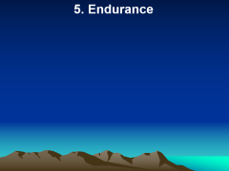
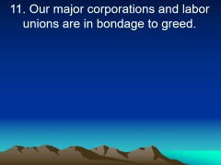
Deuteronomy 31:6
“Be strong and courageous. Do not fear or be in dread of them, for it is the Lord your God who goes with you. He will not leave you or forsake you.”

Slide 32
5. Endurance

Slide 33
Romans 5:3-4
3 More than that, we rejoice in our sufferings, 4 knowing that suffering produces endurance, and endurance produces character, and character produces hope,

Slide 34
James 1:12
12 Blessed is the man who remains steadfast under trial, for when he has stood the test he will receive the crown of life, which God has promised to those who love him.

Slide 35
Hebrews 10:36
For you have need of endurance, so that when you have done the will of God you may receive what is promised.

Slide 36
James 1:2-4
2 Count it all joy, my brothers, when you meet trials of various kinds, 3 for you know that the testing of your faith produces steadfastness. 4 And let steadfastness have its full effect, that you may be perfect and complete, lacking in nothing.

Slide 37
1. What requests are you still waiting for God to answer?

Slide 38
2. Which of His attributes assure you that He is working on your behalf?

Slide 39
3. Do you want the Lord’s will above all else, even if He doesn’t give you what you want when you desire?

Slide 40
4. If not, what is keeping you from trusting Him?

Slide 41
1 Thessalonians 4:13-18
13 But I do not want you to be ignorant, brethren, concerning those who have fallen asleep, lest you sorrow as others who have no hope. 14 For if we believe that Jesus died and rose again, even so God will bring with Him those who sleep in Jesus.

Slide 42
15 For this we say to you by the word of the Lord, that we who are alive and remain until the coming of the Lord will by no means precede those who are asleep. 16 For the Lord Himself will descend from heaven with a shout, with the voice of an archangel, and with the trumpet of God. And the dead in Christ will rise first.

Slide 43
17 Then we who are alive and remain shall be caught up together with them in the clouds to meet the Lord in the air. And thus we shall always be with the Lord. 18 Therefore comfort one another with these words.

Slide 44
Acts 2:38-39
38 Then Peter said to them, "Repent, and let every one of you be baptized in the name of Jesus Christ for the remission of sins; and you shall receive the gift of the Holy Spirit. 39 For the promise is to you and to your children, and to all who are afar off, as many as the Lord our God will call."

