Slide 2
We Need to Seek Your Face God
by Pastor Fee Soliven
Jeremiah 51:6-10
Sunday Morning
April 26, 2020

Slide 3
Jeremiah 51:6-10
6 Flee from the midst of Babylon, And every one save his life! Do not be cut off in her iniquity, For this is the time of the LORD's vengeance; He shall recompense her.

Slide 4
7 Babylon was a golden cup in the LORD's hand, That made all the earth drunk. The nations drank her wine; Therefore the nations are deranged. 8 Babylon has suddenly fallen and been destroyed. Wail for her! Take balm for her pain; Perhaps she may be healed.

Slide 5
9 We would have healed Babylon, But she is not healed. Forsake her, and let us go everyone to his own country; For her judgment reaches to heaven and is lifted up to the skies. 10 The LORD has revealed our righteousness. Come and let us declare in Zion the work of the LORD our God.

Slide 6
1. Close to 70 Million in America have been aborted in the womb since the infamous Supreme Court Decision Roe vs. Wade in 1973 It's been forty years of blood spilling murder!

Slide 7
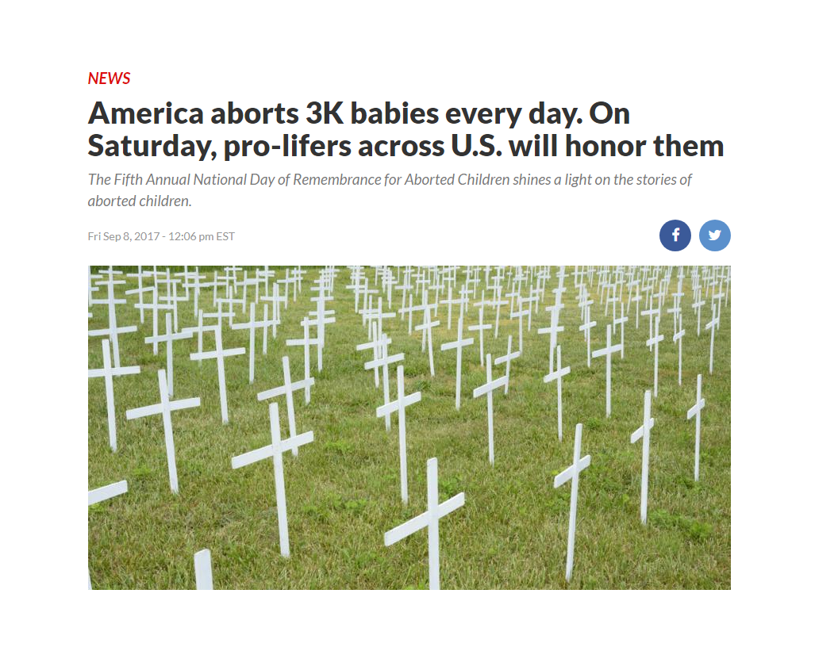

Slide 8
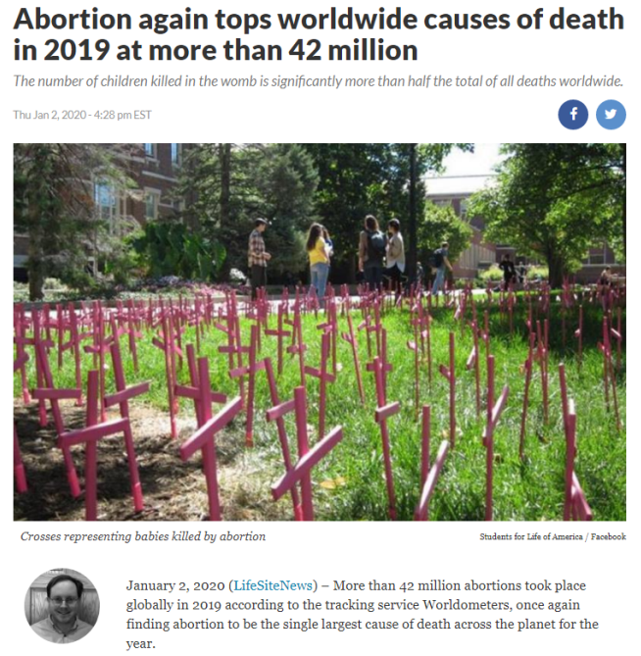

Slide 9
Exodus 20:13
"You shall not murder"

Slide 10
Matthew 19:16-20
16 Now behold, one came and said to Him, "Good Teacher, what good thing shall I do that I may have eternal life?" 17 So He said to him, "Why do you call Me good? No one is good but One, that is, God. But if you want to enter into life, keep the commandments."

Slide 11
18 He said to Him, "Which ones?" Jesus said, " 'You shall not murder,' 'You shall not commit adultery,' 'You shall not steal,' 'You shall not bear false witness,' 19'Honor your father and your mother,' and, 'You shall love your neighbor as yourself."

Slide 12
Matthew 18:1-7
1 At that time the disciples came to Jesus, saying, "Who then is greatest in the kingdom of heaven?" 2 Then Jesus called a little child to Him, set him in the midst of them,

Slide 13
3 and said, "Assuredly, I say to you, unless you are converted and become as little children, you will by no means enter the kingdom of heaven. 4 Therefore whoever humbles himself as this little child is the greatest in the kingdom of heaven.

Slide 14
5 Whoever receives one little child like this in My name receives Me. 6 "But whoever causes one of these little ones who believe in Me to sin, it would be better for him if a millstone were hung around his neck, and he were drowned in the depth of the sea. 7 Woe to the world because of offenses!

Slide 15
2 Kings 17:13-18
13 Yet the LORD testified against Israel and against Judah, by all of His prophets, every seer, saying, "Turn from your evil ways, and keep My commandments and My statutes, according to all the law which I commanded your fathers, and which I sent to you by My servants the prophets."

Slide 16
14 Nevertheless they would not hear, but stiffened their necks, like the necks of their fathers, who did not believe in the LORD their God.

Slide 17
15 And they rejected His statutes and His covenant that He had made with their fathers, and His testimonies which He had testified against them; they followed idols, became idolaters, and went after the nations who were all around them, concerning whom the LORD had charged them that they should not do like them.

Slide 18
16 So they left all the commandments of the LORD their God, made for themselves a molded image and two calves, made a wooden image and worshiped all the host of heaven, and served Baal.

Slide 19
17 And they caused their sons and daughters to pass through the fire, practiced witchcraft and soothsaying, and sold themselves to do evil in the sight of the LORD, to provoke Him to anger.

Slide 20
18 Therefore the LORD was very angry with Israel, and removed them from His sight; there was none left but the tribe of Judah alone.

Slide 21
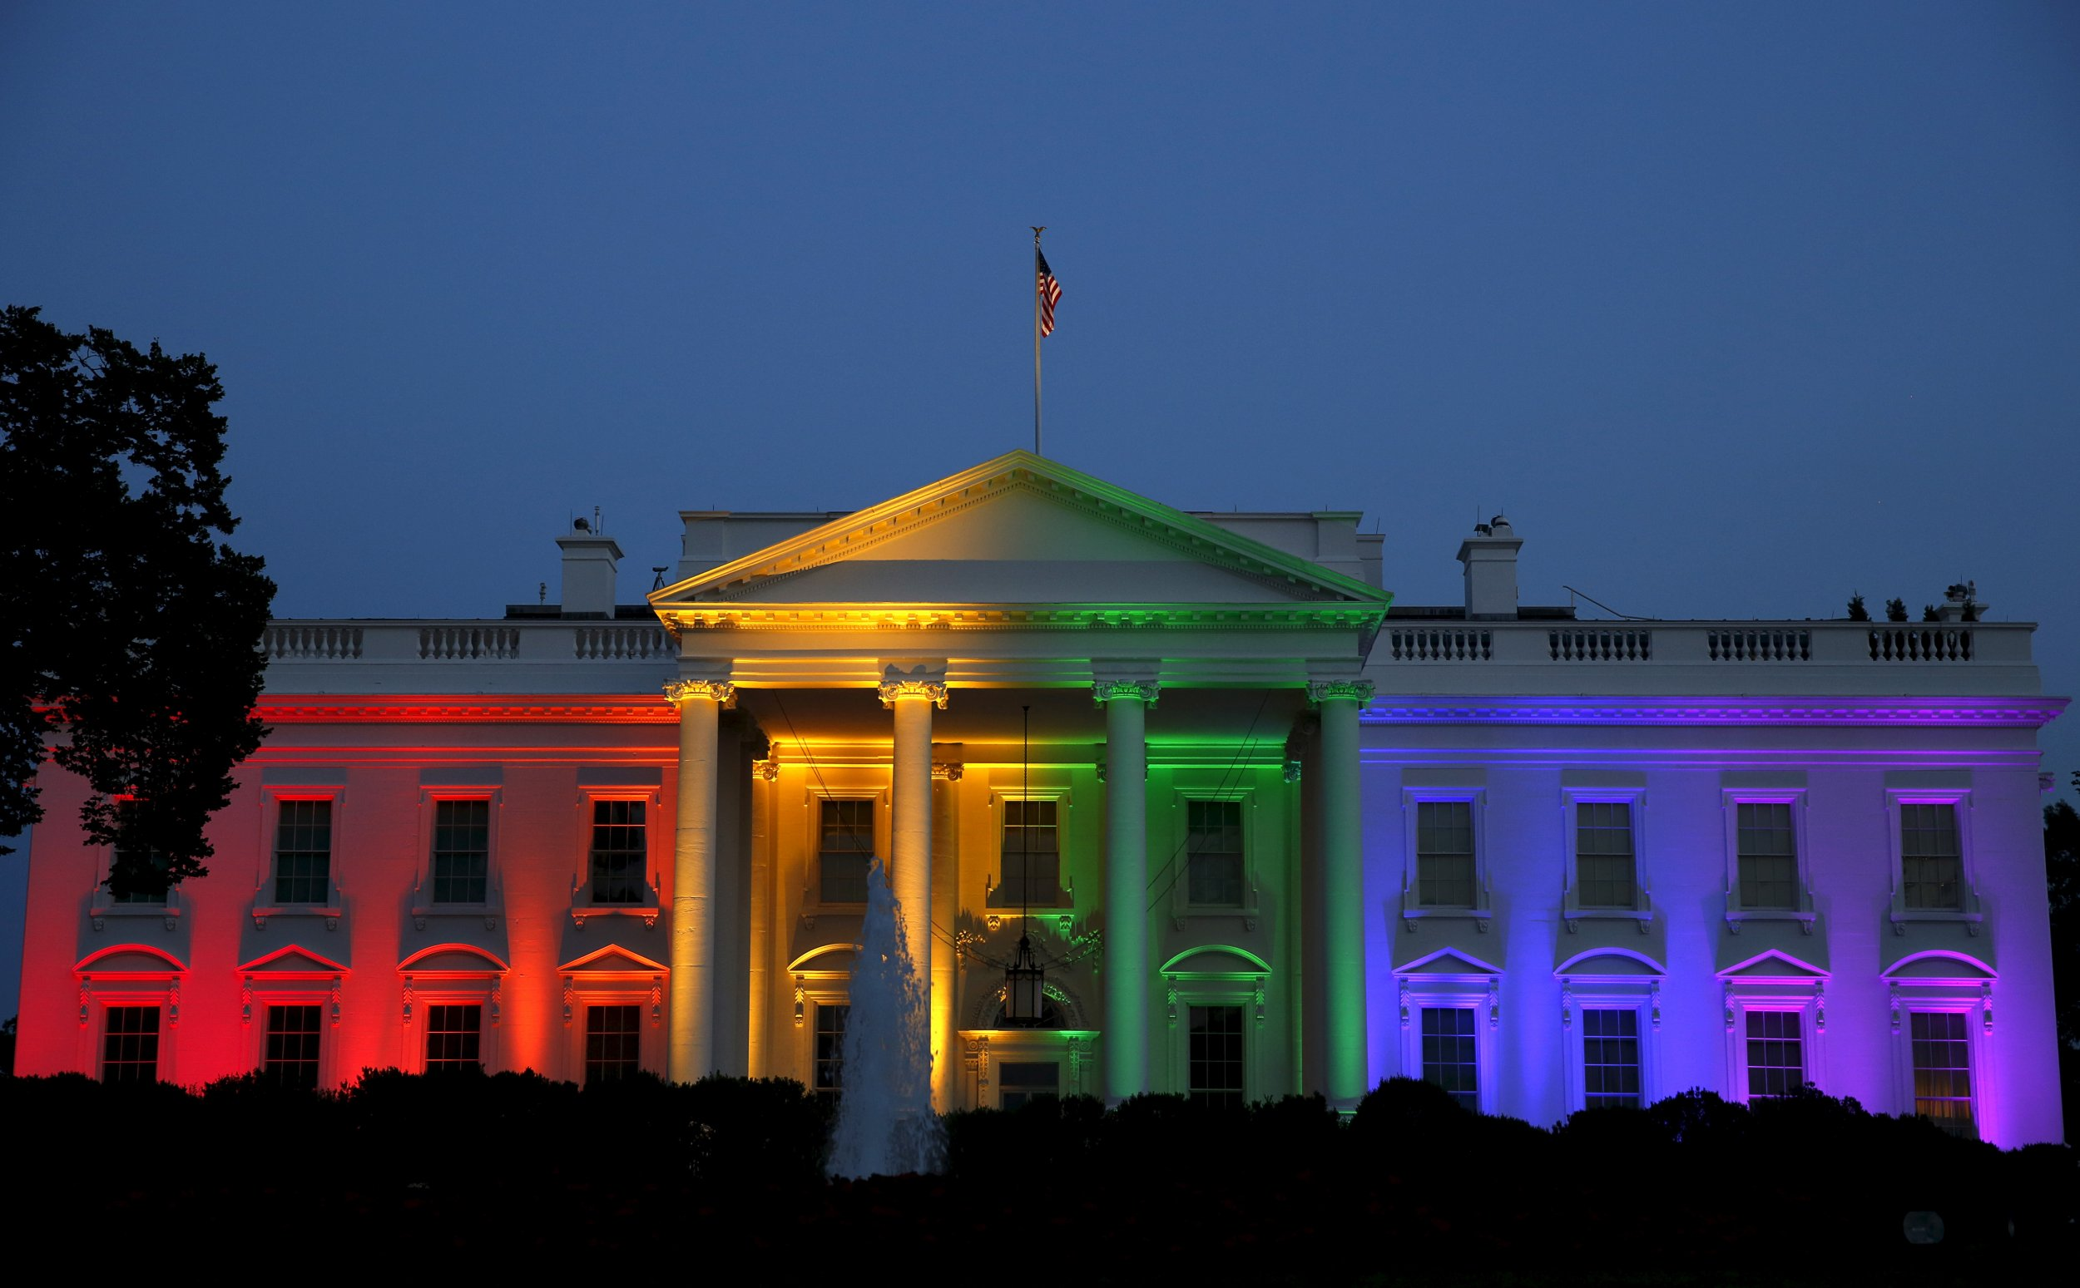
2. The Agenda now for this new age that started in 2015 is for every State of the Union to legalize same Sex Marriage promoted by then
President Obama

Slide 22
Leviticus 18:22
“Do not practice homosexuality, having sex with another man as with a woman. It is a detestable (Abomination) sin"

Slide 23
Romans 1:18-32
(New Living Translation)
18 But God shows his anger from heaven against all sinful, wicked people who suppress the truth by their wickedness. 19 They know the truth about God because he has made it obvious to them.

Slide 24
20 For ever since the world was created, people have seen the earth and sky. Through everything God made, they can clearly see his invisible qualities—his eternal power and divine nature. So theyhave no excuse for not knowing God.

Slide 25
21 Yes, they knew God, but they wouldn’t worship him as God or even give him thanks. And they began to think up foolish ideas of what God was like. As a result, their minds became dark and confused.

Slide 26
22 Claiming to be wise, they instead became utter fools. 23 And instead of worshiping the glorious, ever-living God, they worshiped idols made to look like mere people and birds and animals and reptiles. 24 So God abandoned them to do whatever shameful things their hearts desired. As a result, they did vile and degrading things with each other’s bodies.

Slide 27
25 They traded the truth about God for a lie. So they worshiped and served the things God created instead of the Creator himself, who is worthy of eternal praise! Amen. 26 That is why God abandoned them to their shameful desires. Even the women turned against the natural way to have sex and instead indulged in sex with each other.

Slide 28
27 And the men, instead of
having normal sexual relations with women, burned with lust for each other. Men did shameful things with other men, and as a result of this sin, they suffered within themselves the penalty they deserved.

Slide 29
28 Since they thought it foolish to acknowledge God, he abandoned them to their foolish thinking and let them do things that should never be done. 29 Their lives became full of every kind of wickedness, sin, greed, hate, envy, murder, quarreling, deception, malicious behavior, and gossip.

Slide 30
30 They are backstabbers, haters of God, insolent, proud, and boastful. They invent new ways of sinning, and they disobey their parents. 31 They refuse to understand, break their promises, are heartless, and have no mercy.

Slide 31
32 They know God’s justice requires that those who do these things deserve to die, yet they do them anyway. Worse yet, they encourage others to do them, too.

Slide 32
Jude 5-7 (New Living Translation)
5 So I want to remind you, though you already know these things, that Jesus* first rescued the nation of Israel from Egypt, but later he destroyed those who did not remain faithful.

Slide 33
6 And I remind you of the angels who did not stay within the limits of authority God gave them but left the place where they belonged. God has kept them securely chained in prisons of darkness, waiting for the great day of judgment.

Slide 34
7 And don’t forget Sodom and Gomorrah and their neighboring towns, which were filled with immorality and every kind of sexual perversion. Those cities were destroyed by fire and serve as a warning of the eternal fire of God’s judgment.

Slide 35
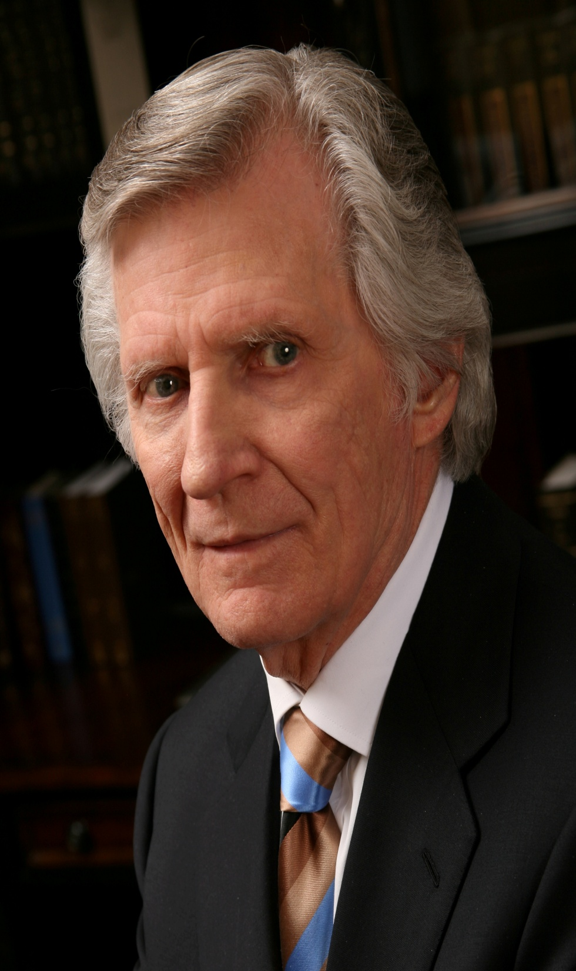
In 1973 & 2011 Evangelist David Wilkerson had 2 of the same visions that hundreds of cities across America will be on fire because of pandemic outbreaks. Looting and pillaging will be rampant. America will be at war within it’s self!

Slide 36
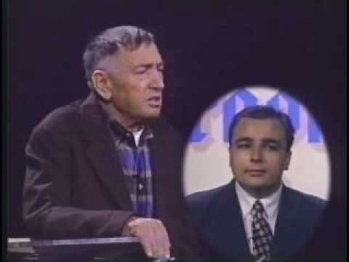
The Prophet from Romania by the name of Dumitru Duduman had a visitation from an Angel in 1984 and showed him 7 major cities in America and called them Sodom & Gomorra. The Angel showed him how Russia was going to drop nuclear missiles on those cities such as LA, NY, Las Vegas, Miami, Chicago, New Orleans and San Francisco.

Slide 37
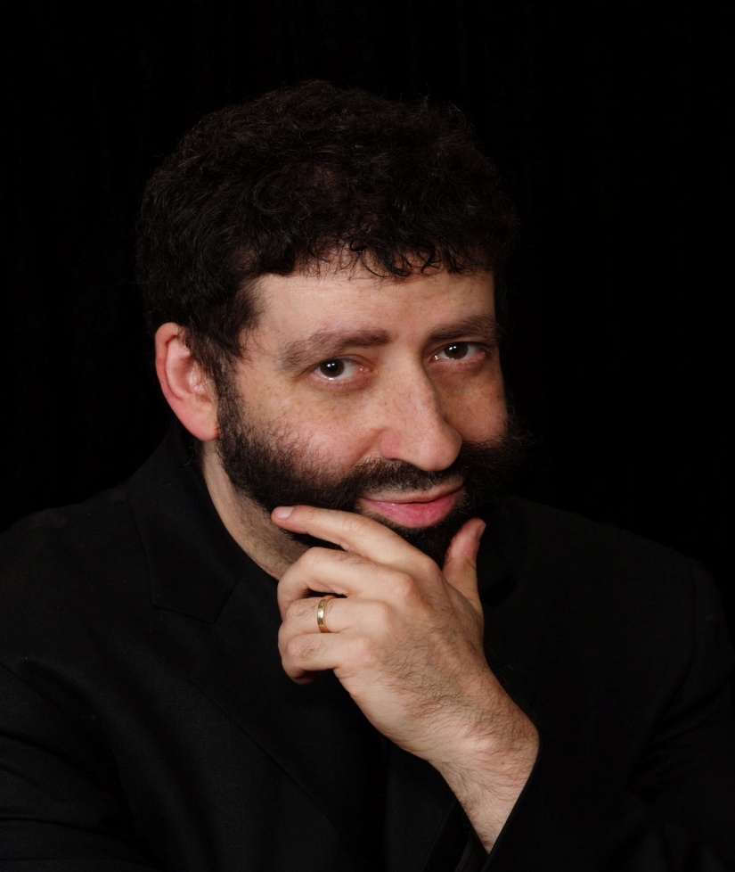
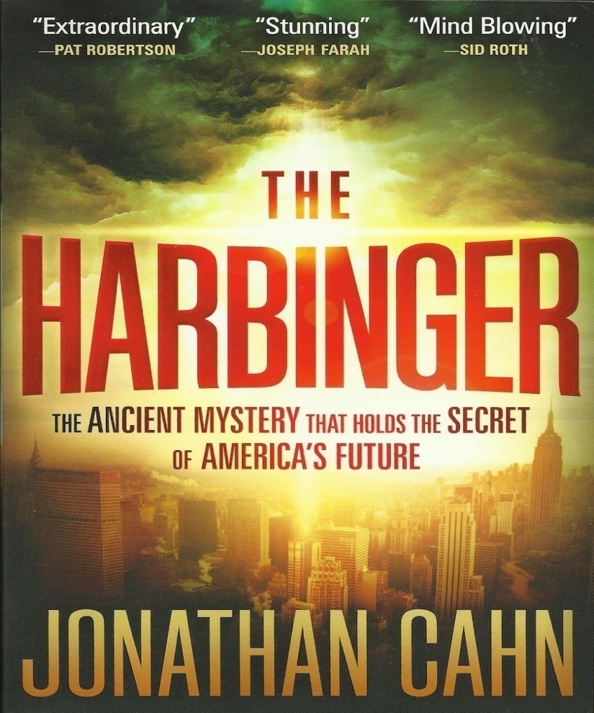
Pastor Jonathan Cahn wrote a book entitled “The Harbinger” and has appeared on the Sid Roth show “it’s Supernatural”, the 700 Club and TBN. God has shown him that in 2020 it will be the next Major Judgment upon America!

Slide 38
On September 11, 2001
The Twin Towers in New York City were struck by Saudia Arabia Terrorists that hijacted commercial planes and killed 2,996

Slide 39
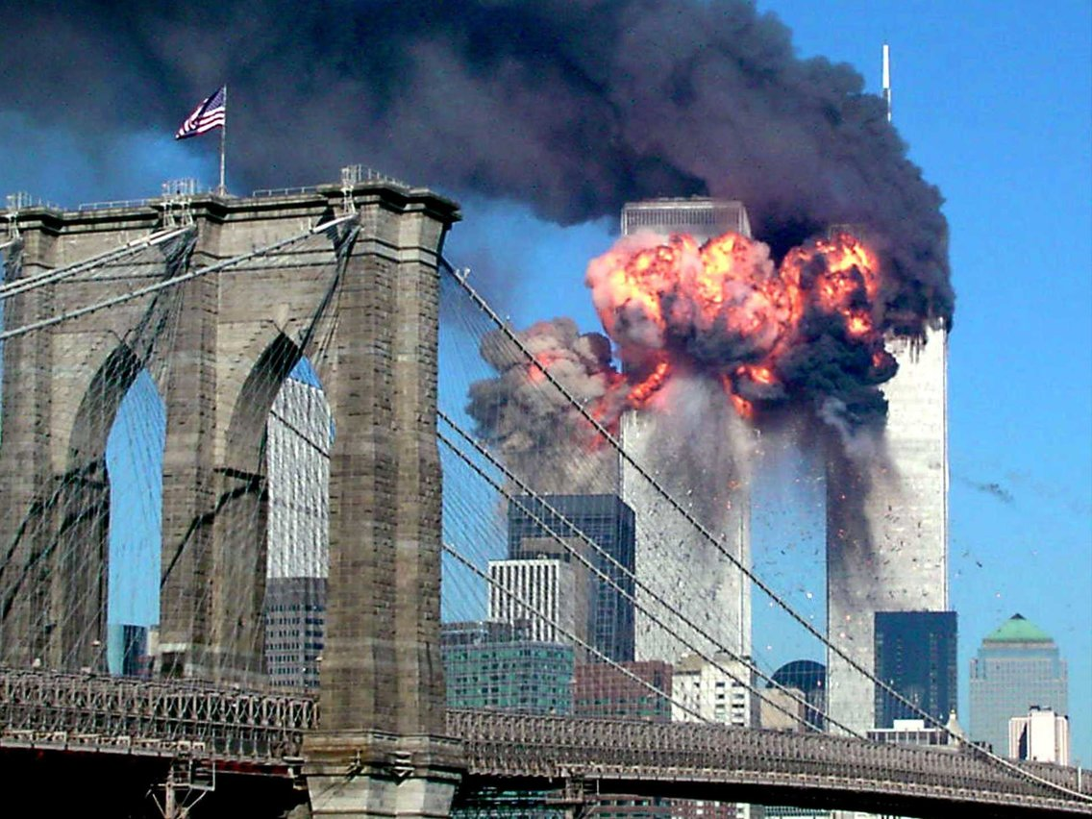
COVID 19 Path of Destruction
World Wide 194,456 deaths
America 50,360 deaths
California 1,537 deaths
San Diego 102 deaths
Epicenter New York 15,740

Slide 40
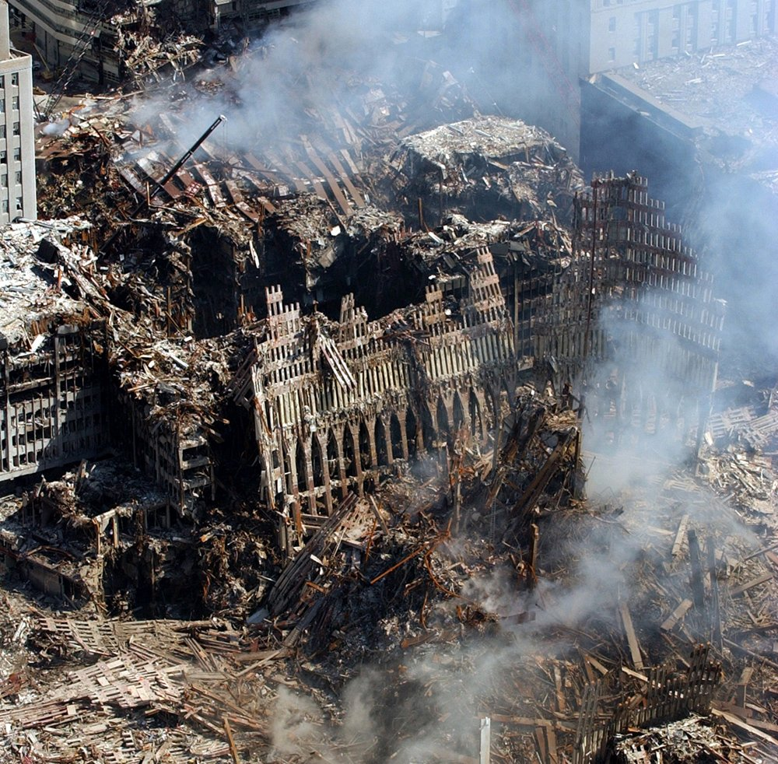
COVID 19 Path of Destruction
World Wide 194,456 deaths
America 50,360 deaths
California 1,537 deaths
San Diego 102 deaths
Epicenter New York 15,740

Slide 41
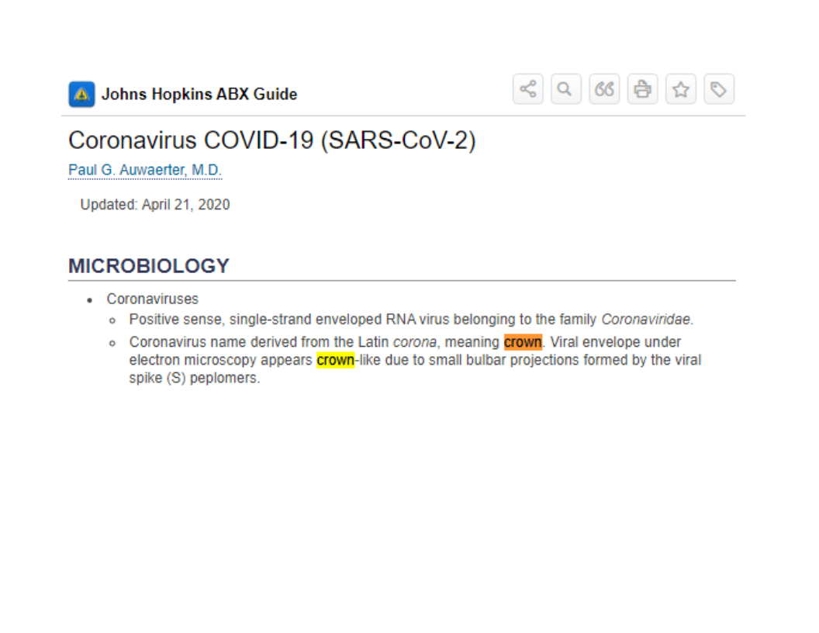
COVID 19 Path of Destruction
World Wide 194,456 deaths
America 50,360 deaths
California 1,537 deaths
San Diego 102 deaths
Epicenter New York 15,740

Slide 42
COVID 19 Path of Destruction
World Wide 194,456 deaths
America 50,360 deaths
California 1,537 deaths
San Diego 102 deaths
Epicenter New York 15,740

Slide 43
Here’s The Irony
When a great shaking came to America on September 11, 2001
19
Years Later a Greater Shaking has occurred in America with the Epicenter in New York Called
CORNOVIRUS (COVID 19)

Slide 44
COVID 19 Path of Destruction
World Wide 194,456 deaths
America 50,360 deaths
California 1,537 deaths
San Diego 102 deaths
The Epicenter is in New York with 15,740 deaths

Slide 45
COVID 19 Path of Destruction
World Wide 194,456 deaths
America 50,360 deaths
California 1,537 deaths
San Diego 102 deaths
The Epicenter is in New York with 15,740 deaths

Slide 46
Proverbs 14:34
"Righteousness exalts a nation, But sin is a reproach to any people"

Slide 47
Psalm 9:17
"The wicked shall be turned into hell, And all the nations that forget God"

Slide 48
Jeremiah 51:6-10
6 Flee from the midst of Babylon, And every one save his life! Do not be cut off in her iniquity, For this is the time of the LORD's vengeance; He shall recompense her. 7 Babylon was a golden cup in the LORD's hand, That made all the earth drunk. The nations drank her wine; Therefore the nations are deranged.

Slide 49
8 Babylon has suddenly fallen and been destroyed. Wail for her! Take balm for her pain; Perhaps she may be healed. 9 We would have healed Babylon, But she isnot healed. Forsake her, and let us go everyone to his own country; For her judgment reaches to heaven and is lifted up to the skies. 10 The LORD has revealed our righteousness. Come and let us declare in Zion the work of the LORD our God.

Slide 50
Revelation 18:1-20
1 After these things I saw another angel coming down from heaven, having great authority, and the earth was illuminated with his glory. 2 And he cried mightily with a loud voice, saying, "Babylon the great is fallen, is fallen, and has become a dwelling place of demons, a prison for every foul spirit, and a cage for every unclean and hated bird!

Slide 51
3 For all the nations have drunk of the wine of the wrath of her fornication, the kings of theearth have committed fornication with her, and the merchants of the earth have become rich through the abundance of her luxury.“ 4 And I heard another voice from heaven saying, "Come out of her, my people, lest you share in her sins, and lest

Slide 52
5 For her sins have reached to heaven, and God has remembered her iniquities. 6 Render to her just as she rendered to you, and repay her double according to her works; in the cup which she has mixed, mix double for you receive of her plagues.

Slide 53
7 In the measure that she glorified herself and lived luxuriously, in the same measure give her torment and sorrow; for she says in her heart, 'I sit as queen, and am no widow, and will not see sorrow.' 8 "Therefore her plagues will come in one day--death and mourning and famine. And she will be utterly burned with fire, for strong is the Lord God who judges her.

Slide 54
9 "The kings of the earth who committed fornication and lived luxuriously with her will weep and lament for her, when they see the smoke of her burning, 10 standing at a distance for fear of her torment, saying, 'Alas, alas, that great city Babylon, that mighty city! For in one hour your judgment has come.'

Slide 55
11 "And the merchants of the earth will weep andmourn over her, for no one buys their merchandise anymore: 12 merchandise of gold and silver, precious stones and pearls, fine linen and purple, silk and scarlet, every kind of citron wood, every kind of object of ivory, every kind of object of most precious wood, bronze, iron, and marble;

Slide 56
13 and cinnamon and incense, fragrant oil and frankincense, wine and oil, fine flour and wheat, cattle and sheep, horses and chariots, and bodies and souls of men. 14 The fruit that your soul longed for has gone from you, and all the things which are rich and splendid have gone from you, and you shall find them no more at all.

Slide 57
15 The merchants of these things, who became rich by her, will stand at a distance for fear of her torment, weeping and wailing, 16 and saying, 'Alas, alas, that great city that was clothed in fine linen, purple, and scarlet, and adorned with gold and precious stones and pearls!

Slide 58
17 For in one hour such great riches came to nothing.’ Every shipmaster, all who travel by ship, sailors, and as many as trade on the sea, stood at a distance 18 and cried out when they saw the smoke of her burning, saying, 'What is like this great city!'

Slide 59
19 "They threw dust on their heads andcried out, weeping and wailing, and saying, 'Alas, alas, that great city, in which all who had ships on the sea became rich by her wealth! For in one hour she is made desolate.' 20 "Rejoice over her, O heaven, and you holy apostles and prophets, for God has avenged you on her!"

Slide 60
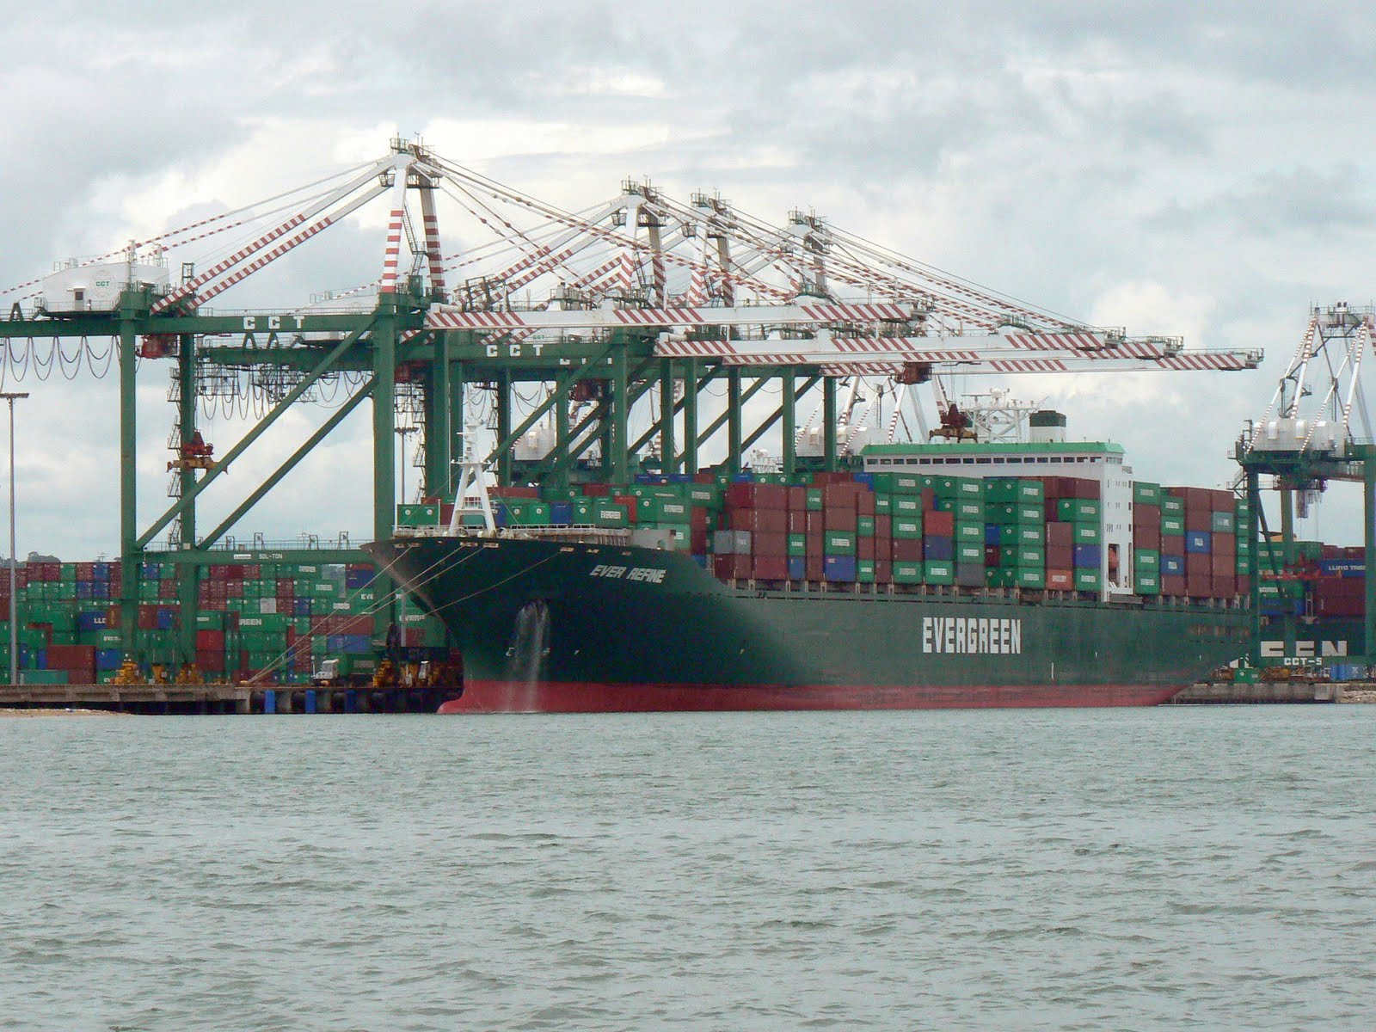

Slide 61
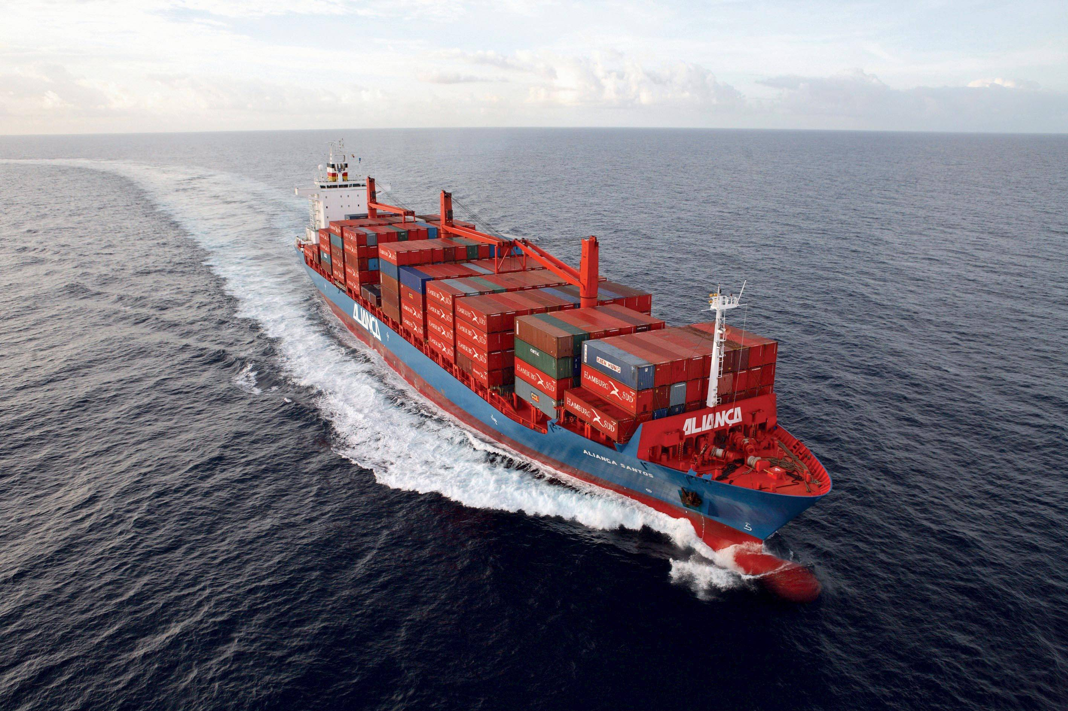

Slide 62
Matthew 24:21-22
21. For then shall be great tribulation, such as was not since the beginning of the world to this time, no, nor ever shall be. 22. And except those days should be shortened, there should no flesh be saved: but for the elect's sake those days shall be shortened.

Slide 64
Repent and Turn Back To God!

Slide 65
2 Chronicles 7:13-15
13 When I shut up heaven and there is no rain, or command the locusts to devour the land, or send pestilence among My people, 14 if My people who are called by My name will humble themselves, and pray and seek My face, and turn from their wicked ways, then I will hear from heaven, and will forgive their sin and heal their land. 15 Now My eyes will be open and My ears attentive to prayer made in this place.

Slide 66
1 Corinthians 15:50-58
50 Now this I say, brethren, that flesh and blood cannot inherit the kingdom of God; nor does corruption inherit incorruption. 51 Behold, I tell you a mystery: We shall not all sleep, but we shall all be changed-- 52 in a moment, in the twinkling of an eye, at the last trumpet. For the trumpet will sound, and the dead will be raised incorruptible, and we shall be changed.

Slide 67
53 For this corruptible must put on incorruption, and this mortal must put on immortality. 54 So when this corruptible has put on incorruption, and this mortal has put on immortality, then shall be brought to pass the saying that is written: "Death is swallowed up in victory." 55 "O Death, where is your sting? O Hades, where is your victory?"

Slide 68
56 The sting of death is sin, and the strength of sin is the law. 57 But thanks be to God, who gives us the victory through our Lord Jesus Christ. 58 Therefore, my beloved brethren, be steadfast, immovable, always abounding in the work of the Lord, knowing that your labor is not in vain in the Lord.

Slide 69
Acts 2:38-39
38 Then Peter said to them, "Repent, and let every one of you be baptized in the name of Jesus Christ for the remission of sins; and you shall receive the gift of the Holy Spirit. 39 For the promise is to you and to your children, and to all who are afar off, as many as the Lord our God will call."

