Slide 2
Jesus is Coming Soon
By Pastor Fee Soliven
Psalm 102:12-17
Sunday Morning
May 3, 2020

Slide 3
Psalm 102:12-17
12 But You, O LORD, shall endure forever, And the remembrance of Your name to all generations. 13 You will arise and have mercy on Zion; For the time to favor her, Yes, the set time, has come. 14 For Your servants take pleasure in her stones, And show favor to her dust.

Slide 4
15 So the nations shall fear the name of the LORD, And all the kings of the earth Your glory. 16 For the LORD shall build up Zion; He shall appear in His glory. 17 He shall regard the prayer of the destitute, And shall not despise their prayer.

Slide 5
1. Israel Would Face Near Extinction Before Christ Returns

Slide 6
Ezekiel 37:1-6
1 The hand of the LORD came upon me and brought me out in the Spirit of the LORD, and set me down in the midst of the valley; and it was full of bones. 2 Then He caused me to pass by them all around, and behold, there were very many in the open valley; and indeed they were very dry.

Slide 7
3 And He said to me, "Son of man, can these bones live?" So I answered, "O Lord GOD, You know." 4 Again He said to me, "Prophesy to these bones, and say to them, 'O dry bones, hear the word of the LORD! 5 Thus says the Lord GOD to these bones: "Surely I will cause breath to enter into you, and you shall live.

Slide 8
6 I will put sinews on you and bring flesh upon you, cover you with skin and put breath in you; and you shall live. Then you shall know that I am the LORD." ' "

Slide 9
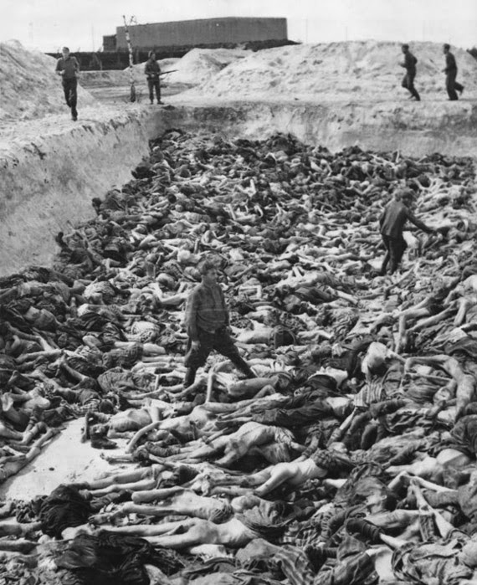
Redeemed From
The Curse Of The Law

Slide 10
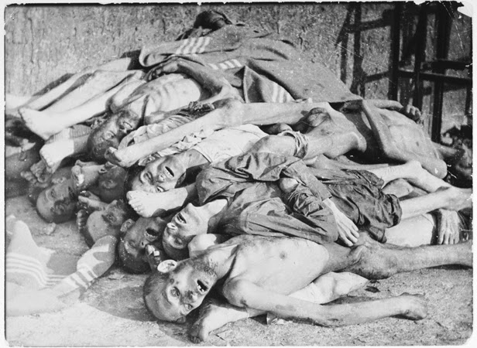
Galatians 3:24-25
24 Therefore the law was our tutor to bring us to Christ, that we might be justified by faith. 25 But after faith has come, we are no longer under a tutor.

Slide 11
2 Corinthians 5:19-21
19 that is, that God was in Christ reconciling the world to Himself, not imputing their trespasses to them, and has committed to us the word of reconciliation. 20 Now then, we are ambassadors for Christ, as though God were pleading through us: we implore you on Christ's behalf, be reconciled to God. 21 For He made Him who knew no sin to be sin for us, that we might become the righteousness of God in Him.

Slide 12
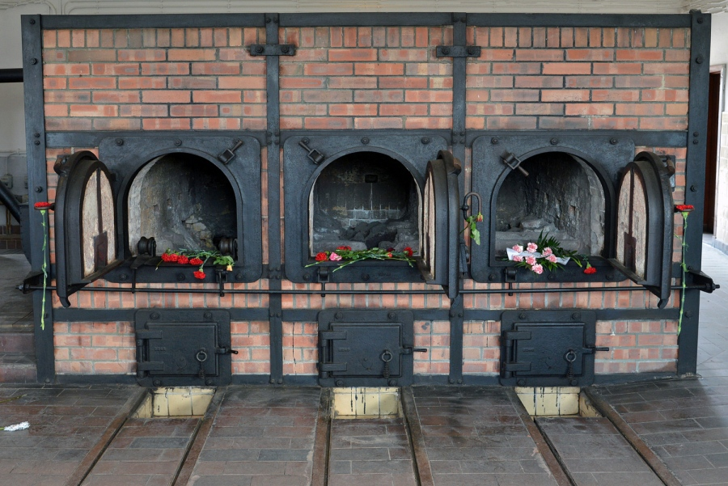
I John 3:16
“Hereby perceive we the love of God, because he laid down his life for us”

Slide 13
2. Israel Would Be Reborn
In One Day

Slide 14
Isaiah 66:8-11
8 Who has heard such a thing? Who has seen such things? Shall the earth be made to give birth in one day? Or shall a nation be born at once? For as soon as Zion was in labor, She gave birth to her children.

Slide 15
9 Shall I bring to the time of birth, and not cause delivery?" says the LORD. "Shall I who cause delivery shut up the womb?" says your God. 10 "Rejoice with Jerusalem, And be glad with her, all you who love her; Rejoice for joy with her, all you who mourn for her;

Slide 16
11 That you may feed and be satisfied With the consolation of her bosom, That you may drink deeply and be delighted With the abundance of her glory."

Slide 17
Joseph Alleine wrote,
“Oh, better were it for you to die in a jail, in a ditch, in a dungeon, than to die in your sins.”

Slide 18
3. Israel Will Be One Nation Not Two

Slide 19
Ezekiel 37:22
“and I will make them one nation in the land, on the mountains of Israel; and one king shall be king over them all; they shall no longer be two nations, nor shall they ever be divided into two kingdoms again.”

Slide 20
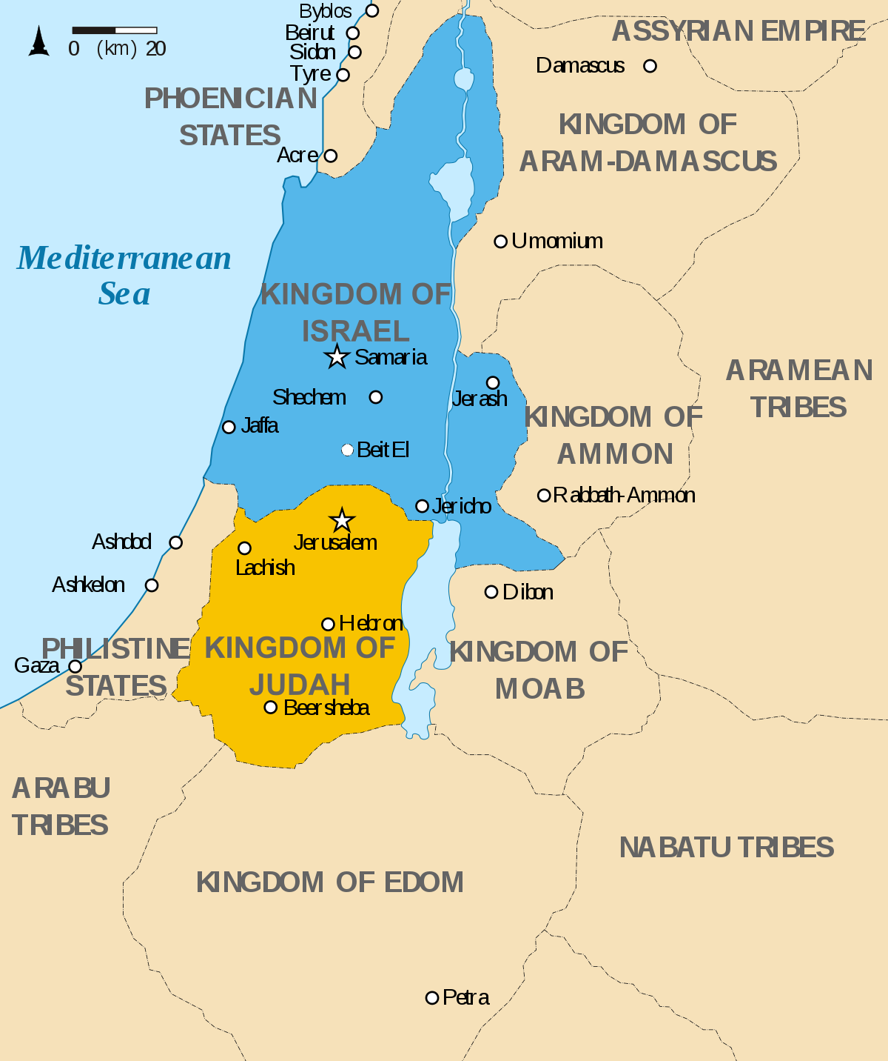
44 You are of your father the devil, and the desires of your father you want to do. He was a murderer from the beginning, and does not stand in the truth, because there is no truth in him. When he speaks a lie, he speaks from his own resources, for he is a liar and the father of it.

Slide 21
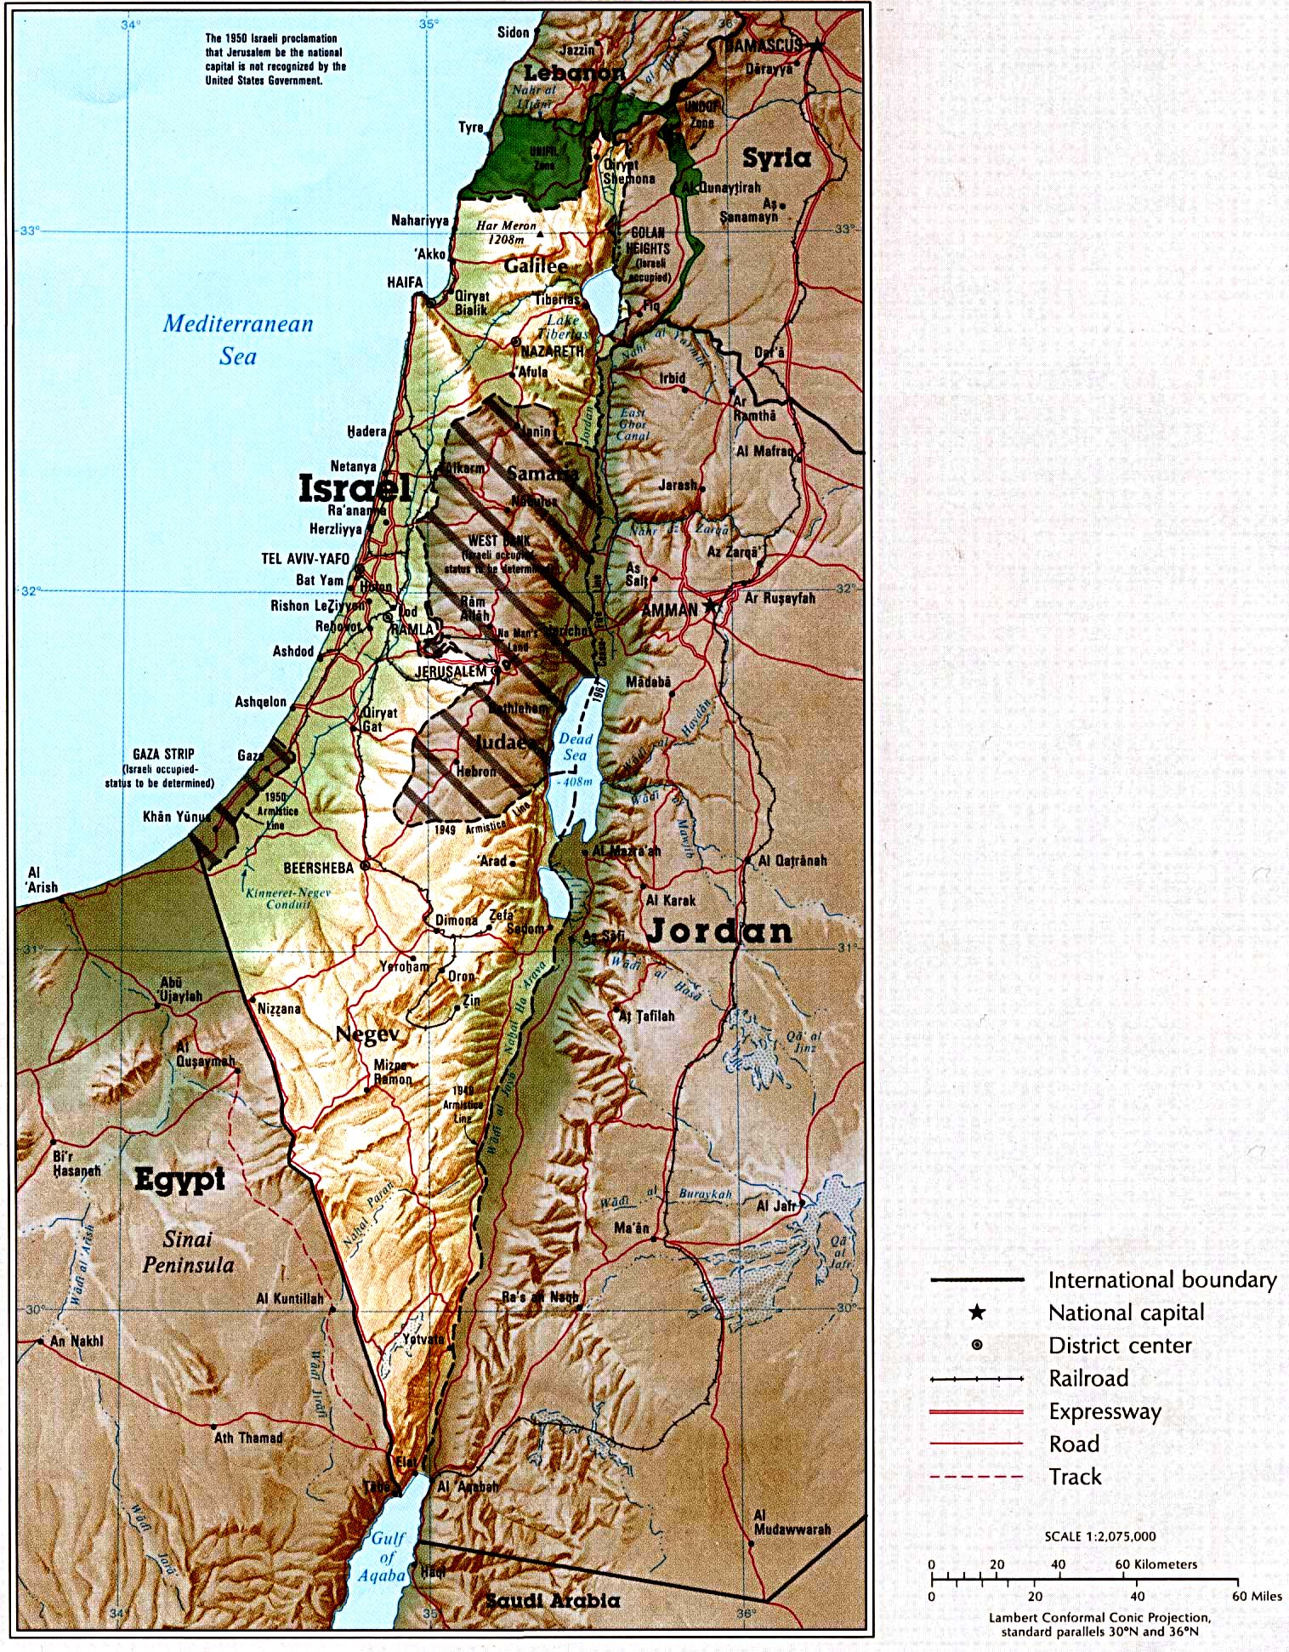
Romans 7:25
“So then with the mind I myself serve the law of God; but with the flesh the law of sin”

Slide 22
4. Israel’s Return Would Be Greater Than The Exodus

Slide 23
Jeremiah 16:14-15
14 "Therefore behold, the days are coming," says the LORD, "that it shall no more be said, 'The LORD lives who brought up the children of Israel from the land of Egypt,' 15 "but, 'The LORD lives who brought up the children of Israel from the land of the north and from all the lands where He had driven them.' For I will bring them back into their land which I gave to their fathers.

Slide 24
Jeremiah 32:37-41
37 Behold, I will gather them out of all countries where I have driven them in My anger, in My fury, and in great wrath; I will bring them back to this place, and I will cause them to dwell safely. 38 They shall be My people, and I will be their God;

Slide 25
39 then I will give them one heart and one way, that they may fear Me forever, for the good of them and their children after them. 40 And I will make an everlasting covenant with them, that I will not turn away from doing them good; but I will put My fear in their hearts so that they will not depart from Me.

Slide 26
41 Yes, I will rejoice over them to do them good, and I will assuredly plant them in this land, with all My heart and with all My soul.'

Slide 27
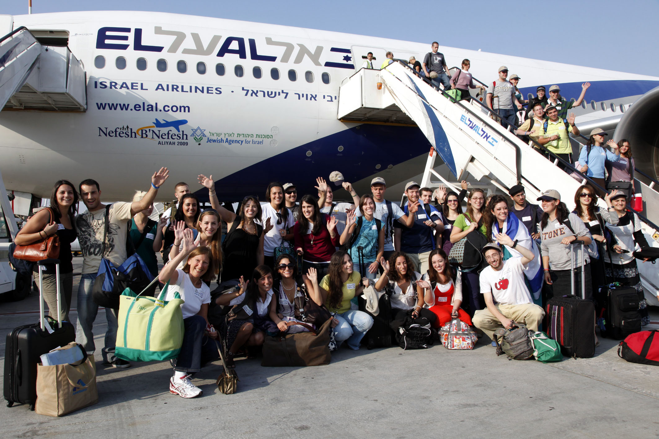
Hebrews 2:17
“Wherefore in all things it behoved him to be made like unto his brethren, that he might be a merciful and faithful high priest in things pertaining to God, to make reconciliation for the sins of the people”

Slide 28
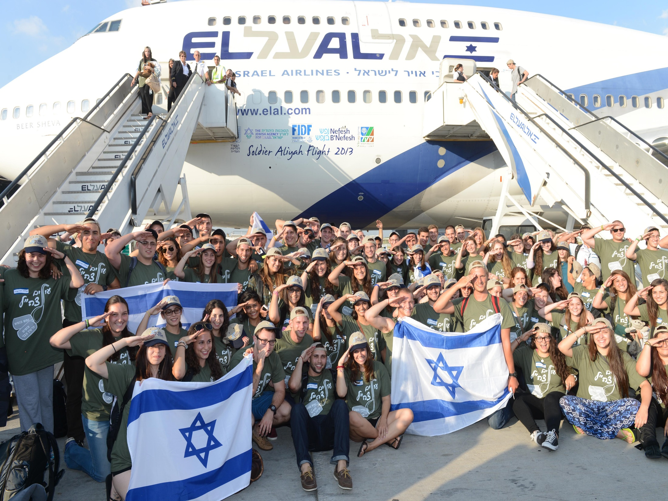
2. Jesus was the only one able to Redeem Us

Slide 29
5. Israel Will Rebuild
Old Cities and Prosper

Slide 30
Amos 9:13-15
13 "Behold, the days are coming," says the LORD, "When the plowman shall overtake the reaper, And the treader of grapes him who sows seed; The mountains shall drip with sweet wine, And all the hills shall flow with it.

Slide 31
14 I will bring back the captives of My people Israel; They shall build the waste cities and inhabit them; They shall plant vineyards and drink wine from them; They shall also make gardens and eat fruit from them. 15 I will plant them in their land, And no longer shall they be pulled up From the land I have given them," Says the LORD your God.

Slide 32
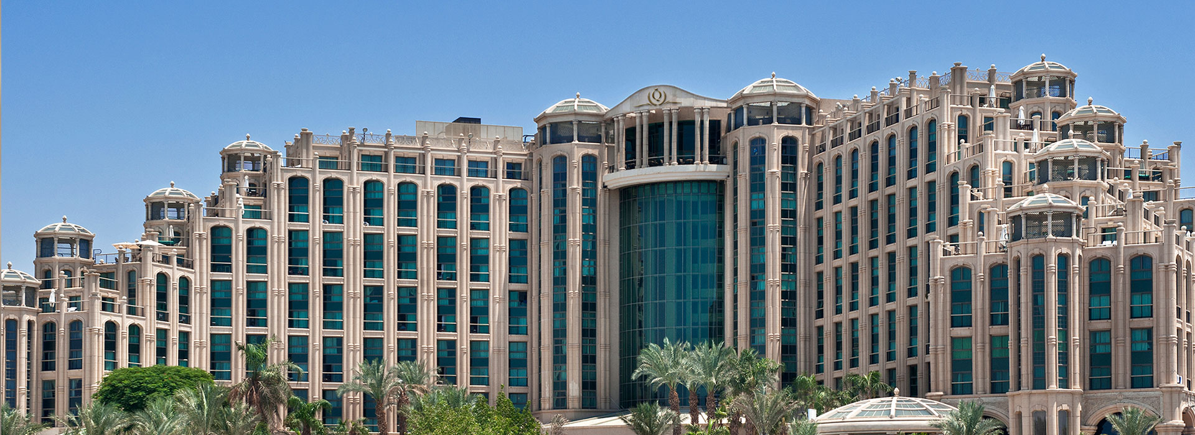
3. Jesus was willing to Redeem Us

Slide 33
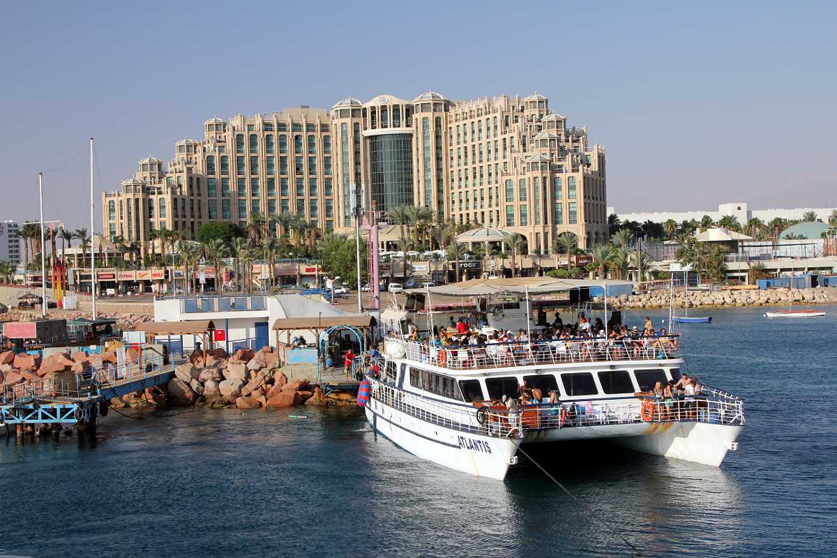
Hebrews 10:7
“Then said I, Lo, I come in the volume of the book it is written of me, to do your will, O God. . . .

Slide 34
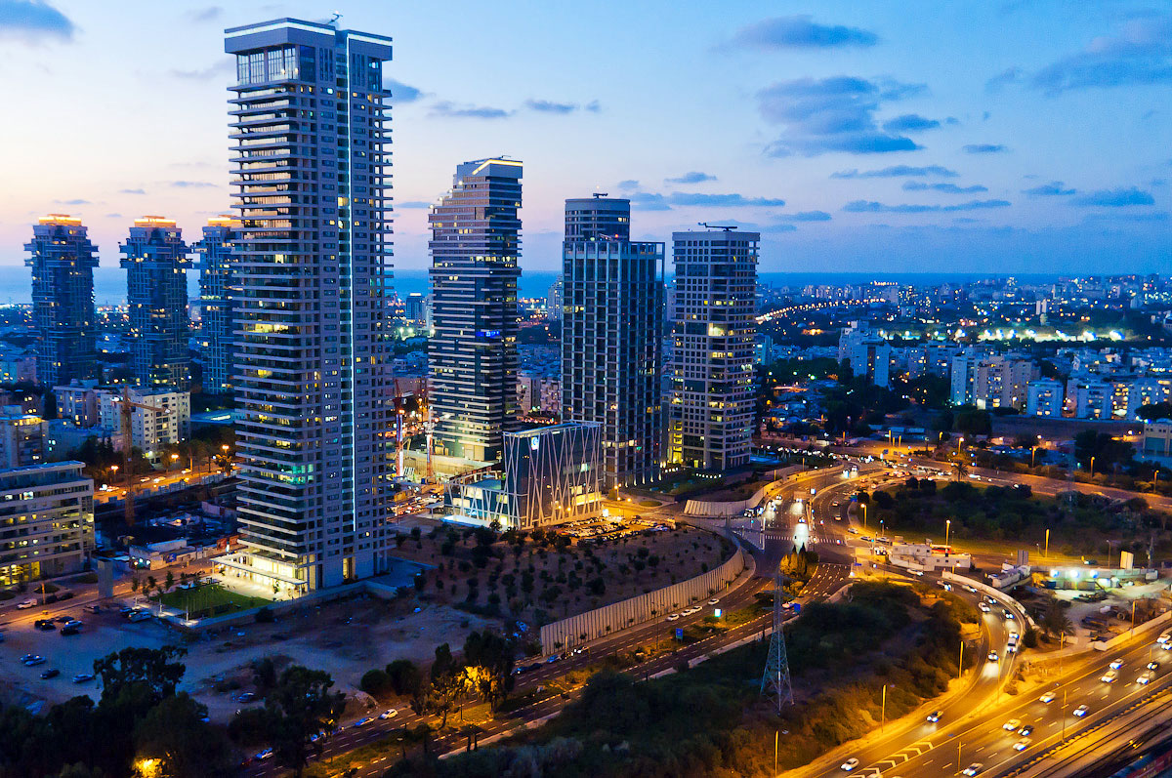
Hebrews 10:10
“By the which will we are sanctified through the offering of the body of Jesus Christ once for all”

Slide 35
6. Israel Would Return And Rebuild A Great Army

Slide 36
Ezekiel 37:10
“So I prophesied as He commanded me, and breath came into them, and they lived, and stood upon their feet, an exceedingly great army.”

Slide 37
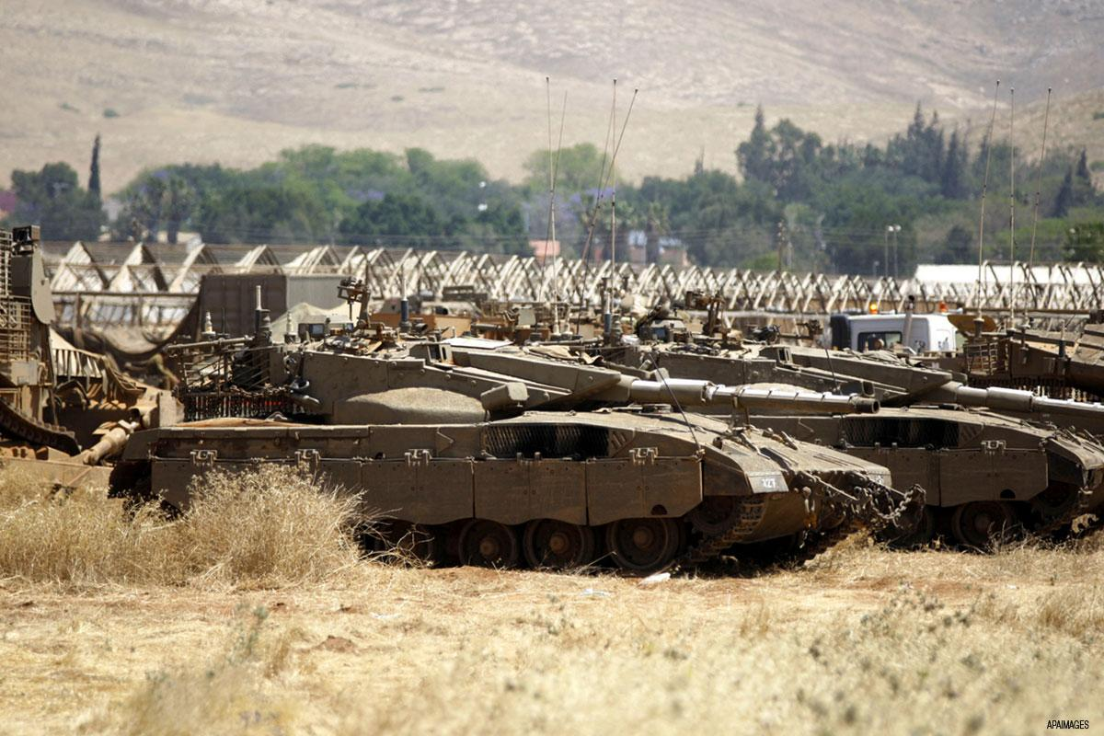
“Cares all past, home at last, ever to rejoice!” All because He redeemed us by His blood!

Slide 38
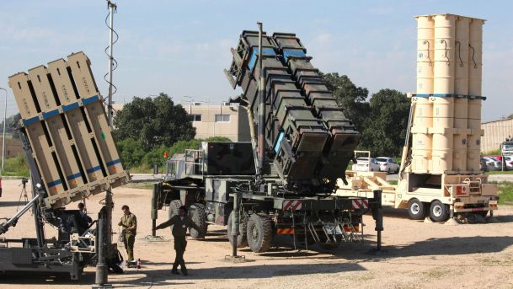
6. Israel Would Return And Rebuild A Great Army

Slide 39
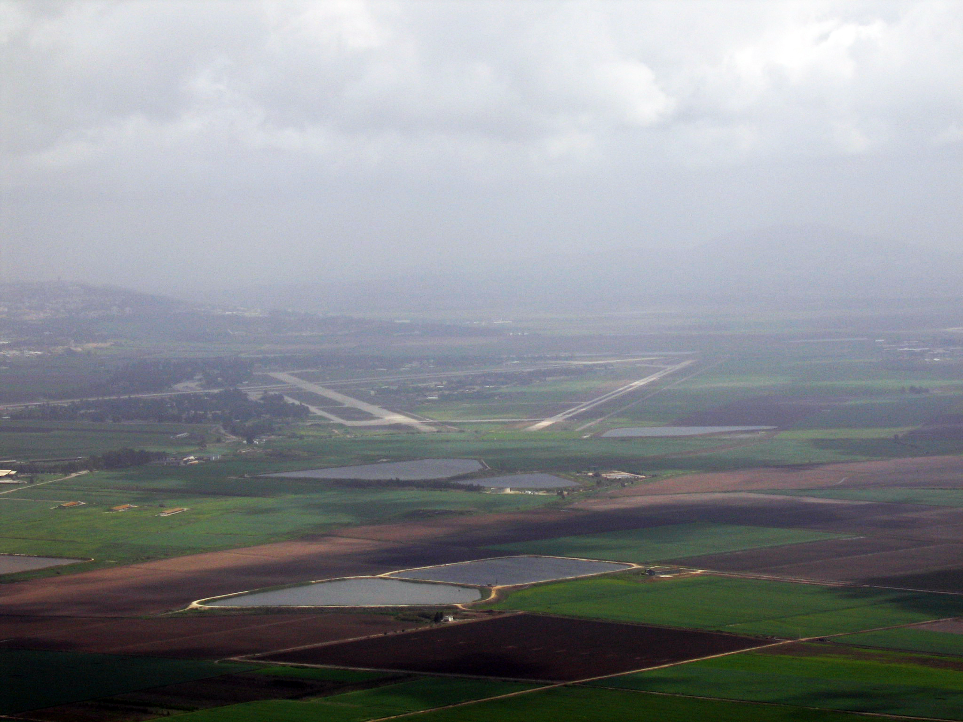
Ezekiel 37:10
“So I prophesied as He commanded me, and breath came into them, and they lived, and stood upon their feet, an exceedingly great army.”

Slide 40
7. Israel Will Fill The Earth With Fruit Grown In Israel

Slide 41
Isaiah 27:6
“Those who come He shall cause to take root in Jacob; Israel shall blossom and bud, And fill the face of the world with fruit.”

Slide 42
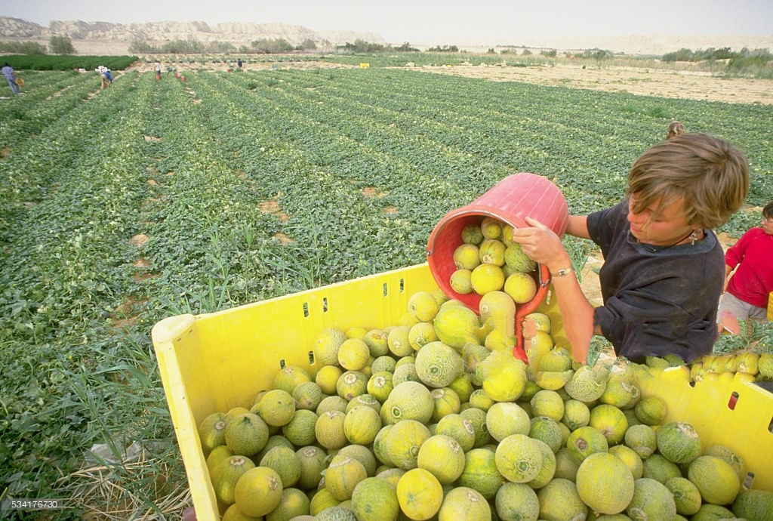
Ezekiel 37:10
“So I prophesied as He commanded me, and breath came into them, and they lived, and stood upon their feet, an exceedingly great army.”

Slide 43
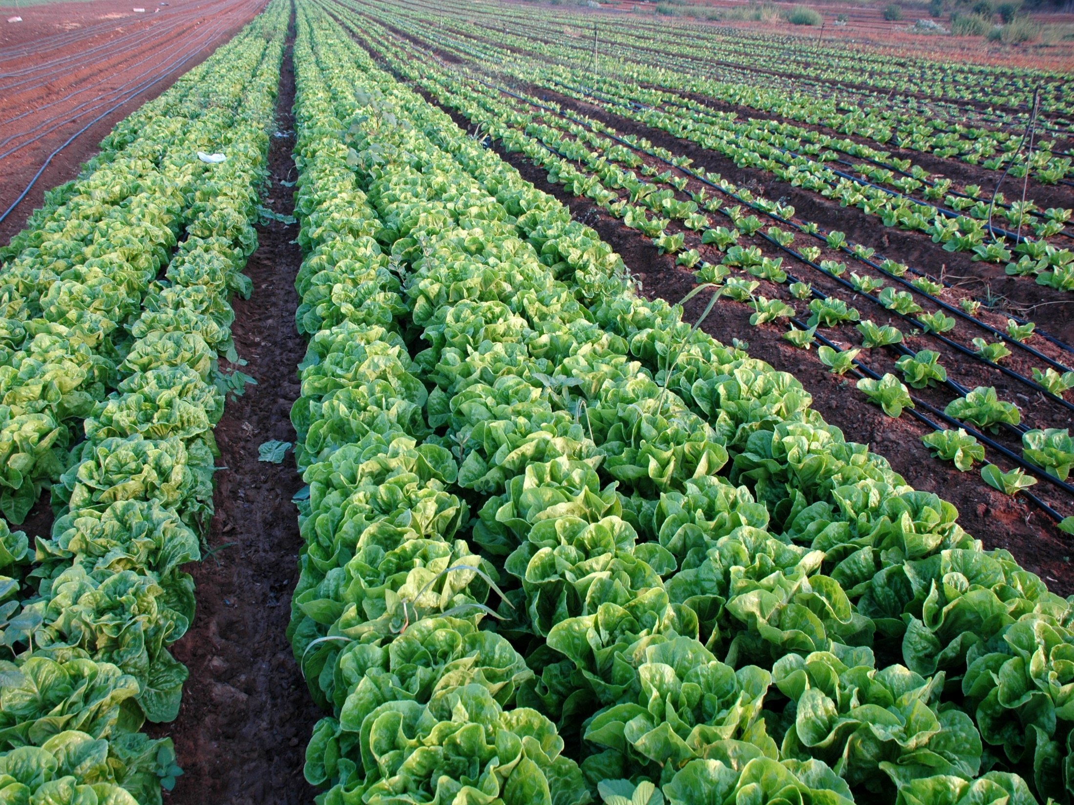
“Cares all past, home at last, ever to rejoice!” All because He redeemed us by His blood!

Slide 44
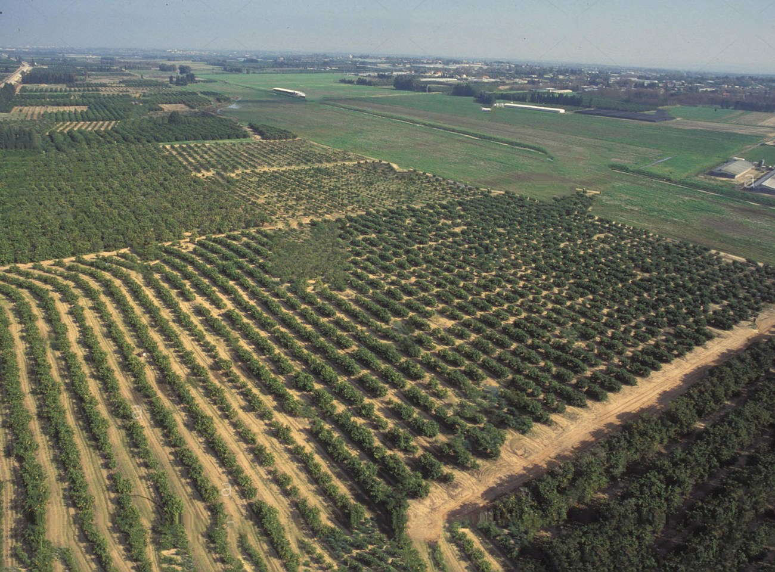
6. Israel Would Return And Rebuild A Great Army

Slide 45
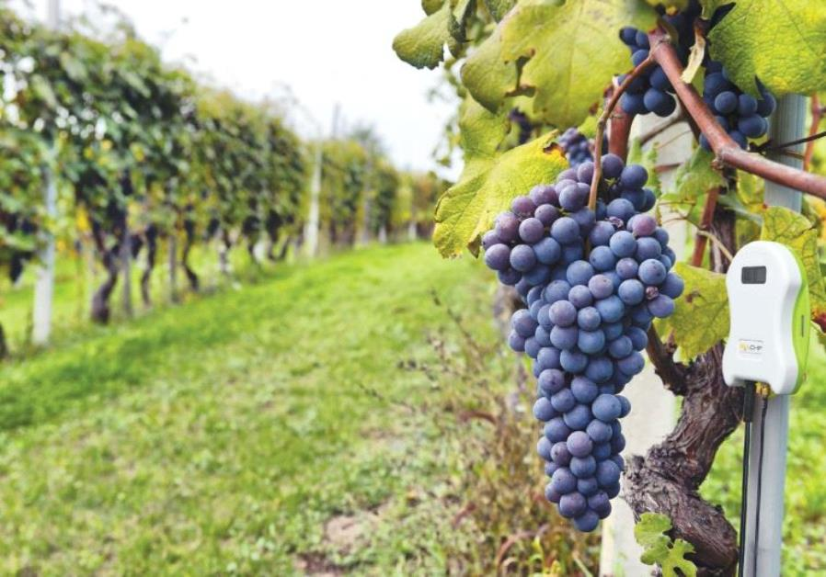
Ezekiel 37:10
“So I prophesied as He commanded me, and breath came into them, and they lived, and stood upon their feet, an exceedingly great army.”

Slide 46
Isaiah 35:1-2
1 The wilderness and the wasteland shall be glad for them, And the desert shall rejoice and blossom as the rose; 2 It shall blossom abundantly and rejoice, Even with joy and singing. The glory of Lebanon shall be given to it, The excellence of Carmel and Sharon. They shall see the glory of the LORD, The excellency of our God.

Slide 47
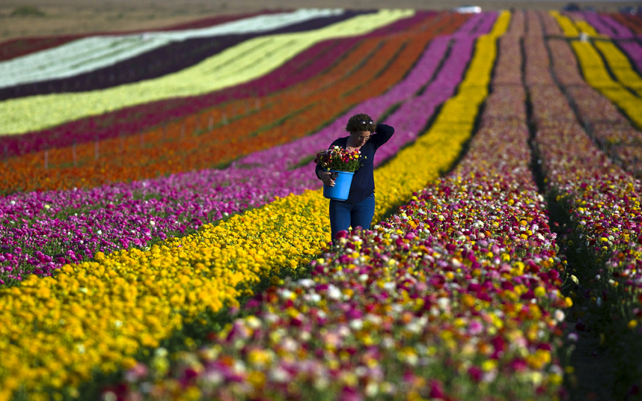
6. Israel Would Return And Rebuild A Great Army

Slide 48
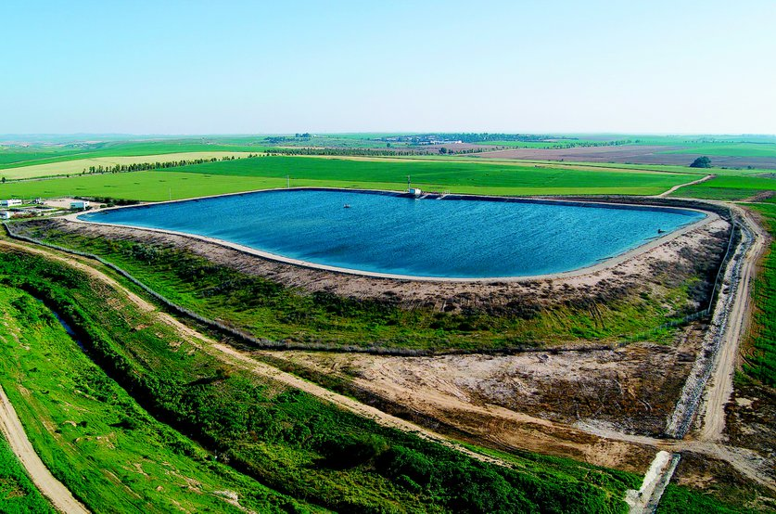
Ezekiel 37:10
“So I prophesied as He commanded me, and breath came into them, and they lived, and stood upon their feet, an exceedingly great army.”

Slide 49
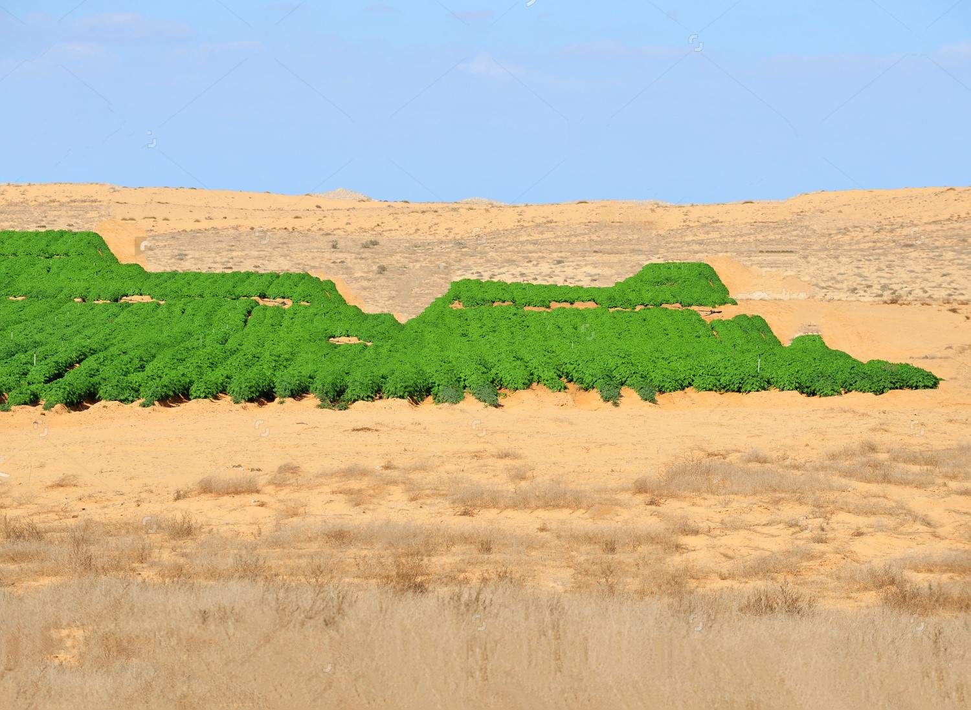
“Cares all past, home at last, ever to rejoice!” All because He redeemed us by His blood!

Slide 50
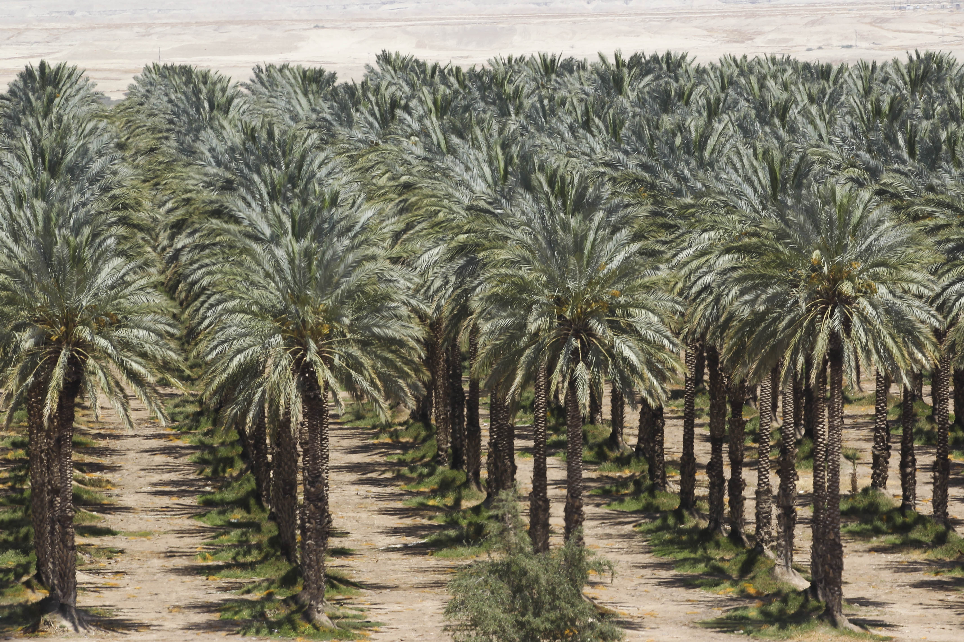
6. Israel Would Return And Rebuild A Great Army

Slide 51
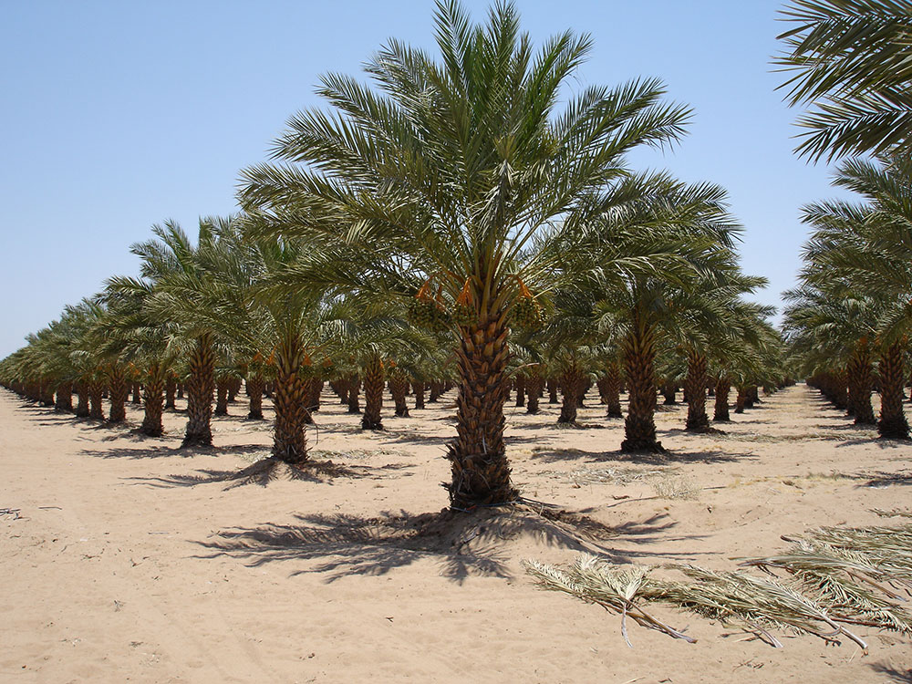
Ezekiel 37:10
“So I prophesied as He commanded me, and breath came into them, and they lived, and stood upon their feet, an exceedingly great army.”

Slide 52
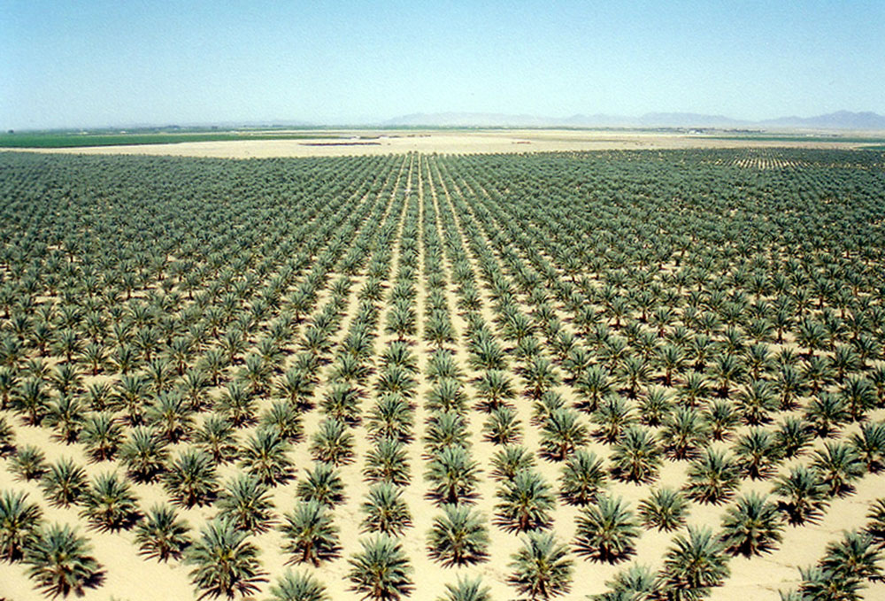
“Cares all past, home at last, ever to rejoice!” All because He redeemed us by His blood!

Slide 53
Deuteronomy 11:8-12
8 "Therefore you shall keep every commandment which I command you today, that you may be strong, and go in and possess the land which you cross over to possess, 9 and that you may prolong your days in the land which the LORD swore to give your fathers, to them and their descendants, 'a land flowing with milk and honey.'

Slide 54
10 "For the land which you go to possess is not like the land of Egypt from which you have come, where you sowed your seed and watered it by foot, as a vegetable garden; 11 but the land which you cross over to possess is a land of hills and valleys, which drinks water from the rain of heaven,

Slide 55
12 a land for which the LORD your God cares; the eyes of the LORD your God are always on it, from the beginning of the year to the very end of the year.

Slide 56
8. Israel Would Gain Control of Jerusalem And Build It Up

Slide 57
Psalm 102:15-16
15 So the nations shall fear the name of the LORD, And all the kings of the earth Your glory. 16 For the LORD shall build up Zion; He shall appear in His glory.

Slide 58
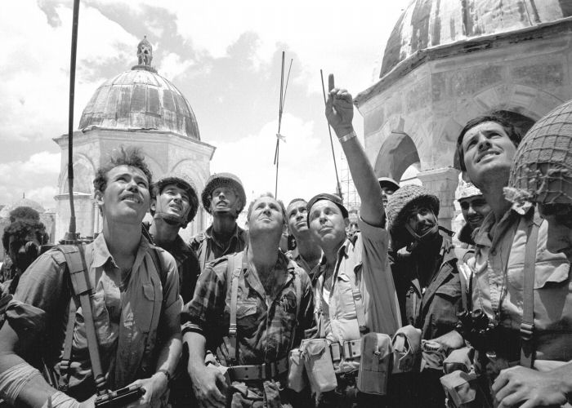
“Cares all past, home at last, ever to rejoice!” All because He redeemed us by His blood!

Slide 59
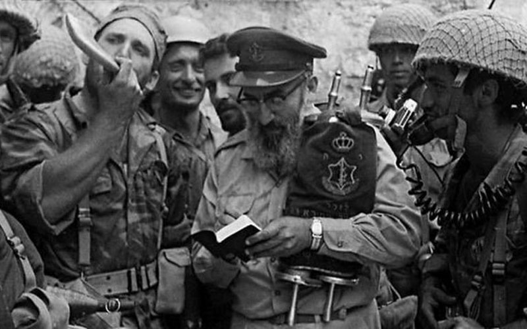
“Cares all past, home at last, ever to rejoice!” All because He redeemed us by His blood!

Slide 60
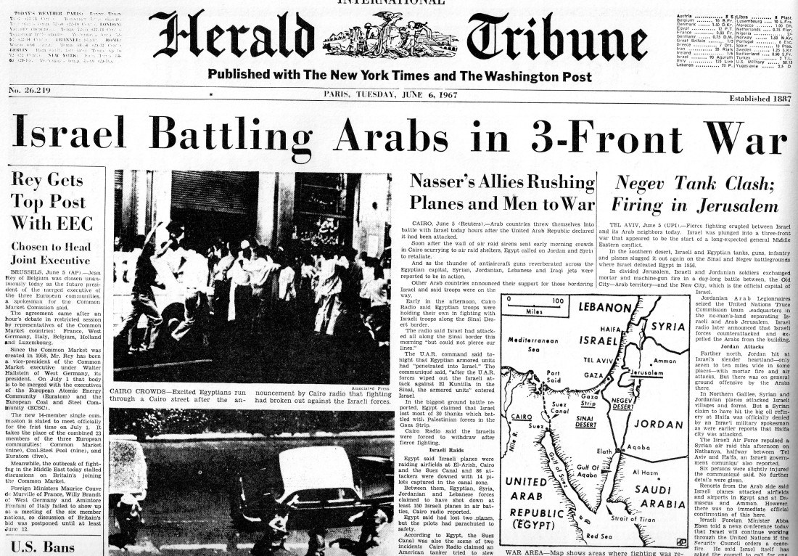
“Cares all past, home at last, ever to rejoice!” All because He redeemed us by His blood!

Slide 61
Genesis 12:2-3
2 I will make you a great nation; I will bless you and make your name great; And you shall be a blessing. 3 I will bless those who bless you, And I will curse him who curses you; And in you all the families of the earth shall be blessed."

Slide 62
9. Israel Would Be More Prosperous At The End
Then Ever Before

Slide 63
Deuteronomy 30:4-6
4 If any of you are driven out to the farthest parts under heaven, from there the LORD your God will gather you, and from there He will bring you. 5 Then the LORD your God will bring you to the land which your fathers possessed, and you shall possess it. He will prosper you and multiply you more than your fathers.

Slide 64
6 And the LORD your God will circumcise your heart and the heart of your descendants, to love the LORD your God with all your heart and with all your soul, that you may live.

Slide 65
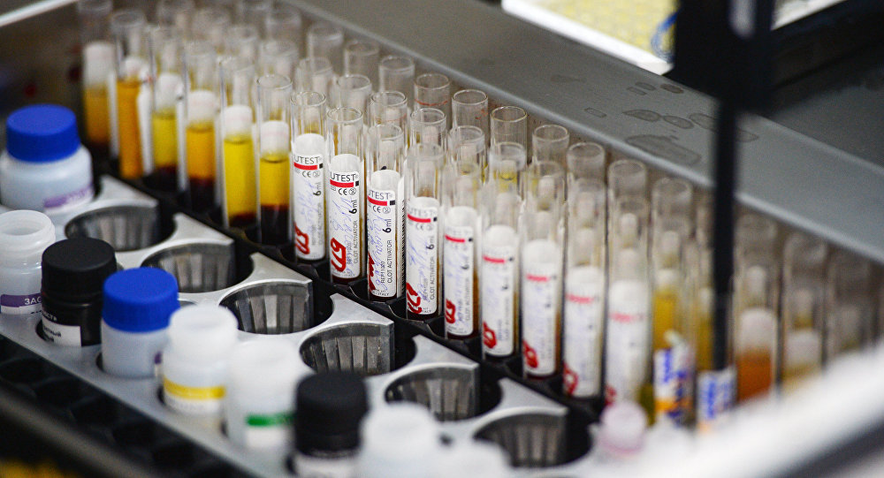
“Cares all past, home at last, ever to rejoice!” All because He redeemed us by His blood!

Slide 66
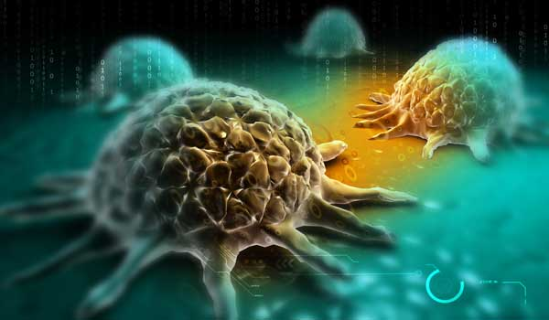
“Cares all past, home at last, ever to rejoice!” All because He redeemed us by His blood!

Slide 67
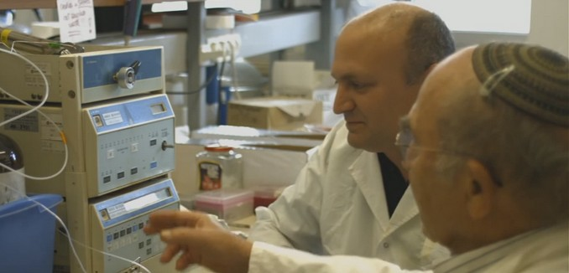
“Cares all past, home at last, ever to rejoice!” All because He redeemed us by His blood!

Slide 68
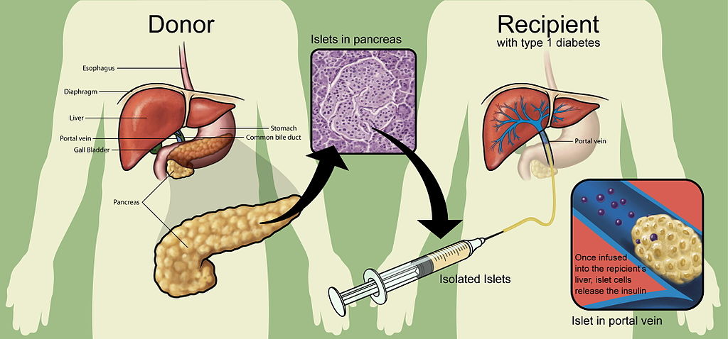
“Cares all past, home at last, ever to rejoice!” All because He redeemed us by His blood!

Slide 69
COVID 19 Path of Destruction
World Wide 194,456 deaths
America 50,360 deaths
California 1,537 deaths
San Diego 102 deaths
Epicenter New York 15,740

Slide 70
10. Israel Will Defeat All Of Her Enemies

Slide 71
Ezekiel 38:1-23
1 Now the word of the LORD came to me, saying, 2 "Son of man, set your face against Gog, of the land of Magog, the prince of Rosh, Meshech, and Tubal, and prophesy against him, 3 and say, 'Thus says the Lord GOD: "Behold, I am against you, O Gog, the prince of Rosh, Meshech, and Tubal.

Slide 72
4 I will turn you around, put hooks into your jaws, and lead you out, with all your army, horses, and horsemen, all splendidly clothed, a great company with bucklers and shields, all of them handling swords. 5 Persia, Ethiopia, and Libya are with them, all of them with shield and helmet; 6 Gomer and all its troops; the house of Togarmah from the far north and all its troops--many people are with you.

Slide 73
7 "Prepare yourself and be ready, you and all your companies that are gathered about you; and be a guard for them. 8 After many days you will be visited. In the latter years you will come into the land of those brought back from the sword and gathered from many people on the mountains of Israel, which had long been desolate; they were brought out of the nations, and now all of them dwell safely.

Slide 74
9 You will ascend, coming like a storm, covering the land like a cloud, you and all your troops and many peoples with you." 10'Thus says the Lord GOD: "On that day it shall come to pass that thoughts will arise in your mind, and you will make an evil plan: 11 You will say, 'I will go up against a land of unwalled villages; I will go to a peaceful people, who dwell safely, all of them dwelling without walls, and having neither bars nor gates'—

Slide 75
12 to take plunder and to take booty, to stretch out your hand against the waste places that are again inhabited, and against a people gathered from the nations, who have acquired livestock and goods, who dwell in the midst of the land. 13 Sheba, Dedan, the merchants of Tarshish, and all their young lions will say to you, 'Have you come to take plunder? Have you gathered your army to take booty, to carry away silver and gold, to take away livestock and goods, to take great plunder?' " '

Slide 76
14 "Therefore, son of man, prophesy and say to Gog, 'Thus says the Lord GOD: "On that day when My people Israel dwell safely, will you not know it? 15 Then you will come from your place out of the far north, you and many peoples with you, all of them riding on horses, a great company and a mighty army.

Slide 77
16 You will come up against My people Israel like a cloud, to cover the land. It will be in the latter days that I will bring you against My land, so that the nations may know Me, when I am hallowed in you, O Gog, before their eyes." 17'Thus says the Lord GOD: "Are you he of whom I have spoken in former days by My servants the prophets of Israel, who prophesied for years in those days that I would bring you against them?

Slide 78
18 "And it will come to pass at the same time, when Gog comes against the land of Israel," says the Lord GOD, "that My fury will show in My face. 19 For in My jealousy and in the fire of My wrath I have spoken: 'Surely in that day there shall be a great earthquake in the land of Israel,

Slide 79
20 so that the fish of the sea, the birds of the heavens, the beasts of the field, all creeping things that creep on the earth, and all men who are on the face of the earth shall shake at My presence. The mountains shall be thrown down, the steep places shall fall, and every wall shall fall to the ground.'

Slide 80
21 "I will call for a sword against Gog throughout all My mountains," says the Lord GOD. "Every man's sword will be against his brother. 22 And I will bring him to judgment with pestilence and bloodshed; I will rain down on him, on his troops, and on the many peoples who are with him, flooding rain, great hailstones, fire, and brimstone. 23 Thus I will magnify Myself and sanctify Myself, and I will be known in the eyes of many nations. Then they shall know that I am the LORD." '

Slide 81
Matthew 24:32-51
32 "Now learn this parable from the fig tree: When its branch has already become tender and puts forth leaves, you know that summer is near. 33 So you also, when you see all these things, know that it is near--at the doors!

Slide 82
34 Assuredly, I say to you, this generation will by no means pass away till all these things take place. 35 Heaven and earth will pass away, but My words will by no means pass away. 36 "But of that day and hour no one knows, not even the angels of heaven, but My Father only. 37 But as the days of Noah were, so also will the coming of the Son of Man be.

Slide 83
38 For as in the days before the flood, they were eating and drinking, marrying and giving in marriage, until the day that Noah entered the ark, 39 and did not know until the flood came and took them all away, so also will the coming of the Son of Man be. 40 Then two men will be in the field: one will be taken and the other left. 41 Two women will be grinding at the mill: one will be taken and the other left.

Slide 84
42 Watch therefore, for you do not know what hour your Lord is coming. 43 But know this, that if the master of the house had known what hour the thief would come, he would have watched and not allowed his house to be broken into. 44 Therefore you also be ready, for the Son of Man is coming at an hour you do not expect.

Slide 85
45 "Who then is a faithful and wise servant, whom his master made ruler over his household, to give them food in due season? 46 Blessed is that servant whom his master, when he comes, will find so doing. 47 Assuredly, I say to you that he will make him ruler over all his goods.

Slide 86
48 But if that evil servant says in his heart, 'My master is delaying his coming,' 49 "and begins to beat his fellow servants, and to eat and drink with the drunkards, 50 the master of that servant will come on a day when he is not looking for him and at an hour that he is not aware of, 51 and will cut him in two and appoint him his portion with the hypocrites. There shall be weeping and gnashing of teeth.

Slide 87
1 Thessalonians 4:13-18
13 But I do not want you to be ignorant, brethren, concerning those who have fallen asleep, lest you sorrow as others who have no hope. 14 For if we believe that Jesus died and rose again, even so God will bring with Him those who sleep in Jesus.

Slide 88
15 For this we say to you by the word of the Lord, that we who are alive and remain until the coming of the Lord will by no means precede those who are asleep. 16 For the Lord Himself will descend from heaven with a shout, with the voice of an archangel, and with the trumpet of God. And the dead in Christ will rise first.

Slide 89
17 Then we who are alive and remain shall be caught up together with them in the clouds to meet the Lord in the air. And thus we shall always be with the Lord. 18 Therefore comfort one another with these words.

Slide 90
Acts 2:38-39
38 Then Peter said to them, "Repent, and let every one of you be baptized in the name of Jesus Christ for the remission of sins; and you shall receive the gift of the Holy Spirit. 39 For the promise is to you and to your children, and to all who are afar off, as many as the
Lord our God will call."

