Slide 1
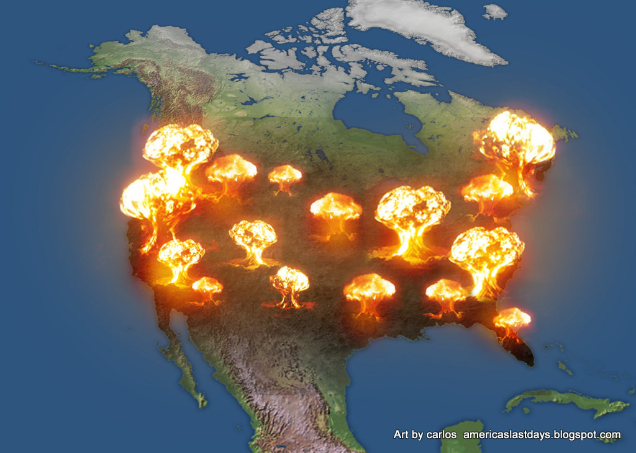
God Help Us Be a Jonah
by Pastor Fee Soliven
Nahum 3:1-5
Sunday Evening
July 19, 2020

Slide 2
1 Woe to the bloody city! It is all full of lies and robbery. Its victim never departs. 2 The noise of a whip And the noise of rattling wheels, Of galloping horses, Of clattering chariots! 3 Horsemen charge with bright sword and glittering spear. There is a multitude of slain, A great number of bodies, Countless corpses--They stumble over the corpses--

Slide 3
4 Because of the multitude of harlotries of the seductive harlot, The mistress of sorceries, Who sells nations through her harlotries, And families through her sorceries. 5 "Behold, I am against you," says the LORD of hosts…

Slide 4
Nahum 3:1
“Woe to the city of blood, full of lies, full of plunder, never without victims!”

Slide 5
Nahum 3:19
“Who has not felt your endless cruelty?”

Slide 6
Nahum 3:8
“Do you think you’re superior to Egyptian Thebes, proudly invincible on the River Nile, Protected by the great River, walled in by the River, secure?”

Slide 7
Matthew 26:52
“For all who take the sword will perish by the sword”

Slide 8
Nahum 1:15
15 Behold, on the mountains The feet of him who brings good tidings, Who proclaims peace! O Judah, keep your appointed feasts, Perform your vows. For the wicked one shall no more pass through you; He is utterly cut off.

Slide 9
Nahum 3:15-19
15 There the fire will devour you, The sword will cut you off; It will eat you up like a locust. Make yourself many--like the locust! Make yourself many--like the swarming locusts! 16 You have multiplied your merchants more than the stars of heaven. The locust plunders and flies away.

Slide 10
17 Your commanders are like swarming locusts, And your generals like great grasshoppers, Which camp in the hedges on a cold day; When the sun rises they flee away, And the place where they are is not known. 18 Your shepherds slumber, O king of Assyria; Your nobles rest in the dust. Your people are scattered on the mountains, And no one gathers them.

Slide 11
19 Your injury has no healing, Your wound is severe. All who hear news of you Will clap their hands over you, For upon whom has not your wickedness passed continually?

Slide 12
Jonah 1:1-2
1 Now the word of the LORD came to Jonah the son of Amittai, saying, 2 "Arise, go to Nineveh, that great city, and cry out against it; for their wickedness has come up before Me."

Slide 13
Jonah 3:1-4
1 Now the word of the LORD came to Jonah the second time, saying, 2 "Arise, go to Nineveh, that great city, and preach to it the message that I tell you." 3 So Jonah arose and went to Nineveh, according to the word of the LORD. Now Nineveh was an exceedingly great city, a three-day journey in extent. 4 And Jonah began to enter the city on the first day's walk. Then he cried out and said, "Yet forty days, and Nineveh shall be overthrown!"

Slide 14
Jonah 3:5-10
5 So the people of Nineveh believed God, proclaimed a fast, and put on sackcloth, from the greatest to the least of them. 6 Then word came to the king of Nineveh; and he arose from his throne and laid aside his robe, covered himself with sackcloth and sat in ashes.

Slide 15
7 And he caused it to be proclaimed and published throughout Nineveh by the decree of the king and his nobles, saying, Let neither man nor beast, herd nor flock, taste anything; do not let them eat, or drink water. 8 But let man and beast be covered with sackcloth, and cry mightily to God; yes, let every one turn from his evil way and from the violence that is in his hands.

Slide 16
9 Who can tell if God will turn and relent, and turn away from His fierce anger, so that we may not perish? 10 Then God saw their works, that they turned from their evil way; and God relented from the disaster that He had said He would bring upon them, and He did not do it.

Slide 17
Is America the Modern City of Nineveh?

Slide 18
Jonah 1:2
"Arise, go to Nineveh, that great city, and cry out against it; for their wickedness has come up before Me."

Slide 19
1. Since Roe V. Wade in 1973 America has slaughtered, butchered and murdered 70,000,000 human babies through abortion!
Exodus 20:13
"You shall not murder”

Slide 20
2. On June 26, 2015 Obama spearheaded the movement of the homosexual agenda and the Supreme Court ruled 5-4 in favor of all 50 states in our nation to allow same sex marriage. This ruling over ruled the people’s right to vote on this matter!

Slide 21
Leviticus 20:13
“If a man lies with a male as he lies with a woman, both of them have committed an abomination. They shall surely be put to death. Their blood shall be upon them.”

Slide 22
Romans 1:26-27
26 For this reason God gave them up to vile passions. For even their women exchanged the natural use for what is against nature. 27 Likewise also the men, leaving the natural use of the woman, burned in their lust for one another, men with men committing what is shameful, and receiving in themselves the penalty of their error which was due.

Slide 23
3. Lawlessness and Civil Unrest
Throughout our land there is now terrorist attacks, cities being a blazed with fire, killing of Peace Officers, racial tension and political corruption!

Slide 24
1 Timothy 1:9-11
9 knowing this: that the law is not made for a righteous person, but for the lawless and insubordinate, for the ungodly and for sinners, for the unholy and profane, for murderers of fathers and murderers of mothers, for manslayers, 10 for fornicators, for sodomites, for kidnappers, for liars, for perjurers, and if there is any other thing that is contrary to sound doctrine,

Slide 25
11 according to the glorious gospel of the blessed God which was committed to my trust.

Slide 26
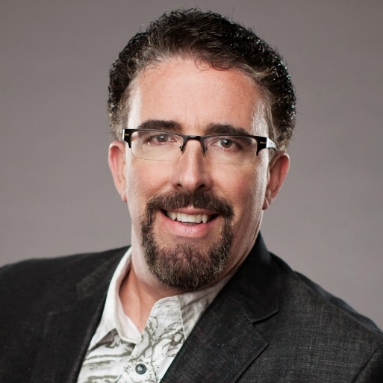
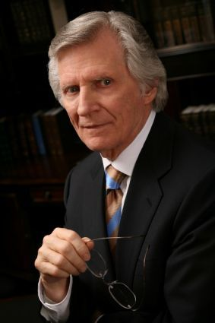
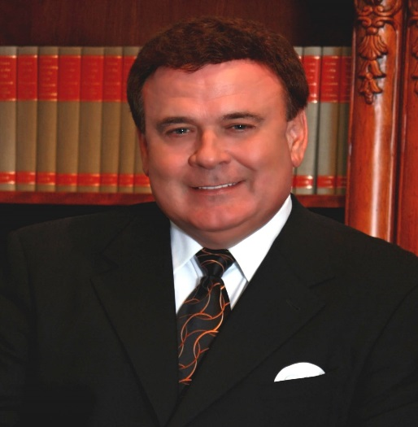
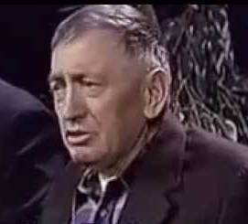
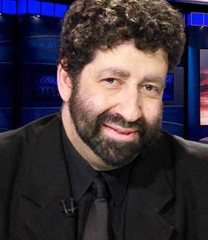
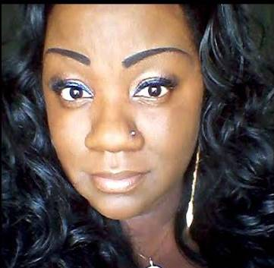
Perry Stone Dave Wilkerson John Kilpatrick
Our Modern Day Prophets
Dimitru Dudeman Jonathan Cahn Mena Lee Grebin

Slide 27
Psalm 124
1 "If it had not been the LORD who was on our side," Let Israel now say--2 "If it had not been the LORD who was on our side, When men rose up against us, 3 Then they would have swallowed us alive, When their wrath was kindled against us;

Slide 28
4 Then the waters would have overwhelmed us, The stream would have gone over our soul; 5 Then the swollen waters Would have gone over our soul." 6 Blessed be the LORD, Who has not given us as prey to their teeth. 7 Our soul has escaped as a bird from the snare of the fowlers; The snare is broken, and we have escaped. 8 Our help is in the name of the LORD, Who made heaven and earth.

Slide 29
1. A Nation Forgets God
Psalm 9:17
“The wicked shall be turned into hell, And all the nations that forget God”

Slide 30
2. An Enemy is Raised Up
Deuteronomy 28:47-51
47 "Because you did not serve the LORD your God with joy and gladness of heart, for the abundance of everything, 48 therefore you shall serve your enemies, whom the LORD will send against you, in hunger, in thirst, in nakedness, and in need of everything; and He will put a yoke of iron on your neck until He has destroyed you.

Slide 31
49 The LORD will bring a nation against you from afar, from the end of the earth, as swift as the eagle flies, a nation whose language you will not understand, 50 a nation of fierce countenance, which does not respect the elderly nor show favor to the young.

Slide 32
3. A Trap is Set
Psalm 91:3
“For it is He who delivers you from the snare of the trapper And from the deadly pestilence”

Slide 33
4. The nation who has forgotten God flies blindly into the trap and is ensnared.
There is no escape.
Proverbs 12:13
“The wicked is ensnared by the transgression of his lips, But the righteous will come through trouble”

Slide 34
5. The fowler (the enemy) comes at some point in the future…not necessarily on the day the trap is laid…and seizes their prey…and completely devours that nation.
Jeremiah 12:17
"But if they will not listen, then I will uproot that nation, uproot and destroy it," declares the LORD.

Slide 35
6. That Nation is swept away by the flood of God’s judgment. It is swallowed alive and whole.
Romans 1:18-19
18 For the wrath of God is revealed from heaven against all ungodliness and unrighteousness of men, who suppress the truth in unrighteousness, 19 because what may be known of God is manifest in them, for God has shown it to them.

Slide 36
7. It’s Destruction is Certain.
Job 12:21-25
21 He pours contempt on princes, And disarms the mighty. 22 He uncovers deep things out of darkness, And brings the shadow of death to light. 23 He makes nations great, and destroys them; He enlarges nations, and guides them.

Slide 37
24 He takes away the understanding of the chiefs of the people of the earth, And makes them wander in a pathless wilderness. 25 They grope in the dark without light, And He makes them stagger like a drunken man.

Slide 38
1 Thessalonians 4:13-18
13 But I do not want you to be ignorant, brethren, concerning those who have fallen asleep, lest you sorrow as others who have no hope. 14 For if we believe that Jesus died and rose again, even so God will bring with Him those who sleep in Jesus.

Slide 39
15 For this we say to you by the word of the Lord, that we who are alive and remain until the coming of the Lord will by no means precede those who are asleep. 16 For the Lord Himself will descend from heaven with a shout, with the voice of an archangel, and with the trumpet of God. And the dead in Christ will rise first.

Slide 40
17 Then we who are alive and remain shall be caught up together with them in the clouds to meet the Lord in the air. And thus we shall always be with the Lord. 18 Therefore comfort one another with these words.

Slide 41
1 Corinthians 15:50-54
50 Now this I say, brethren, that flesh and blood cannot inherit the kingdom of God; nor does corruption inherit incorruption. 51 Behold, I tell you a mystery: We shall not all sleep, but we shall all be changed-- 52 in a moment, in the twinkling of an eye, at the last trumpet. For the trumpet will sound, and the dead will be raised incorruptible, and we shall be changed.

Slide 42
53 For this corruptible must put on incorruption, and this mortal must put on immortality. 54 So when this corruptible has put on incorruption, and this mortal has put on immortality, then shall be brought to pass the saying that is written: "Death is swallowed up in victory."

Slide 43
Acts 2:38-39
38 Then Peter said to them, "Repent, and let every one of you be baptized in the name of Jesus Christ for the remission of sins; and you shall receive the gift of the Holy Spirit. 39 For the promise is to you and to your children, and to all who are afar off, as many as the Lord our God will call."

