Slide 1
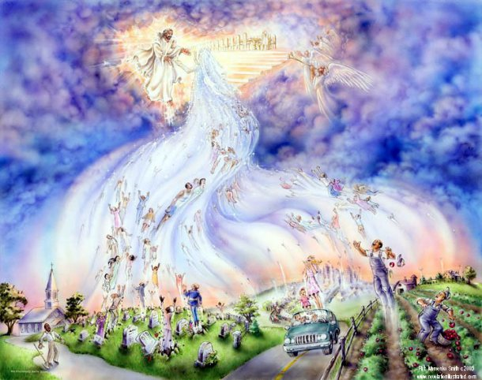
The Awakening Blast
By Pastor Fee Soliven
Daniel 12:1-3
Sunday Evening
July 26, 2020

Slide 2
Daniel 12:1-3
1 "At that time Michael shall stand up, The great prince who stands watch over the sons of your people; And there shall be a time of trouble, Such as never was since there was a nation, Even to that time. And at that time your people shall be delivered, Every one who is found written in the book.

Slide 3
2 And many of those who sleep in the dust of the earth shall awake, Some to everlasting life, Some to shame and everlasting contempt. 3 Those who are wise shall shine Like the brightness of the firmament, And those who turn many to righteousness Like the stars forever and ever.

Slide 4
The Lord’s Return Is Sooner Than We Think

Slide 5
We are about to enter the season of the Fall Feasts

Slide 6
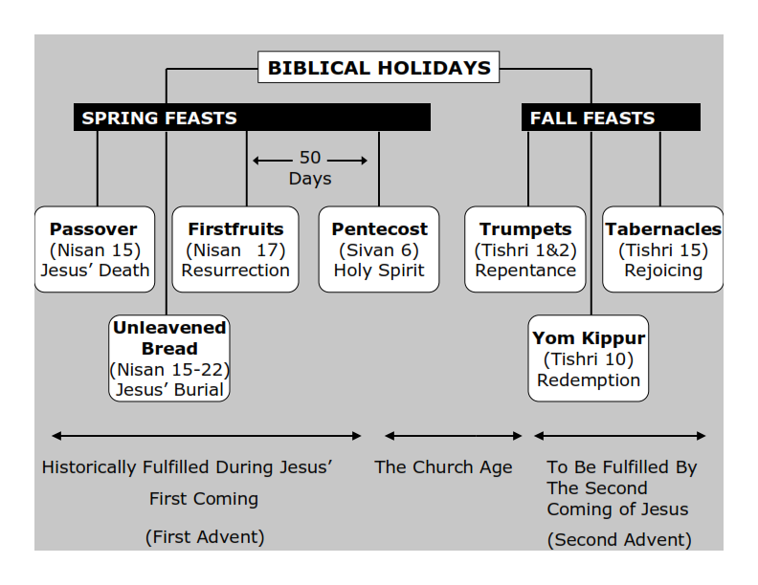
Webster’s Dictionary defines the word tribulation as: 1. grievous trouble; severe trial or suffering. 2. an instance of this; an affliction, trouble, etc.

Slide 7
Leviticus 23:2
And the LORD spoke to Moses, saying, Speak to the children of Israel, and say to them, Concerning the Feasts of the LORD, which you shall proclaim to be holy convocations, even these are my feasts.

Slide 8
The Hebrew word for Feasts is also MOED meaning appointed times. The Hebrew word for convocation is MIQRA meaning a dress rehearsal. It means a holy convocation, a scared assembly or rehearsal of God’s past, present and future acts.

Slide 9
The Hebrew word for sound (kol) is used as the sound of the Shofar and is defined as the sound that walks. It also represents the voice of God.

Slide 10
Genesis 3:8
“And they heard the sound of the LORD God walking in the garden in the cool of the day, and Adam and his wife hid themselves from the presence of the LORD God among the trees of the garden”

Slide 11
Exodus 19:16-17
16 Then it came to pass on the third day, in the morning, that there were thunderings and lightnings, and a thick cloud on the mountain; and the sound of the trumpet was very loud, so that all the people who were in the camp trembled. 17 And Moses brought the people out of the camp to meet with God, and they stood at the foot of the mountain.

Slide 12
The Rapture of The Church

Slide 13
1 Thessalonians 5:8-11
8 But let us who are of the day be sober, putting on the breastplate of faith and love, and as a helmet the hope of salvation. 9 For God did not appoint us to wrath, but to obtain salvation through our Lord Jesus Christ, 10 who died for us, that whether we wake or sleep, we should live together with Him. 11 Therefore comfort each other and edify one another, just as you also are doing.

Slide 14
1 Thessalonians 4:16-18
16 For the Lord Himself will descend from heaven with a shout, with the voice of an archangel, and with the trumpet of God. And the dead in Christ will rise first. 17 Then we who are alive and remain shall be caught up together with them in the clouds to meet the Lord in the air. And thus we shall always be with the Lord. 18 Therefore comfort one another with these words.

Slide 15
1 John 3:2
“We know that when he Christ appears, we shall be like him, for we shall see him as he is”

Slide 16
1 Thessalonians 4:17
Then we who are alive and remain shall be caught up together with them in the clouds to meet the Lord in the air. And thus we shall always be with the Lord.

Slide 17
Zechariah 14:3-4
3 Then the LORD will go forth And fight against those nations, As He fights in the day of battle. 4 And in that day His feet will stand on the Mount of Olives, Which faces Jerusalem on the east. And the Mount of Olives shall be split in two, From east to west, Making a very large valley; Half of the mountain shall move toward the north And half of it toward the south.

Slide 18
1 Corinthians 15:51-52
“Listen, I tell you a mystery: We will not all sleep, but we will all be changed—in a flash, in the twinkling of an eye, at the last trumpet. For the trumpet will sound, the dead will be raised imperishable, and we will be changed”

Slide 19
Revelation 3:10
“Because you have kept My command to persevere, I also will keep you from the hour of trial which shall come upon the whole world, to test those who dwell on the earth”

Slide 20
Greek word translated “from.”

Slide 21
“hour” of trial

Slide 22
1 Thessalonians 5:9-10
9 For God did not appoint us to wrath, but to obtain salvation through our Lord Jesus Christ, 10 who died for us, that whether we wake or sleep, we should live together with Him.

Slide 23
Revelation 3:10
“Because you have kept My command to persevere, I also will keep you from the hour of trial which shall come upon the whole world, to test those who dwell on the earth”

Slide 24
Revelation 18:1-24
Babylon’s Plagues
18 After this I saw another angel coming down from heaven with great authority; the earth was flooded with the light of his glory. 2 He shouted out in a strong voice, and this is what he said: ‘Babylon the great has fallen! She has fallen! She has become a place for demons to live, a refuge for every unclean spirit, a refuge for every unclean bird, a refuge for every unclean, hateful monster.

Slide 25
3 All the nations drank from the wine of the wrath of her fornication; the kings of the earth committed fornication with her, and the traders of the earth became rich from the power of her luxury.’ 4 Then I heard another voice from heaven, and this is what it said: ‘Come out of her, my people, so that you don’t become embroiled in her sins, and so that you don’t receive any of her plagues. 5 Her sins are piled up to the sky, and God has remembered her wickedness.

Slide 26
6 Pay her back as she has paid others; give her double again for all her deeds. Mix her a double dose in her own cup – the cup in which she mixed her poisons. 7 She made herself glorious and lived in luxury; balance that by giving her torture and sorrow! She said in her heart, “I’m the queen! I’m on the throne! I’m not a widow! I’m never going to be a mourner!” 8 Therefore her plagues will come in a single day, death, mourning and famine, and she will be burned with fire, because God the Lord, who judges her, is strong.’

Slide 27
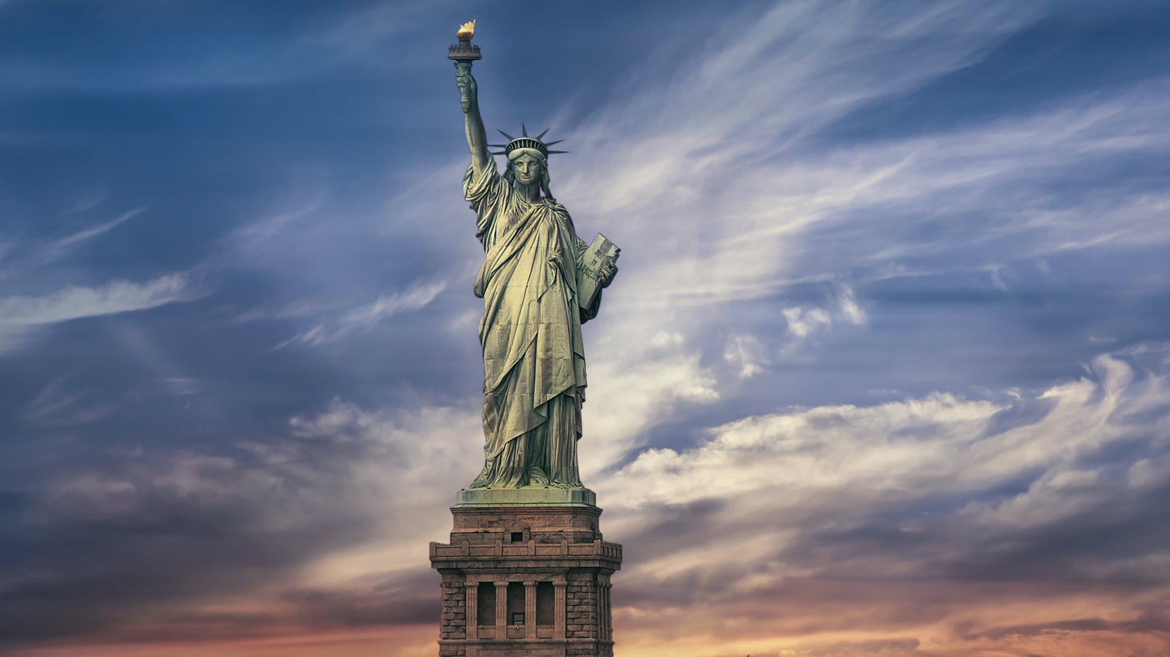
Feast of Trumpets : REPENTANCE
Feast of Yom Kippur: REDEMPTION
Feast of Tabernacles: REJOICING

Slide 28
Babylon’s Judgment
9 The kings of the earth who committed fornication with her and shared her luxury will weep and lament over her when they see the smoke from her fire. 10 They will stand far off, fearful of her tortures. ‘Alas, alas,’ they will say, ‘the great city! Babylon the powerful city! Your judgment has come in a single hour.’ 11 The merchants of the earth will weep and mourn over her, because nobody will buy their cargo any more,

Slide 29
12 their cargo of gold and silver, of precious stones and pearls, fine linen and purple, silk and scarlet, all the sweet-smelling wood, carved ivory, vessels of expensive wood, brass, iron, marble, 13 cinnamon, oriental spice, incense, myrrh, frankincense, wine, olive oil, fine flour, wheat, cattle, sheep, horses, chariots and bodies . . . yes, human lives. 14 All the fruit for which you longed has gone from you; all your luxuries and sparkling objects have been destroyed; you won’t find them any more.

Slide 30
15 The merchants who sold these things, and who made themselves rich from her, will stand a long way off for fear of her tortures. They will weep and mourn, 16 and say, ‘Alas, alas! The great city! It was clothed in fine linen, purple and scarlet, decked out in gold, precious stones and pearls – 17 but in a single hour such great wealth has been destroyed!’ All the master mariners, all those who ply their ships to and fro, all sailors, and all who do business on the sea, stood a long way off

Slide 31
18 and shouted out when they saw the smoke of her fire. ‘Who is like the great city?’ they said. 19 They threw dust on their heads and shouted out, weeping and mourning. ‘Alas, alas,’ they said, ‘the great city! Everyone who had ships on the sea could get rich from her wealth, but in a single hour she has become a desert.’ 20 Celebrate over her, heaven, and you holy ones, apostles and prophets, because God has passed against her the sentence she passed against you.

Slide 32
21 Then a strong angel picked up a rock like a huge millstone and hurled it into the sea, with these words: ‘Babylon the great city will be thrown down like that with a splash, and will never be seen again! 22 Never again will people hear the sound of harps, musicians, flute players and trumpeters in you. Never again will there be any skilled workmen plying their trade in you. Never again will people hear the sound of the mill in you.

Slide 33
23 Never again will anyone see the light of a lamp in you. Never again will anyone hear the voice of bridegroom and bride in you. Your merchants were the mighty ones of the earth; all the nations were deceived by your magic.’ 24 In her has been found the blood of prophets and God’s holy ones, and all those who have been slaughtered on the earth.

Slide 34
Matthew 24:21-22
21 For then there will be great tribulation, such as has not been since the beginning of the world until this time, no, nor ever shall be. 22 And unless those days were shortened, no flesh would be saved; but for the elect's sake those days will be shortened.

Slide 35
The Day of the Awakening Blast
The Rapture of the Church!

Slide 36
On the Feast of Trumpets the Shofar is blown 100 times. There are three sounds made with the shofar:

Slide 37
Tekiah - One long straight blast.
Shevarim - Three shorter blasts.
Teruah – 9 quick blasts in short succession
This series is blown 11 times for a total of 99 blasts and the final blast is known as
“The Last Trump” !

Slide 38
1 John 3:2-3
2 Beloved, now we are children of God; and it has not yet been revealed what we shall be, but we know that when He is revealed, we shall be like Him, for we shall see Him as He is. 3 And everyone who has this hope in Him purifies himself, just as He is pure.

Slide 39
John 14:1-4
1 "Let not your heart be troubled; you believe in God, believe also in Me. 2 In My Father's house are many mansions; if it were not so, I would have told you. I go to prepare a place for you. 3 And if I go and prepare a place for you, I will come again and receive you to Myself; that where I am, there you may be also. 4 And where I go you know, and the way you know."

Slide 40
1 Thessalonians 4:13-18
13 But I do not want you to be ignorant, brethren, concerning those who have fallen asleep, lest you sorrow as others who have no hope. 14 For if we believe that Jesus died and rose again, even so God will bring with Him those who sleep in Jesus.

Slide 41
15 For this we say to you by the word of the Lord, that we who are alive and remain until the coming of the Lord will by no means precede those who are asleep. 16 For the Lord Himself will descend from heaven with a shout, with the voice of an archangel, and with the trumpet of God. And the dead in Christ will rise first.

Slide 42
17 Then we who are alive and remain shall be caught up together with them in the clouds to meet the Lord in the air. And thus we shall always be with the Lord. 18 Therefore comfort one another with these words.

Slide 43
1 Corinthians 15:50-54
50 Now this I say, brethren, that flesh and blood cannot inherit the kingdom of God; nor does corruption inherit incorruption. 51 Behold, I tell you a mystery: We shall not all sleep, but we shall all be changed-- 52 in a moment, in the twinkling of an eye, at the last trumpet. For the trumpet will sound, and the dead will be raised incorruptible, and we shall be changed.

Slide 44
53 For this corruptible must put on incorruption, and this mortal must put on immortality. 54 So when this corruptible has put on incorruption, and this mortal has put on immortality, then shall be brought to pass the saying that is written: "Death is swallowed up in victory."

Slide 45
Acts 2:38-39
38 Then Peter said to them, "Repent, and let every one of you be baptized in the name of Jesus Christ for the remission of sins; and you shall receive the gift of the Holy Spirit. 39 For the promise is to you and to your children, and to all who are afar off, as many as the Lord our God will call."

