Slide 1
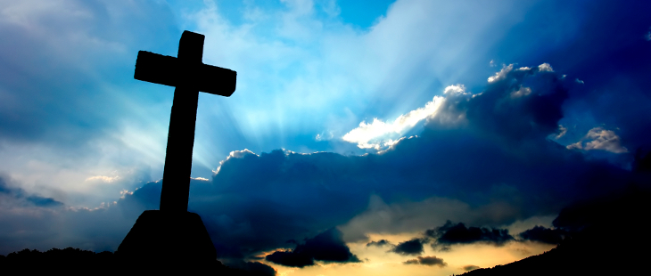

Jesus our Blessed Hope
By Pastor Fee Soliven
John 14:1-6
Sunday Evening
August 9, 2020

Slide 2
John 14:1-6
1 "Let not your heart be troubled; you believe in God, believe also in Me. 2 In My Father's house are many mansions; if it were not so, I would have told you. I go to prepare a place for you. 3 And if I go and prepare a place for you, I will come again and receive you to Myself; that where I am, there you may be also.

Slide 3
4 And where I go you know, and the way you know." 5 Thomas said to Him, "Lord, we do not know where You are going, and how can we know the way?" 6 Jesus said to him, "I am the way, the truth, and the life. No one comes to the Father except through Me.

Slide 4
1. The Promise Of Heaven
2. The Blessings Of Heaven
3. The Heavenly City

Slide 5
The Promise Of Heaven

Slide 6
John 3:1-8
1 There was a man of the Pharisees named Nicodemus, a ruler of the Jews. 2 This man came to Jesus by night and said to Him, "Rabbi, we know that You are a teacher come from God; for no one can do these signs that You do unless God is with him."

Slide 7
3 Jesus answered and said to him, "Most assuredly, I say to you, unless one is born again, he cannot see the kingdom of God." 4 Nicodemus said to Him, "How can a man be born when he is old? Can he enter a second time into his mother's womb and be born?" 5 Jesus answered, "Most assuredly, I say to you, unless one is born of water and the Spirit, he cannot enter the kingdom of God.

Slide 8
6 That which is born of the flesh is flesh, and that which is born of the Spirit is spirit. 7 Do not marvel that I said to you, 'You must be born again.'

Slide 9
Acts 2:38-39
38 Then Peter said to them, "Repent, and let every one of you be baptized in the name of Jesus Christ for the remission of sins; and you shall receive the gift of the Holy Spirit. 39 For the promise is to you and to your children, and to all who are afar off, as many as the Lord our God will call."

Slide 10
Heaven Recognizes Only
One Name For Salvation

Slide 11
Acts 4:12
“Nor is there salvation in any other, for there is no other name under heaven given among men by which we must be saved."
“Jesus”

Slide 12
Revelation 22:14-15
14 Blessed are those who do His commandments, that they may have the right to the tree of life, and may enter through the gates into the city. 15 But outside are dogs and sorcerers and sexually immoral and murderers and idolaters, and whoever loves and practices a lie.

Slide 13
Job 19:25–26
25 “For I know that my redeemer lives, and that he shall stand at the latter day upon the earth: 26 and though after my skin worms destroy this body, yet in my flesh shall I see God”

Slide 14
Hebrews 11:10
“looked for a city which hath foundations, whose builder and maker is God”

Slide 15
Matthew 8:11
“Many shall come from the east and west, and shall sit down with Abraham, and Isaac, and Jacob, in the kingdom of heaven”

Slide 16
1 Thessalonians 4:13-18
13 But I do not want you to be ignorant, brethren, concerning those who have fallen asleep, lest you sorrow as others who have no hope. 14 For if we believe that Jesus died and rose again, even so God will bring with Him those who sleep in Jesus.

Slide 17
15 For this we say to you by the word of the Lord, that we who are alive and remain until the coming of the Lord will by no means precede those who are asleep. 16 For the Lord Himself will descend from heaven with a shout, with the voice of an archangel, and with the trumpet of God. And the dead in Christ will rise first.

Slide 18
17 Then we who are alive and remain shall be caught up together with them in the clouds to meet the Lord in the air. And thus we shall always be with the Lord. 18 Therefore comfort one another with these words.

Slide 19
2 Corinthians 12:1-6
(Living Bible Translation)
1 This boasting is all so foolish, but let me go on. Let me tell about the visions I've had, and revelations from the Lord. 2 Fourteen years ago I was taken up to heaven for a visit. Don't ask me whether my body was there or just my spirit, for I don't know; only God can answer that. But anyway, there I was in paradise,

Slide 20
4 and heard things so astounding that they are beyond a man's power to describe or put in words (and anyway I am not allowed to tell them to others). 5 That experience is something worth bragging about, but I am not going to do it. I am going to boast only about how weak I am and how great God is to use such weakness for his glory.

Slide 21
6 I have plenty to boast about and would be no fool in doing it, but I don't want anyone to think more highly of me than he should from what he can actually see in my life and my message.

Slide 22
The Blessings Of Heaven

Slide 23
Philippians 3:20-21
(The Living Bible Translation)
20 But our homeland is in heaven, where our Savior, the Lord Jesus Christ, is; and we are looking forward to his return from there. 21 When he comes back, he will take these dying bodies of ours and change them into glorious bodies like his own, using the same mighty power that he will use to conquer all else everywhere.

Slide 24
Heaven will be a blessed place, far beyond the fondest dreams of the Human Mind

Slide 25
Revelation 21:4
“And God shall wipe away all tears from their eyes; and there shall be no more death, neither sorrow, nor crying, neither shall there be any more pain: for the former things are passed away”

Slide 26
Revelation 21:8
“But the fearful, and unbelieving, and the abominable, and murderers, and whoremongers, and sorcerers, and idolaters, and all liars, shall have their part in the lake which burns with fire and brimstone: which is the second death”

Slide 27
Matthew 25:34
Then the King will say to those on His right hand, 'Come, you blessed of My Father, inherit the kingdom prepared for you from the foundation of the world:

Slide 28
Matthew 25:41
"Then He will also say to those on the left hand, 'Depart from Me, you cursed, into the everlasting fire prepared for the devil and his angels:

Slide 29
Matthew 25:46
"And these will go away into everlasting punishment, but the righteous into eternal life."

Slide 30
Revelation 20:14
“Then Death and Hades were cast into the lake of fire. This is the second death.”

Slide 31
Revelation 22:14-15
14 Blessed are those who do His commandments, that they may have the right to the tree of life, and may enter through the gates into the city. 15 But outside are dogs and sorcerers and sexually immoral and murderers and idolaters, and whoever loves and practices a lie.

Slide 32
Heaven will be the Fulfillment of all the Promises of God

Slide 33
The Heavenly City

Slide 34
Revelation 21:9-10
9 Then one of the seven angels who had the seven bowls filled with the seven last plagues came to me and talked with me, saying, "Come, I will show you the bride, the Lamb's wife." 10 And he carried me away in the Spirit to a great and high mountain, and showed me the great city, the holy Jerusalem, descending out of heaven from God…

Slide 35
Revelation 22:14
“Blessed are those who do His commandments, that they may have the right to the tree of life, and may enter through the gates into the city.”

Slide 36
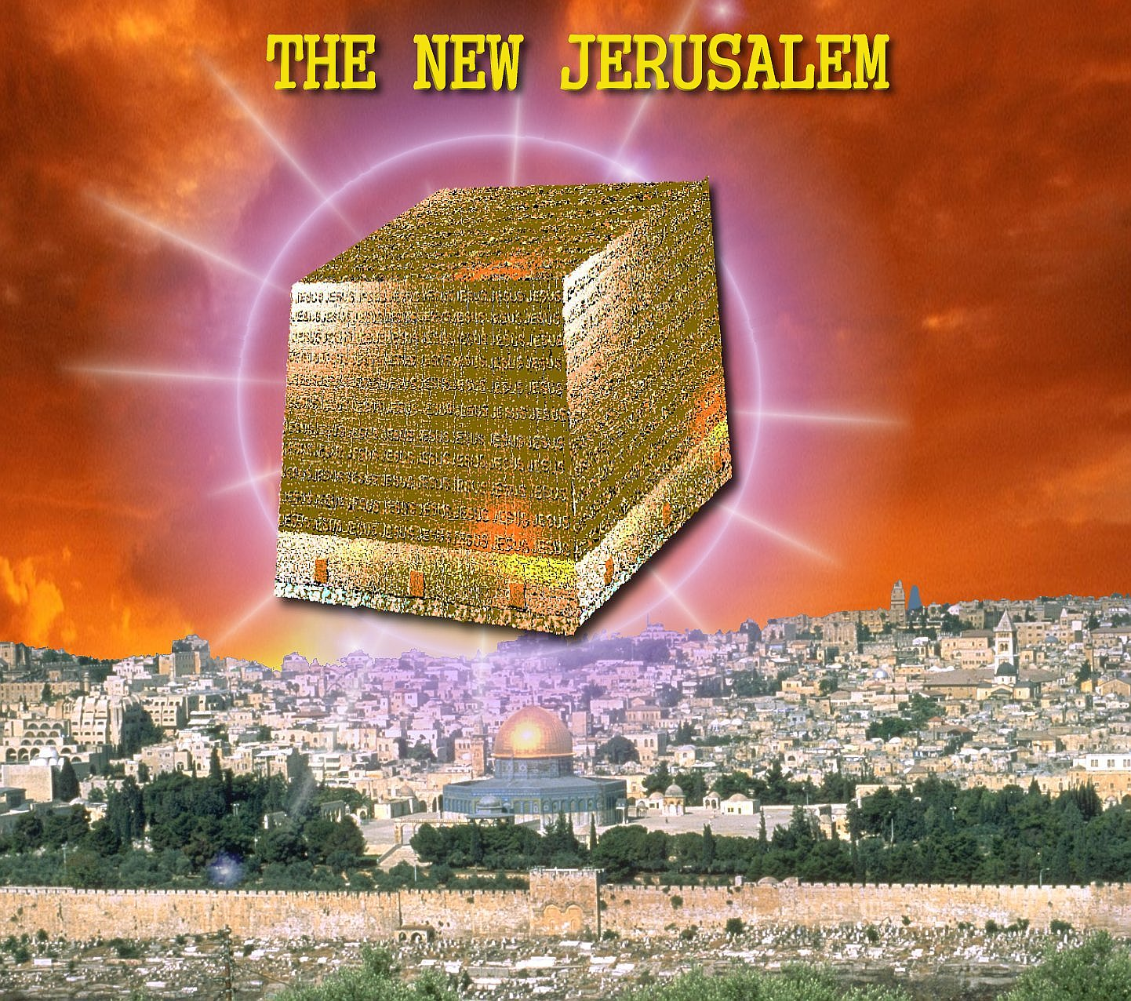
10. 3 States have now legalized Marijuana Washington State, Colorado and now California!
11. Diseases, plagues, incurable sicknesses, unknown viruses

Slide 37
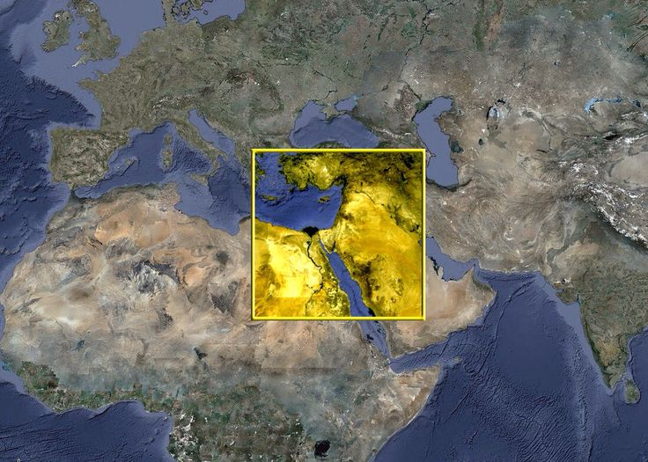
12. Addictions to Drugs, Alcohol, smoking, pornography, and gambling. Ungodly music, gambling, divorce, theft, murder, sex slavery, kidnapping, home invasions, rape, infiltration of foreign gods, militant homosexuals, terrorists civil unrest just to name a few have captivated our nation and held in bondage! It's now an epidemic!

Slide 38
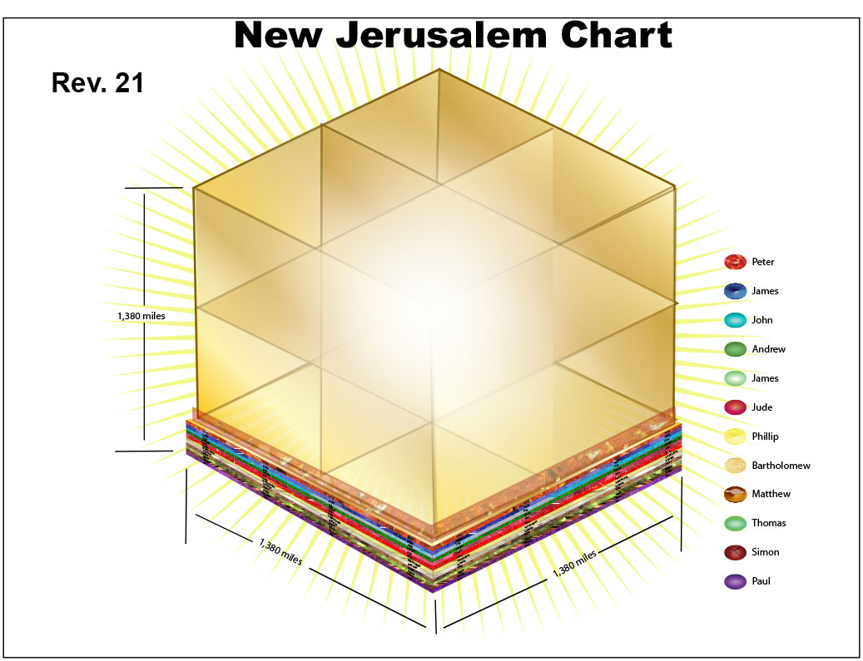
Ezekiel 3:16-21
16 Now it came to pass at the end of seven days that the word of the LORD came to me, saying, 17 "Son of man, I have made you a watchman for the house of Israel; therefore hear a word from My mouth, and give them warning from Me:

Slide 39
Galatians 6:16
(Living Bible Translation)
“May God's mercy and peace be upon all of you who live by this principle and upon those everywhere who are really God's own”

Slide 40
1 Thessalonians 4:13-18
13 But I do not want you to be ignorant, brethren, concerning those who have fallen asleep, lest you sorrow as others who have no hope. 14 For if we believe that Jesus died and rose again, even so God will bring with Him those who sleep in Jesus.

Slide 41
15 For this we say to you by the word of the Lord, that we who are alive and remain until the coming of the Lord will by no means precede those who are asleep. 16 For the Lord Himself will descend from heaven with a shout, with the voice of an archangel, and with the trumpet of God. And the dead in Christ will rise first.

Slide 42
17 Then we who are alive and remain shall be caught up together with them in the clouds to meet the Lord in the air. And thus we shall always be with the Lord. 18 Therefore comfort one another with these words.

Slide 43
1 Corinthians 15:50-54
50 Now this I say, brethren, that flesh and blood cannot inherit the kingdom of God; nor does corruption inherit incorruption. 51 Behold, I tell you a mystery: We shall not all sleep, but we shall all be changed-- 52 in a moment, in the twinkling of an eye, at the last trumpet. For the trumpet will sound, and the dead will be raised incorruptible, and we shall be changed.

Slide 44
53 For this corruptible must put on incorruption, and this mortal must put on immortality. 54 So when this corruptible has put on incorruption, and this mortal has put on immortality, then shall be brought to pass the saying that is written: "Death is swallowed up in victory."

Slide 45
Acts 2:38-39
38 Then Peter said to them, "Repent, and let every one of you be baptized in the name of Jesus Christ for the remission of sins; and you shall receive the gift of the Holy Spirit. 39 For the promise is to you and to your children, and to all who are afar off, as many as the Lord our God will call."

