Slide 1
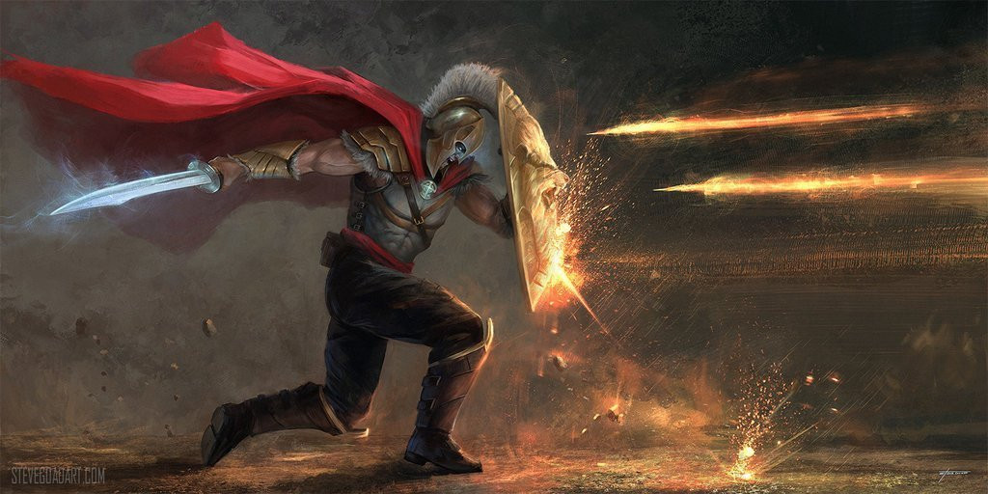

Our Relentless Foe
by Pastor Fee Soliven
Luke 4:1-13
Sunday Evening
August 16, 2020

Slide 2
Luke 4:1-13
1 Then Jesus, being filled with the Holy Spirit, returned from the Jordan and was led by the Spirit into the wilderness, 2 being tempted for forty days by the devil. And in those days He ate nothing, and afterward, when they had ended, He was hungry. 3 And the devil said to Him, "If You are the Son of God, command this stone to become bread."

Slide 3
4 But Jesus answered him, saying, "It is written, 'Man shall not live by bread alone, but by every word of God.' " 5 Then the devil, taking Him up on a high mountain, showed Him all the kingdoms of the world in a moment of time. 6 And the devil said to Him, "All this authority I will give You, and their glory; for this has been delivered to me, and I give it to whomever I wish.

Slide 4
7 Therefore, if You will worship before me, all will be Yours." 8 And Jesus answered and said to him, "Get behind Me, Satan! For it is written, 'You shall worship the LORD your God, and Him only you shall serve.' " 9 Then he brought Him to Jerusalem, set Him on the pinnacle of the temple, and said to Him, "If You are the Son of God, throw Yourself down from here.

Slide 5
10 For it is written: 'He shall give His angels charge over You, To keep You,' 11 "and, 'In their hands they shall bear you up, Lest you dash your foot against a stone.' " 12 And Jesus answered and said to him, "It has been said, 'You shall not tempt the LORD your God.' " 13 Now when the devil had ended every temptation, he departed from Him until an opportune time.

Slide 6
Some people who have trusted Jesus Christ as their Savior have suffered repeated defeat throughout their lives simply because they don’t realize they have a spiritual enemy.

Slide 7
What is a satanic attack?

Slide 8
Ephesians 6:16
“above all, taking the shield of faith with which you will be able to quench all the fiery darts of the wicked one.”

Slide 9
Romans 8:5-6
5 For those who live according to the flesh set their minds on the things of the flesh, but those who live according to the Spirit, the things of the Spirit. 6 For to be carnally minded is death, but to be spiritually minded is life and peace.

Slide 10
Romans 8:7-8
7 Because the carnal mind is enmity against God; for it is not subject to the law of God, nor indeed can be. 8 So then, those who are in the flesh cannot please God.

Slide 11
1 Corinthians 1:18-19
18 For the message of the cross is foolishness to those who are perishing, but to us who are being saved it is the power of God. 19 For it is written: "I will destroy the wisdom of the wise, And bring to nothing the understanding of the prudent."

Slide 12
Romans 8:9
“But you are not in the flesh but in the Spirit, if indeed the Spirit of God dwells in you. Now if anyone does not have the Spirit of Christ, he is not His.”

Slide 13
2 Corinthians 4:3-4
3 But even if our gospel is veiled, it is veiled to those who are perishing, 4 whose minds the god of this age has blinded, who do not believe, lest the light of the gospel of the glory of Christ, who is the image of God, should shine on them.

Slide 14
Satan’s Battleground is the Mind

Slide 15
Satan’s Strategies

Slide 16
He Directs our Attention toward a
Need or Desire

Slide 17
The devil chooses times when
We are the Weakest

Slide 18
He creates doubt in our minds. Satan’s biggest target is the Word of God

Slide 19
Satan wants to get Us in a Debate

Slide 20
The devil uses deception as his key weapon

Slide 21
He Wants to Create Division

Slide 22
Satan’s Goal is to Destroy Us

Slide 23
1. What kinds of battles is Satan waging in your mind?

Slide 24
2. Have you been listening and considering his ideas?

Slide 25
3. What Scripture passages do you know that refute his lies?

Slide 26
4. Do you believe that the Bible is true from Genesis to Revelation?

Slide 27
5. Are you living according to God’s revealed truth, or are you ignoring or not practicing what it teaches?

Slide 28
1 Thessalonians 4:13-18
13 But I do not want you to be ignorant, brethren, concerning those who have fallen asleep, lest you sorrow as others who have no hope. 14 For if we believe that Jesus died and rose again, even so God will bring with Him those who sleep in Jesus.

Slide 29
15 For this we say to you by the word of the Lord, that we who are alive and remain until the coming of the Lord will by no means precede those who are asleep. 16 For the Lord Himself will descend from heaven with a shout, with the voice of an archangel, and with the trumpet of God. And the dead in Christ will rise first.

Slide 30
17 Then we who are alive and remain shall be caught up together with them in the clouds to meet the Lord in the air. And thus we shall always be with the Lord. 18 Therefore comfort one another with these words.

Slide 31
1 Corinthians 15:50-54
50 Now this I say, brethren, that flesh and blood cannot inherit the kingdom of God; nor does corruption inherit incorruption. 51 Behold, I tell you a mystery: We shall not all sleep, but we shall all be changed-- 52 in a moment, in the twinkling of an eye, at the last trumpet. For the trumpet will sound, and the dead will be raised incorruptible, and we shall be changed.

Slide 32
53 For this corruptible must put on incorruption, and this mortal must put on immortality. 54 So when this corruptible has put on incorruption, and this mortal has put on immortality, then shall be brought to pass the saying that is written: "Death is swallowed up in victory."

Slide 33

20 Again, when a righteous man turns from his righteousness and commits iniquity, and I lay a stumbling block before him, he shall die; because you did not give him warning, he shall die in his sin, and his righteousness which he has done shall not be remembered; but his blood I will require at your hand.

Slide 34
Acts 2:38-39
38 Then Peter said to them, "Repent, and let every one of you be baptized in the name of Jesus Christ for the remission of sins; and you shall receive the gift of the Holy Spirit. 39 For the promise is to you and to your children, and to all who are afar off, as many as the Lord our God will call."

