Slide 1
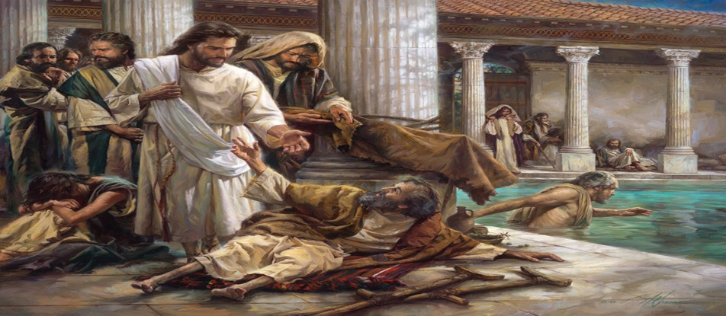
How Do You Handle Your Afflictions?
by Pastor Fee Soliven
Philippians 1:12-14
Wednesday Evening
October 28, 2020

Slide 2
Philippians 1:12-14
12 But I want you to know, brothers, that the things which happened to me have resulted in advancing the gospel, 13 so that my imprisonments in Christ have become known throughout the entire palace guard and to all the rest. 14 And a great many of the brothers in the Lord, having become confident because of my incarcerations, have dared to speak the word without fear.

Slide 3
Acts 19:21-22
21 When these things were accomplished, Paul purposed in the Spirit, when he had passed through Macedonia and Achaia, to go to Jerusalem, saying, "After I have been there, I must also see Rome."

Slide 4
Romans 1:15
“So, as much as is in me, I am ready to preach the gospel to you who are in Rome also.”

Slide 5
1. Paul was not discouraged, because he knew afflictions were part of the life of a Christian!

Slide 6
2 Timothy 2:8-13
8 Remember Jesus Christ, raised from the dead, descended from David, according to my gospel, 9 in which I suffer trouble like a criminal, even with chains. But the word of God is not bound. 10 Therefore I endure all things for the sake of the elect, that they also may obtain the salvation which is in Christ Jesus with eternal glory.

Slide 7
11 This is a faithful saying: If we die with Him, we shall also live with Him. 12 If we endure, we shall also reign with Him. If we deny Him, He also will deny us. 13 If we are faithless, He remains faithful; He cannot deny Himself.

Slide 8
1 Thessalonians 3:3-5
1 Therefore, when we could no longer endure it, we thought it good to be left at Athens alone. 2 We sent Timothy, who is our brother and minister of God and our fellow laborer in the gospel of Christ, to establish and comfort you with regard to your faith, 3 so that no one would be shaken by these afflictions. For you know that we are appointed to this.

Slide 9
4 Indeed, we told you before when we were with you that we would suffer tribulation, just as it came to pass, as you well know. 5 For this reason, when I could no longer endure it, I sent to inquire about your faith, lest by some means the tempter might have tempted you, and our labor might have been in vain.

Slide 10
Philippians 1:28-30
28 Do not be frightened by your adversaries. This is a sign to them of their destruction, but of your salvation, and this from God. 29 For to you it was granted on behalf of Christ not only to believe in Him, but also to suffer for His sake, 30 having the same conflict which you saw in me and now hear is in me.

Slide 11
Philippians 3:7-11
7 But what things were gain to me, I have counted these things to be loss for the sake of Christ. 8 Yes, certainly, I count everything as loss for the excellence of the knowledge of Christ Jesus my Lord, for whom I have forfeited the loss of all things and count them as rubbish that I may gain Christ,

Slide 12
9 and be found in Him, not having my own righteousness which is from the law, but that which is through faith in Christ,[a] the righteousness which is of God on the basis of faith, 10 to know Him, and the power of His resurrection, and the fellowship of His sufferings, being conformed to His death, 11 if somehow I might make it to the resurrection of the dead.

Slide 13
2. Paul’s experiences contradict the “Prosperity Gospel” preached in the church recently!

Slide 14
Acts 20:22-24
22 “Now, compelled by the Spirit, I am going to Jerusalem, not knowing what shall befall me there, 23 except that the Holy Spirit testifies to me in every city that imprisonment and afflictions await me. 24 But none of these things deter me. Nor do I count my life of value to myself, so that I may joyfully finish my course and the ministry which I have received from the Lord Jesus, to testify to the gospel of the grace of God.

Slide 15
2 Corinthians 11:23-28
23 Are they servants of Christ? I speak as a fool. I am more: in labors more abundant, in stripes above measure, in prisons more frequently, in deaths often. 24 Five times I received from the Jews forty lashes minus one. 25 Three times I was beaten with rods; once I was stoned; three times I suffered shipwreck; a night and a day I have been in the deep;

Slide 16
26 in journeys often, in perils of waters, in perils of robbers, in perils by my own countrymen, in perils by the Gentiles, in perils in the city, in perils in the wilderness, in perils in the sea, in perils among false brothers; 27 in weariness and painfulness, in sleeplessness often, in hunger and thirst, in fastings often, and in cold and nakedness. 28 Beside the external things, the care of all the churches pressures me daily.

Slide 17
3. Every affliction we suffer is an investment that God is making in us!

Slide 18
Psalm 32:1-7
1 Blessed is he whose transgression is forgiven, Whose sin is covered. 2 Blessed is the man to whom the LORD does not impute iniquity, And in whose spirit there is no deceit. 3 When I kept silent, my bones grew old Through my groaning all the day long.

Slide 19
4 For day and night Your hand was heavy upon me; My vitality was turned into the drought of summer. Selah 5 I acknowledged my sin to You, And my iniquity I have not hidden. I said, "I will confess my transgressions to the LORD," And You forgave the iniquity of my sin. Selah

Slide 20
6 For this cause everyone who is godly shall pray to You In a time when You may be found; Surely in a flood of great waters They shall not come near him. 7 You are my hiding place; You shall preserve me from trouble; You shall surround me with songs of deliverance.

Slide 21
4. If the Lord did not permit troubles in our lives, that would be the worst form of rejection!

Slide 22
Job 14:1-4
1 "Man who is born of woman Is of few days and full of trouble. 2 He comes forth like a flower and fades away; He flees like a shadow and does not continue. 3 And do You open Your eyes on such a one, And bring me to judgment with Yourself? 4 Who can bring a clean thing out of an unclean? No one!

Slide 23
Philippians 3:12-14
12 Not that I have already attained, or am already perfected; but I press on, that I may lay hold of that for which Christ Jesus has also laid hold of me. 13 Brethren, I do not count myself to have apprehended; but one thing I do, forgetting those things which are behind and reaching forward to those things which are ahead, 14 I press toward the goal for the prize of the upward call of God in Christ Jesus.

Slide 24
5. Some Christians forever stay in kindergarten, where the tests are easier to endure!

Slide 25
Hebrews 12:5-13
5 And you have forgotten the exhortation addressed to you as sons: “My son, do not despise the discipline from the Lord, nor grow weary when you are rebuked by Him; 6 for whom the Lord loves He disciplines, and scourges every son whom He receives.” 7 Endure discipline; God is dealing with you as with sons. For what son is there whom a father does not discipline?

Slide 26
8 If you are without discipline, of which everyone has partaken, then you are illegitimate children and not sons. 9 Furthermore, we have had human fathers, and they corrected us, and we gave them reverence. Shall we not much more be subject to the Father of spirits and live? 10 For they indeed disciplined us for a short time according to their own judgment, but He does so for our profit, that we may partake of His holiness.

Slide 27
11 Now no discipline seems to be joyful at the time, but grievous. Yet afterward it yields the peaceful fruit of righteousness in those who have been trained by it. 12 Therefore lift up your tired hands, and strengthen your weak knees. 13 Make straight paths for your feet, lest that which is lame go out of joint, but rather be healed.

Slide 28
6. God will use afflictions to bring us out into “a place of abundant fruitfulness.”

Slide 29
Psalm 66:8-12
8 Oh, bless our God, you people, and make the voice of His praise to be heard, 9 who keeps our soul among the living, and does not allow our feet to slip. 10 For You, O God, have proved us; You have refined us, as silver is refined.

Slide 30
11 You brought us into the net; You placed distress on our backs. 12 You have allowed people to ride over our heads; we went through fire and through water; but You brought us out into a well-watered place.

Slide 31
7. God needs His seasoned veterans like Paul to show His faithfulness to their generation

Slide 32
Psalm 71:15-21
15 My mouth will declare Your righteousness and Your salvation all the day, for I cannot know their numbers. 16 I will go in the strength of the Lord God; I will make mention of Your righteousness, of Yours only. 17 O God, You have taught me from my youth; and until now I have proclaimed Your wondrous works.

Slide 33
18 Now also when I am old and gray, O God, do not forsake me, until I have proclaimed Your strength to this generation, and Your power to everyone who is to come. 19 Your righteousness, O God, reaches to the heights; You have done great deeds; God, who is like You?

Slide 34
20 You who have shown me great distresses and troubles will revive me again, and will bring me up again from the depths of the earth. 21 You will increase my greatness, and You will encircle and comfort me.

Slide 35
1. We Waste Afflictions by Whining, Murmuring & Complaining in The Present

Slide 36
2. We Waste Afflictions When We Do not Remember Deliverances in The Past

Slide 37
3. We Waste Afflictions When We Do Not See God’s Purposes in The Future

Slide 38
4. God is Preparing You to Be a Veteran of Spiritual Warfare!

Slide 39
Philippians 1:6
“being confident of this very thing, that He who has begun a good work in you will complete it until the day of Jesus Christ…”

Slide 40
1 Thessalonians 4:13-18
13 But I do not want you to be ignorant, brethren, concerning those who have fallen asleep, lest you sorrow as others who have no hope. 14 For if we believe that Jesus died and rose again, even so God will bring with Him those who sleep in Jesus.

Slide 41
15 For this we say to you by the word of the Lord, that we who are alive and remain until the coming of the Lord will by no means precede those who are asleep. 16 For the Lord Himself will descend from heaven with a shout, with the voice of an archangel, and with the trumpet of God. And the dead in Christ will rise first.

Slide 42
17 Then we who are alive and remain shall be caught up together with them in the clouds to meet the Lord in the air. And thus we shall always be with the Lord. 18 Therefore comfort one another with these words.

Slide 43
John 14:2-3
2 In My Father's house are many mansions; if it were not so, I would have told you. I go to prepare a place for you. 3 And if I go and prepare a place for you, I will come again and receive you to Myself; that where I am, there you may be also.

Slide 44
1 Corinthians 15:50-54
50 Now this I say, brethren, that flesh and blood cannot inherit the kingdom of God; nor does corruption inherit incorruption. 51 Behold, I tell you a mystery: We shall not all sleep, but we shall all be changed-- 52 in a moment, in the twinkling of an eye, at the last trumpet. For the trumpet will sound, and the dead will be raised incorruptible, and we shall be changed.

Slide 45
53 For this corruptible must put on incorruption, and this mortal must put on immortality. 54 So when this corruptible has put on incorruption, and this mortal has put on immortality, then shall be brought to pass the saying that is written: "Death is swallowed up in victory."

Slide 46
20 Again, when a righteous man turns from his righteousness and commits iniquity, and I lay a stumbling block before him, he shall die; because you did not give him warning, he shall die in his sin, and his righteousness which he has done shall not be remembered; but his blood I will require at your hand.

Slide 47
Acts 2:38-39
38 Then Peter said to them, "Repent, and let every one of you be baptized in the name of Jesus Christ for the remission of sins; and you shall receive the gift of the Holy Spirit. 39 For the promise is to you and to your children, and to all who are afar off, as many as the Lord our God will call."

