Slide 1
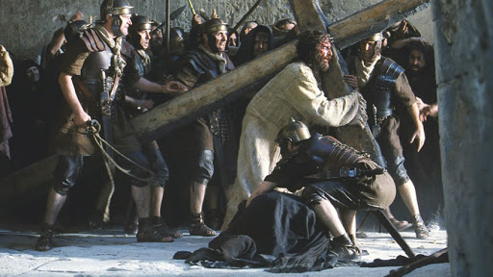
Jesus Help Me Bare My Cross
by Pastor Fee Soliven
Matthew 16:21-28
Wednesday Evening
October 21, 2020

Slide 2
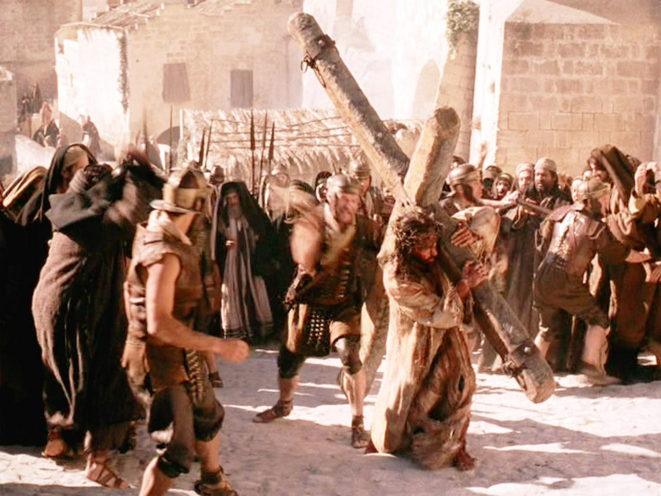
Hebrews 11:1-6
1 Now faith is the substance of things hoped for, the evidence of things not seen. 2 For by it the elders obtained a good testimony. 3 By faith we understand that the worlds were framed by the word of God, so that the things which are seen were not made of things which are visible.

Slide 3
21 From that time Jesus began to show to His disciples that He must go to Jerusalem, and suffer many things from the elders and chief priests and scribes, and be killed, and be raised the third day.

Slide 4
22 Then Peter took Him aside and began to rebuke Him, saying, "Far be it from You, Lord; this shall not happen to You!"

Slide 5
23 But He turned and said to Peter, "Get behind Me, Satan! You are an offense to Me, for you are not mindful of the things of God, but the things of men."

Slide 6
24 Then Jesus said to His disciples, "If anyone desires to come after Me, let him deny himself, and take up his cross, and follow Me.

Slide 7
25 For whoever desires to save his life will lose it, but whoever loses his life for My sake will find it.

Slide 8
26 For what profit is it to a man if he gains the whole world, and loses his own soul? Or what will a man give in exchange for his soul?

Slide 9
27 For the Son of Man will come in the glory of His Father with His angels, and then He will reward each according to his works.

Slide 10
28 Assuredly, I say to you, there are some standing here who shall not taste death till they see the Son of Man coming in His kingdom."

Slide 11
21 From that time Jesus began to show to His disciples that He must go to Jerusalem and suffer many things from the elders and chief priests and scribes, and be killed, and be raised the third day.

Slide 12
Revelation 19:11-16
11 Now I saw heaven opened, and behold, a white horse. And He who sat on him was called Faithful and True, and in righteousness He judges and makes war. 12 His eyes were like a flame of fire, and on His head were many crowns. He had a name written that no one knew except Himself. 13 He was clothed with a robe dipped in blood, and His name is called The Word of God.

Slide 13
14 And the armies in heaven, clothed in fine linen, white and clean, followed Him on white horses. 15 Now out of His mouth goes a sharp sword, that with it He should strike the nations. And He Himself will rule them with a rod of iron. He Himself treads the winepress of the fierceness and wrath of Almighty God. 16 And He has on His robe and on His thigh a name written: KING OF KINGS AND LORD OF LORDS.
22 Then Peter took Him aside and began to rebuke Him, saying, "Far be it from You, Lord; this shall not happen to You!"

Slide 14
22 Then Peter took Him aside and began to rebuke Him, saying, "Far be it from You, Lord; this shall not happen to You!"

Slide 15
Matthew 5:10-12
10 Blessed are those who are persecuted for righteousness' sake, For theirs is the kingdom of heaven. 11 "Blessed are you when they revile and persecute you, and say all kinds of evil against you falsely for My sake. 12 Rejoice and be exceedingly glad, for great is your reward in heaven, for so they persecuted the prophets who were before you.

Slide 16
2 Timothy 3:12-13
12 Yes, and all who desire to live godly in Christ Jesus will suffer persecution. 13 But evil men and impostors will grow worse and worse, deceiving and being deceived.

Slide 17
Acts 9:15-16
15 But the Lord said to him, "Go, for he is a chosen vessel of Mine to bear My name before Gentiles, kings, and the children of Israel. 16 For I will show him how many things he must suffer for My name's sake."

Slide 18
2 Corinthians 11:23-31
23 Are they ministers of Christ?--I speak as a fool--I am more: in labors more abundant, in stripes above measure, in prisons more frequently, in deaths often. 24 From the Jews five times I received forty stripes minus one. 25 Three times I was beaten with rods; once I was stoned; three times I was shipwrecked; a night and a day I have been in the deep;

Slide 19
26 in journeys often, in perils of waters, in perils of robbers, in perils of my own countrymen, in perils of the Gentiles, in perils in the city, in perils in the wilderness, in perils in the sea, in perils among false brethren; 27 in weariness and toil, in sleeplessness often, in hunger and thirst, in fastings often, in cold and nakedness—

Slide 20
28 besides the other things, what comes upon me daily: my deep concern for all the churches. 29 Who is weak, and I am not weak? Who is made to stumble, and I do not burn with indignation? 30 If I must boast, I will boast in the things which concern my infirmity. 31 The God and Father of our Lord Jesus Christ, who is blessed forever, knows that I am not lying.

Slide 21
23 But He turned and said to Peter, "Get behind Me, Satan! You are an offense to Me, for you are not mindful of the things of God, but the things of men."

Slide 22
24 Then Jesus said to His disciples, "If anyone desires to come after Me, let him deny himself, and take up his cross, and follow Me.

Slide 23
“put aside selfish ambition”

Slide 24
“Self” is no longer in charge; but God is

Slide 25
“shoulder the cross”

Slide 26
Following Jesus, therefore, meant identifying with Jesus and his followers, facing social and political oppression and ostracism, and no turning back.

Slide 27
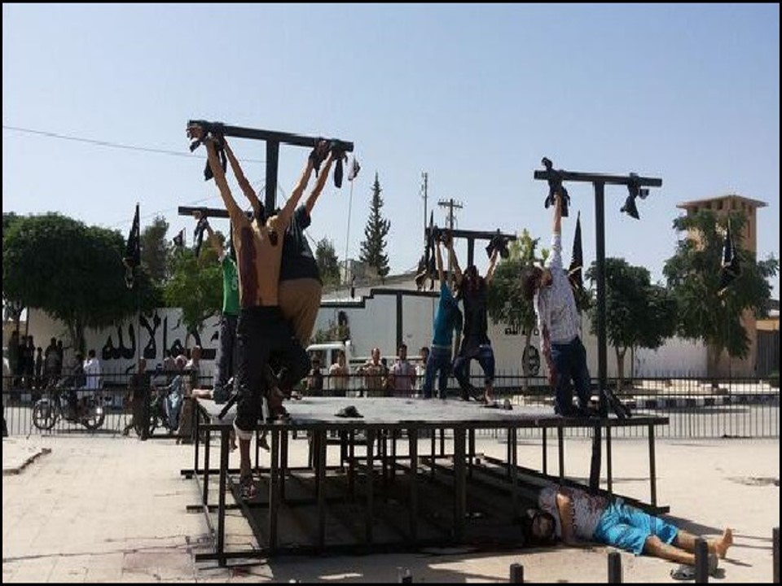
We carry guilt over Present or Past Sins

Slide 28
“follow” Christ is also a moment-by moment decision, requiring compassion and service.

Slide 29
25 For whoever desires to save his life will lose it, but whoever loses his life for My sake will find it.

Slide 30
26 For what profit is it to a man if he gains the whole world, and loses his own soul? Or what will a man give in exchange for his soul?

Slide 31
Hebrews 9:27
“And as it is appointed for men to die once, but after this the judgment…”

Slide 32
27 For the Son of Man will come in the glory of His Father with His angels, and then He will reward each according to his works.

Slide 33
28 Assuredly, I say to you, there are some standing here who shall not taste death till they see the Son of Man coming in His kingdom."

Slide 34
1. Peter, James, and John, who would witness the Transfiguration a few days later

Slide 35
2. Those who would witness the Resurrection and ascension

Slide 36
3. The Holy Spirit’s coming at Pentecost

Slide 37
4. All who would take part in the spread of the church after Pentecost.

Slide 38
1 Thessalonians 4:13-18
13 But I do not want you to be ignorant, brethren, concerning those who have fallen asleep, lest you sorrow as others who have no hope. 14 For if we believe that Jesus died and rose again, even so God will bring with Him those who sleep in Jesus.

Slide 39
15 For this we say to you by the word of the Lord, that we who are alive and remain until the coming of the Lord will by no means precede those who are asleep. 16 For the Lord Himself will descend from heaven with a shout, with the voice of an archangel, and with the trumpet of God. And the dead in Christ will rise first.

Slide 40
17 Then we who are alive and remain shall be caught up together with them in the clouds to meet the Lord in the air. And thus we shall always be with the Lord. 18 Therefore comfort one another with these words.

Slide 41
John 14:2-3
2 In My Father's house are many mansions; if it were not so, I would have told you. I go to prepare a place for you. 3 And if I go and prepare a place for you, I will come again and receive you to Myself; that where I am, there you may be also.

Slide 42
1 Corinthians 15:50-54
50 Now this I say, brethren, that flesh and blood cannot inherit the kingdom of God; nor does corruption inherit incorruption. 51 Behold, I tell you a mystery: We shall not all sleep, but we shall all be changed-- 52 in a moment, in the twinkling of an eye, at the last trumpet. For the trumpet will sound, and the dead will be raised incorruptible, and we shall be changed.

Slide 43
53 For this corruptible must put on incorruption, and this mortal must put on immortality. 54 So when this corruptible has put on incorruption, and this mortal has put on immortality, then shall be brought to pass the saying that is written: "Death is swallowed up in victory."

Slide 44
20 Again, when a righteous man turns from his righteousness and commits iniquity, and I lay a stumbling block before him, he shall die; because you did not give him warning, he shall die in his sin, and his righteousness which he has done shall not be remembered; but his blood I will require at your hand.

Slide 45
Acts 2:38-39
38 Then Peter said to them, "Repent, and let every one of you be baptized in the name of Jesus Christ for the remission of sins; and you shall receive the gift of the Holy Spirit. 39 For the promise is to you and to your children, and to all who are afar off, as many as the Lord our God will call."

