Slide 1
“For the Joy of the Lord is your Strength”
Nehemiah 8:10

Slide 2
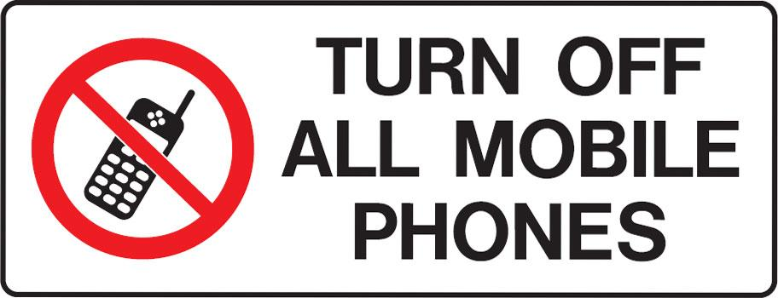

Slide 3
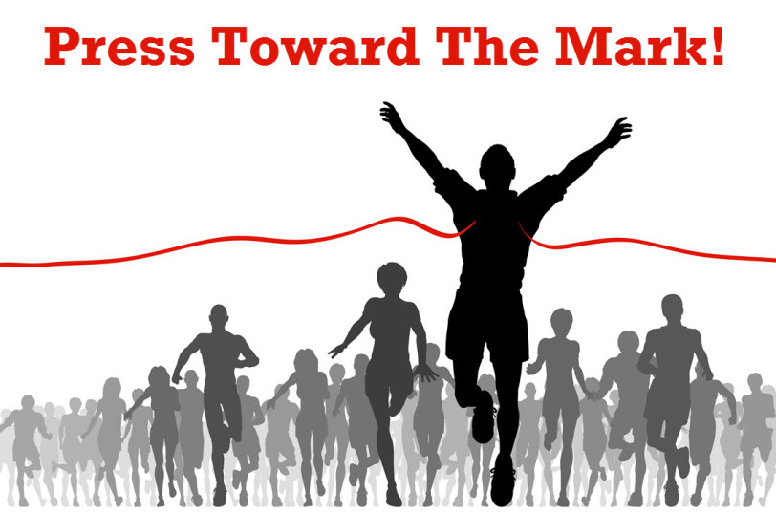
Our Grand Opening Message
by Pastor Fee Soliven
1 Corinthians 9:24-27
Sunday Morning
October 11, 2020

Slide 4
1 Corinthians 9:24-27
24 Do you not know that those who run in a race all run, but one receives the prize? Run in such a way that you may obtain it. 25 And everyone who competes for the prize is temperate in all things. Now they do it to obtain a perishable crown, but we for an imperishable crown.

Slide 5
26 Therefore I run thus: not with uncertainty. Thus I fight: not as one who beats the air. 27 But I discipline my body and bring it into subjection, lest, when I have preached to others, I myself should become disqualified.

Slide 6
How is life like a Race?
Life has a challenging course with many ups and downs
Life has a judge who decides where we place at the end

Slide 7
Life has a finish line
our eternal destiny is either death or life
Life ends with the “winners” receiving their rewards

Slide 8
Hebrews 12:1-2
1 Therefore we also, since we are surrounded by so great a cloud of witnesses, let us lay aside every weight, and the sin which so easily ensnares us, and let us run with endurance the race that is set before us,

Slide 9
2 looking unto Jesus, the author and finisher of our faith, who for the joy that was set before Him endured the cross, despising the shame, and has sat down at the right hand of the throne of God.

Slide 10
At 7 P.M. on October 20, 1968, a few thousand spectators remained in the Mexico City Olympic Stadium. It was cool and dark. The last of the marathon runners, each exhausted, were being carried off to first-aid stations. More than an hour earlier, Mamo Wolde of Ethiopia – looking as fresh as when he started the race - crossed the finish line, the winner of the 26-mile, 385-yard event.

Slide 11
As the remaining spectators prepared to leave, those sitting near the marathon gates suddenly heard the sound of sirens and police whistles. All eyes turned to the gate. A lone figure wearing the colors of T 26 Therefore I run thus: not with uncertainty. Thus I fight: not as one who beats the air. 27 But I discipline anzania entered the stadium.
c

Slide 12
His name was John Stephen Akhwari. He was the last man to finish the marathon. His leg bloodied and bandaged, severely injured in a fall, he grimaced with each step. He hobbled around the 400-meter track. The spectators rose and applauded him as if he were the winner.

Slide 13
After crossing the finish line, Akhwari slowly walked off the field without turning to the cheering crowd. In view of his injury and having no chance of winning a medal, someone asked him why he had not quit. He replied, "My country did not send me 7,000 miles to start the race. They sent me 7,000 miles to finish it.
c

Slide 14
God is Faithful!

Slide 15
2 Timothy 2:9-15
10 Therefore I endure all things for the sake of the elect, that they also may obtain the salvation which is in Christ Jesus with eternal glory. 11 This is a faithful saying: For if we died with Him, We shall also live with Him. 12 If we endure, We shall also reign with Him. If we deny Him, He also will deny us. 13 If we are faithless, He remains faithful; He cannot deny Himself.

Slide 16
14 Remind them of these things, charging them before the Lord not to strive about words to no profit, to the ruin of the hearers. 15 Be diligent to present yourself approved to God, a worker who does not need to be ashamed, rightly dividing the word of truth.

Slide 17
Our Hope is in Christ Alone

Slide 18
One of the Old Testament words for hope is TIQVAH which literally means “a cord.” It comes from QAVAH which means “to bind together by twisting” (like a braid of rope).

Slide 19
Hope – Being connected to God

Slide 20
Hope – Brings us renewed strength in the race of life.

Slide 21
Finish the Race!

Slide 22
Philippians 3:12-14
12 Not that I have already attained, or am already perfected; but I press on, that I may lay hold of that for which Christ Jesus has also laid hold of me. 13 Brethren, I do not count myself to have apprehended; but one thing I do, forgetting those things which are behind and reaching forward to those things which are ahead, 14 I press toward the goal for the prize of the upward call of God in Christ Jesus.

Slide 23
RUN to WIN! RUN with HOPE! RUN to FINISH the RACE!

Slide 24
1 Thessalonians 4:13-18
13 But I do not want you to be ignorant, brethren, concerning those who have fallen asleep, lest you sorrow as others who have no hope. 14 For if we believe that Jesus died and rose again, even so God will bring with Him those who sleep in Jesus.

Slide 25
15 For this we say to you by the word of the Lord, that we who are alive and remain until the coming of the Lord will by no means precede those who are asleep. 16 For the Lord Himself will descend from heaven with a shout, with the voice of an archangel, and with the trumpet of God. And the dead in Christ will rise first.

Slide 26
17 Then we who are alive and remain shall be caught up together with them in the clouds to meet the Lord in the air. And thus we shall always be with the Lord. 18 Therefore comfort one another with these words.

Slide 27
John 14:2-3
2 In My Father's house are many mansions; if it were not so, I would have told you. I go to prepare a place for you. 3 And if I go and prepare a place for you, I will come again and receive you to Myself; that where I am, there you may be also.

Slide 28
1 Corinthians 15:50-54
50 Now this I say, brethren, that flesh and blood cannot inherit the kingdom of God; nor does corruption inherit incorruption. 51 Behold, I tell you a mystery: We shall not all sleep, but we shall all be changed-- 52 in a moment, in the twinkling of an eye, at the last trumpet. For the trumpet will sound, and the dead will be raised incorruptible, and we shall be changed.

Slide 29
53 For this corruptible must put on incorruption, and this mortal must put on immortality. 54 So when this corruptible has put on incorruption, and this mortal has put on immortality, then shall be brought to pass the saying that is written: "Death is swallowed up in victory."

Slide 30
20 Again, when a righteous man turns from his righteousness and commits iniquity, and I lay a stumbling block before him, he shall die; because you did not give him warning, he shall die in his sin, and his righteousness which he has done shall not be remembered; but his blood I will require at your hand.

Slide 31
Acts 2:38-39
38 Then Peter said to them, "Repent, and let every one of you be baptized in the name of Jesus Christ for the remission of sins; and you shall receive the gift of the Holy Spirit. 39 For the promise is to you and to your children, and to all who are afar off, as many as the Lord our God will call."

Slide 32
“For the Joy of the Lord is your Strength”
Nehemiah 8:10

