Slide 1
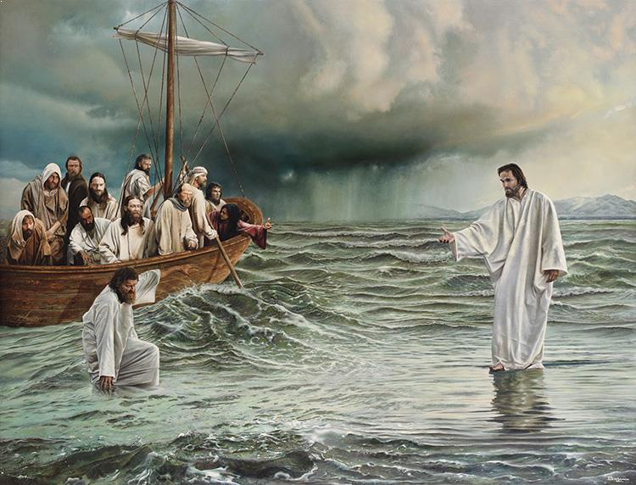
Jesus in the Midst of Our Storms
by Pastor Fee Soliven
Matthew 8:23-27
Wednesday Evening
August 26, 2020

Slide 2
Show Me Your Better Ways Jesus
By Pastor Fee Soliven
Philippians 4:4-7
Wednesday Evening
September 30, 2020

Slide 3
Philippians 4:4-7
4 Rejoice in the Lord always. Again I will say, rejoice! 5 Let your gentleness be known to all men. The Lord is at hand. 6 Be anxious for nothing, but in everything by prayer and supplication, with thanksgiving, let your requests be made known to God; 7 and the peace of God, which surpasses all understanding, will guard your hearts and minds through Christ Jesus.

Slide 4
We are living in the “now” generation. Whatever we want, we can often find a way to get it immediately.

Slide 5
Psalm 27:11-14
11 Teach me Your way, O LORD, And lead me in a smooth path, because of my enemies. 12 Do not deliver me to the will of my adversaries; For false witnesses have risen against me, And such as breathe out violence.

Slide 6
13 I would have lost heart, unless I had believed That I would see the goodness of the LORD In the land of the living. 14 Wait on the LORD; Be of good courage, And He shall strengthen your heart; Wait, I say, on the LORD!

Slide 7
Genesis 25:25-34
24 So when her days were fulfilled for her to give birth, indeed there were twins in her womb. 25 And the first came out red. He was like a hairy garment all over; so they called his name Esau. 26 Afterward his brother came out, and his hand took hold of Esau's heel; so his name was called Jacob. Isaac was sixty years old when she bore them.

Slide 8
27 So the boys grew. And Esau was a skillful hunter, a man of the field; but Jacob was a mild man, dwelling in tents. 28 And Isaac loved Esau because he ate of his game, but Rebekah loved Jacob. 29 Now Jacob cooked a stew; and Esau came in from the field, and he was weary.

Slide 9
30 And Esau said to Jacob, "Please feed me with that same red stew, for I am weary." Therefore his name was called Edom. 31 But Jacob said, "Sell me your birthright as of this day." 32 And Esau said, "Look, I am about to die; so what is this birthright to me?"

Slide 10
33 Then Jacob said, "Swear to me as of this day." So he swore to him, and sold his birthright to Jacob. 34 And Jacob gave Esau bread and stew of lentils; then he ate and drank, arose, and went his way. Thus Esau despised his birthright.

Slide 11
When do we sacrifice our future for the pleasure of the moment?

Slide 12
1. When we Disregard the Sacred Values in Life

Slide 13
2. When we Insist on Immediate Fulfillment of our Desires

Slide 14
3. When our Focus is on the Worldly rather than the Eternal

Slide 15
Galatians 6:6-10
6 Let him who is taught the word share in all good things with him who teaches. 7 Do not be deceived, God is not mocked; for whatever a man sows, that he will also reap. 8 For he who sows to his flesh will of the flesh reap corruption, but he who sows to the Spirit will of the Spirit reap everlasting life.

Slide 16
9 And let us not grow weary while doing good, for in due season we shall reap if we do not lose heart. 10 Therefore, as we have opportunity, let us do good to all, especially to those who are of the household of faith.

Slide 17
(When do we sacrifice our future for the pleasure of the moment?)

Slide 18
4. When we make Irrevocable decisions in periods of Physical and Emotional weakness

Slide 19
Romans 12:1-2
1 I beseech you therefore, brethren, by the mercies of God, that you present your bodies a living sacrifice, holy, acceptable to God, which is your reasonable service. 2 And do not be conformed to this world, but be transformed by the renewing of your mind, that you may prove what is that good and acceptable and perfect will of God.

Slide 20
5. When we have no Respect for Spiritual Things

Slide 21
1 Samuel 15:26
“But Samuel said to Saul, "I will not return with you, for you have rejected the word of the LORD, and the LORD has rejected you from being king over Israel."

Slide 22
1 Samuel 16:14
“But the Spirit of the LORD departed from Saul, and a distressing spirit from the LORD troubled him”

Slide 23
6. When we Fail to Examine the possible Consequences of our Actions

Slide 24
What is in our bowl today that carries disastrous consequences?

Slide 25
Alcohol
We can buy and drink all we want and feel good for a while, but the results of becoming enslaved to it are difficult and long-lasting.

Slide 26
1 Corinthians 6:9-10
9 Do you not know that the unrighteous will not inherit the kingdom of God? Do not be deceived. Neither fornicators, nor idolaters, nor adulterers, nor homosexuals, nor sodomites, 10 nor thieves, nor covetous, nor drunkards, nor revilers, nor extortioners will inherit the kingdom of God.

Slide 27
Prejudice
Passing judgment on others simply because you don’t relate to them never pleases God.

Slide 28
Proverbs 10:18
“Whoever hides hatred has lying lips, And whoever spreads slander is a fool.”

Slide 29
Drugs
No one ever intends to become addicted to drugs, but the sought-after pleasure and relief soon turn into bondage.

Slide 30
Revelation 21:8
“But the cowardly, unbelieving, abominable, murderers, sexually immoral, sorcerers, idolaters, and all liars shall have their part in the lake which burns with fire and brimstone, which is the second death."

Slide 31
Bitterness
It begins with anger and grows into a more destructive emotion that affects our entire being.

Slide 32
Ephesians 4:31-32
31 Let all bitterness, wrath, anger, clamor, and evil speaking be put away from you, with all malice. 32 And be kind to one another, tenderhearted, forgiving one another, just as God in Christ forgave you.

Slide 33
Adultery
Although it’s often glamorized in our culture, adultery destroys individuals and families.

Slide 34
Hebrews 13:4
“Marriage is honorable among all, and the bed undefiled; but fornicators and adulterers God will judge.”

Slide 35
Fornication
Not believing God to live Holy and Sanctified. Having a spirit of self to only gratify one self sexually. This unrepented lifestyle sends one to hell.

Slide 36
1 Corinthians 6:9-10
9 Do you not know that the unrighteous will not inherit the kingdom of God? Do not be deceived. Neither fornicators, nor idolaters, nor adulterers, nor homosexuals, nor sodomites, 10 nor thieves, nor covetous, nor drunkards, nor revilers, nor extortioners will inherit the kingdom of God.

Slide 37
Abortion
It may seem like a way to escape a difficult situation, but those involved in abortion carry a heavy weight of guilt.

Slide 38
Exodus 20:13-14
13 "You shall not murder. 14 "You shall not commit adultery.

Slide 39
Hatred
Even if we feel justified in our hatred, it damages our emotions, health, attitudes, and relationships with others and with God.

Slide 40
Matthew 5:22
But I say to you that everyone who is angry with his brother will be liable to judgment; whoever insults his brother will be liable to the council; and whoever says, ‘You fool!’ will be liable to the hell of fire.

Slide 41
Unforgiveness
The right response to every offense is forgiveness, but harboring unforgiveness is a sin that hinders our lives.

Slide 42
Matthew 6:14-15
14 "For if you forgive men their trespasses, your heavenly Father will also forgive you. 15 But if you do not forgive men their trespasses, neither will your Father forgive your trespasses.

Slide 43
Anger
When we hold on to anger for wrongs committed against us, our bodies, feelings, spirits, and relationships suffer.

Slide 44
Ephesians 4:26
Be angry and do not sin; do not let the sun go down on your anger,

Slide 45
1. Have you, like Esau, ever traded something precious for a moment’s pleasure?

Slide 46
2. What consequences did you experience?

Slide 47
3. What lessons did you learn?

Slide 48
4. The next time you have a strong desire and the ability to fulfill it, what should you do to ensure that you do not make a foolish decision?

Slide 49
5. What spiritual benefits and fruit come from denying ourselves some of our desires?

Slide 50
1 Thessalonians 4:13-18
13 But I do not want you to be ignorant, brethren, concerning those who have fallen asleep, lest you sorrow as others who have no hope. 14 For if we believe that Jesus died and rose again, even so God will bring with Him those who sleep in Jesus.

Slide 51
15 For this we say to you by the word of the Lord, that we who are alive and remain until the coming of the Lord will by no means precede those who are asleep. 16 For the Lord Himself will descend from heaven with a shout, with the voice of an archangel, and with the trumpet of God. And the dead in Christ will rise first.

Slide 52
17 Then we who are alive and remain shall be caught up together with them in the clouds to meet the Lord in the air. And thus we shall always be with the Lord. 18 Therefore comfort one another with these words.

Slide 53
John 14:2-3
2 In My Father's house are many mansions; if it were not so, I would have told you. I go to prepare a place for you. 3 And if I go and prepare a place for you, I will come again and receive you to Myself; that where I am, there you may be also.

Slide 54
1 Corinthians 15:50-54
50 Now this I say, brethren, that flesh and blood cannot inherit the kingdom of God; nor does corruption inherit incorruption. 51 Behold, I tell you a mystery: We shall not all sleep, but we shall all be changed-- 52 in a moment, in the twinkling of an eye, at the last trumpet. For the trumpet will sound, and the dead will be raised incorruptible, and we shall be changed.

Slide 55
53 For this corruptible must put on incorruption, and this mortal must put on immortality. 54 So when this corruptible has put on incorruption, and this mortal has put on immortality, then shall be brought to pass the saying that is written: "Death is swallowed up in victory."

Slide 56
20 Again, when a righteous man turns from his righteousness and commits iniquity, and I lay a stumbling block before him, he shall die; because you did not give him warning, he shall die in his sin, and his righteousness which he has done shall not be remembered; but his blood I will require at your hand.

Slide 57
Acts 2:38-39
38 Then Peter said to them, "Repent, and let every one of you be baptized in the name of Jesus Christ for the remission of sins; and you shall receive the gift of the Holy Spirit. 39 For the promise is to you and to your children, and to all who are afar off, as many as the Lord our God will call."

