Slide 1
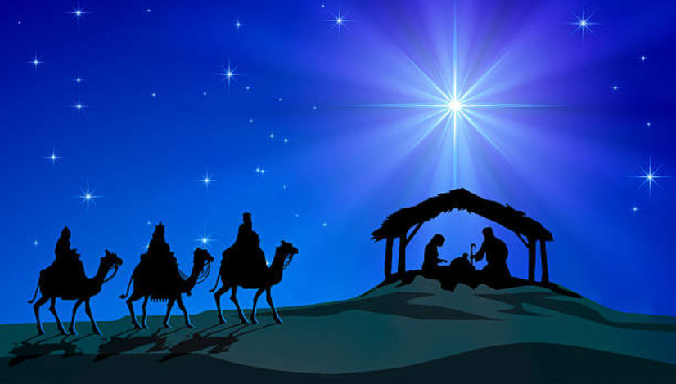

It’s All About Jesus
by Pastor Fee Soliven
Matthew 1:18-21
Wednesday Evening
December 23, 2020

Slide 2
Matthew 1:18-21
18 Now the birth of Jesus Christ was as follows: After His mother Mary was betrothed to Joseph, before they came together, she was found with child of the Holy Spirit. 19 Then Joseph her husband, being a just man, and not wanting to make her a public example, was minded to put her away secretly.

Slide 3
20 But while he thought about these things, behold, an angel of the Lord appeared to him in a dream, saying, "Joseph, son of David, do not be afraid to take to you Mary your wife, for that which is conceived in her is of the Holy Spirit. 21 And she will bring forth a Son, and you shall call His name JESUS, for He will save His people from their sins."

Slide 4
Who is Jesus?

Slide 5
Jesus lived before being conceived in His mother’s womb

Slide 6
1. Our Triune God

Slide 7
Genesis 1:26
"Then God said, "Let Us make man in Our image, according to Our likeness"

Slide 8
2. Jesus Is The Word

Slide 9
John 1:1-5
1 In the beginning was the Word, and the Word was with God, and the Word was God. 2 He was in the beginning with God. 3 All things were made through Him, and without Him nothing was made that was made. 4 In Him was life, and the life was the light of men. 5 And the light shines in the darkness, and the darkness did not comprehend it.

Slide 10
3. Jesus Existed Before Abraham

Slide 11
John 8:58
"Jesus said to them, "Most assuredly, I say to you, before Abraham was, I AM."

Slide 12
4. God's Love for His Son

Slide 13
John 17:24
"Father, I desire that they also whom You gave Me may be with Me where I am, that they may behold My glory which You have given Me; for You loved Me before the foundation of the world."

Slide 14
The Father and the Son created all things

Slide 15
John 1:3
"All things were made through Him, and without Him nothing was made that was made."

Slide 16
Colossians 1:16-18
16 For by Him all things were created that are in heaven and that are on earth, visible and invisible, whether thrones or dominions or principalities or powers. All things were created through Him and for Him. 17 And He is before all things, and in Him all things consist. 18 And He is the head of the body, the church, who is the beginning, the firstborn from the dead, that in all things He may have the preeminence.

Slide 17
Hebrews 1:1-3
1 "God, who at various times and in various ways spoke in time past to the fathers by the prophets, 2 has in these last days spoken to us by His Son, whom He has appointed heir of all things, through whom also He made the worlds; 3 who being the brightness of His glory and the express image of His person, and upholding all things by the word of His power, when He had by Himself purged our sins, sat down at the right hand of the Majesty on high..."
Jesus was born of an earthly mother and a heavenly Father
Luke 1:33-36
34 Then Mary said to the angel, "How can this be, since I do not know a man?" 35 And the angel answered and said to her, "The Holy Spirit will come upon you, and the power of the Highest will overshadow you; therefore, also, that Holy One who is to be born will be called the Son of God.
Jesus was both God and the Son of God

Slide 18
Jesus was born of an earthly mother and a heavenly Father

Slide 19
Luke 1:33-36
34 Then Mary said to the angel, "How can this be, since I do not know a man?" 35 And the angel answered and said to her, "The Holy Spirit will come upon you, and the power of the Highest will overshadow you; therefore, also, that Holy One who is to be born will be called the Son of God.

Slide 20
Jesus was both God and the Son of God

Slide 21
John 10:30
“I and my Father are one.”

Slide 22
John 12:44-45
44 Then Jesus cried out and said, "He who believes in Me, believes not in Me but in Him who sent Me. 45 And he who sees Me sees Him who sent Me.

Slide 23
John 14:7
"If you had known Me, you would have known My Father also; and from now on you know Him and have seen Him."

Slide 24
Colossians 1:15
"He is the image of the invisible God, the firstborn over all creation."

Slide 25
Jesus’ Teaching was often Perplexing

Slide 26
Matthew 5:11-12
11 "Blessed are you when they revile and persecute you, and say all kinds of evil against you falsely for My sake. 12 Rejoice and be exceedingly glad, for great is your reward in heaven, for so they persecuted the prophets who were before you.

Slide 27
Matthew 5:44
"But I say to you, love your enemies, bless those who curse you, do good to those who hate you, and pray for those who spitefully use you and persecute you..."

Slide 28
Matthew 20:27-28
27 And whoever desires to be first among you, let him be your slave-- 28 just as the Son of Man did not come to be served, but to serve, and to give His life a ransom for many."

Slide 29
Mark 8:34-35
34 When He had called the people to Himself, with His disciples also, He said to them, "Whoever desires to come after Me, let him deny himself, and take up his cross, and follow Me. 35 For whoever desires to save his life will lose it, but whoever loses his life for My sake and the gospel's will save it.

Slide 30
Matthew 5:5
"Blessed are the meek, For they shall inherit the earth."

Slide 31
Matthew 10:34-39
34 "Do not think that I came to bring peace on earth. I did not come to bring peace but a sword. 35 For I have come to 'set a man against his father, a daughter against her mother, and a daughter-in-law against her mother-in-law'; 36 and 'a man's enemies will be those of his own household.'

Slide 32
37 He who loves father or mother more than Me is not worthy of Me. And he who loves son or daughter more than Me is not worthy of Me. 38 And he who does not take his cross and follow after Me is not worthy of Me. 39 He who finds his life will lose it, and he who loses his life for My sake will find it.

Slide 33
Jesus’ Name is like no Other

Slide 34
Philippians 2:9-11
9 Therefore God also has highly exalted Him and given Him the name which is above every name, 10 that at the name of Jesus every knee should bow, of those in heaven, and of those on earth, and of those under the earth, 11 and that every tongue should confess that Jesus Christ is Lord, to the glory of God the Father.

Slide 35
Luke 24:47
"and that repentance and remission of sins should be preached in His name to all nations, beginning at Jerusalem."

Slide 36
John 14:13-14
13 And whatever you ask in My name, that I will do, that the Father may be glorified in the Son. 14 If you ask anything in My name, I will do it.

Slide 37
Matthew 18:20
"For where two or three are gathered together in My name, I am there in the midst of them."

Slide 38
Acts 3:6
"Then Peter said, "Silver and gold I do not have, but what I do have I give you: In the name of Jesus Christ of Nazareth, rise up and walk."

Slide 39
Acts 4:12
"Nor is there salvation in any other, for there is no other name under heaven given among men by which we must be saved."

Slide 40
Jesus will return to earth as the reigning King and Judge of all mankind

Slide 41
Matthew 25:31-46
31 "When the Son of Man comes in His glory, and all the holy angels with Him, then He will sit on the throne of His glory. 32 All the nations will be gathered before Him, and He will separate them one from another, as a shepherd divides his sheep from the goats. 33 And He will set the sheep on His right hand, but the goats on the left.

Slide 42
34 Then the King will say to those on His right hand, 'Come, you blessed of My Father, inherit the kingdom prepared for you from the foundation of the world: 35 for I was hungry and you gave Me food; I was thirsty and you gave Me drink; I was a stranger and you took Me in; 36 I was naked and you clothed Me; I was sick and you visited Me; I was in prison and you came to Me.'

Slide 43
37 "Then the righteous will answer Him, saying, 'Lord, when did we see You hungry and feed You, or thirsty and give You drink? 38 When did we see You a stranger and take You in, or naked and clothe You? 39 Or when did we see You sick, or in prison, and come to You?' 40 "And the King will answer and say to them, 'Assuredly, I say to you, inasmuch as you did it to one of the least of these My brethren, you did it to Me.'

Slide 44
41 "Then He will also say to those on the left hand, 'Depart from Me, you cursed, into the everlasting fire prepared for the devil and his angels: 42 for I was hungry and you gave Me no food; I was thirsty and you gave Me no drink; 43 I was a stranger and you did not take Me in, naked and you did not clothe Me, sick and in prison and you did not visit Me.'

Slide 45
44 "Then they also will answer Him, saying, 'Lord, when did we see You hungry or thirsty or a stranger or naked or sick or in prison, and did not minister to You?' 45 "Then He will answer them, saying, 'Assuredly, I say to you, inasmuch as you did not do it to one of the least of these, you did not do it to Me.' 46 "And these will go away into everlasting punishment, but the righteous into eternal life."

Slide 46
1. When you hear the name of Jesus, what thoughts and perceptions come to mind?

Slide 47
2. What emotions do you feel at the sound of His name?

Slide 48
3. Have you ever tried to explain who Jesus is to someone who is ignorant or antagonistic toward Him?

Slide 49
4. If so, what happened?

Slide 50
5. Did you feel adequately equipped to give an answer?

Slide 51
6. What new truths have you learned that provide a greater understanding of the Lord Jesus?

Slide 52
1 Thessalonians 4:13-18
13 But I do not want you to be ignorant, brethren, concerning those who have fallen asleep, lest you sorrow as others who have no hope. 14 For if we believe that Jesus died and rose again, even so God will bring with Him those who sleep in Jesus.

Slide 53
15 For this we say to you by the word of the Lord, that we who are alive and remain until the coming of the Lord will by no means precede those who are asleep. 16 For the Lord Himself will descend from heaven with a shout, with the voice of an archangel, and with the trumpet of God. And the dead in Christ will rise first.

Slide 54
17 Then we who are alive and remain shall be caught up together with them in the clouds to meet the Lord in the air. And thus we shall always be with the Lord. 18 Therefore comfort one another with these words.

Slide 55
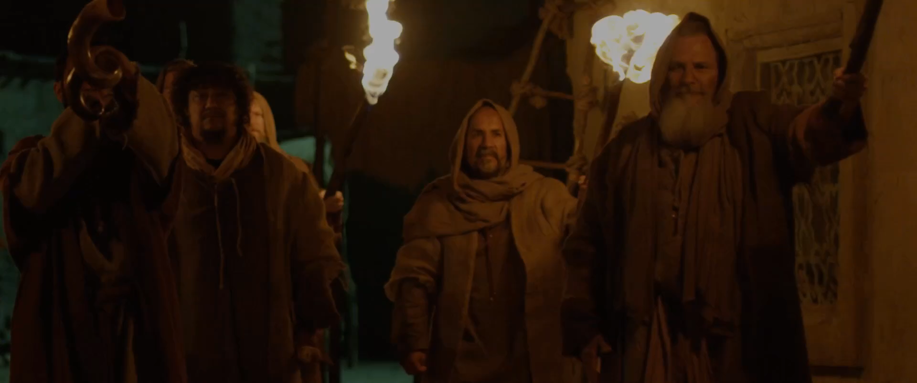
John 14:2-3
2 In My Father's house are many mansions; if it were not so, I would have told you. I go to prepare a place for you. 3 And if I go and prepare a place for you, I will come again and receive you to Myself; that where I am, there you may be also.

Slide 56
1 Corinthians 15:50-54
50 Now this I say, brethren, that flesh and blood cannot inherit the kingdom of God; nor does corruption inherit incorruption. 51 Behold, I tell you a mystery: We shall not all sleep, but we shall all be changed-- 52 in a moment, in the twinkling of an eye, at the last trumpet. For the trumpet will sound, and the dead will be raised incorruptible, and we shall be changed.

Slide 57
53 For this corruptible must put on incorruption, and this mortal must put on immortality. 54 So when this corruptible has put on incorruption, and this mortal has put on immortality, then shall be brought to pass the saying that is written: "Death is swallowed up in victory."

Slide 58

20 Again, when a righteous man turns from his righteousness and commits iniquity, and I lay a stumbling block before him, he shall die; because you did not give him warning, he shall die in his sin, and his righteousness which he has done shall not be remembered; but his blood I will require at your hand.

Slide 59
Acts 2:38-39
38 Then Peter said to them, "Repent, and let every one of you be baptized in the name of Jesus Christ for the remission of sins; and you shall receive the gift of the Holy Spirit. 39 For the promise is to you and to your children, and to all who are afar off, as many as the Lord our God will call."

