Slide 1


Jesus Keep Me Closer to You in 2021
by Pastor Fee Soliven
James 4:7-10
Sunday Evening
December 27, 2020

Slide 2
James 4:7-10
7 Therefore submit to God. Resist the devil and he will flee from you. 8 Draw near to God and He will draw near to you. Cleanse your hands, you sinners; and purify your hearts, you double-minded. 9 Lament and mourn and weep! Let your laughter be turned to mourning and your joy to gloom. 10 Humble yourselves in the sight of the Lord, and He will lift you up.

Slide 3
What is a godly life, and how is it achieved?

Slide 4
Leviticus 20:7-8
7 So sanctify yourselves and be holy, for I am the Lord your God. 8 You must obey all of my commandments, for I am the Lord who sanctifies you.

Slide 5
1 Peter 2:9-12
9 But you are a chosen generation, a royal priesthood, a holy nation, His own special people, that you may proclaim the praises of Him who called you out of darkness into His marvelous light;

Slide 6
10 who once were not a people but are now the people of God, who had not obtained mercy but now have obtained mercy. 11 Beloved, I beg you as sojourners and pilgrims, abstain from fleshly lusts which war against the soul, 12 having your conduct honorable among the Gentiles, that when they speak against you as evildoers, they may, by your good works which they observe, glorify God in the day of visitation.

Slide 7
Several Habits of a Godly Life

Slide 8
A Life of Prayer

Slide 9
Mark 1:35
“In the early morning, while it was still dark, Jesus got up, left the house, and went away to a secluded place, and was praying there.”

Slide 10
Luke 4:42
“When day came, Jesus left and went to a secluded place; and the crowds were searching for Him, and came to Him and tried to keep Him from going away from them.”

Slide 11
Luke 11:1
Now it came to pass, as He was praying in a certain place, when He ceased, that one of His disciples said to Him, "Lord, teach us to pray, as John also taught his disciples."

Slide 12
Faith

Slide 13
Psalm 103:19
“The Lord has established His throne in the heavens, and His sovereignty rules over all.”

Slide 14
Hebrews 11:6
“But without faith it is impossible to please Him, for he who comes to God must believe that He is, and that He is a rewarder of those who diligently seek Him”

Slide 15
Proverbs 3:5-6
5 “Trust in the Lord with all your heart and do not lean on your own understanding. 6 In all your ways acknowledge Him, and He will make your paths straight.”

Slide 16
Meditation on the Word of God

Slide 17
Psalm 63:6
“When I remember You on my bed, I meditate on You in the night watches”

Slide 18
Psalm 119:133
“Establish my footsteps in Your word, and do not let any iniquity have dominion over me.”

Slide 19
Obedience

Slide 20
Deuteronomy 28:1
“If you diligently obey the Lord your God, being careful to do all His commandments which I commanded you today, the Lord your God will set you high above all the nations of the earth”

Slide 21
Romans 2:7-11
7 eternal life to those who by patient continuance in doing good seek for glory, honor, and immortality; 8 but to those who are self-seeking and do not obey the truth, but obey unrighteousness--indignation and wrath,

Slide 22
9 tribulation and anguish, on every soul of man who does evil, of the Jew first and also of the Greek; 10 but glory, honor, and peace to everyone who works what is good, to the Jew first and also to the Greek. 11 For there is no partiality with God.

Slide 23
Dependence upon the Holy Spirit

Slide 24
Ephesians 5:18
“be filled with the Spirit”

Slide 25
John 14:25-27
25 "These things I have spoken to you while being present with you. 26 But the Helper, the Holy Spirit, whom the Father will send in My name, He will teach you all things, and bring to your remembrance all things that I said to you. 27 Peace I leave with you, My peace I give to you; not as the world gives do I give to you. Let not your heart be troubled, neither let it be afraid.

Slide 26
Giving to God and Others

Slide 27
Luke 6:38
“Give, and it will be given to you. They will pour into your lap a good measure—pressed down, shaken together, and running over. For by your standard of measure it will be measured to you in return.”

Slide 28
Forgiving other People

Slide 29
Ephesians 4:29-32
29 Let no corrupt word proceed out of your mouth, but what is good for necessary edification, that it may impart grace to the hearers. 30 And do not grieve the Holy Spirit of God, by whom you were sealed for the day of redemption. 31 Let all bitterness, wrath, anger, clamor, and evil speaking be put away from you, with all malice. 32 And be kind to one another, tenderhearted, forgiving one another, just as God in Christ forgave you.

Slide 30
Matthew 6:14-15
14 "For if you forgive men their trespasses, your heavenly Father will also forgive you. 15 But if you do not forgive men their trespasses, neither will your Father forgive your trespasses.

Slide 31
1. What changes would you have to make to cultivate these seven godly habits?

Slide 32
2. Which areas are the most challenging for you?

Slide 33
3. What obstacles will you need to overcome?

Slide 34
1 Thessalonians 4:13-18
13 But I do not want you to be ignorant, brethren, concerning those who have fallen asleep, lest you sorrow as others who have no hope. 14 For if we believe that Jesus died and rose again, even so God will bring with Him those who sleep in Jesus.

Slide 35
15 For this we say to you by the word of the Lord, that we who are alive and remain until the coming of the Lord will by no means precede those who are asleep. 16 For the Lord Himself will descend from heaven with a shout, with the voice of an archangel, and with the trumpet of God. And the dead in Christ will rise first.

Slide 36
17 Then we who are alive and remain shall be caught up together with them in the clouds to meet the Lord in the air. And thus we shall always be with the Lord. 18 Therefore comfort one another with these words.

Slide 37
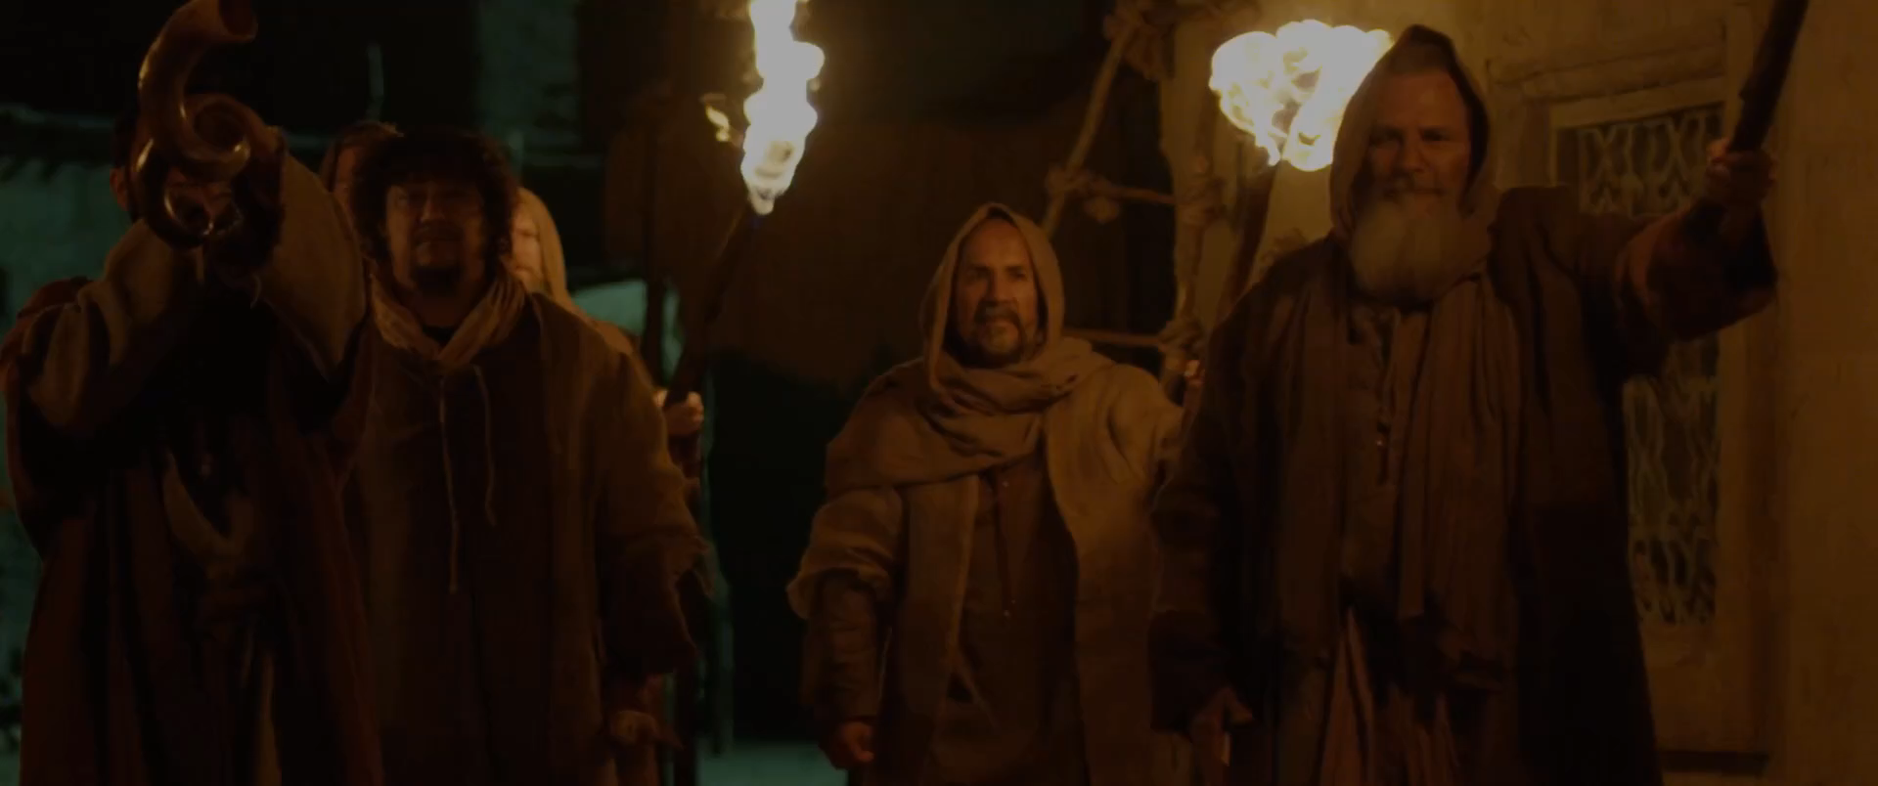
John 14:2-3
2 In My Father's house are many mansions; if it were not so, I would have told you. I go to prepare a place for you. 3 And if I go and prepare a place for you, I will come again and receive you to Myself; that where I am, there you may be also.

Slide 38
1 Corinthians 15:50-54
50 Now this I say, brethren, that flesh and blood cannot inherit the kingdom of God; nor does corruption inherit incorruption. 51 Behold, I tell you a mystery: We shall not all sleep, but we shall all be changed-- 52 in a moment, in the twinkling of an eye, at the last trumpet. For the trumpet will sound, and the dead will be raised incorruptible, and we shall be changed.

Slide 39
53 For this corruptible must put on incorruption, and this mortal must put on immortality. 54 So when this corruptible has put on incorruption, and this mortal has put on immortality, then shall be brought to pass the saying that is written: "Death is swallowed up in victory."

Slide 40

20 Again, when a righteous man turns from his righteousness and commits iniquity, and I lay a stumbling block before him, he shall die; because you did not give him warning, he shall die in his sin, and his righteousness which he has done shall not be remembered; but his blood I will require at your hand.

Slide 41
Acts 2:38-39
38 Then Peter said to them, "Repent, and let every one of you be baptized in the name of Jesus Christ for the remission of sins; and you shall receive the gift of the Holy Spirit. 39 For the promise is to you and to your children, and to all who are afar off, as many as the Lord our God will call."

