Slide 1


Preach the Gospel
By Pastor Fee Soliven
Matthew 28:11-20
Wednesday Evening
January 13, 2021

Slide 2
11 Now while they were going, behold, some of the guard came into the city and reported to the chief priests all the things that had happened. 12 When they had assembled with the elders and consulted together, they gave a large sum of money to the soldiers,

Slide 3
13 saying, "Tell them, 'His disciples came at night and stole Him away while we slept.' 14 "And if this comes to the governor's ears, we will appease him and make you secure." 15 So they took the money and did as they were instructed; and this saying is commonly reported among the Jews until this day.

Slide 4
1. Why would Jesus’ disciples, who already had run off on him at his arrest, risk a return at night to a guarded and sealed tomb in an effort to steal a body—an offense that could incur the death penalty?

Slide 5
2. And if they had done so, would they have taken the time to unwrap the body?

Slide 6
3. If this had occurred while the guards were sleeping, how could the guards possibly have known what had occurred?

Slide 7
4. If this truly happened, why didn’t the religious leaders arrest the disciples in order to prosecute them?

Slide 8
16 Then the eleven disciples went away into Galilee, to the mountain which Jesus had appointed for them. 17 When they saw Him, they worshiped Him; but some doubted. 18 And Jesus came and spoke to them, saying, "All authority has been given to Me in heaven and on earth.

Slide 9
19 Go therefore and make disciples of all the nations, baptizing them in the name of the Father and of the Son and of the Holy Spirit, 20 teaching them to observe all things that I have commanded you; and lo, I am with you always, even to the end of the age." Amen.

Slide 10
18 And Jesus came and spoke to them, saying, "All authority has been given to Me in heaven and on earth.

Slide 11
Romans 6:1-4
1 What shall we say then? Shall we continue in sin that grace may abound? 2 Certainly not! How shall we who died to sin live any longer in it? 3 Or do you not know that as many of us as were baptized into Christ Jesus were baptized into His death? 4 Therefore we were buried with Him through baptism into death, that just as Christ was raised from the dead by the glory of the Father, even so we also should walk in newness of life.

Slide 12
What Are The 5 Fundamentals of The Christian Faith?

Slide 13
The Divinity of Christ
Prove that He is God in Scriptures

Slide 14
2. The Virgin Birth
The Immaculate Conception

Slide 15
3. The Crucifixion of Christ
His Blood Atonement for our sins

Slide 16
4. The Resurrection of Christ
Jesus rose from the dead

Slide 17
5. The Second Coming of Christ
Jesus will reign on earth again

Slide 18
The Father, Son and Holy Ghost

Slide 19
Father

Slide 20
God the Father is the:
God of all Creation

Slide 21
Mark 10:6
“But from the beginning of the creation, God 'made them male and female.”

Slide 22
1 Corinthians 8:6
“yet for us there is one God, the Father, of whom are all things, and we for Him; and one Lord Jesus Christ, through whom are all things, and through whom we live”

Slide 23
Isaiah 9:6
“For unto us a Child is born, Unto us a Son is given; And the government will be upon His shoulder. And His name will be called Wonderful, Counselor, Mighty God, Everlasting Father, Prince of Peace”

Slide 24
Ephesians 3:8-9
8 To me, who am less than the least of all the saints, this grace was given, that I should preach among the Gentiles the unsearchable riches of Christ, 9 and to make all see what is the fellowship of the mystery, which from the beginning of the ages has been hidden in God who created all things through Jesus Christ;

Slide 25
Psalm 68:4-5
4 Sing to God, sing praises to His name; Extol Him who rides on the clouds, By His name YAH, And rejoice before Him. 5 A father of the fatherless, a defender of widows, Is God in His holy habitation.

Slide 26
Son

Slide 27
2. Jesus the Son of God is
“The Son of Redemption”

Slide 28
1 Timothy 3:16
“And without controversy great is the mystery of godliness: God was manifested in the flesh, Justified in the Spirit, Seen by angels, Preached among the Gentiles, Believed on in the world, Received up in glory”

Slide 29
John 1:1
“In the beginning was the Word, and the Word was with God, and the Word was God”

Slide 30
John 1:14
“And the Word became flesh and dwelt among us, and we beheld His glory, the glory as of the only begotten of the Father, full of grace and truth”

Slide 31
John 10:27-30
27 My sheep hear My voice, and I know them, and they follow Me. 28 And I give them eternal life, and they shall never perish; neither shall anyone snatch them out of My hand. 29 My Father, who has given them to Me, is greater than all; and no one is able to snatch them out of My Father's hand. 30 I and My Father are one."

Slide 32
Colossians 1:12-16
12 giving thanks to the Father who has qualified us to be partakers of the inheritance of the saints in the light. 13 He has delivered us from the power of darkness and conveyed us into the kingdom of the Son of His love, 14 in whom we have redemption through His blood, the forgiveness of sins.

Slide 33
15 He is the image of the invisible God, the firstborn over all creation. 16 For by Him all things were created that are in heaven and that are on earth, visible and invisible, whether thrones or dominions or principalities or powers. All things were created through Him and for Him.

Slide 34
Galatians 3:13-14
13 Christ has redeemed us from the curse of the law, having become a curse for us (for it is written, "Cursed is everyone who hangs on a tree"), 14 that the blessing of Abraham might come upon the Gentiles in Christ Jesus, that we might receive the promise of the Spirit through faith.

Slide 35
Hebrews 9:12-15
12 Not with the blood of goats and calves, but with His own blood He entered the Most Holy Place once for all, having obtained eternal redemption. 13 For if the blood of bulls and goats and the ashes of a heifer, sprinkling the unclean, sanctifies for the purifying of the flesh,

Slide 36
14 how much more shall the blood of Christ, who through the eternal Spirit offered Himself without spot to God, cleanse your conscience from dead works to serve the living God? 15 And for this reason He is the Mediator of the new covenant, by means of death, for the redemption of the transgressions under the first covenant, that those who are called may receive the promise of the eternal inheritance.

Slide 37
Holy Spirit

Slide 38
3. The Holy Spirit convicts the whole world of sin and
“Dwells Inside of Every True Believer”

Slide 39
John 16:7-9
7 Nevertheless I tell you the truth. It is to your advantage that I go away; for if I do not go away, the Helper will not come to you; but if I depart, I will send Him to you. 8 And when He has come, He will convict the world of sin, and of righteousness, and of judgment: 9 of sin, because they do not believe in Me…

Slide 40
John 3:5-7
5 Jesus answered, "Most assuredly, I say to you, unless one is born of water and the Spirit, he cannot enter the kingdom of God. 6 That which is born of the flesh is flesh, and that which is born of the Spirit is spirit. 7 Do not marvel that I said to you, 'You must be born again.'

Slide 41
2 Timothy 1:14
“That good thing which was committed to you, keep by the Holy Spirit who dwells in us”

Slide 42
1 Corinthians 6:17-20
17 But he who is joined to the Lord is one spirit with Him. 18 Flee sexual immorality. Every sin that a man does is outside the body, but he who commits sexual immorality sins against his own body. 19 Or do you not know that your body is the temple of the Holy Spirit who is in you, whom you have from God, and you are not your own? 20 For you were bought at a price; therefore glorify God in your body and in your spirit, which are God's.

Slide 43
Acts 1:1-3
1 The former account I made, O Theophilus, of all that Jesus began both to do and teach, 2 until the day in which He was taken up, after He through the Holy Spirit had given commandments to the apostles whom He had chosen…

Slide 44
Acts 2:38-39
38 Then Peter said to them, "Repent, and let every one of you be baptized in the name of Jesus Christ for the remission of sins; and you shall receive the gift of the Holy Spirit. 39 For the promise is to you and to your children, and to all who are afar off, as many as the Lord our God will call."

Slide 45
Acts 10:44-48
44 While Peter was still speaking these words, the Holy Spirit fell upon all those who were listening to the message. 45 All the circumcised believers who came with Peter were amazed, because the gift of the Holy Spirit had been poured out on the Gentiles also.

Slide 46
46 For they were hearing them speaking with tongues and exalting God. Then Peter answered, 47 "Surely no one can refuse the water for these to be baptized who have received the Holy Spirit just as we did, can he?" 48 And he ordered them to be baptized in the name of Jesus Christ. Then they asked him to stay on for a few days.

Slide 47
Acts 4:12
“Nor is there salvation in any other, for there is no other name under heaven given among men by which we must be saved."

Slide 48
Colossians 3:17
“And whatever you do in word or deed, do all in the name of the Lord Jesus, giving thanks to God the Father through Him”

Slide 49
1 Thessalonians 4:13-18
13 But I do not want you to be ignorant, brethren, concerning those who have fallen asleep, lest you sorrow as others who have no hope. 14 For if we believe that Jesus died and rose again, even so God will bring with Him those who sleep in Jesus.

Slide 50
15 For this we say to you by the word of the Lord, that we who are alive and remain until the coming of the Lord will by no means precede those who are asleep. 16 For the Lord Himself will descend from heaven with a shout, with the voice of an archangel, and with the trumpet of God. And the dead in Christ will rise first.

Slide 51
17 Then we who are alive and remain shall be caught up together with them in the clouds to meet the Lord in the air. And thus we shall always be with the Lord. 18 Therefore comfort one another with these words.

Slide 52
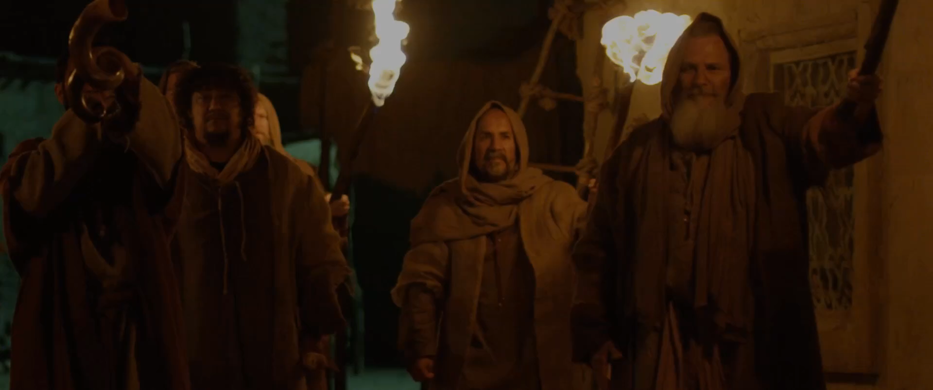
John 14:2-3
2 In My Father's house are many mansions; if it were not so, I would have told you. I go to prepare a place for you. 3 And if I go and prepare a place for you, I will come again and receive you to Myself; that where I am, there you may be also.

Slide 53
1 Corinthians 15:50-54
50 Now this I say, brethren, that flesh and blood cannot inherit the kingdom of God; nor does corruption inherit incorruption. 51 Behold, I tell you a mystery: We shall not all sleep, but we shall all be changed-- 52 in a moment, in the twinkling of an eye, at the last trumpet. For the trumpet will sound, and the dead will be raised incorruptible, and we shall be changed.

Slide 54
53 For this corruptible must put on incorruption, and this mortal must put on immortality. 54 So when this corruptible has put on incorruption, and this mortal has put on immortality, then shall be brought to pass the saying that is written: "Death is swallowed up in victory."

Slide 55

20 Again, when a righteous man turns from his righteousness and commits iniquity, and I lay a stumbling block before him, he shall die; because you did not give him warning, he shall die in his sin, and his righteousness which he has done shall not be remembered; but his blood I will require at your hand.

Slide 56
Acts 2:38-39
38 Then Peter said to them, "Repent, and let every one of you be baptized in the name of Jesus Christ for the remission of sins; and you shall receive the gift of the Holy Spirit. 39 For the promise is to you and to your children, and to all who are afar off, as many as the Lord our God will call."

