Slide 1
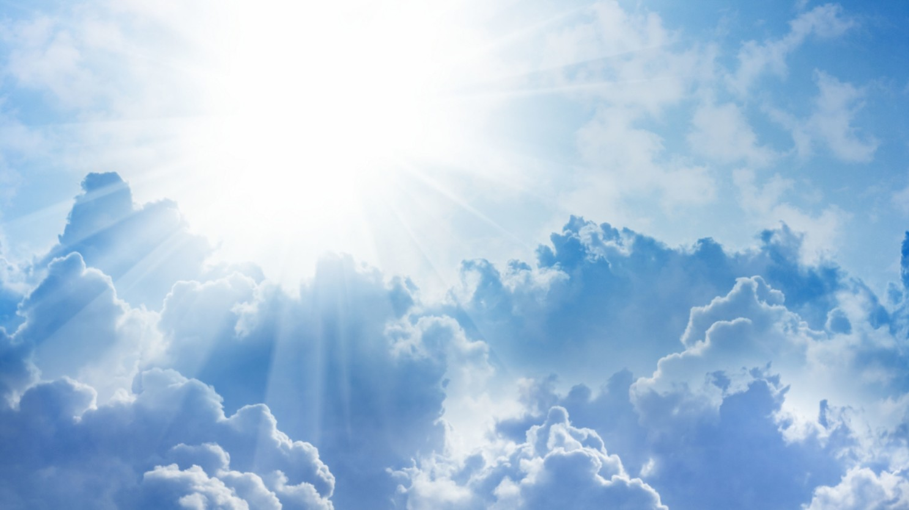

The Light Shall Expel the Darkness
by Pastor Fee Soliven
Psalm 27:1-6
Wednesday Evening
January 20, 2021

Slide 2
Psalm 27:1-6
1 The LORD is my light and my salvation; Whom shall I fear? The LORD is the strength of my life; Of whom shall I be afraid? 2 When the wicked came against me To eat up my flesh, My enemies and foes, They stumbled and fell. 3 Though an army may encamp against me, My heart shall not fear; Though war should rise against me, In this I will be confident.

Slide 3
4 One thing I have desired of the LORD, That will I seek: That I may dwell in the house of the LORD All the days of my life, To behold the beauty of the LORD, And to inquire in His temple. 5 For in the time of trouble He shall hide me in His pavilion; In the secret place of His tabernacle He shall hide me; He shall set me high upon a rock.

Slide 4
6 And now my head shall be lifted up above my enemies all around me; Therefore I will offer sacrifices of joy in His tabernacle; I will sing, yes, I will sing praises to the LORD.

Slide 5
Isaiah 60:1-3
1 Arise, shine; For your light has come! And the glory of the LORD is risen upon you. 2 For behold, the darkness shall cover the earth, And deep darkness the people; But the LORD will arise over you, And His glory will be seen upon you. 3 The Gentiles shall come to your light, And kings to the brightness of your rising.

Slide 6
The Abortion Catastrophe

Slide 7
1. “America’s in a Moral Free Fall”

Slide 8
2. “America has murdered 60 Million babies in the womb since 1973 Roe v Wade

Slide 9
3. If they survive the womb, America tries to seduce them into transgender sexual deviation when they’re young

Slide 10
4. If they survive that, America corrupts them with a godless education,”

Slide 11
5. “If they survive that, the divorce rate in America has left millions of families without Fathers for Godly and Moral support.

Slide 12
6. If they can survive the abortion mills and grow to be adults, America drowns them in a sea of pornography,”

Slide 13
Homosexuality is a Detestable and Unnatural Act

Slide 14
Matthew 19:4-6
4 “Have you not read that He who created them from the beginning made them male and female, 5 and said, ‘For this reason a man shall leave his father and mother and be joined to his wife, and the two shall become one flesh’? 6 So they are no longer two, but one flesh. What therefore God has joined together, let no man separate.”

Slide 15
Genesis 2:23-24
23 And Adam said: "This is now bone of my bones And flesh of my flesh; She shall be called Woman, Because she was taken out of Man." 24 Therefore a man shall leave his father and mother and be joined to his wife, and they shall become one flesh.

Slide 16
“Amoral”
lacking a moral sense; unconcerned with the rightness or wrongness of something.

Slide 17
Leviticus 18:22
You shall not lie with a male as with a woman; it is an abomination.

Slide 18
Romans 1:27
And the men likewise gave up natural relations with women and were consumed with passion for one another, men committing shameless acts with men and receiving in themselves the due penalty for their error.

Slide 19
1 Corinthians 6:9-10
Or do you not know that the unrighteous will not inherit the kingdom of God? Do not be deceived; neither fornicators, nor idolaters, nor adulterers, nor effeminate, nor homosexuals, 10 nor thieves, nor the covetous, nor drunkards, nor revilers, nor swindlers, will inherit the kingdom of God.

Slide 20
Romans 1:28-32
28 And even as they did not like to retain God in their knowledge, God gave them over to a reprobate mind, to do those things which are not convenient; 29 Being filled with all unrighteousness, fornication, wickedness, covetousness, maliciousness; full of envy, murder, debate, deceit, malignity; whisperers,

Slide 21
30 Backbiters, haters of God, violent, proud, boasters, inventors of evil things, disobedient to parents, 31 Without understanding, covenant breakers, without natural affection, implacable, unmerciful: 32 Who knowing the judgment of God, that they which commit such things are worthy of death, not only do the same but have pleasure in them that do them.

Slide 22
“This is a nation so far down in the sewer of immorality and wickedness that Most Americans are numb and have accepted the licentiousness of our Dark Nation “America”

Slide 23
Is There Hope for Our Nation?

Slide 24
Yes, the answer is Jesus!

Slide 25
John 8:12
Then Jesus spoke to them again, saying, "I am the light of the world. He who follows Me shall not walk in darkness, but have the light of life."

Slide 26
John 9:4-5
4 I must work the works of Him who sent Me while it is day; the night is coming when no one can work. 5 As long as I am in the world, I am the light of the world."

Slide 27
The Word of God is Our Remedy!

Slide 28
Romans 13:11-14
11 And do this, knowing the time, that now it is high time to awake out of sleep; for now our salvation is nearer than when we first believed. 12 The night is far spent, the day is at hand. Therefore let us cast off the works of darkness, and let us put on the armor of light.

Slide 29
13 Let us walk properly, as in the day, not in revelry and drunkenness, not in lewdness and lust, not in strife and envy. 14 But put on the Lord Jesus Christ, and make no provision for the flesh, to fulfill its lusts.

Slide 30
John 14:6
“Jesus said to him, "I am the way, the truth, and the life. No one comes to the Father except through Me”

Slide 31
As a True Child of God Born of The Holy Spirit, there is an inward witness of Truth burned in our Hearts through Faith!

Slide 32
God’s Chosen People Can Truly Discern Unrighteousness

Slide 33
1 Corinthians 2:14-16
14 But the natural man does not receive the things of the Spirit of God, for they are foolishness to him; nor can he know them, because they are spiritually discerned. 15 But he who is spiritual judges all things, yet he himself is rightly judged by no one. 16 For "who has known the mind of the LORD that he may instruct Him?" But we have the mind of Christ.

Slide 34
1 Peter 2:9-10
9 But you are a chosen generation, a royal priesthood, a holy nation, His own special people, that you may proclaim the praises of Him who called you out of darkness into His marvelous light; 10 who once were not a people but are now the people of God, who had not obtained mercy but now have obtained mercy.

Slide 35
Satan Has Blinded the
Eyes of All Unbelievers

Slide 36
2 Corinthians 4:1-4
1 Therefore, since we have this ministry, as we have received mercy, we do not lose heart. 2 But we have renounced the hidden things of shame, not walking in craftiness nor handling the word of God deceitfully, but by manifestation of the truth commending ourselves to every man's conscience in the sight of God.

Slide 37
3 But even if our gospel is veiled, it is veiled to those who are perishing, 4 whose minds the god of this age has blinded, who do not believe, lest the light of the gospel of the glory of Christ, who is the image of God, should shine on them.

Slide 38
1 John 2:7-11
8 Again, a new commandment I write to you, which thing is true in Him and in you, because the darkness is passing away, and the true light is already shining. 9 He who says he is in the light, and hates his brother, is in darkness until now.

Slide 39
10 He who loves his brother abides in the light, and there is no cause for stumbling in him. 11 But he who hates his brother is in darkness and walks in darkness, and does not know where he is going, because the darkness has blinded his eyes.

Slide 40
We Must Continue to Follow Jesus!

Slide 41
John 10:27-30
27 My sheep hear My voice, and I know them, and they follow Me. 28 And I give them eternal life, and they shall never perish; neither shall anyone snatch them out of My hand. 29 My Father, who has given them to Me, is greater than all; and no one is able to snatch them out of My Father's hand. 30 I and My Father are one."

Slide 42
Saints, Soon and Very soon, Jesus is about to appear, we are almost out of here!

Slide 43
1 Thessalonians 4:13-18
13 But I do not want you to be ignorant, brethren, concerning those who have fallen asleep, lest you sorrow as others who have no hope. 14 For if we believe that Jesus died and rose again, even so God will bring with Him those who sleep in Jesus.

Slide 44
15 For this we say to you by the word of the Lord, that we who are alive and remain until the coming of the Lord will by no means precede those who are asleep. 16 For the Lord Himself will descend from heaven with a shout, with the voice of an archangel, and with the trumpet of God. And the dead in Christ will rise first.

Slide 45
17 Then we who are alive and remain shall be caught up together with them in the clouds to meet the Lord in the air. And thus we shall always be with the Lord. 18 Therefore comfort one another with these words.

Slide 46
1 Corinthians 15:50-54
50 Now this I say, brethren, that flesh and blood cannot inherit the kingdom of God; nor does corruption inherit incorruption. 51 Behold, I tell you a mystery: We shall not all sleep, but we shall all be changed-- 52 in a moment, in the twinkling of an eye, at the last trumpet. For the trumpet will sound, and the dead will be raised incorruptible, and we shall be changed.

Slide 47
53 For this corruptible must put on incorruption, and this mortal must put on immortality. 54 So when this corruptible has put on incorruption, and this mortal has put on immortality, then shall be brought to pass the saying that is written: "Death is swallowed up in victory."

Slide 48

20 Again, when a righteous man turns from his righteousness and commits iniquity, and I lay a stumbling block before him, he shall die; because you did not give him warning, he shall die in his sin, and his righteousness which he has done shall not be remembered; but his blood I will require at your hand.

Slide 49
Acts 2:38-39
38 Then Peter said to them, "Repent, and let every one of you be baptized in the name of Jesus Christ for the remission of sins; and you shall receive the gift of the Holy Spirit. 39 For the promise is to you and to your children, and to all who are afar off, as many as the Lord our God will call."

