Slide 1
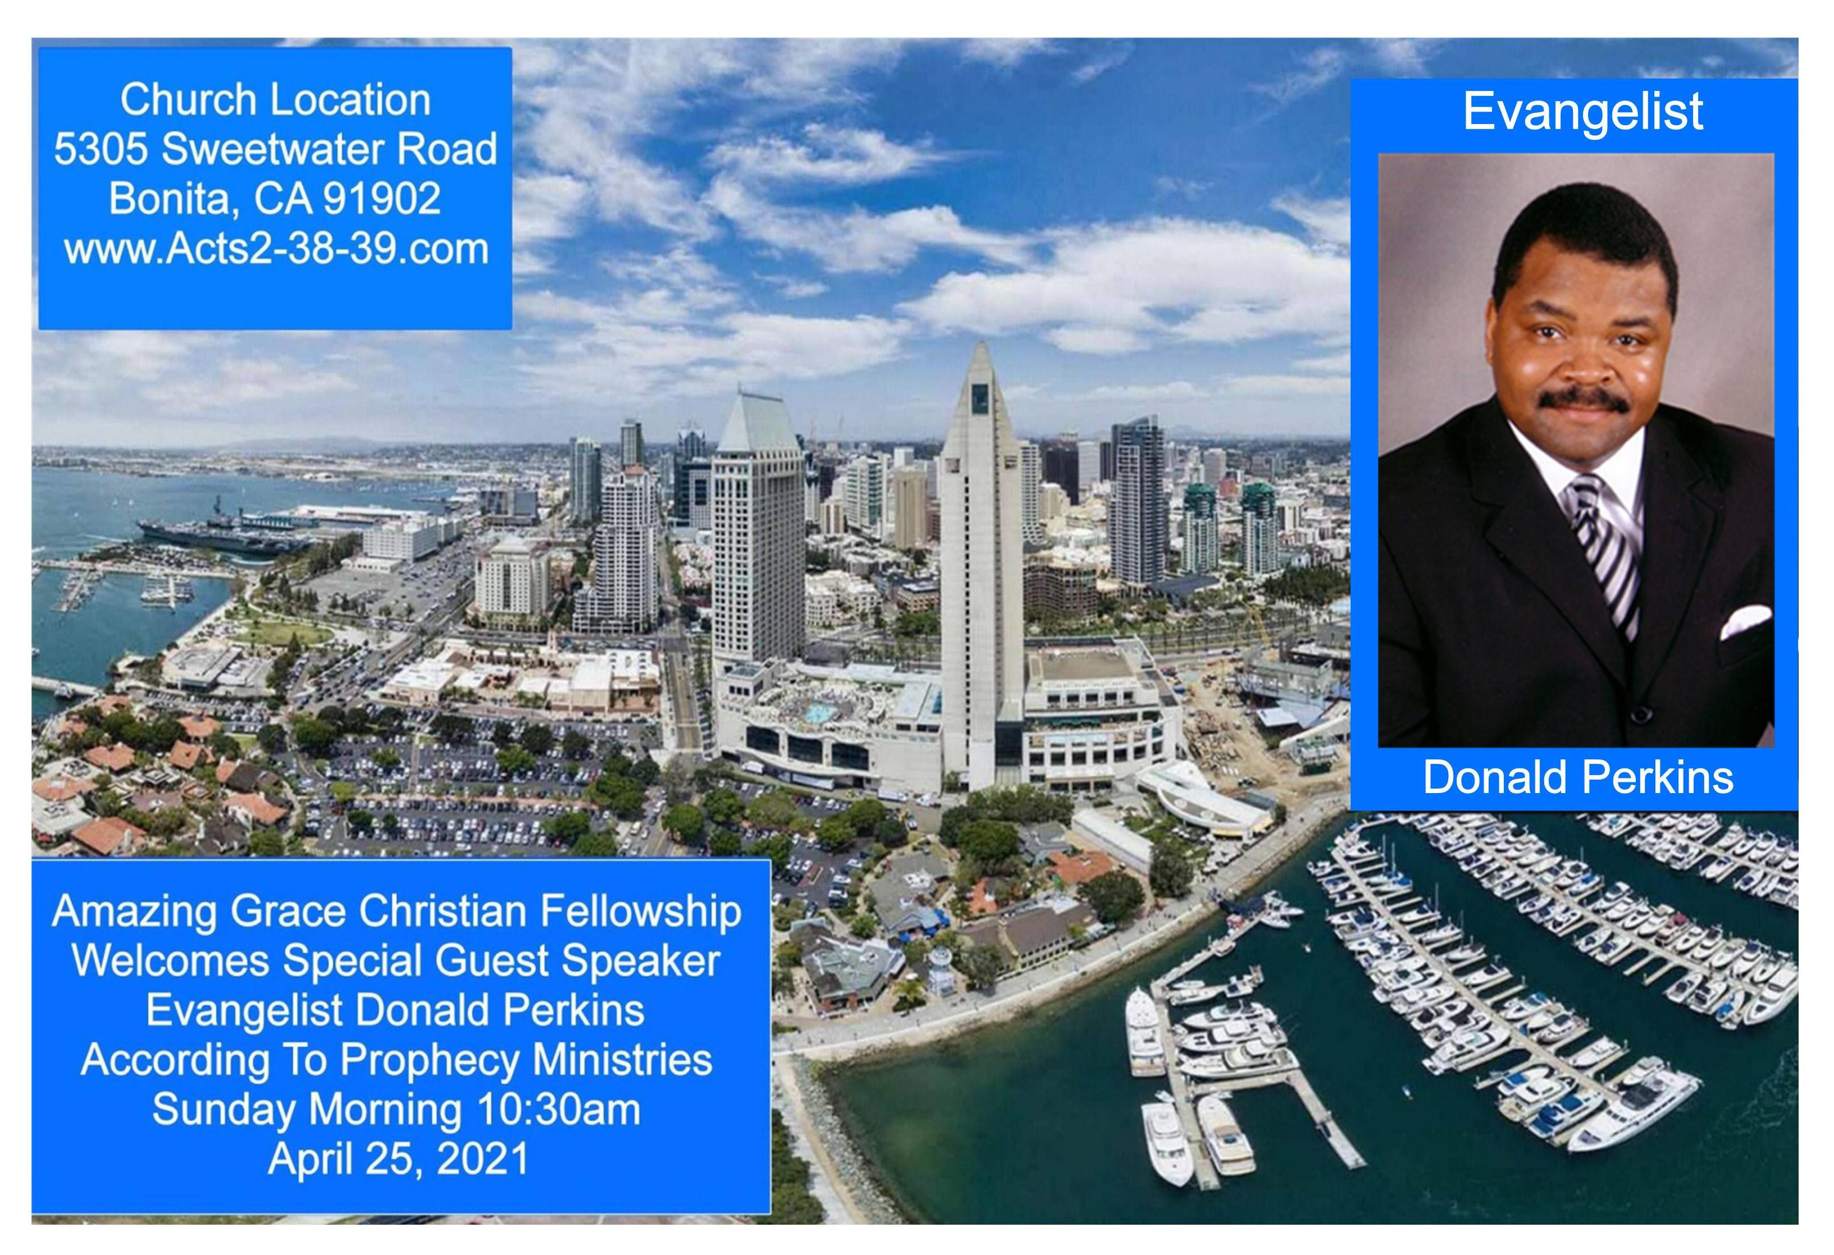

Slide 2


Faith to Grow in Christ
by Pastor Fee Soliven
James 2:19-26
Wednesday Evening
March 31, 2021

Slide 3
James 2:19-26
19 You believe that there is one God. You do well. Even the demons believe--and tremble! 20 But do you want to know, O foolish man, that faith without works is dead? 21 Was not Abraham our father justified by works when he offered Isaac his son on the altar?

Slide 4
22 Do you see that faith was working together with his works, and by works faith was made perfect? 23 And the Scripture was fulfilled which says, "Abraham believed God, and it was accounted to him for righteousness." And he was called the friend of God. 24 You see then that a man is justified by works, and not by faith only.

Slide 5
25 Likewise, was not Rahab the harlot also justified by works when she received the messengers and sent them out another way? 26 For as the body without the spirit is dead, so faith without works is dead also.

Slide 6
19 You believe that there is one God. You do well. Even the demons believe--and tremble!

Slide 7
Mark 5:1-14
1 Then they came to the other side of the sea, to the country of the Gadarenes. 2 And when He had come out of the boat, immediately there met Him out of the tombs a man with an unclean spirit, 3 who had his dwelling among the tombs; and no one could bind him, not even with chains,

Slide 8
4 because he had often been bound with shackles and chains. And the chains had been pulled apart by him, and the shackles broken in pieces; neither could anyone tame him. 5 And always, night and day, he was in the mountains and in the tombs, crying out and cutting himself with stones. 6 When he saw Jesus from afar, he ran and worshiped Him.

Slide 9
7 And he cried out with a loud voice and said, "What have I to do with You, Jesus, Son of the Most High God? I implore You by God that You do not torment me." 8 For He said to him, "Come out of the man, unclean spirit!"

Slide 10
9 Then He asked him, "What is your name?" And he answered, saying, "My name is Legion; for we are many." 10 Also he begged Him earnestly that He would not send them out of the country. 11 Now a large herd of swine was feeding there near the mountains. 12 So all the demons begged Him, saying, "Send us to the swine, that we may enter them."

Slide 11
13 And at once Jesus gave them permission. Then the unclean spirits went out and entered the swine (there were about two thousand); and the herd ran violently down the steep place into the sea, and drowned in the sea. 14 So those who fed the swine fled, and they told it in the city and in the country. And they went out to see

Slide 12
20 But do you want to know, O foolish man, that faith without works is dead?

Slide 13
21 Was not Abraham our father justified by works when he offered Isaac his son on the altar?

Slide 14
Genesis 22:4-14
4 Then on the third day Abraham lifted his eyes and saw the place afar off. 5 And Abraham said to his young men, "Stay here with the donkey; the lad and I will go yonder and worship, and we will come back to you." 6 So Abraham took the wood of the burnt offering and laid it on Isaac his son; and he took the fire in his hand, and a knife, and the two of them went together.

Slide 15
7 But Isaac spoke to Abraham his father and said, "My father!" And he said, "Here I am, my son." Then he said, "Look, the fire and the wood, but where is the lamb for a burnt offering?" 8 And Abraham said, "My son, God will provide for Himself the lamb for a burnt offering." So the two of them went together.

Slide 16
9 Then they came to the place of which God had told him. And Abraham built an altar there and placed the wood in order; and he bound Isaac his son and laid him on the altar, upon the wood. 10 And Abraham stretched out his hand and took the knife to slay his son. 11 But the Angel of the LORD called to him from heaven and said, "Abraham, Abraham!" And he said, "Here I am."

Slide 17
12 And He said, "Do not lay your hand on the lad, or do anything to him; for now I know that you fear God, since you have not withheld your son, your only son, from Me." 13 Then Abraham lifted his eyes and looked, and there behind him was a ram caught in a thicket by its horns. So Abraham went and took the ram, and offered it up for a burnt offering instead of his son.

Slide 18
14 And Abraham called the name of the place, The-Lord-Will-Provide; as it is said to this day, "In the Mount of The LORD it shall be provided."

Slide 19
22 Do you see that faith was working together with his works, and by works faith was made perfect?

Slide 20
Genesis 15:4-6
4 And behold, the word of the LORD came to him, saying, "This one shall not be your heir, but one who will come from your own body shall be your heir." 5 Then He brought him outside and said, "Look now toward heaven, and count the stars if you are able to number them." And He said to him, "So shall your descendants be." 6 And he believed in the LORD, and He accounted it to him for righteousness.

Slide 21
1 Thessalonians 1:3-6
3 remembering without ceasing your work of faith, labor of love, and patience of hope in our Lord Jesus Christ in the sight of our God and Father, 4 knowing, beloved brethren, your election by God. 5 For our gospel did not come to you in word only, but also in power, and in the Holy Spirit and in much assurance, as you know what kind of men we were among you for your sake.

Slide 22
23 And the Scripture was fulfilled which says, "Abraham believed God, and it was accounted to him for righteousness." And he was called the friend of God.

Slide 23
2 Chronicles 20:7
"Are You not our God, who drove out the inhabitants of this land before Your people Israel, and gave it to the descendants of Abraham Your friend forever?"

Slide 24
Isaiah 41:8
"But you, Israel, are My servant, Jacob whom I have chosen, The descendants of Abraham My friend."

Slide 25
24 You see then that a man is justified by works, and not by faith only.

Slide 26
1 John 2:4
"If you say you have come to know Him, yet you do not keep His commandments, then the truth is not in you and you are a liar."

Slide 27
25 Likewise, was not Rahab the harlot also justified by works when she received the messengers and sent them out another way?

Slide 28
Hebrews 11:30-31
30 By faith the walls of Jericho fell down after they were encircled for seven days. 31 By faith the harlot Rahab did not perish with those who did not believe, when she had received the spies with peace.

Slide 29
26 For as the body without the spirit is dead, so faith without works is dead also.

Slide 30
Galatians 5:6
"For in Christ Jesus neither circumcision nor uncircumcision avails anything, but faith working through love"

Slide 31
1 Thessalonians 4:13-18
13 But I do not want you to be ignorant, brethren, concerning those who have fallen asleep, lest you sorrow as others who have no hope. 14 For if we believe that Jesus died and rose again, even so God will bring with Him those who sleep in Jesus.

Slide 32
15 For this we say to you by the word of the Lord, that we who are alive and remain until the coming of the Lord will by no means precede those who are asleep. 16 For the Lord Himself will descend from heaven with a shout, with the voice of an archangel, and with the trumpet of God. And the dead in Christ will rise first.

Slide 33
17 Then we who are alive and remain shall be caught up together with them in the clouds to meet the Lord in the air. And thus we shall always be with the Lord. 18 Therefore comfort one another with these words.

Slide 34
1 Corinthians 15:50-54
50 Now this I say, brethren, that flesh and blood cannot inherit the kingdom of God; nor does corruption inherit incorruption. 51 Behold, I tell you a mystery: We shall not all sleep, but we shall all be changed-- 52 in a moment, in the twinkling of an eye, at the last trumpet. For the trumpet will sound, and the dead will be raised incorruptible, and we shall be changed.

Slide 35
53 For this corruptible must put on incorruption, and this mortal must put on immortality. 54 So when this corruptible has put on incorruption, and this mortal has put on immortality, then shall be brought to pass the saying that is written: "Death is swallowed up in victory."

Slide 36

20 Again, when a righteous man turns from his righteousness and commits iniquity, and I lay a stumbling block before him, he shall die; because you did not give him warning, he shall die in his sin, and his righteousness which he has done shall not be remembered; but his blood I will require at your hand.

Slide 37
Acts 2:38-39
38 Then Peter said to them, "Repent, and let every one of you be baptized in the name of Jesus Christ for the remission of sins; and you shall receive the gift of the Holy Spirit. 39 For the promise is to you and to your children, and to all who are afar off, as many as the Lord our God will call."

Slide 38


