Slide 1
My Testimony
(Elevation Worship)

Slide 2
I saw satan fall like lightning. I saw darkness run for cover. But still the miracle that I just can’t get over

Slide 3
My name is registered in heaven. I believe in signs and wonders. I have resurrection power. Still the

Slide 4
Miracles that I just cant get over. My name is registered in heaven. My praise belongs to you

Slide 5
forever. This is my testimony from dead to life. Cause grace rewrote my story, I’ll testify By Jesus

Slide 6
Christ the righteous I’m Justified. This is my Testimony. This is my Testimony. Come together

Slide 7
sons and daughters. Bought with blood and washed in water.Sing the praises of the Spirit Son and Father

Slide 8
Our God will finish what he started. Our God will finish what he started. This is my testimony from

Slide 9
dead to life. Cause grace rewrote my story, I’ll testify
By Jesus Christ the righteous I’m Justified . This is

Slide 10
My Testimony. This is my Testimony. This is my testimony from from dead to life. Cause grace

Slide 11
rewrote my story, I’ll testify By Jesus righteous I’m Justified. This is my testimony. This is my testimony.

Slide 12
If I’m not dead your not done. Greater things are still to come Oh I believe. If I’m not dead your not done.

Slide 13
Greater things are still to come Oh I believe. If I’m not dead your not done. Greater things are still to

Slide 14
come Oh I believe. If I’m not dead your not done your not done. Greater things are still to come. Oh I

Slide 15
Believe. This is My testimony from death to life. Cause Grace rewrote my story, I’ll testify. By Jesus

Slide 16
Christ the righteous im Justified. This is my testimony. This is My Testimony. This is My

Slide 17
Testimony from death to life. Cause grace rewrote my story, I’ll testify. By Jesus Christ the righteous I’m

Slide 18
Justified. This is my Testimony. This is My Testimony.

Slide 19
God So Loved
(We The Kingdom)

Slide 20
Come all you weary. Come all you thirsty. Come to the well. That never runs dry. Drink of the water.

Slide 21
Come and thirst no more. Come all you sinners. Come find his mercy. Come to the table. He will

Slide 22
Satisfy. Taste of his good The world that he gave us. His one and only son to save us. Whoever believes

Slide 23
In him will live forever. Bring all your failures. Bring your addictions. Come lay them down at the foot of

Slide 24
the cross. Jesus is waiting there with open arms. See his open arms. For God so loved the world.

Slide 25
That he gave us. His one and only Son to save us. Whoever believes in him. Will live forever. The

Slide 26
Power of hell forever defeated. Now it is well. I’m walking in freedom. For God so loved. God so

Slide 27
loved the world. Praise God. Praise God. From whom all blessings flow. Praise him. Praise him.

Slide 28
For the wonders of his love. Praise God. Praise God. From whom all blessings flow. Praise him.

Slide 29
Praise him. For the wonders of his love. His amazing love. For God so Loved the world. That he

Slide 30
gave us. His one and only . Son to save. For God so loved the world that he gave us. His one and only

Slide 31
Son to save us. Whoever believes in him. Will live forever. The power of hell forever defeated. Now it is

Slide 32
Well. I’m walking in freedom. For God so loved. God so loved the world. Bring all your failures. Bring

Slide 33
your addictions. Come lay them down at the foot of the cross. Jesus is waiting. God so loved the world.

Slide 34
The Blessing
(Kari Jobe)

Slide 35
The Lord bless you and keep you. Make his face shine upon you. And be gracious to you. The Lord

Slide 36
turn his face towards and give you peace. Amen, Amen, Amen, Amen, Amen, Amen. The Lord bless

Slide 37
You and keep you. Make his face shine upon you. And be gracious to you. The Lord turn his. Face

Slide 38
towards you. And give you peace. Amen, Amen, Amen, Amen, Amen, Amen. May his favor be

Slide 39
upon you and a thousand generations. And your family and your children, and their children, and their

Slide 40
children. May his favor be upon you. And a thousand generations. And your family and your

Slide 41
children. And their children, and their children. May his presence. Go before you. And behind you

Slide 42
and beside you. All around you, and within you. He is with you. He is with you. In the morning, In the

Slide 43
evening. In your coming, and your going. In your weeping, and rejoicing. He is for you, He is for you.

Slide 44
He is for you, He is for you, He is for you, He is for you, He is for you, he is for you. Amen, Amen, Amen

Slide 45
Amen, Amen, Amen. May his presence go before you. And behind you, and beside you. All around

Slide 46
you, and with you, he is with you, he is with you. In the morning, In the evening, In your coming, and

Slide 47
your going. In your weeping, and rejoicing. He is for you.

Slide 48
Forever
(Kari Jobe)

Slide 49
The morning stars they wept. The morning sun was dead. The savior of the world was fallen.

Slide 50
His body on the cross. His blood poured out for us. The weight of every curse upon him.

Slide 51
One final breath he gave.As heaven looked away. The son of God was laid in darkness. A battle in

Slide 52
the grave. The wr on death was waged. The power of hell forever broken. The ground began to shake.

Slide 53
The stone was rolled away. His perfect love could not be overcome. Now death where is

Slide 54
your sting. Our resurrected King. Has rendered you defeated. Forever, he is glorified. Forever, he is

Slide 55
is lifted high. Forever he is risen. He is alive. He is alive. The ground began to shake. The stone was

Slide 56
rolled away. His perfect love could not be overcome. Now death where is your sting. Our resurrected King

Slide 57
Has rendered you defeated. Forever, he is glorified. Forever he is lifted high. Forever, He is risen.

Slide 58
He is alive. He is alive. We sing hallelujah. We sing Hallelujah. We sing Hallelujah. The Lamb has over

Slide 59
Come. We sing Hallelujah. We sing Hallelujah. We sing Hallelujah. The Lamb has overcome.

Slide 60
Forever he is glorified. Forever he is lifted high. Forever he is risen. He is alive. He is Alive.

Slide 61
The King of My Heart
(Bethel)

Slide 62
Let the king of my heart. Be the mountain where I run. The fountain I drink from. Oh, he is my song.

Slide 63
Let the king of my heart. Be the shadow for my hide. The ransom for my life. Oh he is my song.

Slide 64
Cause you are good. You are good, oh oh.
You are good, you are good, oh oh. You are good

Slide 65
you are good, oh oh. You are good. You are good. Oh oh. And let the king of my heart be the wind

Slide 66
inside my sails. The anchor in the waves. Oh oh he is my song. Let the King of my heart. Be the fire

Slide 67
Inside my veins. The echo of my days oh he is my song. Cause you are good. You are good oh oh.

Slide 68
You are good. You are good oh oh. You are good you are good oh oh. Yes you are good . You’re good,

Slide 69
oh oh. You’re never gonna let. You’re never gonna let me down. And you’re never gonna let. You’re

Slide 70
never gonna let me down.. You’re never gonna let. You’re never gonna let me down. You’re never gonna

Slide 71
let never gonna let me down.You’re never gonna let. You’re never gonna let me down. You’re never gonna

Slide 72
You’re never gonna let. You’re never gonna let me down. You’re never gonna let. You’re never gonna

Slide 73
let me down. Oh, cause you are good. You are good oh oh. You are good. Oh oh. You are good. You are

Slide 74
good oh oh. Your never gonna let. You’re never gonna let me down. You’re never gonna let. You’re

Slide 75
never gonna let me down. You’re never gonna let. You’re never gonna let me down. You’re never gonna

Slide 76
let. You’re never gonna let me down. Cause you are good. You are good oh oh. You are good. You are

Slide 77
good oh oh.

Slide 80
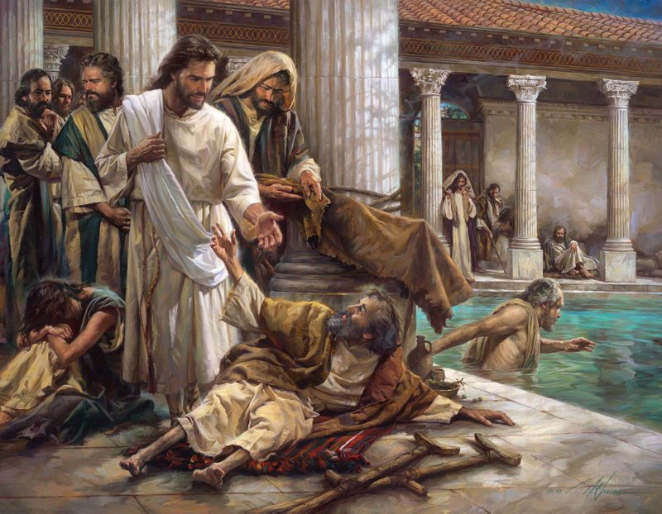
Jesus Our Great Physician
by Pastor Fee Soliven
1 Peter 2:21-25
Sunday Morning
March 7, 2021

Slide 81
1 Peter 2:21-25
21 For to this you were called, because Christ also suffered for us, leaving us an example, that you should follow His steps: 22 "Who committed no sin, Nor was deceit found in His mouth"; 23 who, when He was reviled, did not revile in return; when He suffered, He did not threaten, but committed Himself to Him who judges righteously;

Slide 82
24 who Himself bore our sins in His own body on the tree, that we, having died to sins, might live for righteousness--by whose stripes you were healed. 25 For you were like sheep going astray, but have now returned to the Shepherd and Overseer of your souls.

Slide 83
“Do You Want to Be Healed”?

Slide 84
John 5:1-10
1 After this there was a feast of the Jews, and Jesus went up to Jerusalem. 2 Now there is in Jerusalem by the Sheep Gate a pool, which is called in Hebrew, Bethesda, having five porches. 3 In these lay a great multitude of sick people, blind, lame, paralyzed, waiting for the moving of the water.

Slide 85
4 For an angel went down at a certain time into the pool and stirred up the water; then whoever stepped in first, after the stirring of the water, was made well of whatever disease he had. 5 Now a certain man was there who had an infirmity thirty-eight years. 6 When Jesus saw him lying there, and knew that he already had been in that condition a long time, He said to him, "Do you want to be made well?"

Slide 86
7 The sick man answered Him, "Sir, I have no man to put me into the pool when the water is stirred up; but while I am coming, another steps down before me." 8 Jesus said to him, "Rise, take up your bed and walk." 9 And immediately the man was made well, took up his bed, and walked. And that day was the Sabbath.

Slide 87
1. The Circumstance

Slide 88
Matthew 5:17-20
17 "Do not think that I came to destroy the Law or the Prophets. I did not come to destroy but to fulfill. 18 For assuredly, I say to you, till heaven and earth pass away, one jot or one tittle will by no means pass from the law till all is fulfilled.

Slide 89
19 Whoever therefore breaks one of the least of these commandments, and teaches men so, shall be called least in the kingdom of heaven; but whoever does and teaches them, he shall be called great in the kingdom of heaven.

Slide 90
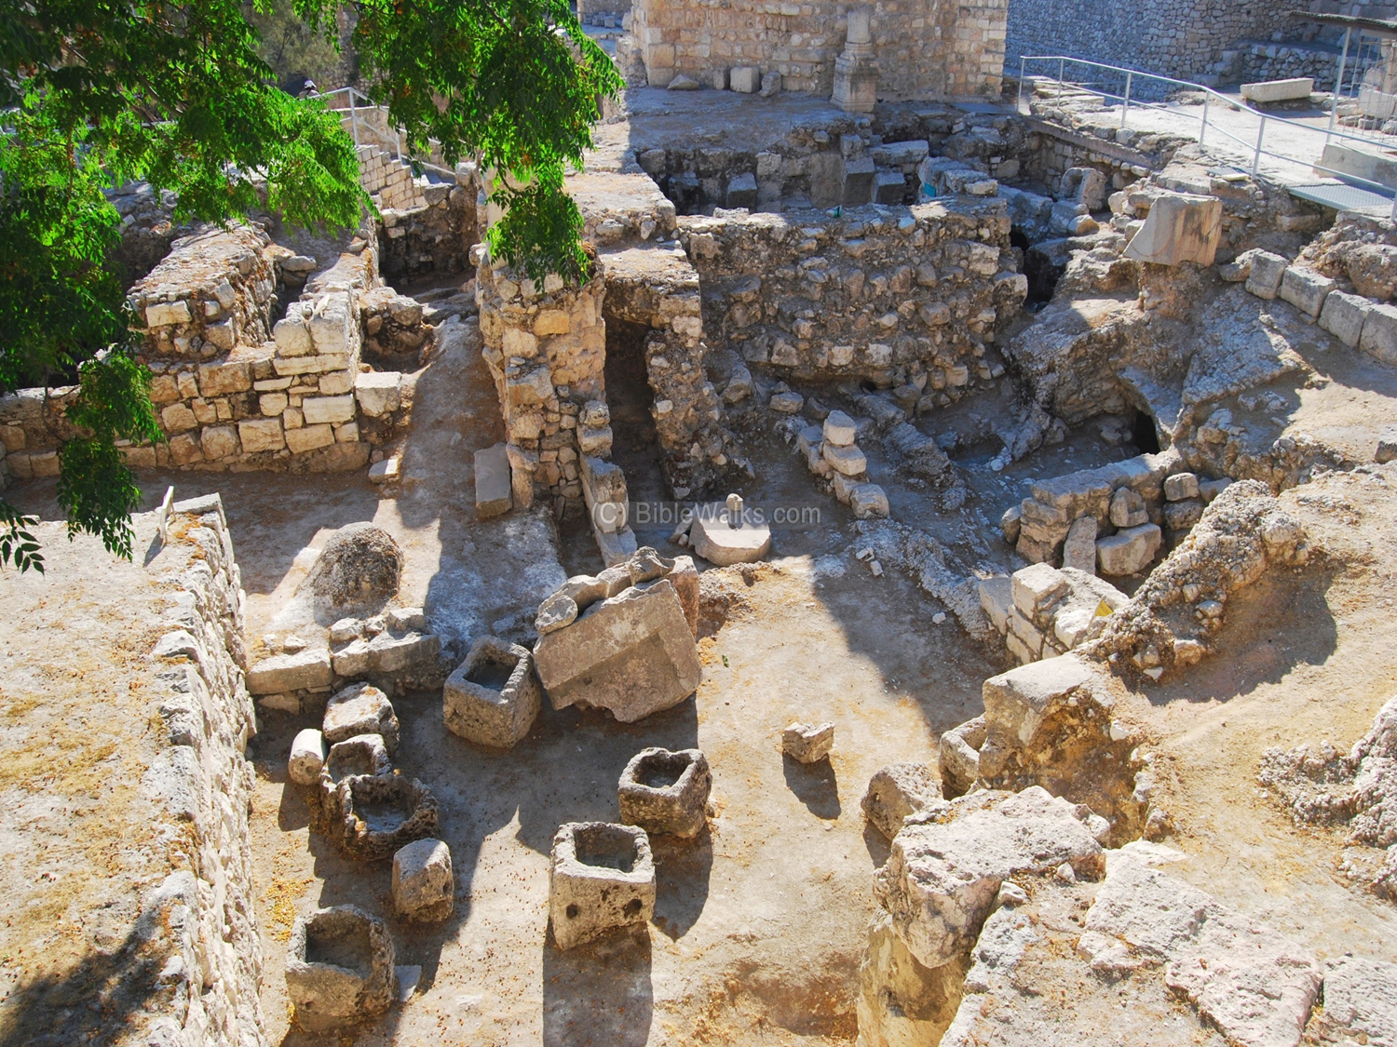
2. Being Good-Tempered
.

Slide 92
2. The Crisis

Slide 93
John 5:5-7
5 Now a certain man was there who had an infirmity thirty-eight years. 6 When Jesus saw him lying there, and knew that he already had been in that condition a long time, He said to him, "Do you want to be made well?" 7 The sick man answered Him, "Sir, I have no man to put me into the pool when the water is stirred up; but while I am coming, another steps down before me."

Slide 94
The significance of the number 38: It speaks of 3, the number of God and 8 the number of a new beginning. 38 = 5 x 7 + 3, 5 being the number of grace, 7 the number of perfection and 3 the number of God.

Slide 95
What is your pool?

Slide 96
What place are you stuck in?

Slide 97
What thing are you are fixated on?

Slide 98
What false hope takes your eyes off the Lord?

Slide 99
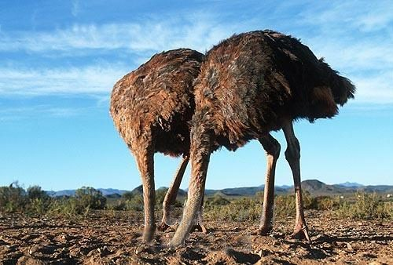
Slide Photo of Ostriches in the sand>

Slide 100
3. The Cure

Slide 101
John 5:6-9
6 When Jesus saw him lying there, and knew that he already had been in that condition a long time, He said to him, "Do you want to be made well?" 7 The sick man answered Him, "Sir, I have no man to put me into the pool when the water is stirred up; but while I am coming, another steps down before me.

Slide 102
"8 Jesus said to him, "Rise, take up your bed and walk." 9 And immediately the man was made well, took up his bed, and walked. And that day was the Sabbath.

Slide 103
4. The Command and the Obedience

Slide 104
Get Up (Rise)

Slide 105
Pick Up Your Mat (Bed)

Slide 106
Walk (In Your Healing)

Slide 107
Hebrews 11:6
"But without faith it is impossible to please Him, for he who comes to God must believe that He is, and that He is a rewarder of those who diligently seek Him."

Slide 108
5. The Criticism

Slide 109
John 5:8-13
8 Jesus said to him, "Rise, take up your bed and walk." 9 And immediately the man was made well, took up his bed, and walked. And that day was the Sabbath. 10 The Jews therefore said to him who was cured, "It is the Sabbath; it is not lawful for you to carry your bed."

Slide 110
11 He answered them, "He who made me well said to me, 'Take up your bed and walk.' " 12 Then they asked him, "Who is the Man who said to you, 'Take up your bed and walk'?" 13 But the one who was healed did not know who it was, for Jesus had withdrawn, a multitude being in that place.

Slide 111
John 5:13-15
14 Afterward Jesus found him in the temple, and said to him, "See, you have been made well. Sin no more, lest a worse thing come upon you." 15 The man departed and told the Jews that it was Jesus who had made him well.

Slide 112
What is your view on sin no more?

Slide 113
Are we stuck at our own pools of Bethesda?

Slide 114
1 Thessalonians 4:13-18
13 But I do not want you to be ignorant, brethren, concerning those who have fallen asleep, lest you sorrow as others who have no hope. 14 For if we believe that Jesus died and rose again, even so God will bring with Him those who sleep in Jesus.

Slide 115
15 For this we say to you by the word of the Lord, that we who are alive and remain until the coming of the Lord will by no means precede those who are asleep. 16 For the Lord Himself will descend from heaven with a shout, with the voice of an archangel, and with the trumpet of God. And the dead in Christ will rise first.

Slide 116
17 Then we who are alive and remain shall be caught up together with them in the clouds to meet the Lord in the air. And thus we shall always be with the Lord. 18 Therefore comfort one another with these words.

Slide 117
1 Corinthians 15:50-54
50 Now this I say, brethren, that flesh and blood cannot inherit the kingdom of God; nor does corruption inherit incorruption. 51 Behold, I tell you a mystery: We shall not all sleep, but we shall all be changed-- 52 in a moment, in the twinkling of an eye, at the last trumpet. For the trumpet will sound, and the dead will be raised incorruptible, and we shall be changed.

Slide 118
53 For this corruptible must put on incorruption, and this mortal must put on immortality. 54 So when this corruptible has put on incorruption, and this mortal has put on immortality, then shall be brought to pass the saying that is written: "Death is swallowed up in victory."

Slide 119
20 Again, when a righteous man turns from his righteousness and commits iniquity, and I lay a stumbling block before him, he shall die; because you did not give him warning, he shall die in his sin, and his righteousness which he has done shall not be remembered; but his blood I will require at your hand.

Slide 120
Acts 2:38-39
38 Then Peter said to them, "Repent, and let every one of you be baptized in the name of Jesus Christ for the remission of sins; and you shall receive the gift of the Holy Spirit. 39 For the promise is to you and to your children, and to all who are afar off, as many as the Lord our God will call."

