Slide 1
“This is Amazing Grace”
(Phil Wickham)

Slide 2
Who breaks the power of sin and darkness. Who’s love is mighty and so much stronger. The King of

Slide 3
glory ,the king above all kings. Who shakes the whole earth with holy thunder. And leaves us

Slide 4
in awe and wonder? The King of Glory, the King above all Kings. This is amazing grace. This is

Slide 5
unfailing love. That you would would take my place. That you would bear my cross. You laid down your

Slide 6
life. That I would be set free. Oh, Jesus I sing for all that you’ve done for me. Who brings our chaos back

Slide 7
into order. Who makes the orphans a son and daughter. The King of Glory, The King of Glory

Slide 8
into order. Who makes the orphans a son and daughter. The King of Glory, The King of Glory

Slide 9
Who rules the nation. With truth and justice.Shines like the sun in all of his brilliance. The King of Glory

Slide 10
The King above all Kings. This is Amazing Grace. This is unfailing love. That you would take my place.

Slide 11
That you would bear my cross. You laid down your life. That I would be set free. Oh, Jesus, I sing for

Slide 12
All that you,ve done for me. Worthy is the Lamb who was slain. Worthy is the King who conquered the

Slide 13
grave. Worthy is the Lamb who was slain. Worthy is the King who conquered the grave. Worthy is the

Slide 14
Lamb who was slain. Worthy, Worthy,Worthy. This is Amazing Grace. This is unfailing love. That you

Slide 15
would take my place. That you would bear my cross. You laid down your life. That I would be set free

Slide 16
Oh, Jesus I sing for. All that you’ve done for me.

Slide 17
“Lion and the Lamb”
(Bethel)

Slide 18
He’s coming on the clouds. Kings and Kingdoms will bow down. And every chain will break. As broken

Slide 19
Hearts declare his praise. For who can stop the Lord all mighty. And Our God is the lion. The Lion of Judah

Slide 20
He’s roaring with power.. And fighting our battles. And every knee will bow before him. Our God is

Slide 21
The Lamb. The Lamb that was slain. For the sins of the world. His blood breaks the chains. And every

Slide 22
Knee will bow before the Lion and the Lamb. Yes Every knee will bow before him. So open up the

Slide 23
Gates. Make way before the King of Kings. The God who comes to save. Is here to set the captives free.

Slide 24
For who can stop the Lord Almighty. Our God is the Lion. The Lion of Judah. He’s roaring with power

Slide 25
And fighting our battles. Every knee will bow before him. Our God is the lamb. The lamb that was slain.

Slide 26
For the sins of the world his blood breaks the chains. And every knee will bow before the Lion and the

Slide 27
The Lamb. Every knee will bow before him. For who can stop the Lord almighty. Who can stop the Lord

Slide 28
Almighty. Who can stop the Lord Almighty. No One.
Who can stop the Lord almighty. Who can stop the

Slide 29
Lord almighty. Who can stop the Lord almighty. Who can stop the Lord. And Our God is the Lion. The

Slide 30
Lion of Judah. He’s roaring with power and fighting our battles. Every knee will bow before him.

Slide 31
Our God is the Lamb. The lamb that was slain. For the sins of the world. His blood breaks the chains

Slide 32
And every knee will bow before the Lion ans the Lamb. Every knee will bow before him.

Slide 33
”No Longer Slaves”
(Bethel)

Slide 34
You unravel me. With a melody. You surround me with song of deliverance. From my enemies. Til all

Slide 35
My fears are gone.. I’m no longer a slave to fear. I am a child of God. I’m no longer a slave to fear.

Slide 36
I am a child of God. From my mother’s womb you have chosen me. Love has called my name.

Slide 37
I’ve been born again. Into your family. Your blood flows through my veins. I’m no longer slave to fear

Slide 38
I am a child of God. I’m no longer a slave to fear. I am a child of God. Ooh, oooh. Ooh,oooh. Ooh, oooh.

Slide 39
Ooh, oooh. You split the sea so I could walk right through it. My fears are drowned in perfect Love.

Slide 40
You rescue me. So I could stand and say. I am a child of God. You split the sea so I could walk right

Slide 41
Through it. My fears are drowned in perfect love. You rescued me. So I could stand and say. I am a child

Slide 42
Of God. I am a child of God. Yes I am a child of God.

Slide 43
"Something Has To Break”
(Essential Worship and Red Rocks Worship)

Slide 44
I feel it in this room. Holy Spirit move. Cause when you have your way. Something has to break. Tear

Slide 45
Down every lie. Set the wrong thing right. Cause when you have your way. Something has to break.

Slide 46
Something has to break. I feel it in this room. Holy Spirit move. Cause when you have your way

Slide 47
Something has to break. Tear down every lie. Set the wrong thing right. Cause when you have your way

Slide 48
Something has to break. Something has to break.
Right now in you name. Something has to break.

Slide 49
Something has to break. Something has to break.
Right now in your name. Something has to break.

Slide 50
I believe you’ll get me to it. I believe you’ll get me through it. I believe that you will do it right now.

Slide 51
Something has to break. I believe you’ll get me to it. I believe you’ll get me through it. I believe that you will

Slide 52
do it right now. Something has to break. I believe you’ll get me to it. I believe you’ll get me through it. I

Slide 53
believe that you will do it right now. Something has to break. Something has to break. Right now in your

Slide 54
name. Something has to break. Something has to break. Something has to break. Right now in your

Slide 55
Name. Something has to break.

Slide 56
”By The Cross”
(Red Rocks Worship)

Slide 57
Long my soul has waited for you. Bound by sin and nature’s night. But in the secret, I will find you.

Slide 58
Mighty ray of holy night. Oh’ these chains were sweetly broken. Bound by shame, You set me free.

Slide 59
Perfect love, my fear was stolen. When, thou, My Jesus, died for me. By the cross of Jesus Christ.

Slide 60
Every sin was brought at the highest price. And every fear was lost, every sin erased. When Jesus

Slide 61
So free, so infinite, Your glory. That I am Yours and you are mine. By the Cross of Jesus. Every sin was

Slide 62
was bought at the highest price. And every fear was lost, every sin erased. When Jesus took the cross

Slide 63
He took my place, yeah. Then sings my soul. Then cries my heart. Til Kingdom come, til heaven’s part.

Slide 64
Til he returns or calls me home. I’ll praise the name of Christ alone. Then sings my soul, then cries my

Slide 65
Heart. Til Kingdom come, Til Heaven’s part. Til he returns or calls me home. I’ll praise the name of

Slide 66
Christ alone. I’ll praise the name of Christ alone. Long my soul has waited for you. Bound by sin and

Slide 67
Natures night. But in secret, I will find you. A mighty flood of Holy light. Yeah,yeah,yeah. And by the

Slide 68
Cross of Jesus Christ. Every sin was bought at highest price. And every fear was lost., every sin

Slide 69
Erased. When Jesus took the cross, He took my place. And by the cross of Jesus Christ. Every sin

Slide 70
Was bought at the highest price. And every fear was lost, every sin erased. When Jesus took the Cross

Slide 71
He took my place. When Jesus took the cross, He took my place.

Slide 72


Slide 73
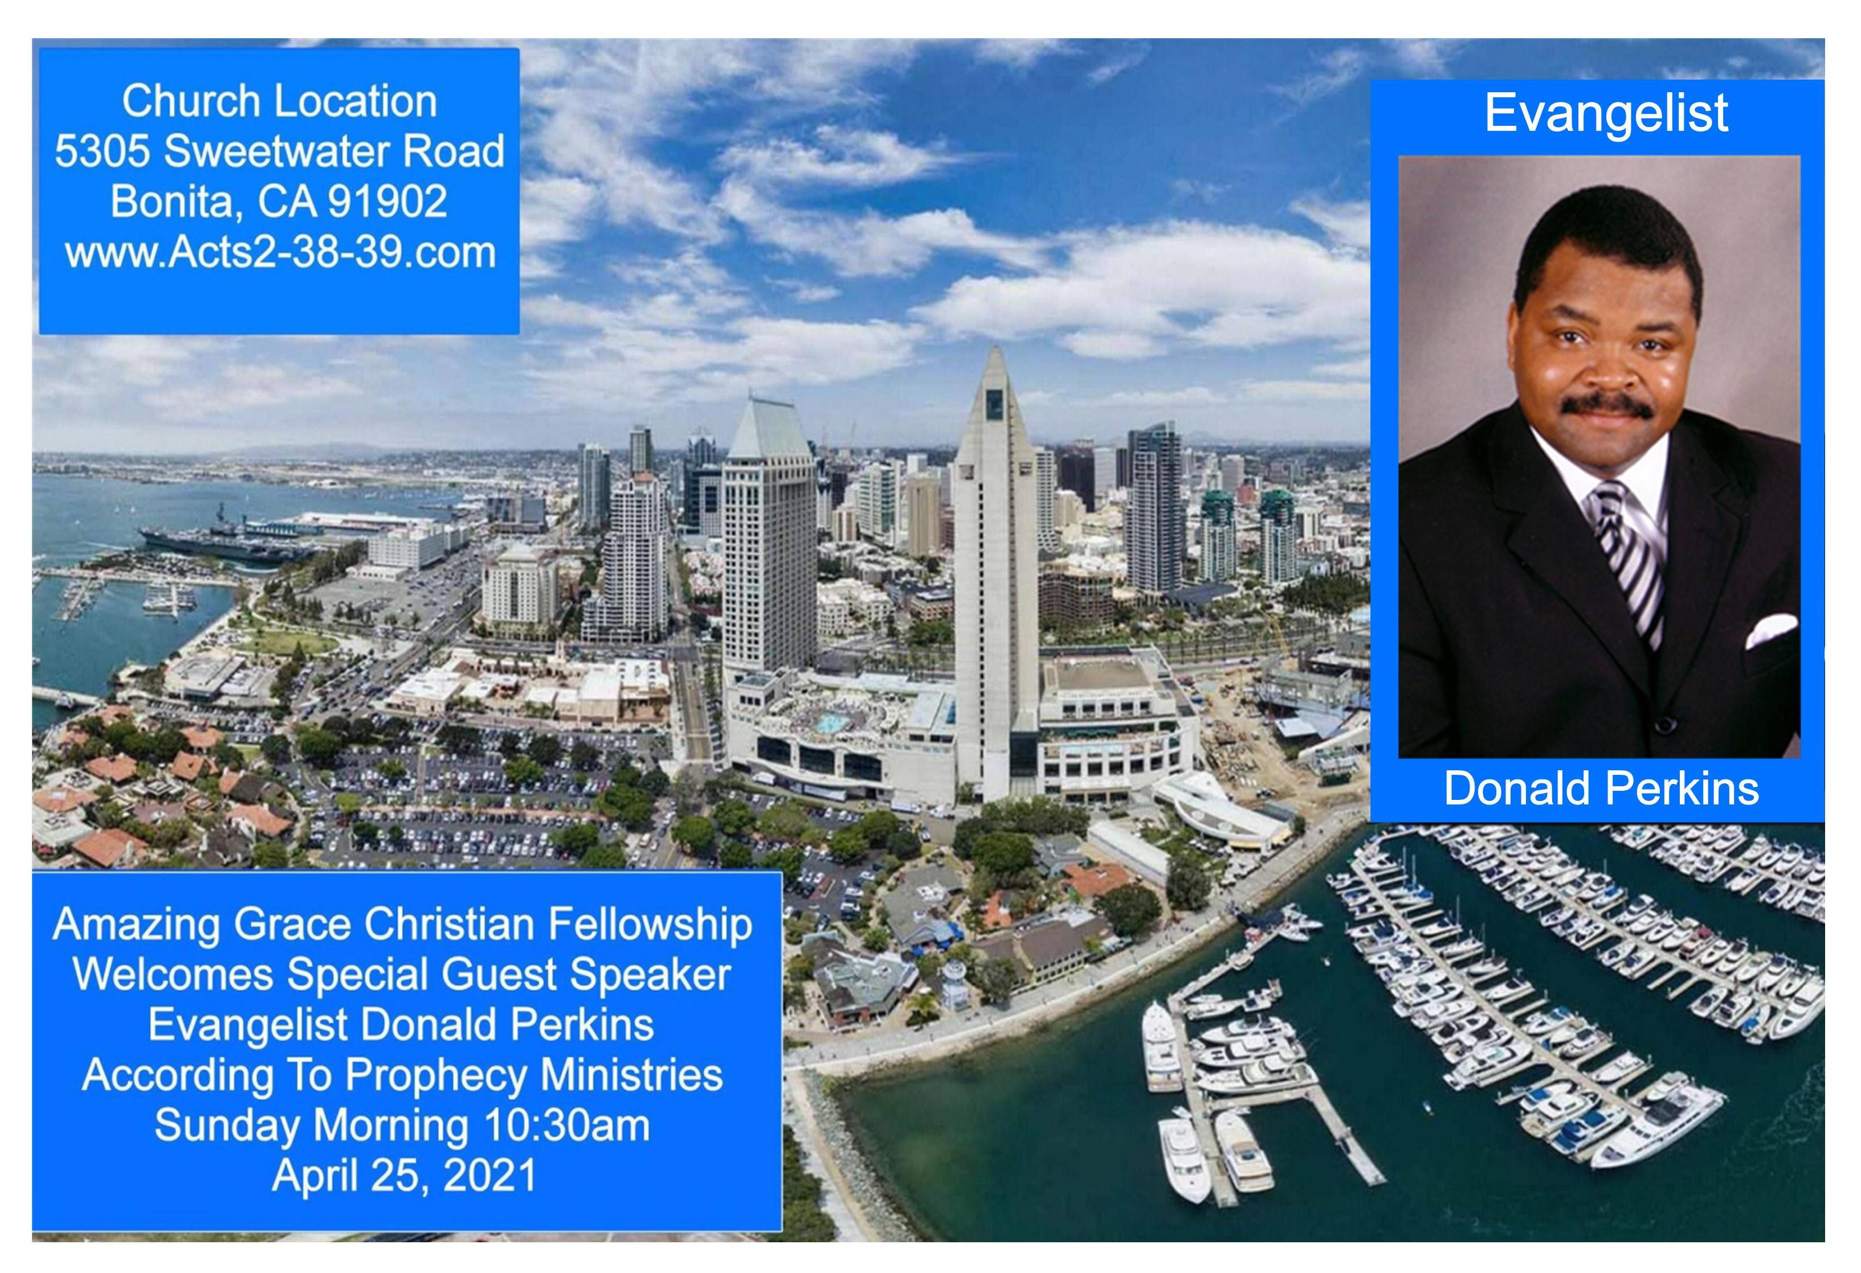

Slide 74


Jesus is Our Freedom
by Pastor Fee Soliven
John 8:28-32
Sunday Morning
April 18, 2021

Slide 75
John 8:28-32
28 Then Jesus said to them, "When you lift up the Son of Man, then you will know that I am He, and that I do nothing of Myself; but as My Father taught Me, I speak these things. 29 And He who sent Me is with Me. The Father has not left Me alone, for I always do those things that please Him."

Slide 76
30 As He spoke these words, many believed in Him. 31 Then Jesus said to those Jews who believed Him, "If you abide in My word, you are My disciples indeed. 32 And you shall know the truth, and the truth shall make you free."

Slide 77
Genesis 1:27
"So God created man in His own image; in the image of God He created him; male and female He created them"

Slide 78
John 8:31-32
31 Then Jesus said to those Jews who believed Him, "If you abide in My word, you are My disciples indeed. 32 And you shall know the truth, and the truth shall make you free."

Slide 79
Reasons Jesus Came for Us

Slide 80
1. Seek and Save The Lost

Slide 81
Luke 19:9-10
9 And Jesus said to him (Zacchaeus), "Today salvation has come to this house, because he also is a son of Abraham; 10 for the Son of Man has come to seek and to save that which was lost."

Slide 82
2. Experience the Abundant Life

Slide 83
John 10:10
"The thief does not come except to steal, and to kill, and to destroy. I have come that they may have life, and that they may have it more abundantly"

Slide 84
Psalm 16:11
You will show me the path of life; In Your presence is fullness of joy; At Your right hand are pleasures forevermore.

Slide 85
3. Jesus Set the Captives Free

Slide 86
Luke 4:18
"The Spirit of the LORD is upon Me, Because He has anointed Me To preach the gospel to the poor; He has sent Me to heal the brokenhearted, To proclaim liberty to the captives And recovery of sight to the blind, To set at liberty those who are oppressed..."

Slide 87
Causes of Captivity

Slide 88
Errors

Slide 89
1 John 4:6
"We are of God. He who knows God hears us; he who is not of God does not hear us. By this we know the spirit of truth and the spirit of error"

Slide 90
Evil Habits

Slide 91
“This is my life;
I can do whatever I want.”

Slide 92
Lying and Deception

Slide 93
Proverbs 19:22-23
22 What is desired in a man is kindness, And a poor man is better than a liar. 23 The fear of the LORD leads to life, And he who has it will abide in satisfaction; He will not be visited with evil.

Slide 94
Sexual Immorality

Slide 95
1 Corinthians 6:18-20
18 Flee sexual immorality. Every sin that a man does is outside the body, but he who commits sexual immorality sins against his own body. 19 Or do you not know that your body is the temple of the Holy Spirit who is in you, whom you have from God, and you are not your own? 20 For you were bought at a price; therefore glorify God in your body and in your spirit, which are God's.

Slide 96
Drunkenness

Slide 97
1 Peter 4:1-6
(New Living Translation)
1 So then, since Christ suffered physical pain, you must arm yourselves with the same attitude he had, and be ready to suffer, too. For if you have suffered physically for Christ, you have finished with sin. 2 You won’t spend the rest of your lives chasing your own desires, but you will be anxious to do the will of God.

Slide 98
3 You have had enough in the past of the evil things that godless people enjoy—their immorality and lust, their feasting and drunkenness and wild parties, and their terrible worship of idols. 4 Of course, your former friends are surprised when you no longer plunge into the flood of wild and destructive things they do. So they slander you.

Slide 99
5 But remember that they will have to face God, who will judge everyone, both the living and the dead. 6 That is why the Good News was preached to those who are now dead so although they were destined to die like all people, they now live forever with God in the Spirit.

Slide 100
Drugs & Smoking

Slide 101
Galatians 5:19-22
19 Now the works of the flesh are evident, which are: adultery, fornication, uncleanness, lewdness, 20 idolatry, sorcery, hatred, contentions, jealousies, outbursts of wrath, selfish ambitions, dissensions, heresies, 21 envy, murders, drunkenness, revelries, and the like; of which I tell you beforehand, just as I also told you in time past, that those who practice such things will not inherit the kingdom of God.

Slide 102
Profanity

Slide 103
Colossians 3:4-8
4 When Christ who is our life appears, then you also will appear with Him in glory. 5 Therefore put to death your members which are on the earth: fornication, uncleanness, passion, evil desire, and covetousness, which is idolatry. 6 Because of these things the wrath of God is coming upon the sons of disobedience,

Slide 104
7 in which you yourselves once walked when you lived in them. 8 But now you yourselves are to put off all these: anger, wrath, malice, blasphemy, filthy language out of your mouth...

Slide 105
Emotions

Slide 106
Fear

Slide 107
2 Timothy 1:7
"For God has not given us a spirit of fear, but of power and of love and of a sound mind"

Slide 108
False Guilt

Slide 109
Psalm 103:8-12
8 The LORD is merciful and gracious, Slow to anger, and abounding in mercy. 9 He will not always strive with us, Nor will He keep His anger forever. 10 He has not dealt with us according to our sins, Nor punished us according to our iniquities.

Slide 110
11 For as the heavens are high above the earth, So great is His mercy toward those who fear Him; 12 As far as the east is from the west, So far has He removed our transgressions from us.

Slide 111
Jealousy

Slide 112
Psalm 84:11
"For the LORD God is a sun and shield; The LORD will give grace and glory; No good thing will He withhold From those who walk uprightly"

Slide 113
Worry, Doubt and Anxiety

Slide 114
Proverbs 3:5-6
5 Trust in the LORD with all your heart, And lean not on your own understanding; 6 In all your ways acknowledge Him, And He shall direct your paths.

Slide 115
Bitterness & Unforgiveness

Slide 116
Ephesians 4:31-32
"31 Let all bitterness, wrath, anger, clamor, and evil speaking be put away from you, with all malice. 32 And be kind to one another, tenderhearted, forgiving one another, just as God in Christ forgave you."

Slide 117
Effects of Captivity

Slide 118
“The Truth Will Make You Free,”

Slide 119
2 Peter 1:3-4
3 as His divine power has given to us all things that pertain to life and godliness, through the knowledge of Him who called us by glory and virtue, 4 by which have been given to us exceedingly great and precious promises, that through these you may be partakers of the divine nature, having escaped the corruption that is in the world through lust.

Slide 120
1. Is there anything in your life that is difficult to relinquish?

Slide 121
2. Is there an area of bondage that is hindering your spiritual growth?

Slide 122
3. Are you repeatedly struggling with a particular problem or recurring sin?

Slide 123
4. Would you be willing to ask the Lord to reveal and heal the area of emotional bondage that is causing your struggle?

Slide 124
5. What price are you paying by living in this type of personal captivity?

Slide 125
1 Thessalonians 4:13-18
13 But I do not want you to be ignorant, brethren, concerning those who have fallen asleep, lest you sorrow as others who have no hope. 14 For if we believe that Jesus died and rose again, even so God will bring with Him those who sleep in Jesus.

Slide 126
15 For this we say to you by the word of the Lord, that we who are alive and remain until the coming of the Lord will by no means precede those who are asleep. 16 For the Lord Himself will descend from heaven with a shout, with the voice of an archangel, and with the trumpet of God. And the dead in Christ will rise first.

Slide 127
17 Then we who are alive and remain shall be caught up together with them in the clouds to meet the Lord in the air. And thus we shall always be with the Lord. 18 Therefore comfort one another with these words.

Slide 128
1 Corinthians 15:50-54
50 Now this I say, brethren, that flesh and blood cannot inherit the kingdom of God; nor does corruption inherit incorruption. 51 Behold, I tell you a mystery: We shall not all sleep, but we shall all be changed-- 52 in a moment, in the twinkling of an eye, at the last trumpet. For the trumpet will sound, and the dead will be raised incorruptible, and we shall be changed.

Slide 129
53 For this corruptible must put on incorruption, and this mortal must put on immortality. 54 So when this corruptible has put on incorruption, and this mortal has put on immortality, then shall be brought to pass the saying that is written: "Death is swallowed up in victory."

Slide 130

20 Again, when a righteous man turns from his righteousness and commits iniquity, and I lay a stumbling block before him, he shall die; because you did not give him warning, he shall die in his sin, and his righteousness which he has done shall not be remembered; but his blood I will require at your hand.

Slide 131
Acts 2:38-39
38 Then Peter said to them, "Repent, and let every one of you be baptized in the name of Jesus Christ for the remission of sins; and you shall receive the gift of the Holy Spirit. 39 For the promise is to you and to your children, and to all who are afar off, as many as the Lord our God will call."

Slide 132


