Slide 1
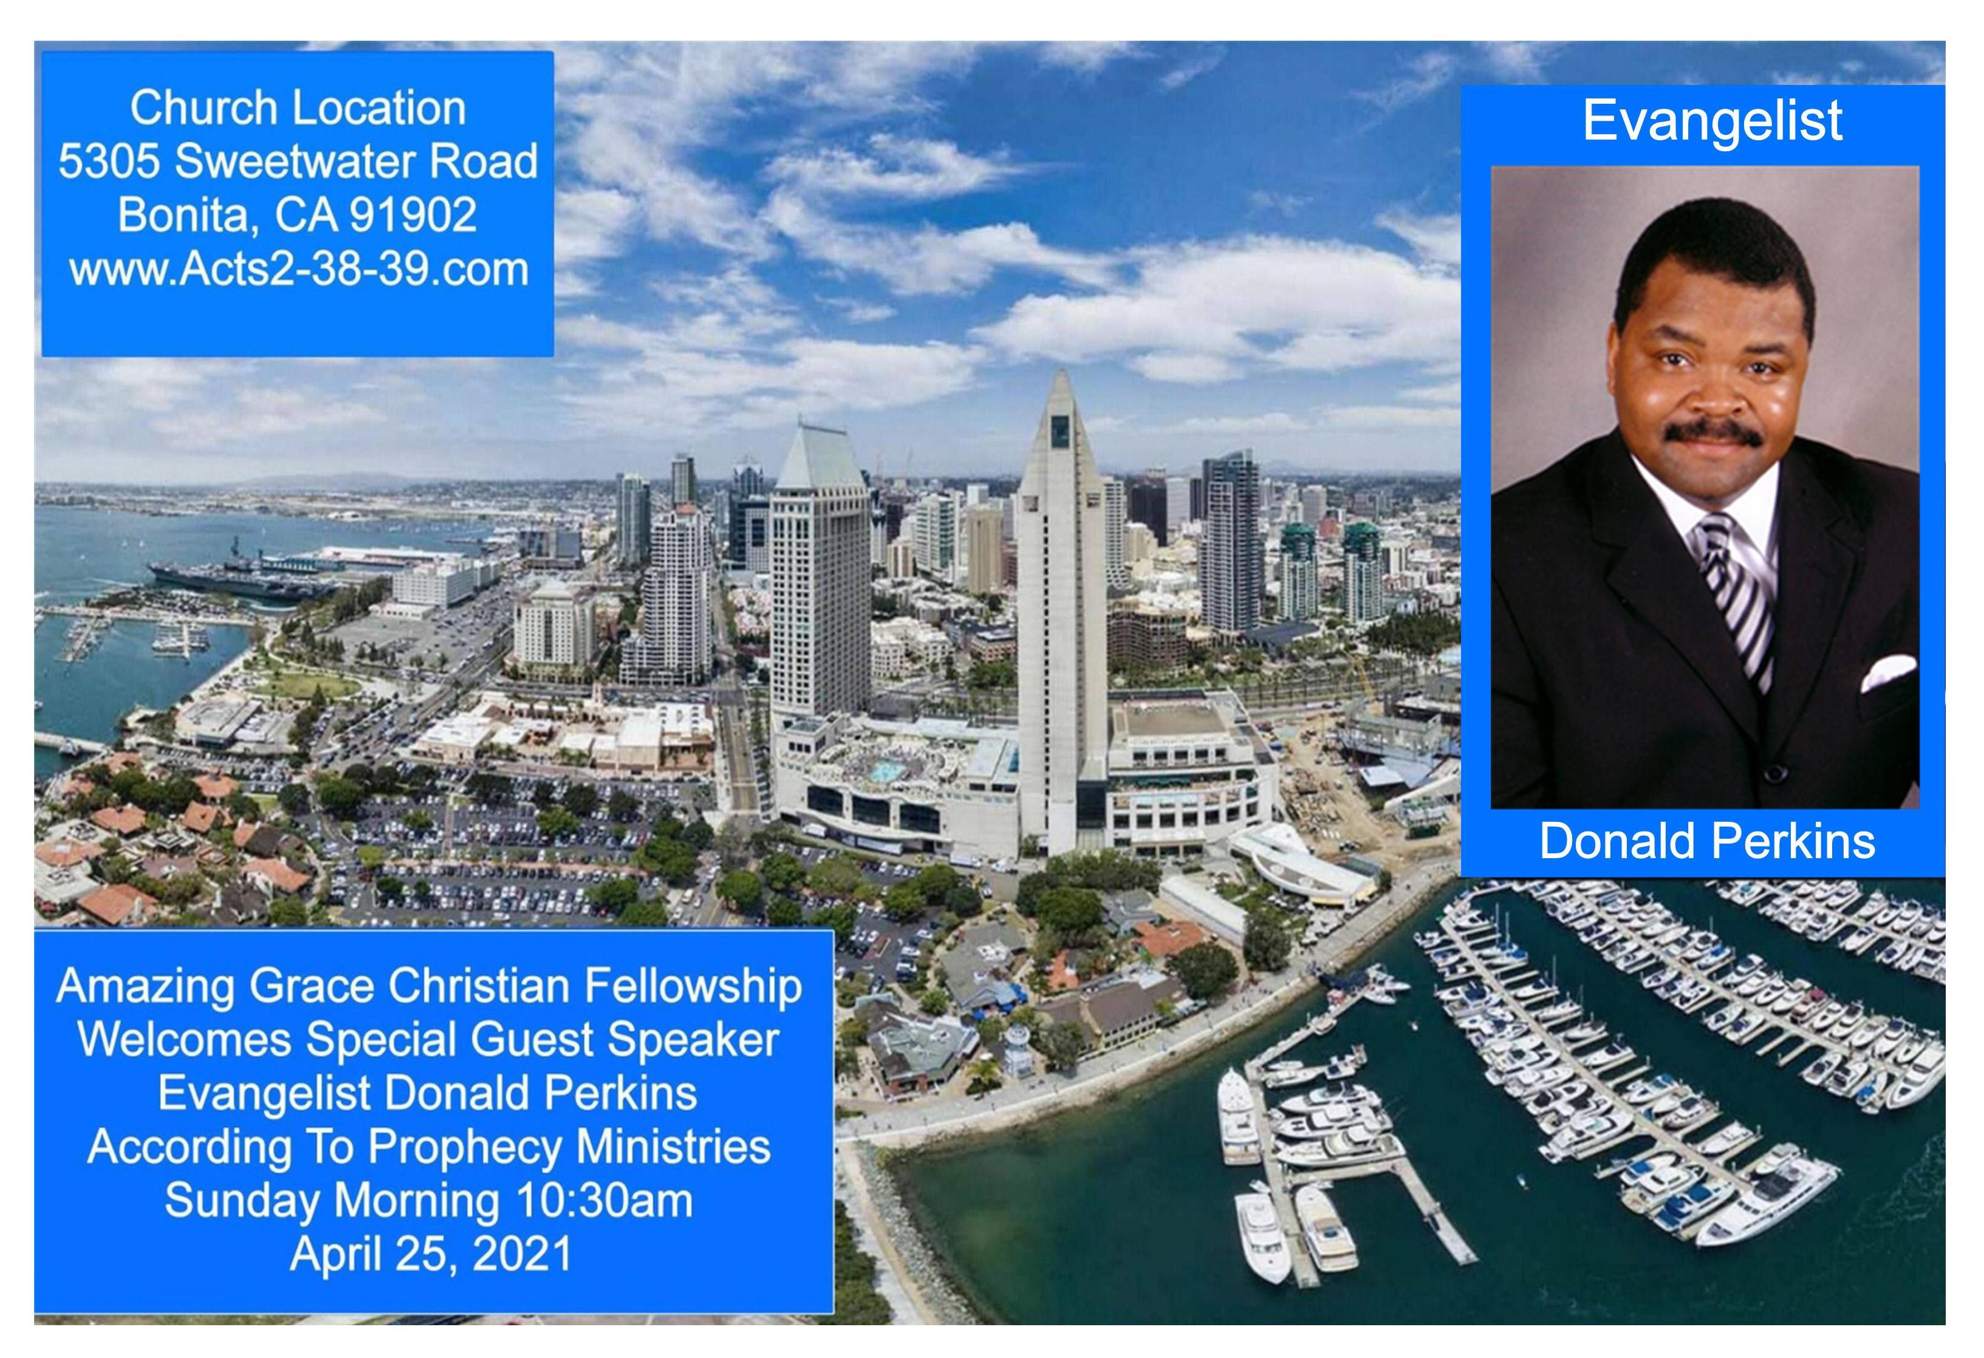

Slide 2


The Last Day Scoffers
by Pastor Fee Soliven
2 Peter 3:1-9
Wednesday Evening
April 21, 2021

Slide 3
2 Peter 3:1-9
1 Beloved, I now write to you this second epistle (in both of which I stir up your pure minds by way of reminder), 2 that you may be mindful of the words which were spoken before by the holy prophets, and of the commandment of us, the apostles of the Lord and Savior,

Slide 4
3 knowing this first: that scoffers will come in the last days, walking according to their own lusts, 4 and saying, "Where is the promise of His coming? For since the fathers fell asleep, all things continue as they were from the beginning of creation." 5 For this they willfully forget: that by the word of God the heavens were of old, and the earth standing out of water and in the water,

Slide 5
6 by which the world that then existed perished, being flooded with water. 7 But the heavens and the earth which are now preserved by the same word, are reserved for fire until the day of judgment and perdition of ungodly men. 8 But, beloved, do not forget this one thing, that with the Lord one day is as a thousand years, and a thousand years as one day.

Slide 6
9 The Lord is not slack concerning His promise, as some count slackness, but is longsuffering toward us, not willing that any should perish but that all should come to repentance.

Slide 7
1 Beloved, I now write to you this second epistle (in both of which I stir up your pure minds by way of reminder),

Slide 8
Philippians 4:8-9
8 Finally, brethren, whatever things are true, whatever things are noble, whatever things are just, whatever things are pure, whatever things are lovely, whatever things are of good report, if there is any virtue and if there is anything praiseworthy--meditate on these things. 9 The things which you learned and received and heard and saw in me, these do, and the God of peace will be with you.

Slide 9
2 that you may be mindful of the words which were spoken before by the holy prophets, and of the commandment of us, the apostles of the Lord and Savior,

Slide 10
3 knowing this first: that scoffers will come in the last days, walking according to their own lusts,

Slide 11
1 Timothy 4:1-2
1 Now the Spirit expressly says that in latter times some will depart from the faith, giving heed to deceiving spirits and doctrines of demons, 2 speaking lies in hypocrisy, having their own conscience seared with a hot iron…

Slide 12
2 Timothy 3:1-5
1 But know this, that in the last days perilous times will come: 2 For men will be lovers of themselves, lovers of money, boasters, proud, blasphemers, disobedient to parents, unthankful, unholy, 3 unloving, unforgiving, slanderers, without self-control, brutal, despisers of good, 4 traitors, headstrong, haughty, lovers of pleasure rather than lovers of God, 5 having a form of godliness but denying its power. And from such people turn away!

Slide 13
4 and saying, "Where is the promise of His coming? For since the fathers fell asleep, all things continue as they were from the beginning of creation."

Slide 14
Mark 13:24-27
24 "But in those days, after that tribulation, the sun will be darkened, and the moon will not give its light; 25 the stars of heaven will fall, and the powers in heaven will be shaken.

Slide 15
26 Then they will see the Son of Man coming in the clouds with great power and glory. 27 And then He will send His angels, and gather together His elect from the four winds, from the farthest part of earth to the farthest part of heaven.

Slide 16
5 For this they willfully forget: that by the word of God the heavens were of old, and the earth standing out of water and in the water, 6 by which the world that then existed perished, being flooded with water.

Slide 17
Genesis 1:1-2
1 In the beginning God created the heavens and the earth. 2 The earth was without form, and void; and darkness was on the face of the deep. And the Spirit of God was hovering over the face of the waters.

Slide 18
Genesis 7:23-24
23 So He destroyed all living things which were on the face of the ground: both man and cattle, creeping thing and bird of the air. They were destroyed from the earth. Only Noah and those who were with him in the ark remained alive. 24 And the waters prevailed on the earth one hundred and fifty days.

Slide 19
7 But the heavens and the earth which are now preserved by the same word, are reserved for fire until the day of judgment and perdition of ungodly men.

Slide 20
Isaiah 66:15-16
15 For behold, the LORD will come with fire And with His chariots, like a whirlwind, To render His anger with fury, And His rebuke with flames of fire. 16 For by fire and by His sword The LORD will judge all flesh; And the slain of the LORD shall be many.

Slide 21
Malachi 4:1
1 "For behold, the day is coming, Burning like an oven, And all the proud, yes, all who do wickedly will be stubble. And the day which is coming shall burn them up," Says the LORD of hosts, "That will leave them neither root nor branch.

Slide 22
Revelation 20:12-15
12 And I saw the dead, small and great, standing before God, and books were opened. And another book was opened, which is the Book of Life. And the dead were judged according to their works, by the things which were written in the books.

Slide 23
13 The sea gave up the dead who were in it, and Death and Hades delivered up the dead who were in them. And they were judged, each one according to his works. 14 Then Death and Hades were cast into the lake of fire. This is the second death. 15 And anyone not found written in the Book of Life was cast into the lake of fire.

Slide 24
2 Peter 3:10-11
10 But the day of the Lord will come as a thief in the night, in which the heavens will pass away with a great noise, and the elements will melt with fervent heat; both the earth and the works that are in it will be burned up. 11 Therefore, since all these things will be dissolved, what manner of persons ought you to be in holy conduct and godliness…

Slide 25
8 But, beloved, do not forget this one thing, that with the Lord one day is as a thousand years, and a thousand years as one day.

Slide 26
2 Peter 3:8-9
8 But, beloved, do not forget this one thing, that with the Lord one day is as a thousand years, and a thousand years as one day. 9 The Lord is not slack concerning His promise, as some count slackness, but is longsuffering toward us, not willing that any should perish but that all should come to repentance.

Slide 27
Psalm 90:4
“For a thousand years in Your sight Are like yesterday when it is past, And like a watch in the night”

Slide 28
9 The Lord is not slack concerning His promise, as some count slackness, but is longsuffering toward us, not willing that any should perish but that all should come to repentance.

Slide 29
Acts 3:18-20
18 But those things which God foretold by the mouth of all His prophets, that the Christ would suffer, He has thus fulfilled. 19 Repent therefore and be converted, that your sins may be blotted out, so that times of refreshing may come from the presence of the Lord, 20 and that He may send Jesus Christ, who was preached to you before…

Slide 30
1 Thessalonians 4:13-18
13 But I do not want you to be ignorant, brethren, concerning those who have fallen asleep, lest you sorrow as others who have no hope. 14 For if we believe that Jesus died and rose again, even so God will bring with Him those who sleep in Jesus.

Slide 31
15 For this we say to you by the word of the Lord, that we who are alive and remain until the coming of the Lord will by no means precede those who are asleep. 16 For the Lord Himself will descend from heaven with a shout, with the voice of an archangel, and with the trumpet of God. And the dead in Christ will rise first.

Slide 32
17 Then we who are alive and remain shall be caught up together with them in the clouds to meet the Lord in the air. And thus we shall always be with the Lord. 18 Therefore comfort one another with these words.

Slide 33
1 Corinthians 15:50-54
50 Now this I say, brethren, that flesh and blood cannot inherit the kingdom of God; nor does corruption inherit incorruption. 51 Behold, I tell you a mystery: We shall not all sleep, but we shall all be changed-- 52 in a moment, in the twinkling of an eye, at the last trumpet. For the trumpet will sound, and the dead will be raised incorruptible, and we shall be changed.

Slide 34
53 For this corruptible must put on incorruption, and this mortal must put on immortality. 54 So when this corruptible has put on incorruption, and this mortal has put on immortality, then shall be brought to pass the saying that is written: "Death is swallowed up in victory."

Slide 35

20 Again, when a righteous man turns from his righteousness and commits iniquity, and I lay a stumbling block before him, he shall die; because you did not give him warning, he shall die in his sin, and his righteousness which he has done shall not be remembered; but his blood I will require at your hand.

Slide 36
Acts 2:38-39
38 Then Peter said to them, "Repent, and let every one of you be baptized in the name of Jesus Christ for the remission of sins; and you shall receive the gift of the Holy Spirit. 39 For the promise is to you and to your children, and to all who are afar off, as many as the Lord our God will call."

Slide 37


