Slide 1
“Glorious Day”
(Passion)

Slide 2
I was buried beneath my shame. Who coild carry that kind of weight. It was my tomb. When I met you.

Slide 3
I was breathing, but not alive. All my failures I tried to hide. It was my tomb. Til I met you.

Slide 4
You Called my name. Then I ran out of that grave. Out of the darkness. Into your glorious day.

Slide 5
You called my name. And I ran out of that grave. Out of the darkness. Into your glorious day.

Slide 6
Now your mercy has saved my soul. Now your freedom is all that I know. The old made new. Jesus

Slide 7
When I met you. When you called my name. And I ran out of that grave.. Out of the darkness. Into your

Slide 8
Glorious day. You called my name. Then I ran out of that grave. Out of the darkness. Into your glorious

Slide 9
Day. I needed rescue my sin was heavy. But chains break at the weight of your glory. I needed shelter .

Slide 10
I was an orphan. But you call me a citizen of heaven. When I was broken. You were my healing. Now your

Slide 11
Love is the air that im breathing. I have a future my eyes are open. Cause when you called my name.

Slide 12
I ran out of that grave. Out of the darkness. Into your glorious day. You called my name. And I ran out of

Slide 13
That grave. Out of the darkness. Into your glorious day.

Slide 14
“Glory to Glory”
(Bethel)

Slide 15
Created from dust. You came and you lived among us. You took on our frame. You walked in our pain

Slide 16
And now you’re taking us higher. You stepped into time. You laid down your life to save us. You took all

Slide 17
Our shame. On the cross it was laid and now your taking us higher. We go from glory to glory to glory.

Slide 18
We’ll never be the same never be the same. We go from glory to glory to glory. We’re forever changed

Slide 19
Forever changed. You call me your friend. Brought into your endless kingdom. By the blood I was made.

Slide 20
No longer a slave and now you’re taking us higher. Until we reach that day, love conquers everything.

Slide 21
We’ll cry an anthem singing, Holy, Holy. And when we see that day, we’re standing face to face. We’ll

Slide 22
Shout n anthem singing, Holy, Holy. You took on the grave. So, not even death can shake us. The victor

Slide 23
Has won and heaven has come. And now you’re taking us higher.And now you’re taking us higher.

Slide 24
We go from glory to glory to glory. We’ll never be the same. Never be the same. You take us higher and

Slide 25
Higher and higher. We’re forever changed. Were forever changed. We go from glory to glory to glory.

Slide 26
We go from glory to glory to glory. You take us higher and higher and higher. We’re forever changed. We’re

Slide 27
Forever changed.

Slide 28
“Forever”
( Kari Jobe)

Slide 29
The moon and stars they wept. The morning sun was dead. The savior of the world was fallen. His body on

Slide 30
The cross, his blood poured out for us.The weight of every curse upon him. One final breath he gave.

Slide 31
As heaven looked away. The son of God lid down in darkness. A battle in the grave, the war on death was

Slide 32
Waged. The power of hell forever broken. The ground began to shake. The stone was rolled away

Slide 33
His perfect love could not be overcome. Now, death were is your sting. Our resurrection King and

Slide 34
Rendered you defeated. Now, forever he is glorified. Forever he is lifted high. Forever he is risen. He is

Slide 35
Alive. He is alive. We sing hallelujah, we sing hallelujah, we sing hallelujah. The Lamb is overcome

Slide 36
We sing hallelujah, We sing hallelujah, we sing hallelujah. Forever he is glorified. Forever he is lifted

Slide 37
High. Forever he is risen. He is alive. He is alive.

Slide 38
“Jesus we love you”

Slide 39
Old things have passed away.Your love has stayed the same. Your constant grace remains the

Slide 40
Cornerstone. Things that we thought were dead. Are breathing in life again.. You cause your son to shine

Slide 41
On darkest nights. For all that you’ve done we will pour out our love. This will be our anthem song.

Slide 42
Jesus we love you. Oh how we love you. You are the one our hearts adore. The hopeless have found their

Slide 43
Hope. The orphans now have a home. All that was lost has found it’s place in you. You lift our weary

Slide 44
Head. You make us strong instead. You took these rags and made us beautiful. For all that you’ve done

Slide 45
We will pour out our love. This will be our anthem song Jesus we love you. Oh how we love you. You

Slide 46
Are the one our hearts adore. Jesus we love you oh we love you. You are the one our hearts adore.

Slide 47
Our affection, our devotion poured out on the feet of Jesus. Our affection our devotion poured out on the

Slide 48
Feet of Jesus. Our affection our devotion poured out on the feet of Jesus. Our affection our devotion

Slide 49
Poured out on the feet of Jesus we love you. Oh how we love you. You are the one our hearts adore.

Slide 50
Jesus we love you. Oh how we love you. You are the one our hearts Adore. You are the one our hearts

Slide 51
Adore.

Slide 52
“Worthy is the Lamb”
(Darlene Zechech)

Slide 53
Thank you for the cross Lord. Thank you for the price you paid. Bearing all my sin and shame. In love you

Slide 54
Came and gave amazing grace. Thank you for this love Lord.Thank you for the nail pierced hands.

Slide 55
Washed me in your cleansing flow. Now all I know is your forgiveness and embrace. Worthy is the Lamb

Slide 56
Seated on the throne. Crown you now with many crowns . You reign victorious. High and lifted up.

Slide 57
Jesus son of god. The darling of heaven crucified. Worthy is the Lamb. Worthy is the Lamb.

Slide 58
Thank you for the cross Lord. Thank you for the price you paid. Bearing all my sin and shame. In love you

Slide 59
Came and gave amazing grace. Thank you for this love Lord. Thank you for the nail pierced hands

Slide 60
Washed me in your cleansing flow. Now all I know. Is your forgiveness and embrace. Worthy is the Lamb

Slide 61
Seated on the throne. Crown you now with many crowns. You reign victorious. High and lifted up.

Slide 62
Jesus son of God. The darling of heaven crucified. Worthy is the Lamb. Worthy is the Lamb.

Slide 65
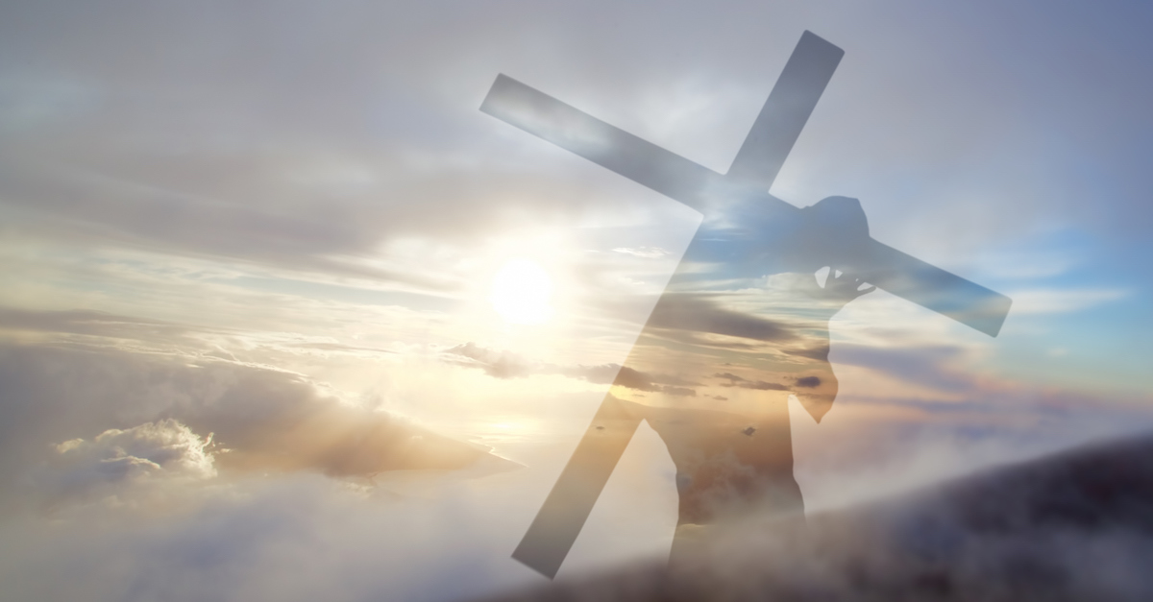
Jesus Please Lead the Way
by Pastor Fee Soliven
Romans 8:12-17
Sunday Morning
May 2, 2021

Slide 66
Romans 8:12-17
12 Therefore, brethren, we are debtors--not to the flesh, to live according to the flesh. 13 For if you live according to the flesh you will die; but if by the Spirit you put to death the deeds of the body, you will live. 14 For as many as are led by the Spirit of God, these are sons of God.

Slide 67
15 For you did not receive the spirit of bondage again to fear, but you received the Spirit of adoption by whom we cry out, "Abba, Father." 16 The Spirit Himself bears witness with our spirit that we are children of God, 17 and if children, then heirs--heirs of God and joint heirs with Christ, if indeed we suffer with Him, that we may also be glorified together

Slide 68
Who or what is guiding your life?

Slide 69
Psalm 25:4-7
Show me Your ways, O LORD; Teach me Your paths. 5 Lead me in Your truth and teach me, For You are the God of my salvation; On You I wait all the day. 6 Remember, O LORD, Your tender mercies and Your lovingkindnesses, For they are from of old. 7 Do not remember the sins of my youth, nor my transgressions; According to Your mercy remember me, For Your goodness' sake, O LORD.

Slide 70
Exodus 13:21-22
21 And the LORD went before them by day in a pillar of cloud to lead the way, and by night in a pillar of fire to give them light, so as to go by day and night. 22 He did not take away the pillar of cloud by day or the pillar of fire by night from before the people.

Slide 71
Today we have God’s written Word as our infallible guide for Life’s Journey

Slide 72
John 14:15-18
15 "If you love Me, keep My commandments. 16 And I will pray the Father, and He will give you another Helper, that He may abide with you forever-- 17 the Spirit of truth, whom the world cannot receive, because it neither sees Him nor knows Him; but you know Him, for He dwells with you and will be in you. 18 I will not leave you orphans; I will come to you.

Slide 73
John 14:26
“But the Comforter, which is the Holy Ghost, whom the Father will send in my name, he shall teach you all things, and bring all things to your remembrance, whatsoever I have said unto you”

Slide 74
Proverbs 3:5-6
5 Trust in the LORD with all your heart, And lean not on your own understanding; 6 In all your ways acknowledge Him, And He shall direct your paths.

Slide 75
Living According to God’s Guidance Requires…

Slide 76
1. Meditation upon His Word

Slide 77
Psalm 119:105
“Your word is a lamp to my feet And a light to my path”

Slide 78
2. Sensitivity to the leadership of the Holy Spirit

Slide 79
John 16:13
“However, when He, the Spirit of truth, has come, He will guide you into all truth; for He will not speak on His own authority, but whatever He hears He will speak; and He will tell you things to come”

Slide 80
John 17:17
“Sanctify them through thy truth: thy word is truth”

Slide 81
3. Willingness to wait for God’s Timing

Slide 82
Isaiah 64:4
“For since the beginning of the world Men have not heard nor perceived by the ear, Nor has the eye seen any God besides You, Who acts for the one who waits for Him”

Slide 83
4. Following God when the Way is Unclear

Slide 84
Proverbs 3:5-8
5 Trust in the LORD with all your heart, And lean not on your own understanding; 6 In all your ways acknowledge Him, And He shall direct your paths. 7 Do not be wise in your own eyes; Fear the LORD and depart from evil. 8 It will be health to your flesh, And strength to your bones.

Slide 85
5. Walking in the Spirit of God in order to be Strong and Courageous

Slide 86
Joshua 1:8-9
8 This Book of the Law shall not depart from your mouth, but you shall meditate in it day and night, that you may observe to do according to all that is written in it. For then you will make your way prosperous, and then you will have good success. 9 Have I not commanded you? Be strong and of good courage; do not be afraid, nor be dismayed, for the LORD your God is with you wherever you go."

Slide 87
6. Willingness to Face Conflict

Slide 88
Acts 5:29-32
29 But Peter and the other apostles answered and said: "We ought to obey God rather than men. 30 The God of our fathers raised up Jesus whom you murdered by hanging on a tree. 31 Him God has exalted to His right hand to be Prince and Savior, to give repentance to Israel and forgiveness of sins. 32 And we are His witnesses to these things, and so also is the Holy Spirit whom God has given to those who obey Him."

Slide 89
7. Willingness to obey God and leave all the consequences to Him

Slide 90
John 14:15
“If you love me, you will keep my commandments”

Slide 91
Acts 5:29
But Peter and the apostles answered, “We must obey God rather than men”

Slide 92
1 Peter 1:14
“As obedient children, do not be conformed to the passions of your former ignorance”

Slide 93
1 John 5:3
“For this is the love of God, that we keep his commandments. And his commandments are not burdensome”

Slide 94
Isaiah 1:19
“If you are willing and obedient, you shall eat the good of the land”

Slide 95
1. Do you begin each day by reading and meditating on God’s Word? How well do you know the Lord as He’s revealed Himself in His Word?

Slide 96
2. Are you familiar with His ways? What role do social media, television, friends, and cultural norms play in influencing how you think, what you value, and what you do?

Slide 97
3. Do you know Scripture well enough to discern when these sources are in opposition to God?

Slide 98
1 Thessalonians 4:13-18
13 But I do not want you to be ignorant, brethren, concerning those who have fallen asleep, lest you sorrow as others who have no hope. 14 For if we believe that Jesus died and rose again, even so God will bring with Him those who sleep in Jesus.

Slide 99
15 For this we say to you by the word of the Lord, that we who are alive and remain until the coming of the Lord will by no means precede those who are asleep. 16 For the Lord Himself will descend from heaven with a shout, with the voice of an archangel, and with the trumpet of God. And the dead in Christ will rise first.

Slide 100
17 Then we who are alive and remain shall be caught up together with them in the clouds to meet the Lord in the air. And thus we shall always be with the Lord. 18 Therefore comfort one another with these words.

Slide 101
1 Corinthians 15:50-54
50 Now this I say, brethren, that flesh and blood cannot inherit the kingdom of God; nor does corruption inherit incorruption. 51 Behold, I tell you a mystery: We shall not all sleep, but we shall all be changed-- 52 in a moment, in the twinkling of an eye, at the last trumpet. For the trumpet will sound, and the dead will be raised incorruptible, and we shall be changed.

Slide 102
53 For this corruptible must put on incorruption, and this mortal must put on immortality. 54 So when this corruptible has put on incorruption, and this mortal has put on immortality, then shall be brought to pass the saying that is written: "Death is swallowed up in victory."

Slide 103
20 Again, when a righteous man turns from his righteousness and commits iniquity, and I lay a stumbling block before him, he shall die; because you did not give him warning, he shall die in his sin, and his righteousness which he has done shall not be remembered; but his blood I will require at your hand.

Slide 104
Acts 2:38-39
38 Then Peter said to them, "Repent, and let every one of you be baptized in the name of Jesus Christ for the remission of sins; and you shall receive the gift of the Holy Spirit. 39 For the promise is to you and to your children, and to all who are afar off, as many as the Lord our God will call."

